Slide 1
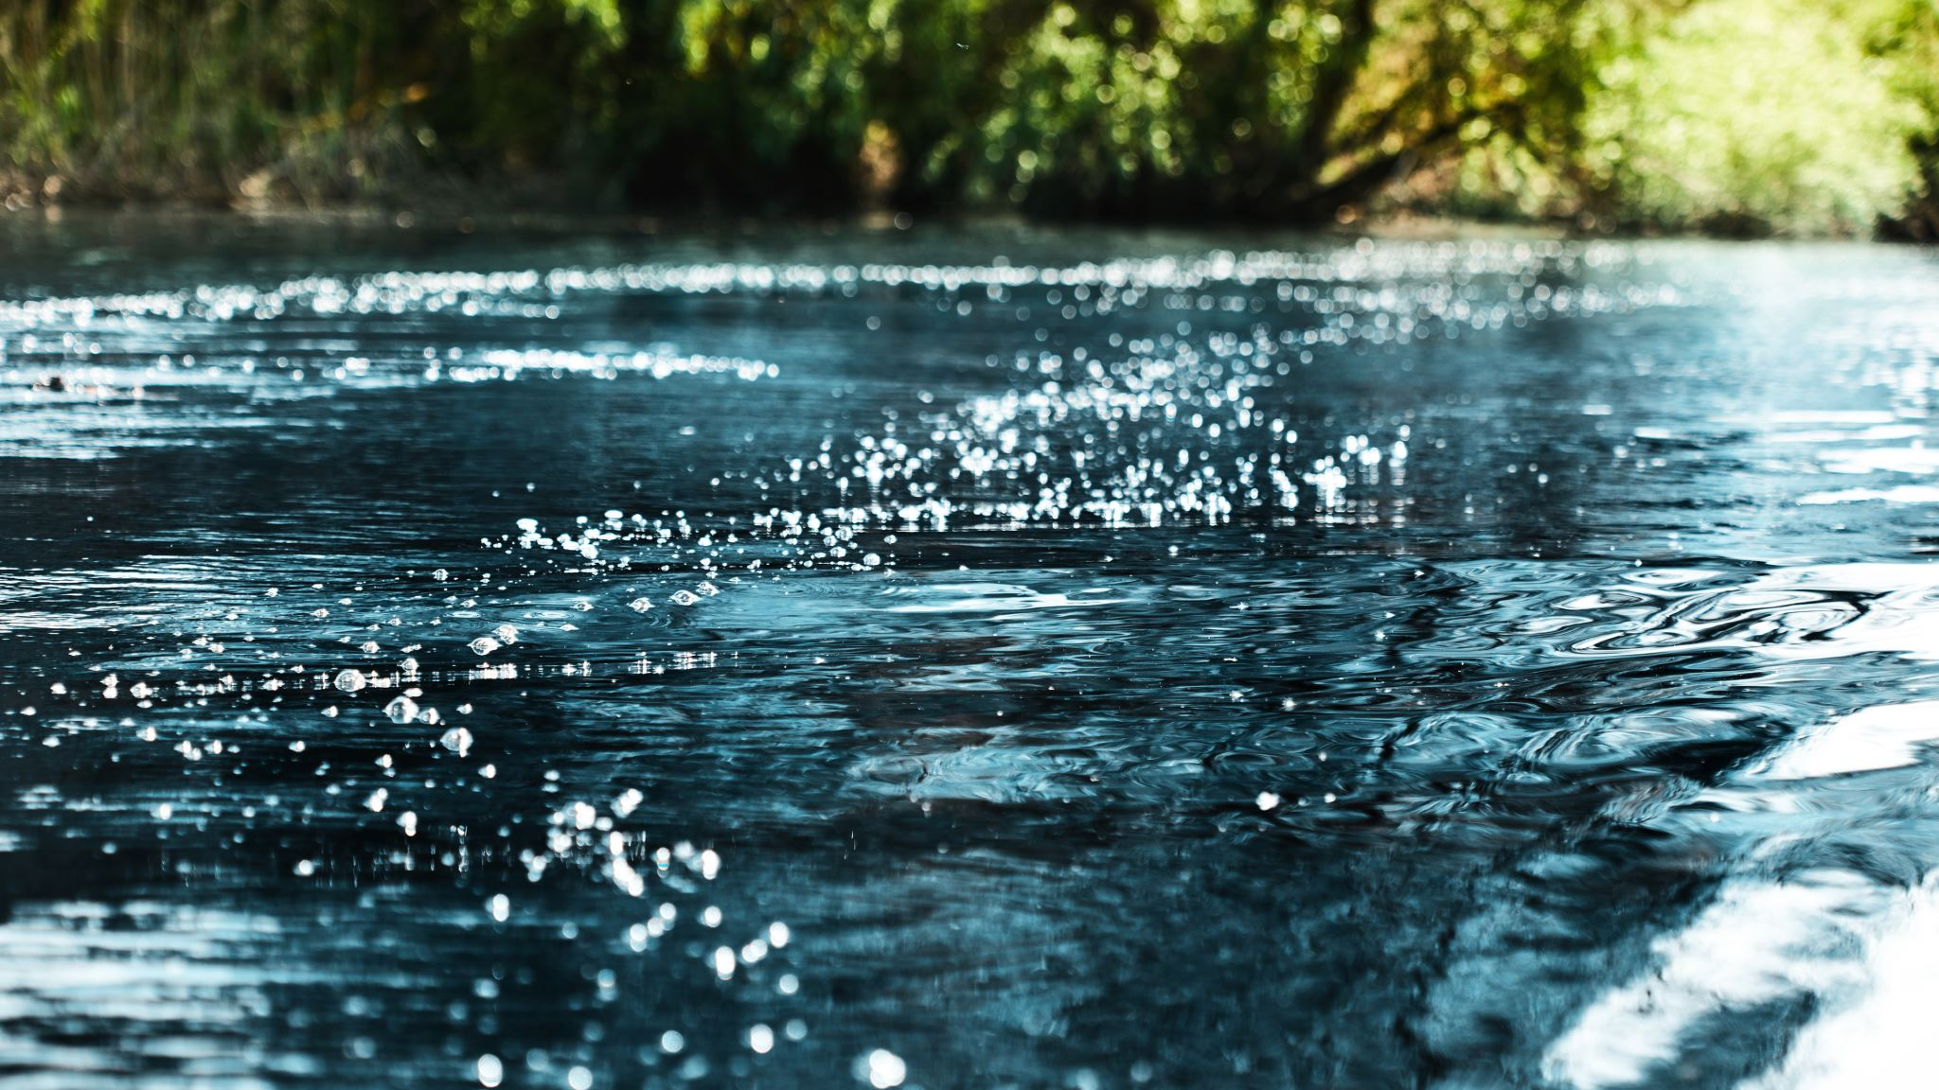
Water water everywhere…
Sustainable strategies for managing supply in the 21st century

Slide 2
Where did water come from?
Many theories
Liquid water was present 4.4 billion years ago, formed from many sources
Internal magmatic hydrogen
Cosmic asteroids and ice comets that impacted the early Earth, bringing water with them
Later volcanic eruptions which spewed water vapor onto the surface
Water was lost to space
At the Moon-forming impact 4.5 billion years ago
Through photolysis, which breaks up H2O molecules. Hydrogen escapes the atmosphere.

Slide 3
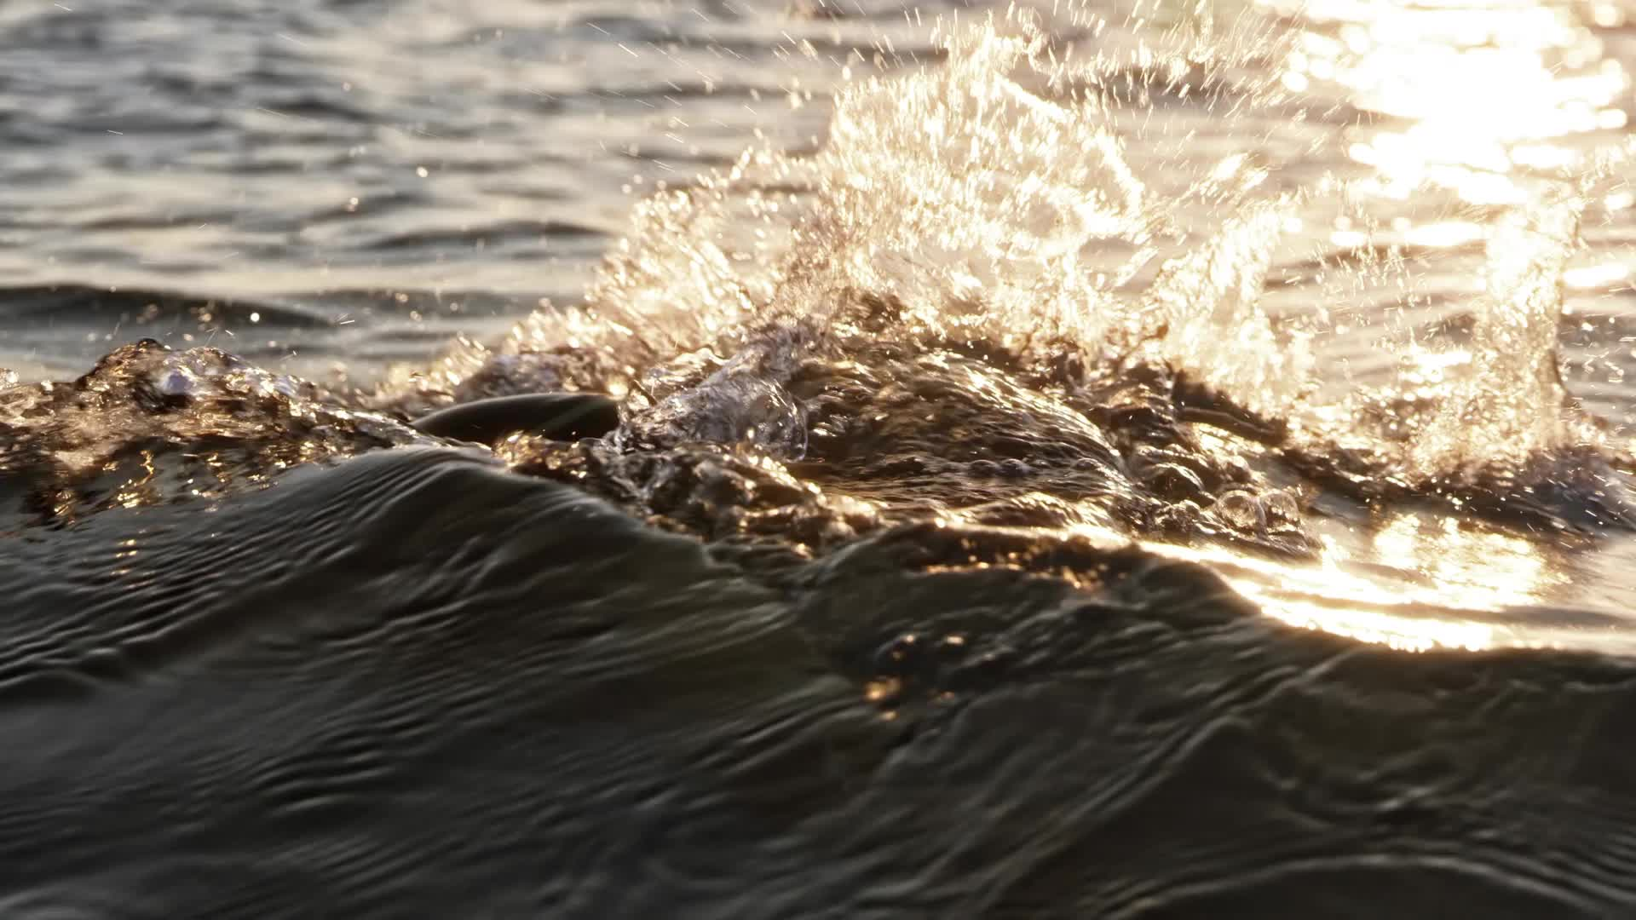
THERE IS NO NEW WATER!!!!
Notes:
Students need to understand that water moves from fresh systems to salt systems and back again through the water cycle. We just speed that up through desalinization, but we don’t actually create new water.

Slide 4
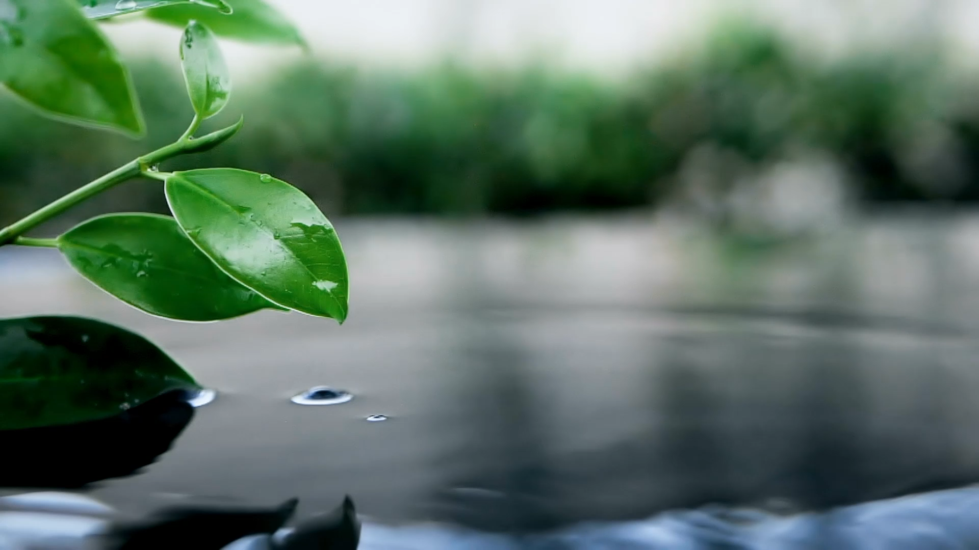
We have to take care of the water we have because that’s all we get.
Notes:
Water is life, period. If we didn’t have liquid water on Earth, it wouldn’t sustain life.

Slide 5
Can water be destroyed?
Through electrolysis we can break up H2O into hydrogen and oxygen to make those gasses.
But otherwise, not really…
But we CAN pollute it so badly that it cannot be used.

Slide 6
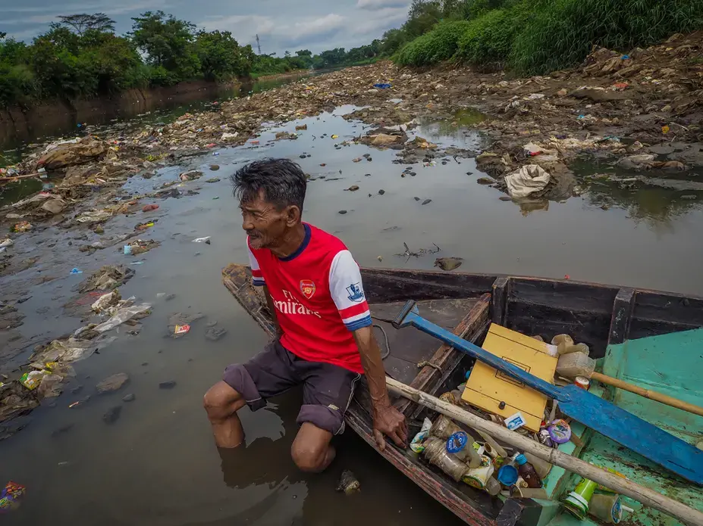
The Citarum River
Indonesia

Slide 7
What’s in the Citarum?
Industrial discharge from over 2000 plants, including over 200 textile mills
Solid waste and raw sewage from upstream villages that lack sanitation and solid waste management
Algal blooms from rice paddy runoff containing fertilizer
This same water is used for drinking water and crop irrigation, causing health issues to residents all along the river.

Slide 8
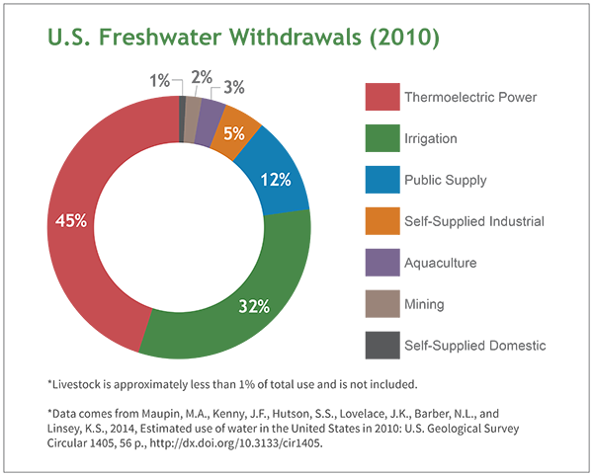
Major uses of water

Slide 9
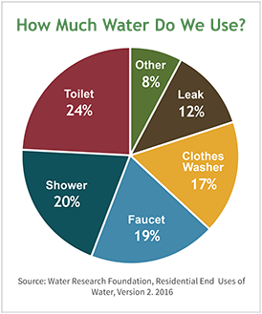
How do households use water?

Slide 10
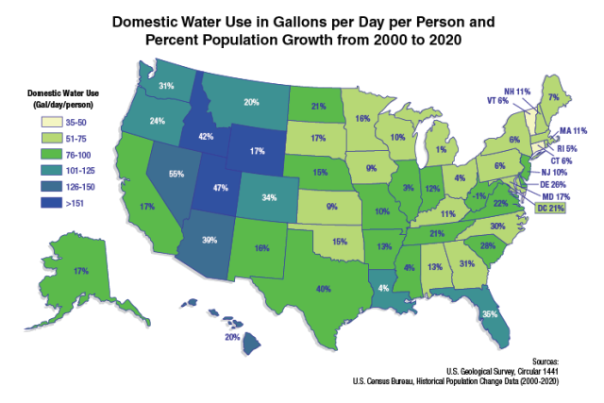
Domestic water use and population growth

Slide 11
What do these maps together tell us?

Slide 12
Water Footprint Calculator
https://watercalculator.org/footprint/what-is-a-water-footprint/
Includes indoor, outdoor, and virtual water consumption
The amount of water consumed, evaporated, and polluted from our daily activities.

Slide 13
Virtual Water
Water “embedded” in the products, services, and processes we buy and use
Direct water: water we see as we use it—for cooking, washing, flushing, drinking, etc.
Indirect water: the water used in making products, growing and raising food, sourcing energy, transportation
Indirect water moves from the point of use to the point of consumption
So, a tomato crop literally takes water from California and transports it to Texas. We call that water export.
When we export virtual water from a water stressed region (California) to a water-rich region (south Texas), we are are making a poor water use decision.
Indirect water should move from water-rich to water-poor regions to be sustainable.

Slide 14
Making water use more sustainable
Scale
Global: expand water knowledge to less privileged countries—some of whom have a LOT of water resources!
National: need a water policy that recognizes water overuse issues
Stop subsidizing thirsty crops in water-stressed regions
Stop encouraging urban growth in arid environments
Recognize and quantify the impact of climate change on water resources.
Quantify and manage groundwater resources
State: modernizing water law
Ex. Texas: the law of the biggest pump
Local: encourage household water awareness, conservation, and reuse

Slide 15
Household Water Awareness
Smart water meters
Provide data on times and amount of water usage through the day
Low-flow fixtures
Some states give away low flow toilets and showerheads!
Gray water systems
Reuse water from sinks, washer, dishwasher for toilets and outdoor irrigation
Composting toilets
Do not use water
Fixing leaks
Leaks account for about 12% of domestic water use!

Slide 16
Make smarter choices about virtual water
Buy locally grown food—meat, eggs, produce
Buy fewer, more sustainable pieces of clothing—no fast fashion!!!
Regenerative textiles: cotton and hemp grown to reduce water use and restore soil health
Natural animal fibers: wool, alpaca, cashmere, from animals raised humanely and sustainably
Plant fibers: linen, Tencel, rayon, that are sustainably produced
Synthetics: recycled polyester
Note that washing any polyester, but especially synthetic, generates microplastic fibers in wash water; you can use a point of use filter on your washer, or put those polyester clothes in a special bag that catches those fibers.
Launder less frequently—no need to wash your clothes every day unless they are sweaty, smelly, or dirty
Donate used clothing, shoes, household linens
Thrift!

Slide 17
Take care of your water
Use
Use biodegradable soaps and detergents
Use
Use wool balls, not dryer sheets or fabric softeners
Reduce
Reduce the use of harsh household chemicals. Vinegar and water do most cleaning jobs well!
Reduce or eliminate
Reduce or eliminate lawn fertilizers.
Consider
Consider Xeriscaping your yard!
Add
Add rain barrels to collect roof runoff.

Slide 18
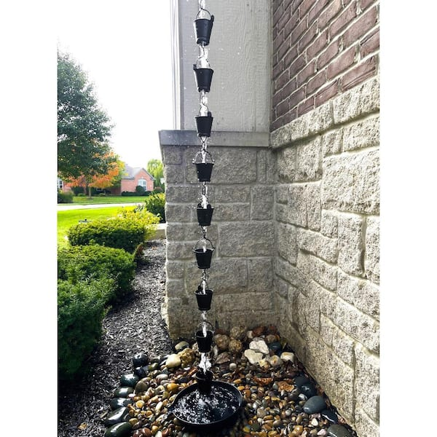
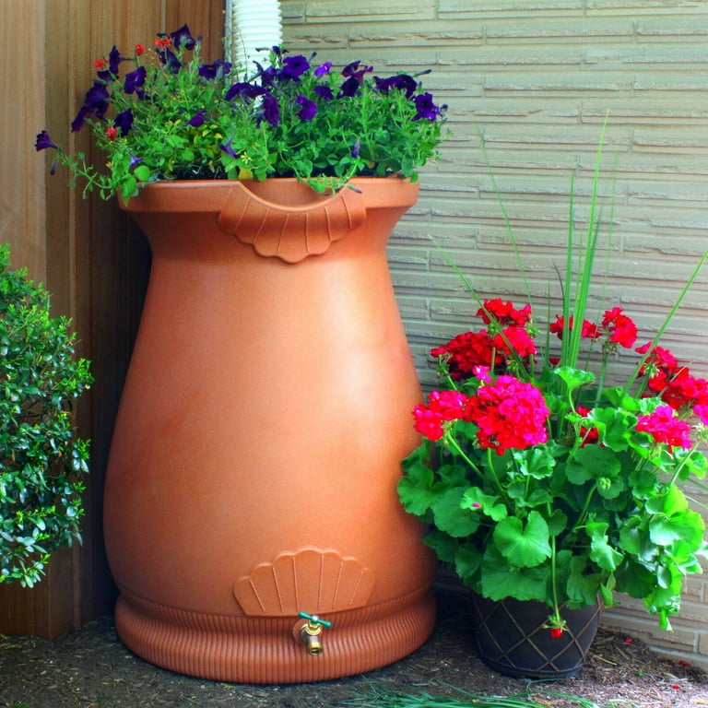

Rain chains, rain barrels, xeriscaping: saving and reusing can be beautiful!

Slide 19
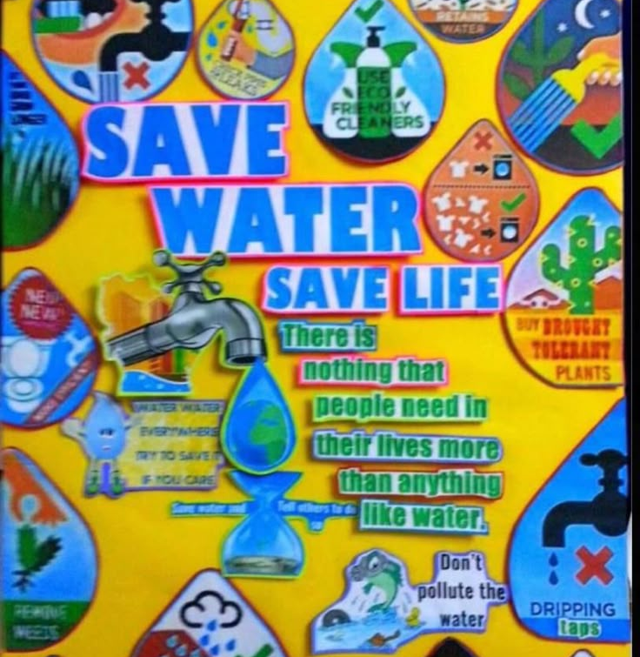
Kathy’s Household water sustainability rules:
Use less water
Use fewer water pollutants
Make wise purchasing choices
As much as possible, keep your water to yourself!

