Slide 1
Wildlife Habitat and Conservation
An overview of ecological concepts, biodiversity, and wildlife management
Presented by: Ricardo Cagigal
Natural Resources Specialist, Region 4

Slide 2
Habitat and Wildlife Requirements
Habitat refers to the natural environment in which a species lives. Wildlife habitat requirements include:
  food
  water
  shelter
  space
Factors affecting habitat suitability include:
  climate
  vegetation
  human activity
  Resource availability

Slide 3
Ecosystem, Community, and Population
An ecosystem includes all living organisms and their non-living environment.
A community is a group of interacting species in an area.
A population is a group of individuals of the same species in a specific area.
Communities interact with abiotic factors to form ecosystems.

Slide 4
Wildlife Population Dynamics
Population dynamics involve birth rates, mortality, age structure, sex ratio, and mating systems. Limiting factors (e.g., food, water) and decimating factors (e.g., disease, predation) influence population size and wildlife management.

Slide 5
Adaptations of Wildlife
Adaptations are traits that help organisms survive in their environment. These include anatomical (e.g., fur), physiological (e.g., hibernation), and behavioral (e.g., migration) adaptations.

Slide 6
Understanding Biodiversity
Biodiversity refers to the variety of life in all its forms. It is important for ecosystem stability, resilience, and human well-being.

Slide 7
Levels of Biodiversity
Genetic diversity: variation within species.
Species diversity: variety of species in an area.
Ecosystem diversity: variety of ecosystems.
Loss at any level can disrupt ecological balance.

Slide 8
Habitat Requirements of Wildlife
Different species have specific habitat preferences. Understanding these helps in conservation and land management to protect both wildlife and ecosystems.

Slide 9
Carrying Capacity
Biological carrying capacity: maximum population an environment can support.
Cultural carrying capacity: population level acceptable to humans.
Land use conflicts arise when human needs clash with wildlife habitat needs.

Slide 10
Wildlife Management Practices
Practices include habitat restoration, controlled burns, population monitoring, and regulation of hunting. These methods aim to maintain healthy wildlife populations and ecosystems.

Slide 11
Role of Wildlife Agencies
Federal, state, and provincial agencies manage and protect wildlife and habitats. They enforce laws, conduct research, and provide education and outreach.

Slide 12

Hunter Education Programs
Texas has a mandatory hunter education program. These promote safety, ethics, and conservation awareness among hunters.

Slide 13
Invasive Species and Biodiversity
Non-native invasive species can outcompete native species and degrade habitats. Invasive plants alter ecosystems and reduce habitat quality for wildlife.

Slide 14
Land Use and Wildlife
Land use decisions affect wildlife through habitat loss and fragmentation. Human population growth and environmental degradation increase pressure on wildlife resources.

Slide 15
Wildlife Diseases
Wildlife can be affected by diseases caused by microbes, parasites, toxins, and other agents. Monitoring and managing diseases is crucial for wildlife health.

Slide 16
Diseases
🦠 Bacterial Diseases
Tuberculosis – Affects deer, bison, and other mammals.
Brucellosis – Found in bison, elk, and other ungulates; can be transmitted to livestock and humans.
Salmonellosis – Affects birds, reptiles, and mammals; often linked to contaminated food or water.
🦠 Viral Diseases
Rabies – Affects mammals, especially raccoons, bats, foxes, and skunks; fatal if untreated.
Canine Distemper – Affects carnivores like foxes, raccoons, and coyotes.
Avian Influenza – Affects wild birds and can spread to domestic poultry and humans.
🧫 Parasitic Diseases
Sarcoptic Mange – Caused by mites; affects foxes, coyotes, and bears.
Lungworms and Liver Flukes – Common in deer and other ungulates.
Botfly Infestation (Myiasis) – Affects rodents and small mammals.
🍄 Fungal Diseases
White-Nose Syndrome – Affects bats; caused by a fungus that grows on skin during hibernation.
Chytridiomycosis – A deadly fungal disease affecting amphibians worldwide.
🧪 Other Notable Diseases
Chronic Wasting Disease (CWD) – A prion disease affecting deer, elk, and moose.
West Nile Virus – A mosquito-borne virus affecting birds, horses, and humans.
Toxoplasmosis – A protozoan disease that can affect many mammals and birds.

Slide 17
Threatened and Endangered Species
Terms:
extinct (gone forever)
extirpated (gone locally)
endangered (high risk of extinction)
threatened (likely to become endangered)
candidate species (under consideration)
reintroduction (restoring species).

Slide 18
Characteristics of Endangered Species
Many endangered species have small populations, limited ranges, and/or specialized habitat needs. Examples include the whooping crane, black-rail, and Houston Toads.

Slide 19




Endangered Species Act and Conservation
The Endangered Species Act protects species at risk of extinction. Agencies like USFWS, TPWD, CITES, and IUCN list and protect species at global, federal, and state levels.

Slide 20
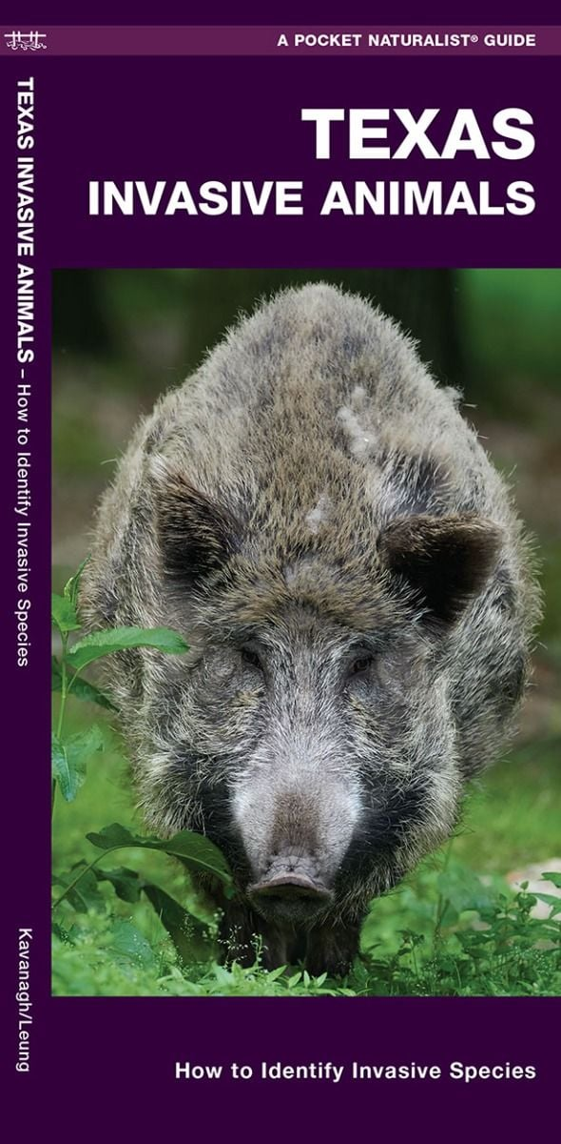
Invasive Species
Invasive species—both wildlife and vegetation—can severely disrupt native ecosystems.
Invasive animals often outcompete native species for food and habitat, spread diseases, and lack natural predators, allowing their populations to grow unchecked.
Similarly, invasive plants can dominate landscapes, alter soil chemistry, and displace native vegetation, reducing the quality and availability of habitat for native wildlife.
Together, these invaders threaten biodiversity, degrade ecosystem health, and interfere with natural ecological processes.

Slide 21
Dental Formulas

Slide 22
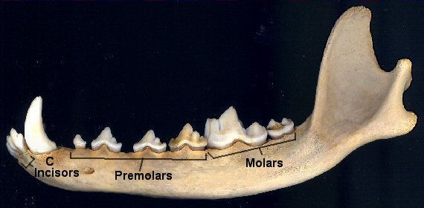
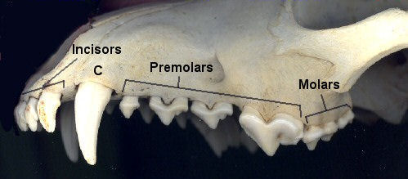
What & How?
Dental formula refers to the number of each type of tooth (incisor, canine, premolar, or molar) found in one quadrant of an animal's mouth. This can be used to determine the species and dietary strategy used by that animal.
Start by counting the teeth on upper and lower jaw, only on the left side of the skull.
Add all upper and lower jaw counts then multiply by 2, to get the total number of teeth.

Slide 23
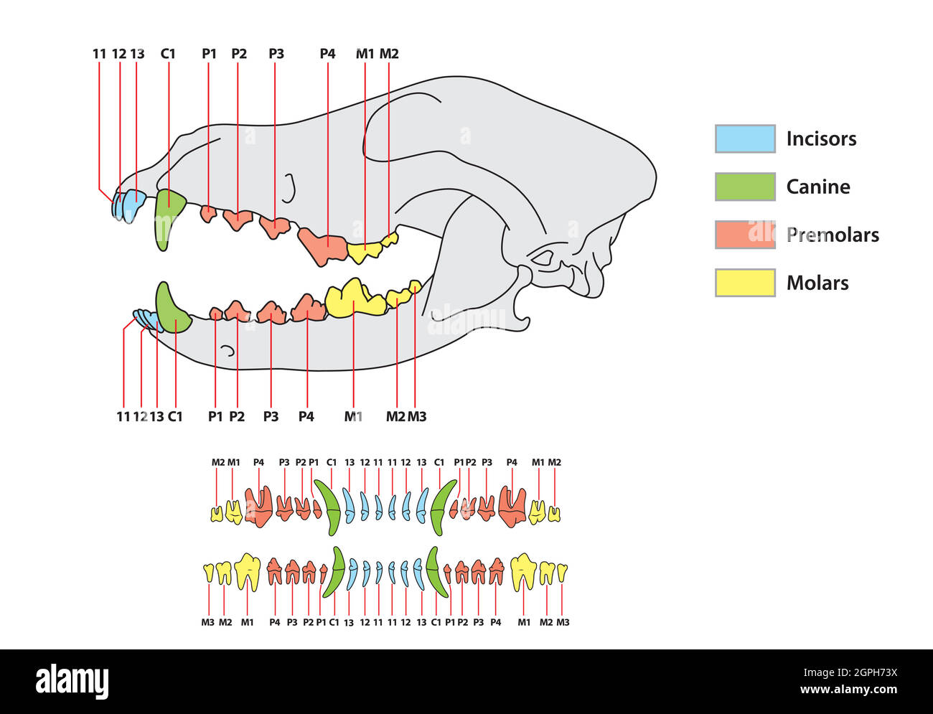
Illustration – Dentition

Slide 24
Dental Formula
 | I (Incisors) | C (Canines) | P (Premolar) | M (Molar) | Total (# teeth)
Dog | 3/3 | 1/1 | 4/4 | 2/3 | 42
Mouse | 1/1 | 0/0 | 0/0 | 3/3 | 16
Racoon | 3/3 | 1/1 | 4/4 | 2/2 | 40
Elephant | 1/0 | 0/0 | 0/0 | 3/3 | 14

Slide 25

The End

Slide 26
Thank you!
Thank you!
Questions?
Contact: Ricardo Cagigal
Cellphone: (281) 782-4121
Ricardo.CagigalPerez@tpwd.texas.gov

