Slide 1

Teacher Training
Texas Envirothon 2025 | Forestry

Slide 2
Agenda
Introductions
Review of Texas forestry criteria
Overview of study resources
Tree anatomy mini review
Forest pest overview
Hands-on breakout
Tree ID 101
Forestry tools demo

Slide 3
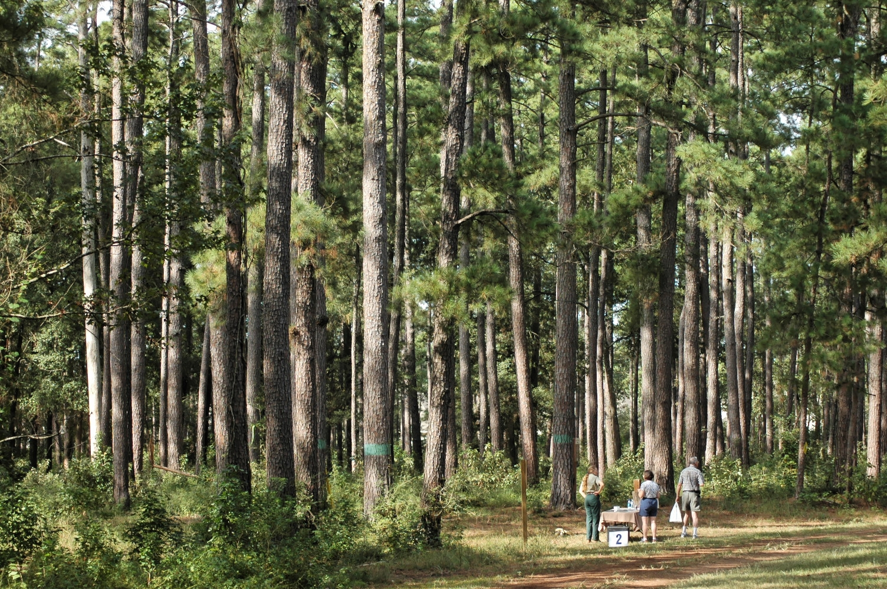
Texas A&M Forest Service | Our Mission
Texas A&M Forest Service provides statewide leadership and technical assistance to ensure trees, forests and related natural resources are sustained for the benefit of all. The agency supports the state’s incident response capability, protecting against wildfire and responding to a range of all-hazard incidents.
W.G. Jones State Forest in Montgomery County, TX. Jones State Forest is one of five state forests managed by the Texas A&M Forest Service.
Notes:
Super quick spiel about who TFS is

Slide 4


Texas Envirothon Forestry Contacts
Sam Hill
Woodland Ecologist | Water Resources
sam.hill@tfs.tamu.edu
Jaden Kelly
Program Specialist | Conservation Education
jaden.kelly@tfs.tamu.edu
Texas A&M Forest Service Homepage
Texas Forest Info

Slide 5
Texas Forestry Criteria – Teams should be able to…
Describe the value of trees in rural, urban, and suburban settings.
Explain fundamentals concepts of tree biology, such as tree anatomy, growth habits, and adaptations.
Explain the cause-and-effect relationship of factors affecting tree growth and forest development (climate, insects, microorganisms, wildlife, etc.)
Identify common Texas trees by leaves, bark, branching patterns, buds, fruit, and other characteristics without using a key.
Identify region-specific trees by leaves, bark, branching patterns, buds, fruit, and other characteristics with the use of a key.
Identify common forest pests and diseases affecting Texas trees without use of a key, describe how they are spread, and list methods of control.
Explain forest ecology concepts and factors affecting them, including the relationship between soil and forest types, tree communities, regeneration, competition, and succession.
Correlate the effect of proper forest management practices on biological diversity, forest fragmentation, air quality, aesthetics, fire, climate change, and recreation.
Create forest management recommendations using best management practices (BMPs) and land-use goals.
Explain the environmental, historical, and societal differences between wildfires and prescribed burns, and the effects of both.
Use common forestry tools, such as diameter tape, Biltmore sticks, and clinometers, to make common forestry measurements, such as diameter at breast height (DBH), chain, cord, total tree heigh, merchantable height, board feet, log, and basal area.

Slide 6
Study Resources
Slide Decks
Additional Resources
Forestry Field Skills
Forestry tools, measurements
Tree ID
Pest ID
Tree Biology
One-pagers, quick guides
Videos
Website resources
Resources are uploaded to the Envirothon Texas webpage.

Slide 7
Tree Anatomy
More information about tree anatomy can be found in the Tree Biology slide deck.

Slide 8
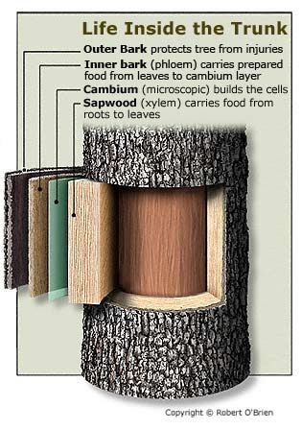
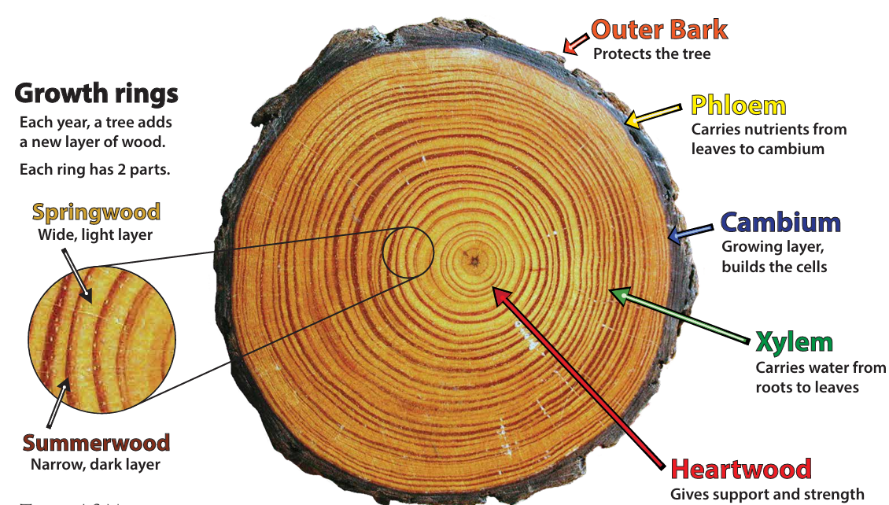
Tree Tissues
Water moves “xy high” to the rest of the tree through the xylem. Sugars in the leaves “phlo low” down to the rest of the tree through the phloem.
Notes:
chrome-extension://efaidnbmnnnibpcajpcglclefindmkaj/https://tfsweb.tamu.edu/uploadedFiles/TFSMain/Learn_and_Explore/Conservation_Education_Resources/Tree%20Cookie%20Parts.pdf

Slide 9
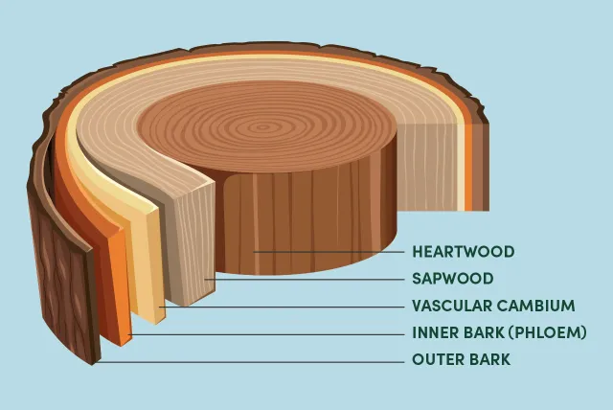
Tree Tissues
Outer bark
Protects tree from environment (temperature, moisture), pests
Inner bark (Phloem)
“Pipeline” for sugars created in leaves to flow to rest of tree
Short-lived; eventually becomes part of outer bark
Cambium cell layer
Produces new bark (phloem) and new wood (xylem) on either side of layer
Sapwood (Xylem)
Transports water and nutrients from roots to rest of tree
New wood that eventually becomes heartwood as new cells are created from cambium
Heartwood
Dead wood that provides mechanical support to tree
Diagram of different tissue layers in a tree
Arbor Day Foundation

Slide 10
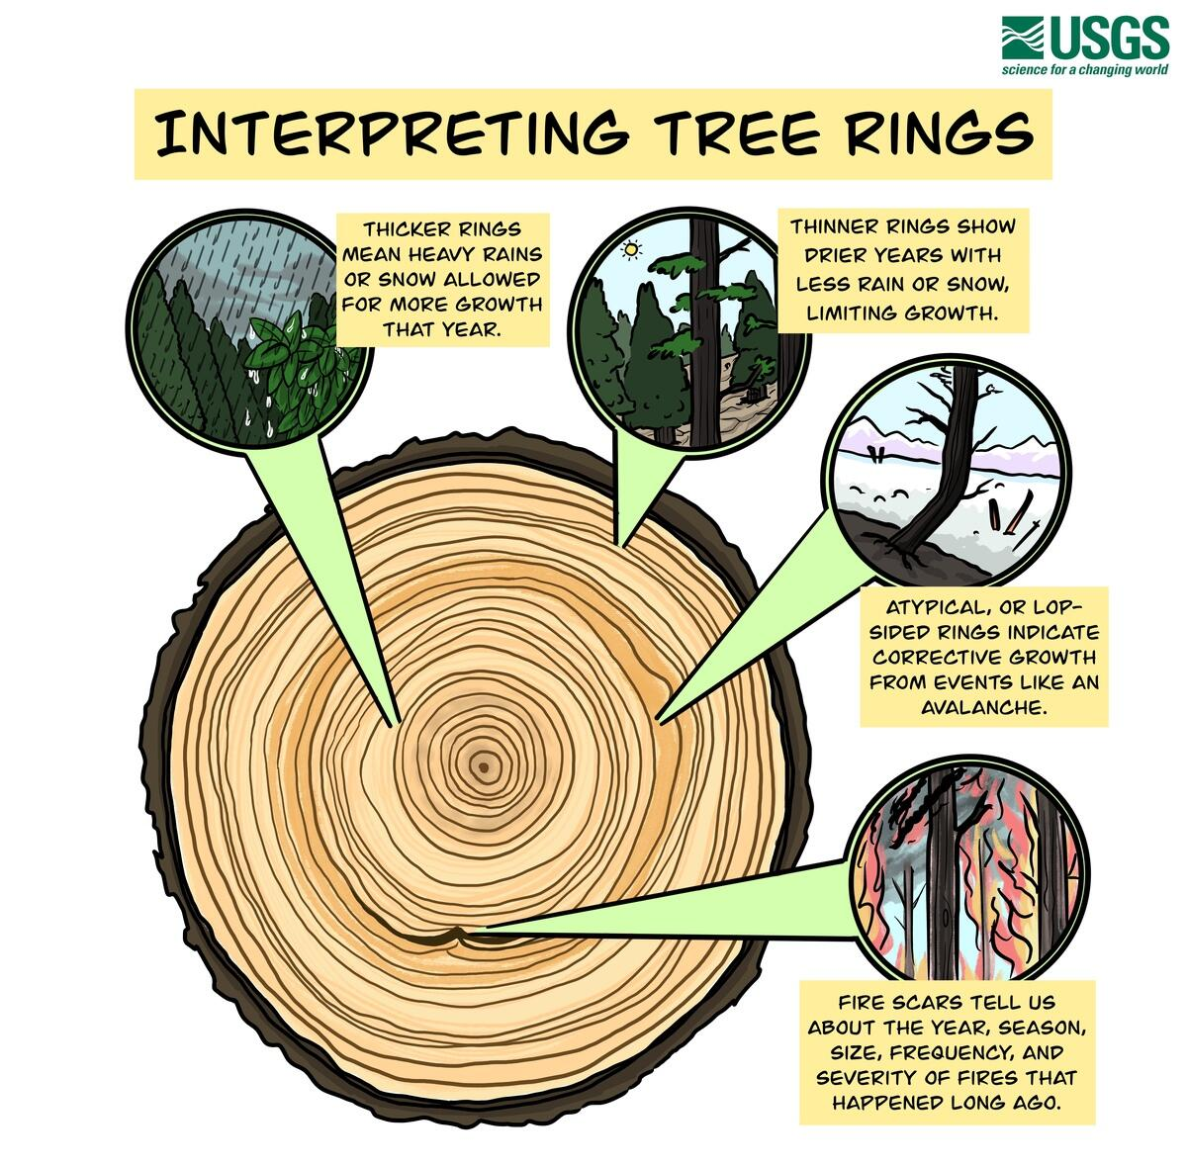
Tree Rings and Dating Trees
Trees grow two rings each year
Springwood/earlywood; usually thicker and lighter in color
Summerwood/latewood; usually thinner and darker
Only count one type of wood when counting growth rings
Analyzing tree rings to determine a tree’s age and past environmental conditions is called dendrochronology

Slide 11
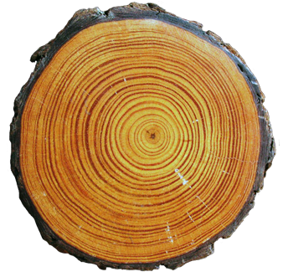
Dendrochronology
Narrow rings could mean slower growth from not getting enough water, sunlight, space, or nutrients.

Slide 12
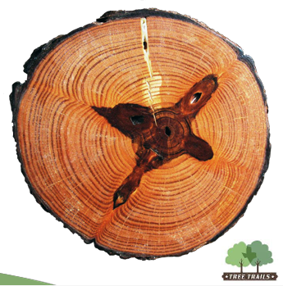
Dendrochronology
This tree shows scars where branches have died or fallen off and the tree has grown around and over them.

Slide 13
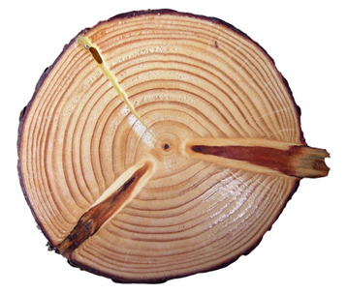
Dendrochronology
Wide rings could mean the available water, sunlight, space, or nutrients allowed the tree to grow vigorously.
Narrow rings toward the outer edge could mean that the younger trees are starting to crowd each other.

Slide 14
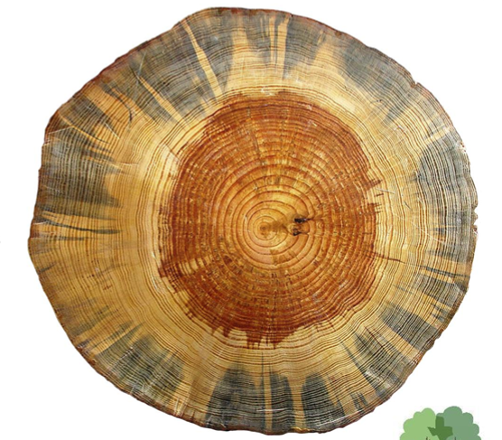
Dendrochronology
This tree shows the difference in color of the heartwood and sapwood.
Blue stain fungus is also evident in the sapwood. The fungus is carried by bark beetles and quickens the tree’s death after attack by the beetles.

Slide 15
Forest Pests
Detailed information and additional resources about these pests and disorders are included in the Forestry Field Skills slide deck.

Slide 16
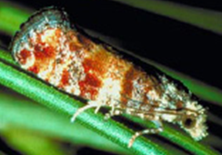
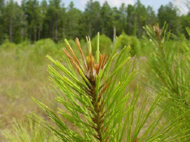
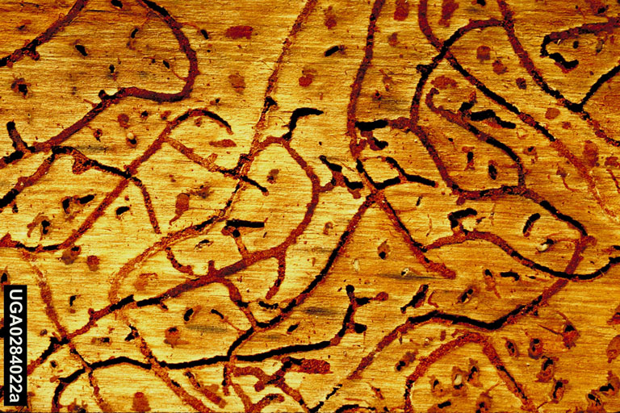
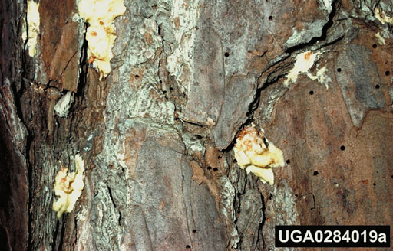
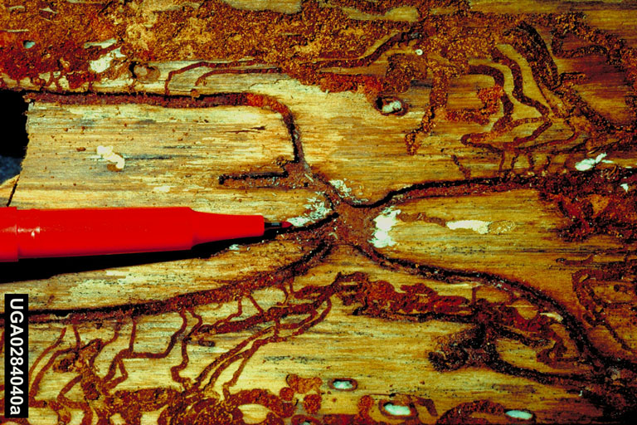
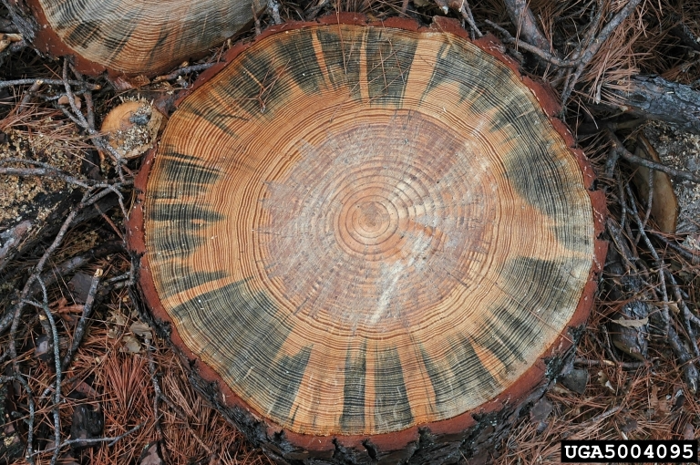
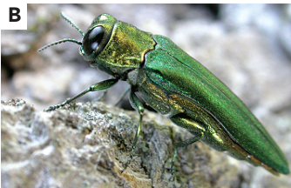
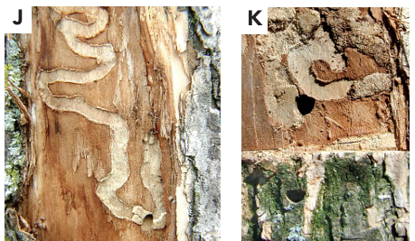
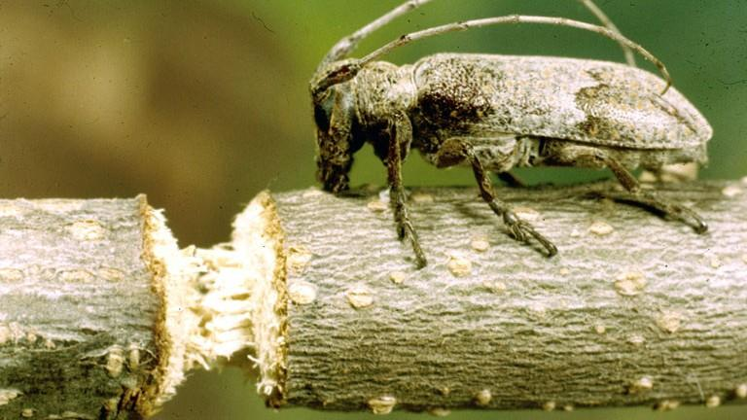
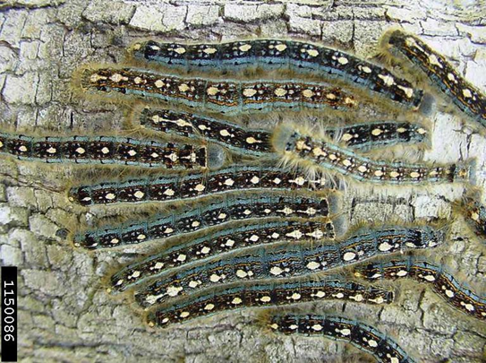
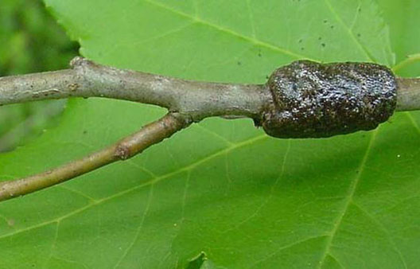
Tree/Forest Insect Pests
Tree/Forest Insect Pests
Photos | Pest Species/Affected Tree | Tree Symptoms | Galleries
 | Pine Tip Moth Pine species, especially loblolly and shortleaf | Brown, dying shoots, sometimes with webbing or resin on the end of the terminal | -
 | Southern Pine Beetle Pine species, especially loblolly and shortleaf | Whitish to reddish pitch tubes | S-shaped and winding
 | Ips Bark Beetles Pine species | Whitish to reddish pitch tubes Blue-stained wood from fungus carried by beetle | I-, Y-, H-, or X-shaped vertical galleries
 | Emerald Ash Borer Ash species | D-shaped exit holes Leafy shoots form trunk Dead branches at top of tree Split bark over gallery Increased woodpecker activity. | S-shaped
 | Twig Girdler Many hardwood species | Girdled twigs on ground Partially-girdled twigs may still be attached to tree | -
 | Forest Tent Caterpillar Many species of oaks, several other hardwoods | Defoliated trees (trees with no leaves) “Mats” of caterpillars may be visible on bark and twigs | -
Notes:
See individual slides for picture citations.

Slide 17
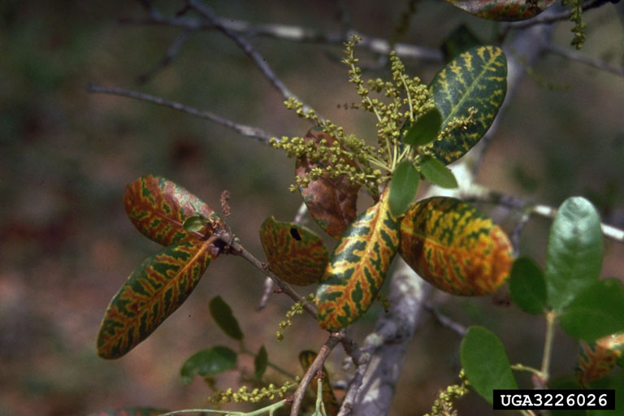
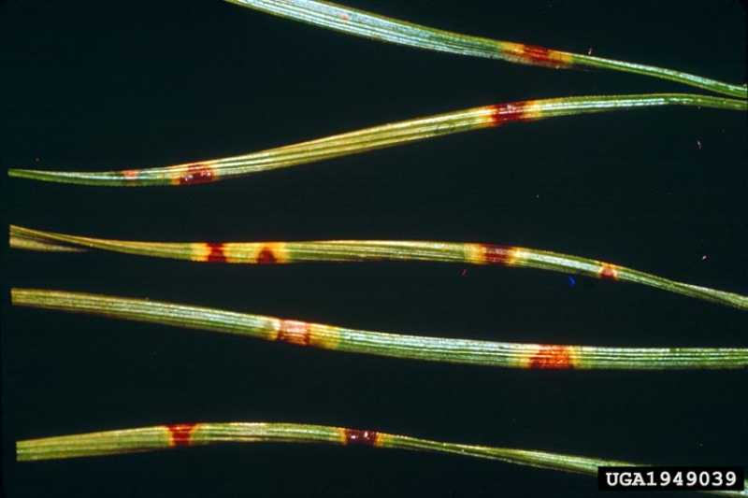
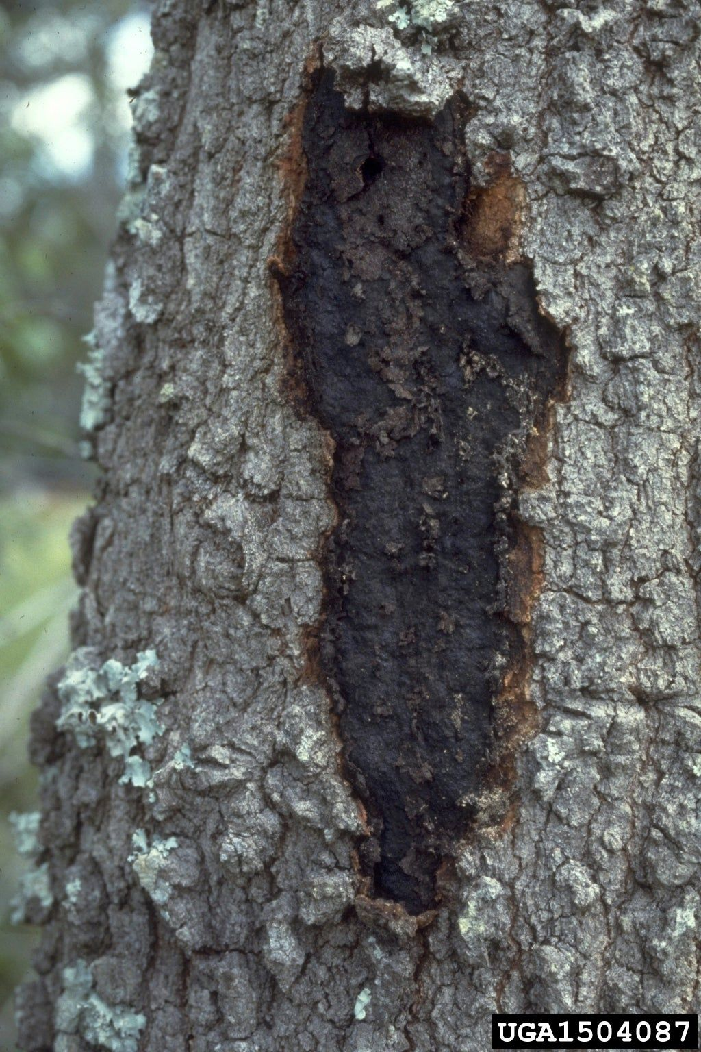
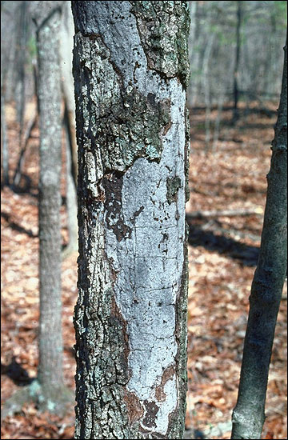
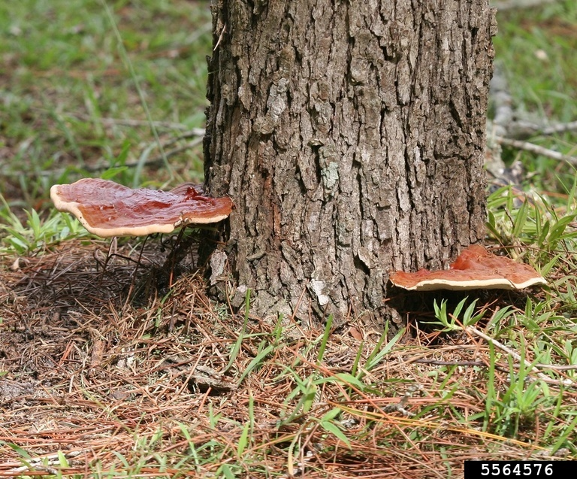
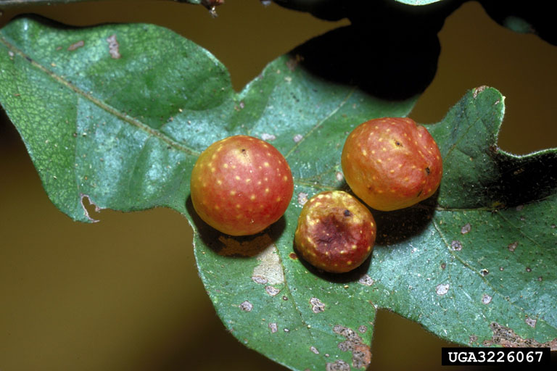
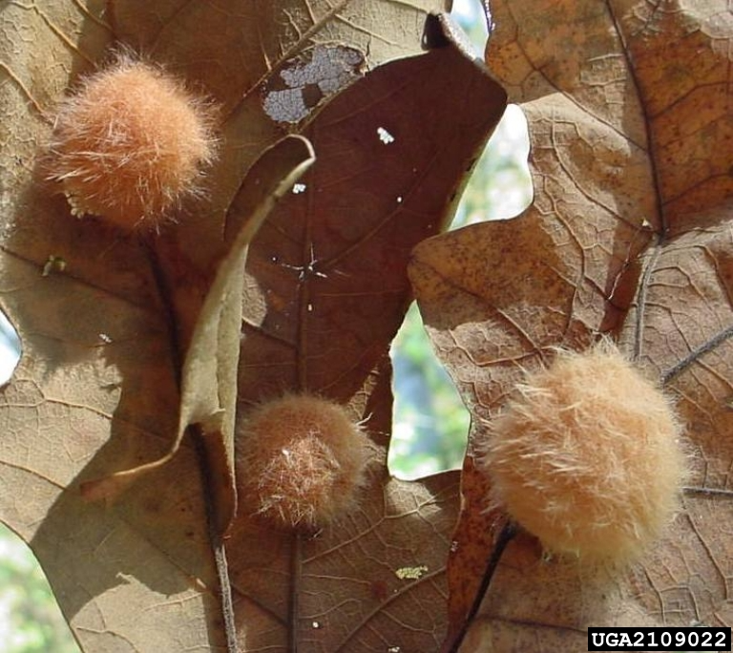
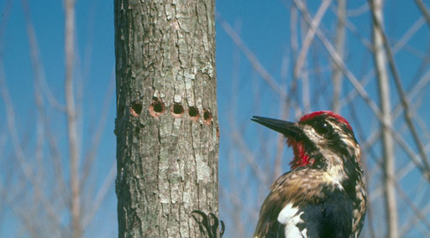
Tree/Forest Pests Continued
Tree/Forest Pests Continued
Photos | Pest Species/Affected Tree | Tree Symptoms
 | Oak Wilt Oaks, especially red oaks | Dying tissue along leaf margin and leaf vein Leaves may prematurely fall off Fungal mats beneath bark
 | Brown Spot Needle Blight Various pine species, especially loblolly and longleaf | Yellow spots on leaves that turn reddish brown Brown bands on leaves surrounded by yellow halo Bare lower branches Slow growth
 | Hypoxylon Canker Many hardwood trees, especially oaks | Cankers that are brown, grey, or black, often powdery, present on limbs and trunk
 | Butt (Root) Rots Many woody plant species | Swelling and cracks in bark, Conks (shelf-like mushrooms), especially along base and trunk of tree
 | Oak Galls Various oak species | Abnormal tissue growth on twigs, leaves
 | Sapsuckers and Woodpeckers Many tree species | Shallow holes in rows (sapsuckers) Holes in a random pattern (woodpeckers)
Notes:
See individual slides for picture citations.

Slide 18
Tree ID
More information about tree ID, including information about the common tree list species, can be found in the Forestry Field Skills and Tree Biology slide decks.

Slide 19
2025 Envirothon Texas Tree List
Bald Cypress
Eastern Redcedar
Loblolly Pine
Bur Oak
Southern Live Oak
Shumard Oak
Water Oak
American Elm
Yaupon
Southern Magnolia
Red Maple
Red Mulberry
Green Ash
Chinese Tallow
American Sycamore
Pecan
Wax Myrtle
Black Willow
Eastern Cottonwood
Sweetgum

Slide 20
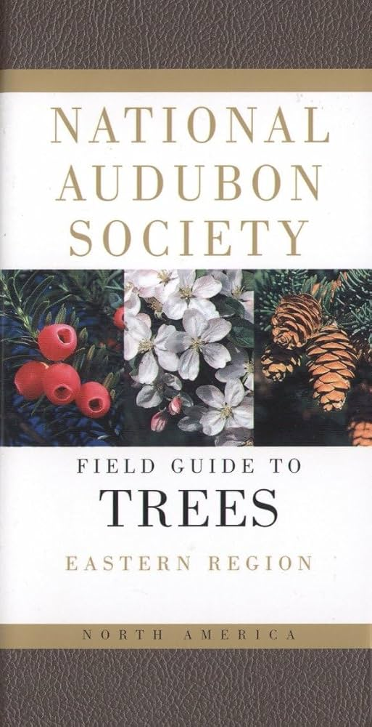
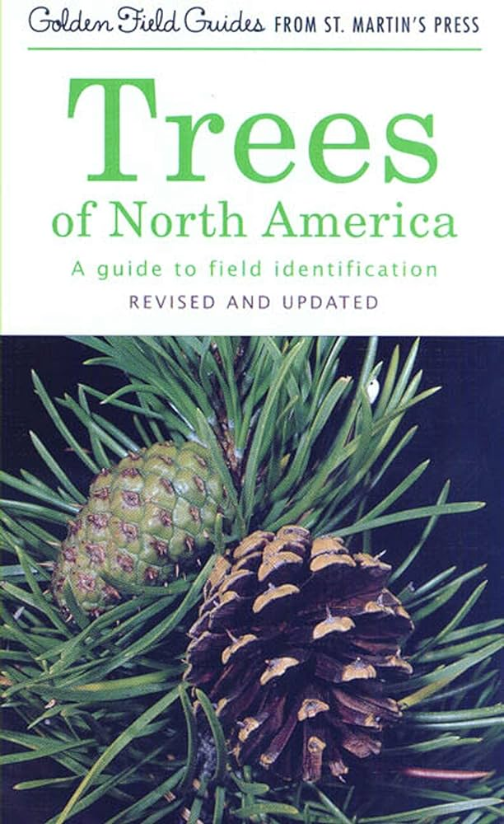

Additional Resources
iNaturalist website and apps (including Seek)
National Audubon Society Field Guide to North American Trees: Eastern Region
Trees of North America: A Guide to Field Identification

Slide 21
Tree Identification
When trying to identify a species of tree, the following characteristics can be used.
Note that a species may not have leaves, flowers, or fruit when you are trying to ID it, so knowing multiple characteristics of that species is beneficial.
Tree Identification Characteristics
Habitat | Tree Form
Twigs | Buds
Bark | Flowers
Leaves | Leaf arrangement
Leaf shape | Fruit
Parts of leaf | Seeds
Cones | Wood

Slide 22
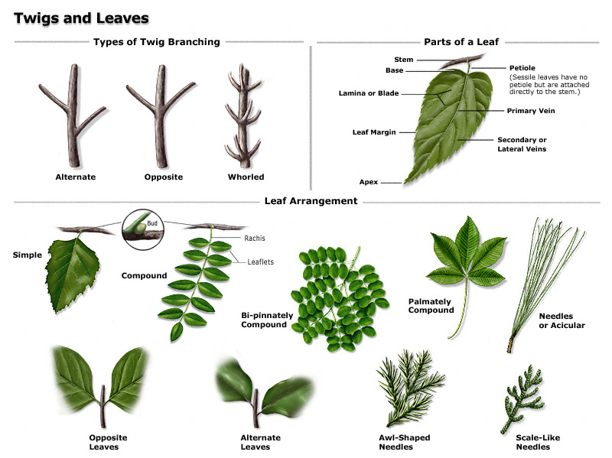
Leaf Morphology
Refer to the Plant Biology slide deck for more information on tree morphology and taxonomic classification.

Slide 23
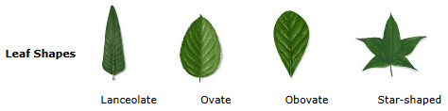
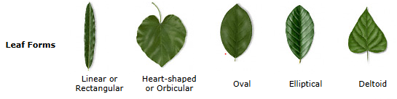
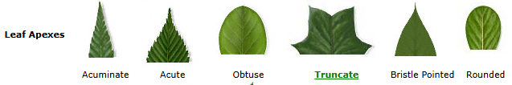
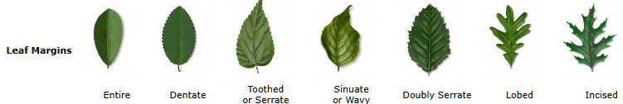
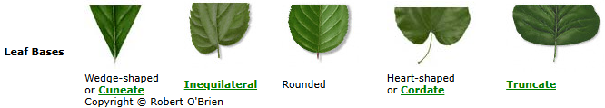
Common Leaf Shapes
Notes:
http://texastreeid.tamu.edu/content/howToID/

Slide 24
Forestry Skills Workshop
Inside
Outside
At your own pace;
Tree ID using leaf samples, field guides, apps, keys
Tree cookie gallery
Jaden and Sam will both be outside assisting with the forestry tools;
Clinometers
D-tape
Biltmore sticks

Slide 25

Upcoming Events
Project Learning Tree Trainings

