Slide 1
Texas Wildlife

Slide 2
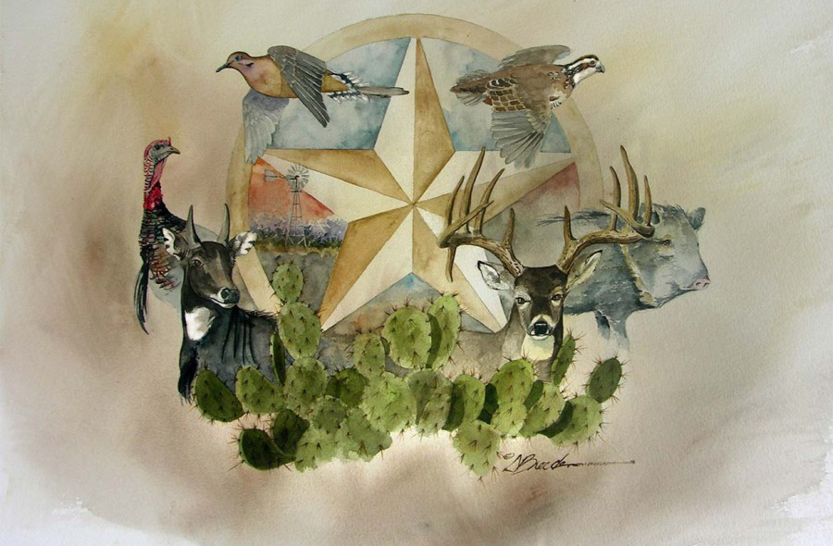
Agenda
Birds
Mammals
Insects
Reptiles
Amphibians
Invasive wildlife

Slide 3
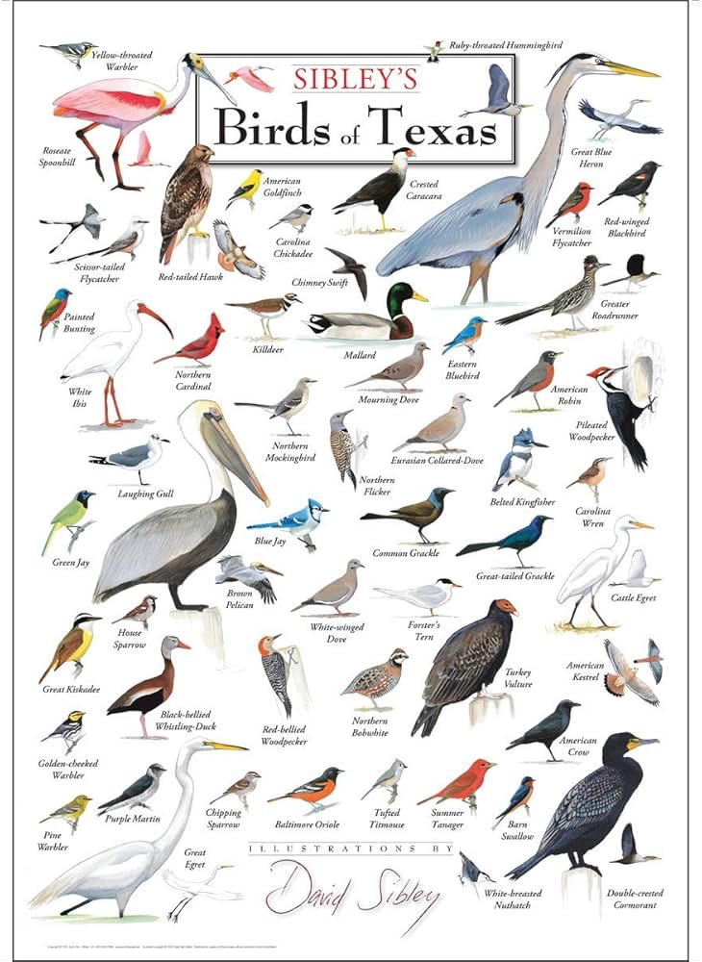
Birds

Slide 4
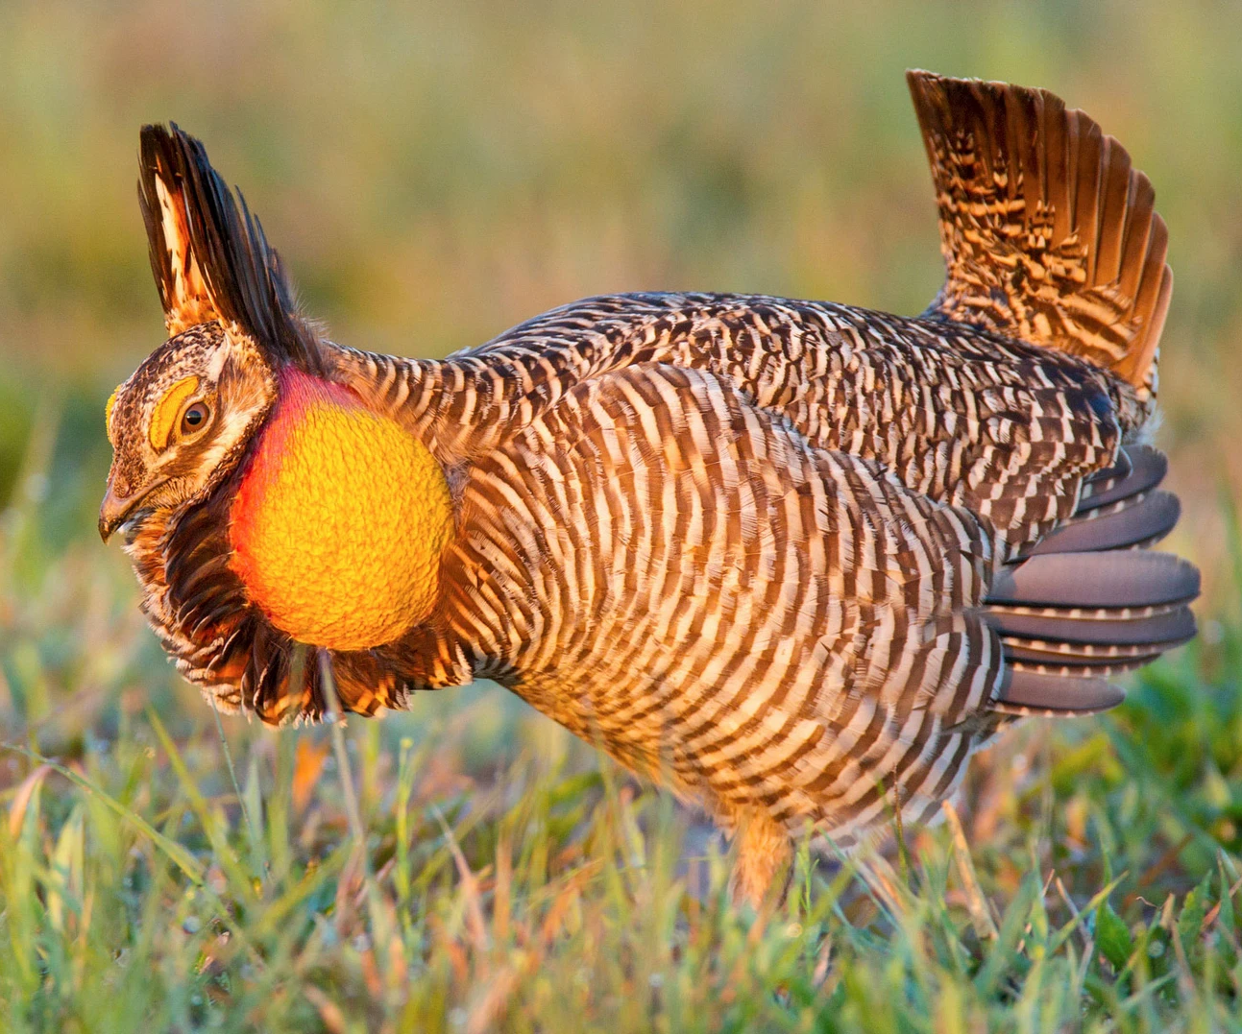
Attwater's Prairie Chicken
• Highly-endangered subspecies of the extinct Heath Hen.
• When displaying, the males erect earlike plumes on the head and blow up bright orange air sacs on the neck, transforming themselves from brownish chickenlike birds into brightly colored performers
• Famous for their “Booming” mating ritual
• Male Attwater’s Prairie-Chickens gathered in makeshift arenas called leks.
• Best time to spot one is late March and early May.

Slide 5
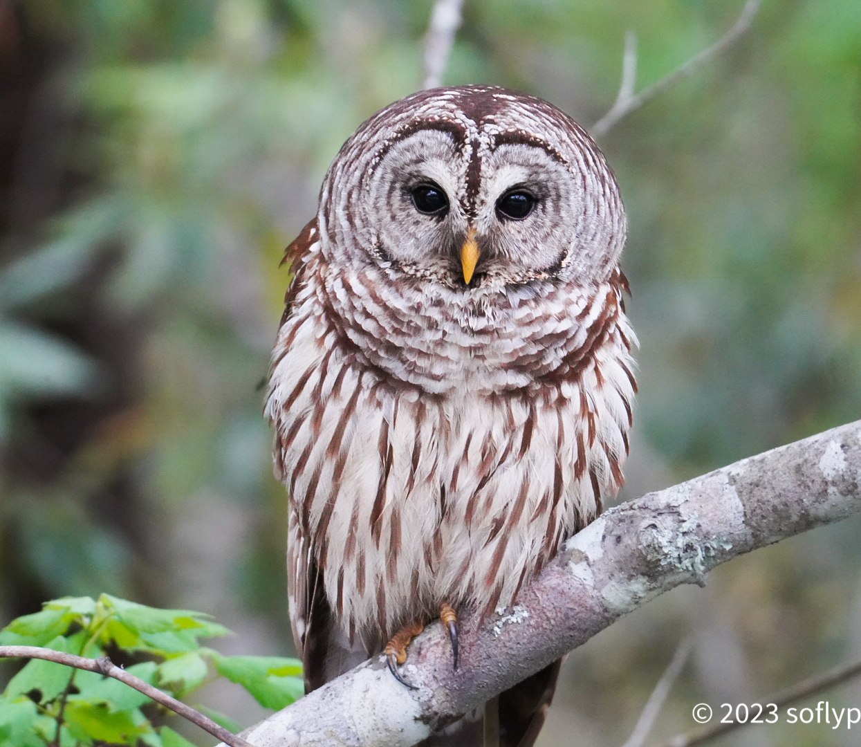
Barred Owl
• Large, stocky red-gray owl without ear tufts
• Wide vertical barring on chest and belly
• Distinct two-lobed facial disk dissected
by nose and bill ridge
• Prefers mixed wooded areas
• More common to the east in South Texas Thornscrub, Oaks and Prairies and East Texas Pineywoods. Present statewide
• Call is the distinctive “Who cooks, who cooks for you all”

Slide 6
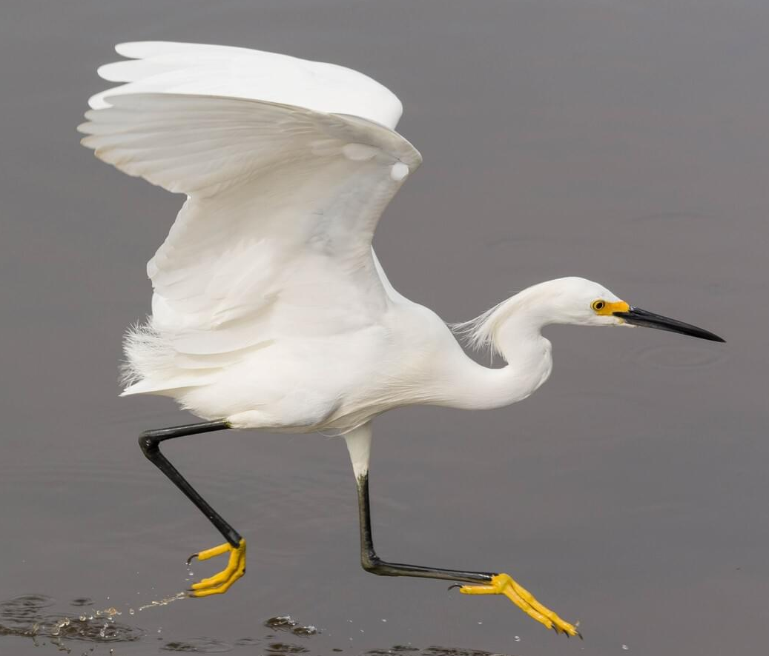
Snowy Egret
• Snowy Egret sets off immaculate white plumage with black legs and brilliant yellow feet.
• Species was endangered due to the beautiful breeding plumage.
• In 1886 these plumes were valued at $32 per ounce, which was twice the price of gold at the time.
• Prefers shallow wetlands and breed in woody marshes and cypress stands.
• They have been known to hybridize with Tricolored Herons, Little Blue Herons, and Cattle Egrets.

Slide 7
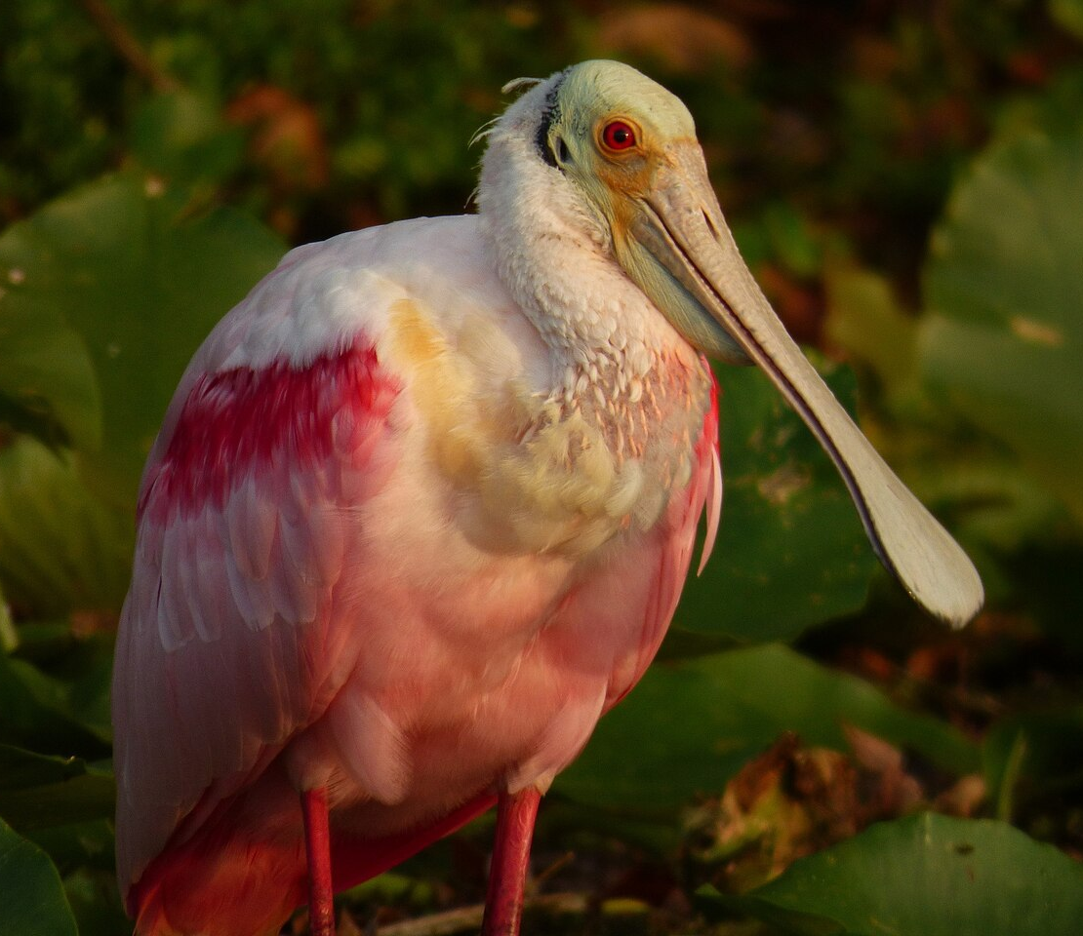
Roseate spoonbill
• Only species of spoonbill in our continent & the most colorful one
• Range extends to South America and the Caribean
• Distinct two-lobed facial disk dissected
by nose and bill ridge
• Prefers mixed wooded areas
• More common to the east in South Texas Thornscrub, Oaks and Prairies and East Texas Pineywoods. Present statewide
• Call is the distinctive “Who cooks, who cooks for you all”

Slide 8
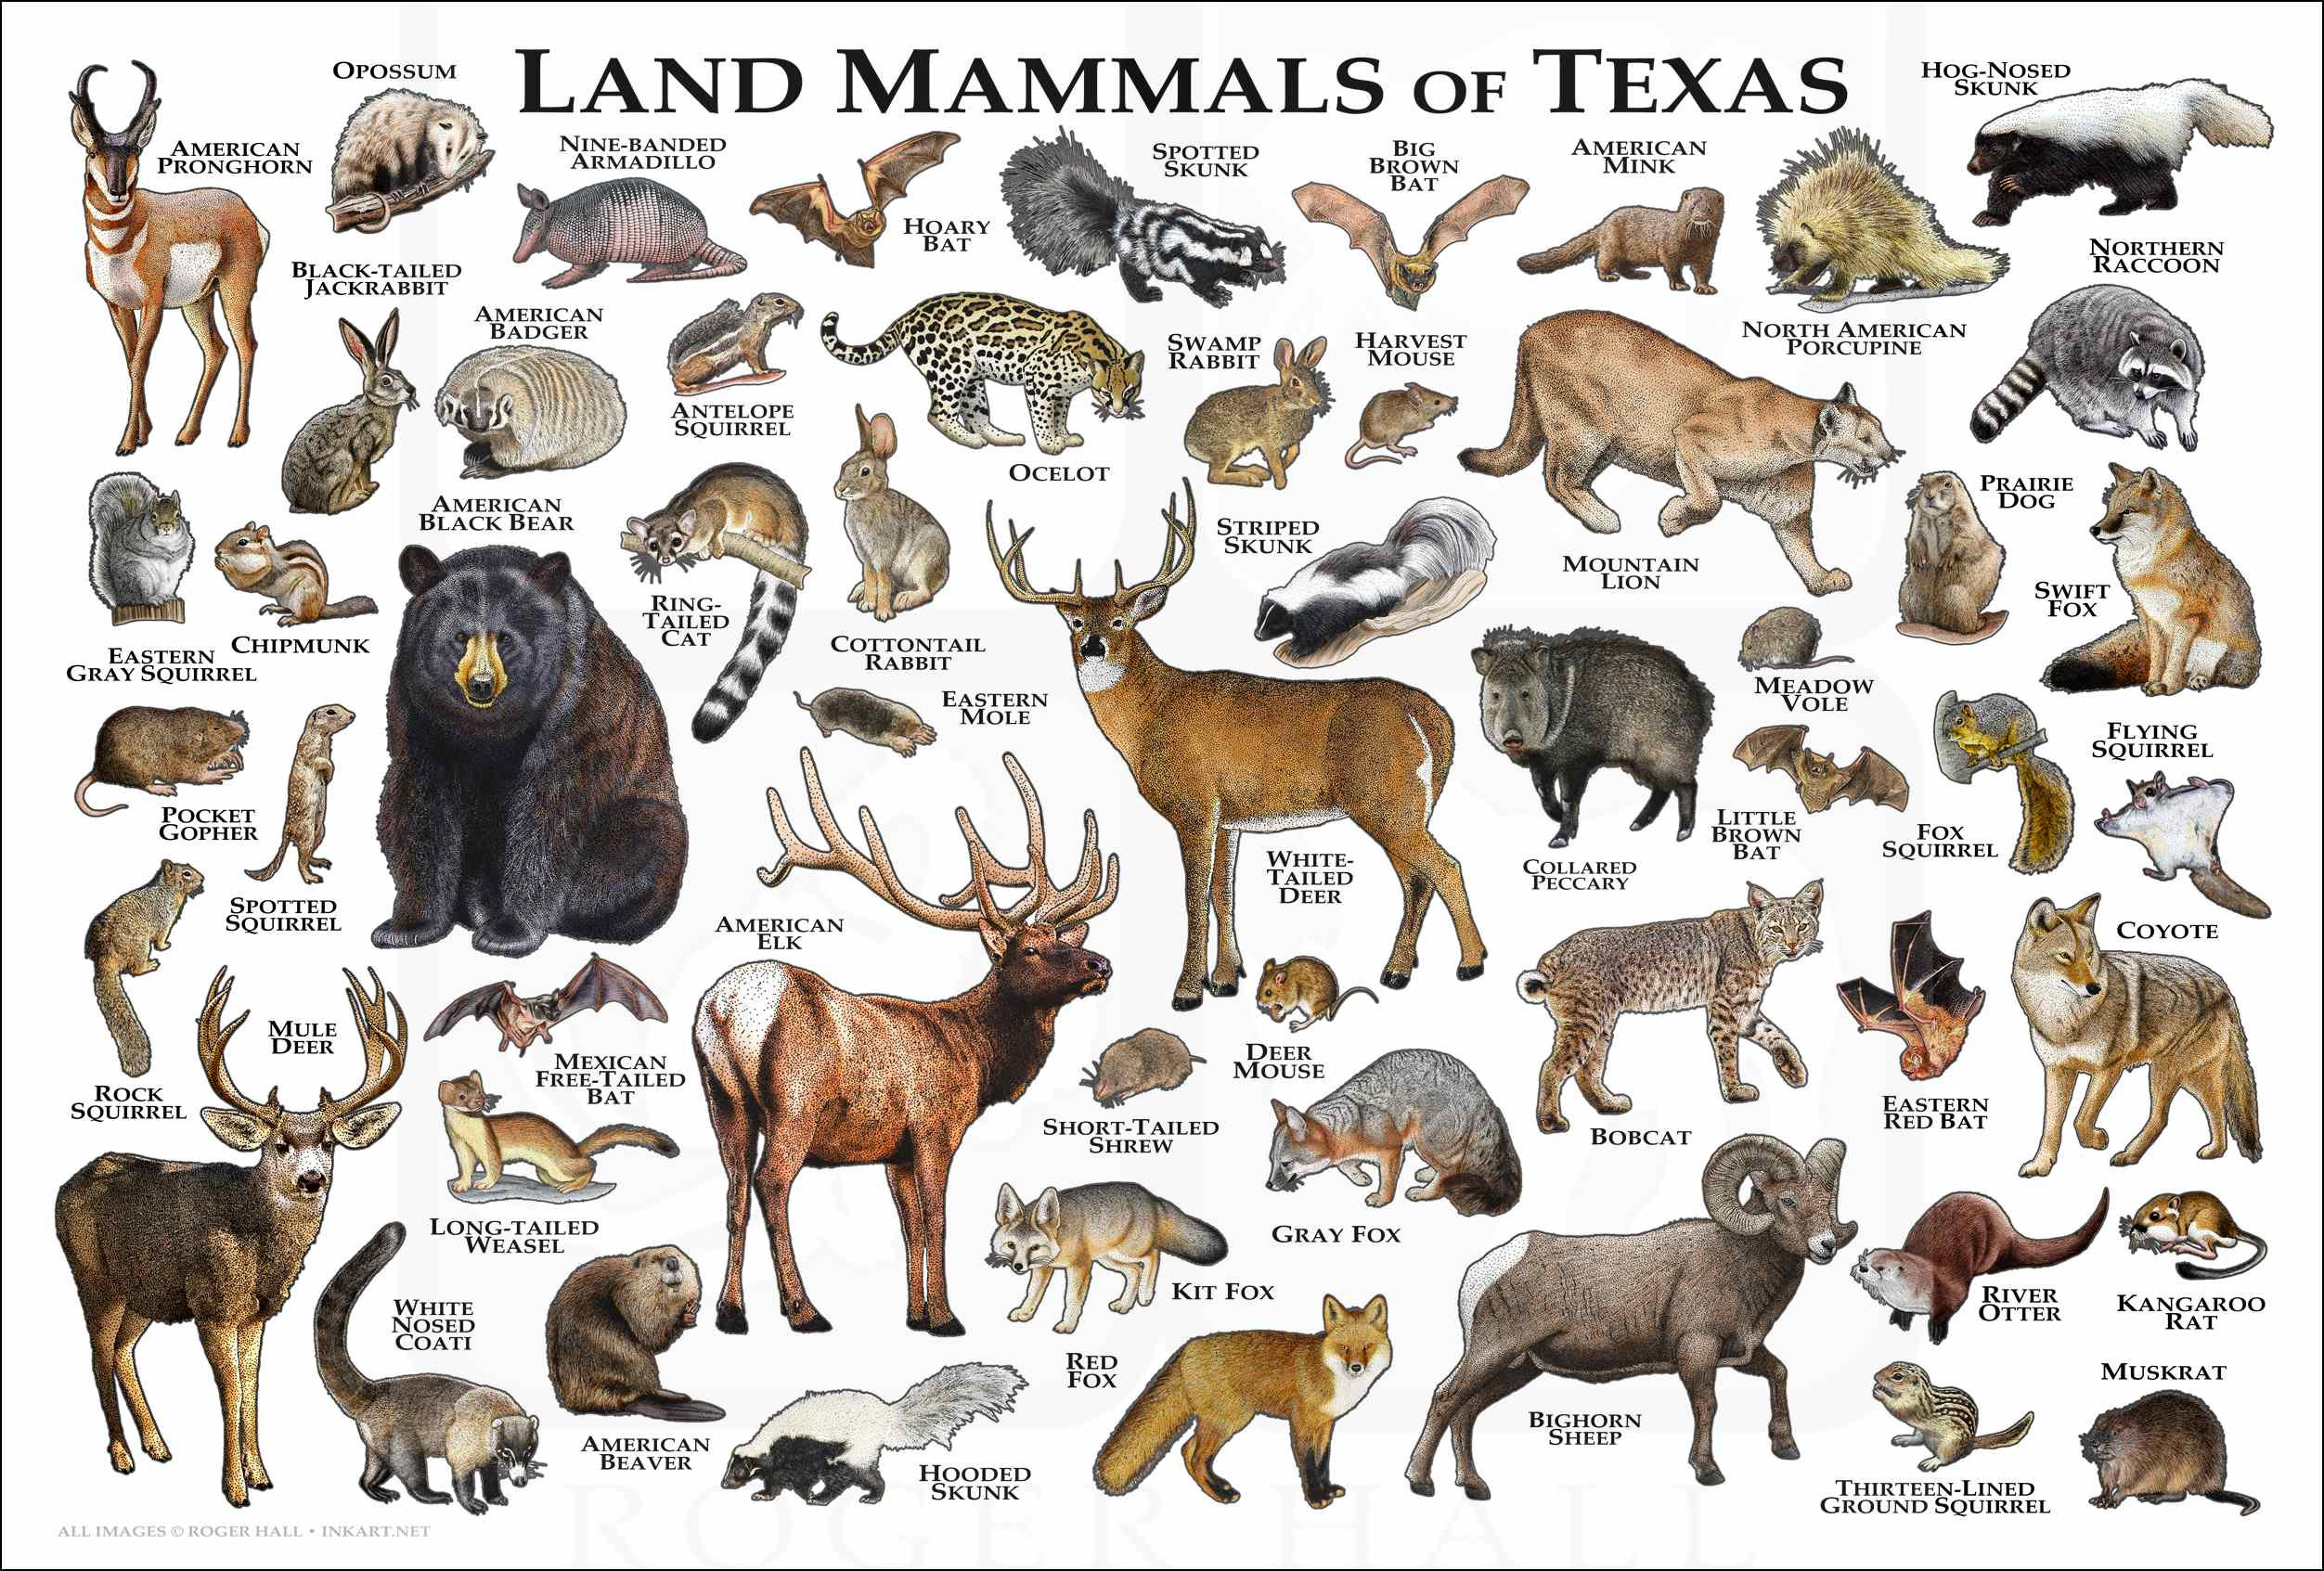
Mammals

Slide 9
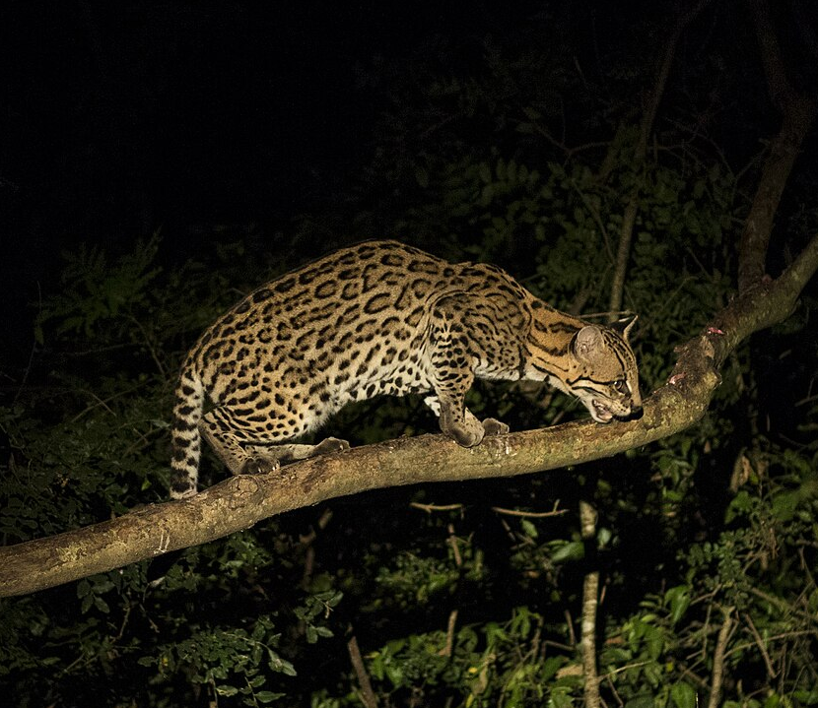
Ocelot
• Listed as endangered in the US, are only found in South Texas w/less than 100 specimens left.
• Medium-sized wildcats with creamy-colored fur covered in reddish-brown spots outlined in black.
• Carnivores whose diet consists primarily of rabbits, small rodents, and birds.
• Prefer dense, thorny, low brush such as spiny hackberry, lotebush, and blackbrush.
• The Caesar Kleberg Wildlife Research Institute (CKWRI) at Texas A&M University-Kingsville is building an Ocelot Conservation Facility.

Slide 10
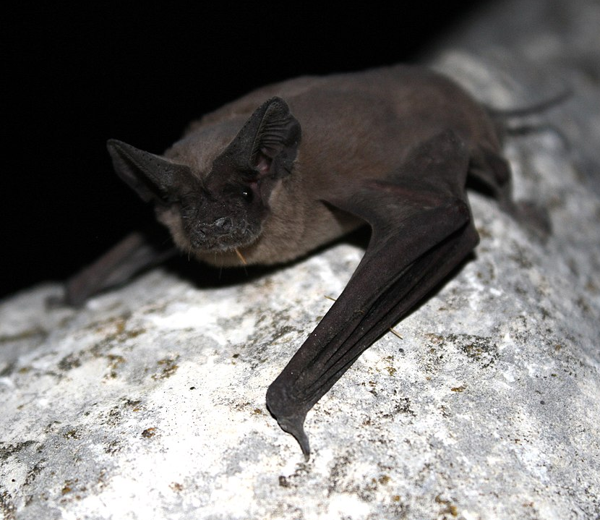
Mexican free-tailed bat
• Their fur is reddish to dark brown or gray in color. They have broad, black, forward pointing ears, and wrinkled lips. Their tails extend more than one third beyond the tail membranes
• Most of these bats migrate south to Central America and Mexico during the winter.
• Mexican free-tails prefer to roost in caves, but will also choose attics, under bridges, or in abandoned buildings. They choose roosts near water. The water attracts the insects they eat, as well as allowing them the opportunity to drink.
• Some roosts are known to contain millions of bats. In those colonies it is estimated that 250 tons of insects can be consumed every night.

Slide 11
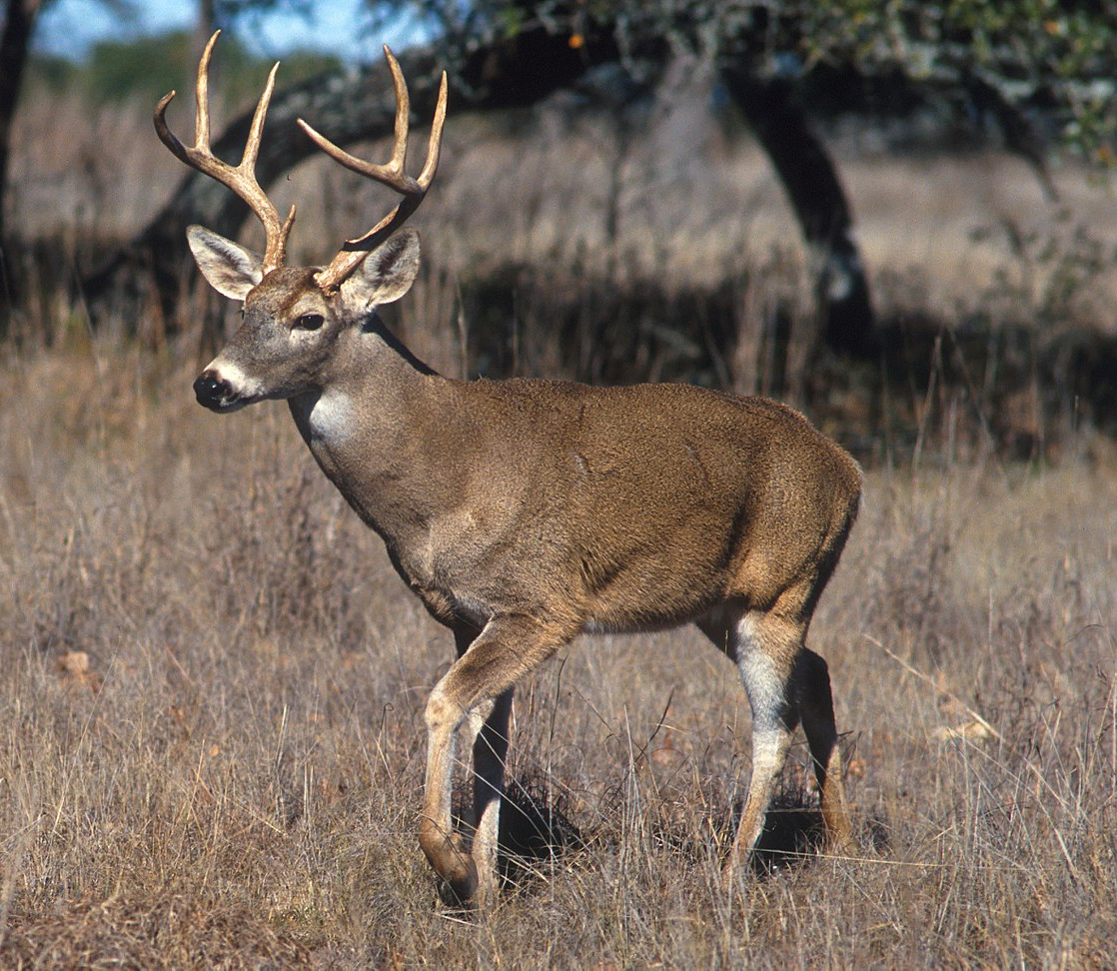
White-tailed deer
• White-tailed deer are grayish in winter and tannish to reddish brown in summer. Their underside and throats are white. They have a large tail that is white underneath and when threatened the deer raise their tail like a bright white flag.
• Known to eat grasses, forbs, browse, acorns and fruits.
• Smallest member of the Deer family (Cervidae)
• Antlers are made of bone & keratin and vary in size as the animal ages.

Slide 12
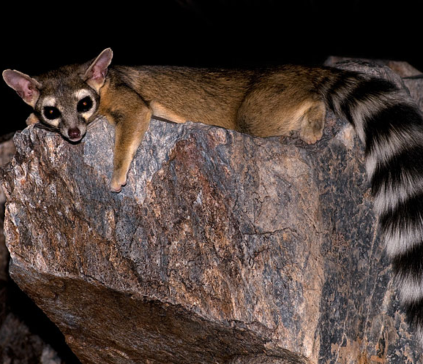
Ring-tailed cat
• Are in the Racoon family.
• Weigh in at 2-3 lb. they have a long, bushy tail with black-and-white stripes.
• Nocturnal omnivores, diet ranging from small mammals and insects to fruits and berries
• Prefer rocky landscapes, woodlands, and semi-arid areas.
• In the wild a ringtail will live around 6-9 year, it’s predators include great horned owls, bobcats and coyotes.

Slide 13
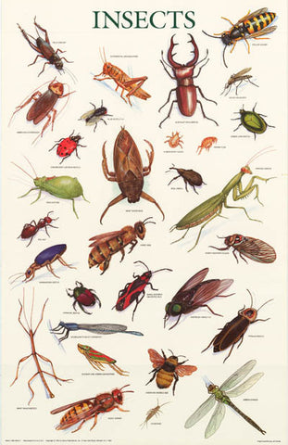
Insects

Slide 14
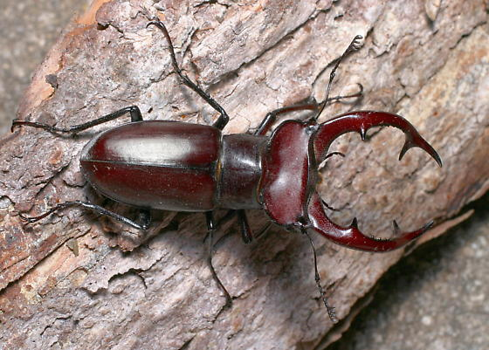
Stag Beetle
• Large, robust beetles typically dark brown in color.
• Males have elongated mandibles that are used to joust with rival males.
• Few species in Texas, Giant Stag beetle has the most elaborate mandible.
• Adults may feed on leaves but Texas species are seldom common enough to be considered pests.
• Larvae take a year or multiple years to develop in damp, decaying wood.
•Adult emergence peaks in late May and June (spring and summer).

Slide 15
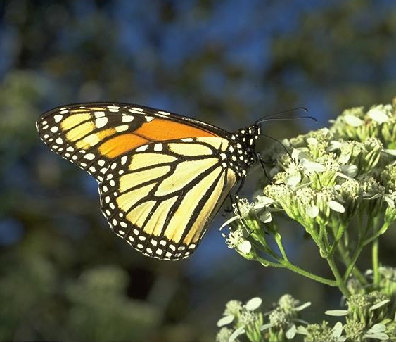
Monarch Butterfly
• Possess two pairs of brilliant orange-red wings, featuring black veins and white spots along the edges.
• They travel between 1,200 and 2,800 miles or more from the northeast United States, and southeast Canada to the mountain forests in central Mexico.
• Milkweed is the only plant on which monarchs will lay their eggs and the only source of food for baby caterpillars.
• Each adult butterfly lives only about four to five weeks.

Slide 16
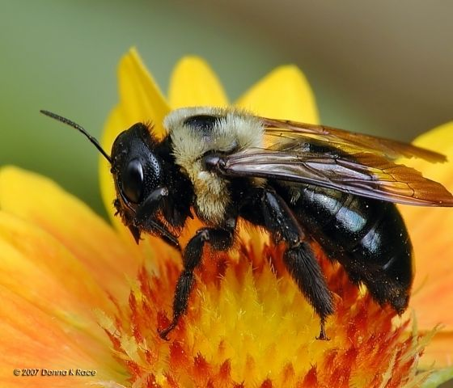
Eastern carpenter bee
• Known for its large size and shiny, black abdomen, often mistaken for bumblebees, but with a bare abdomen.
• They create nests by chewing round, dime-sized holes in wooden structures and then tunneling through the wood.
• Adults spend the winter in nests constructed the previous year, and become active in April or May.
• Females collect pollen and nectar to produce a dough-like mass called “bee bread.” Eggs hatch into larvae that feed on the bee bread in their cells.

Slide 17
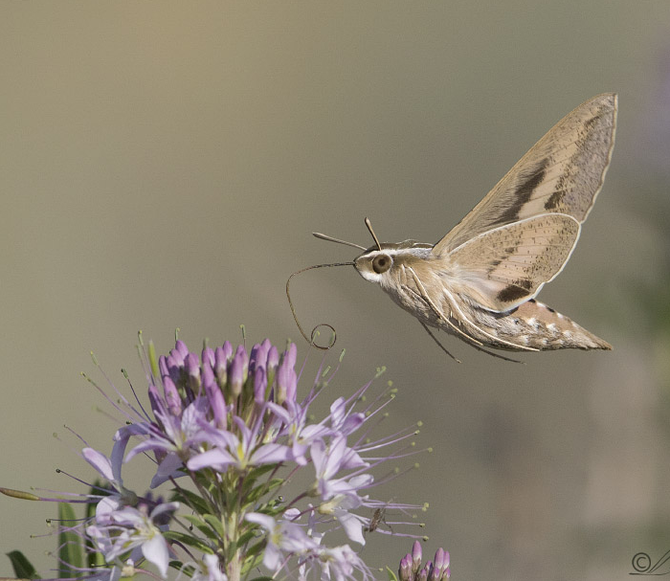
Sphinx Moth
• Also known as hummingbird moth.
• Mimicry is their key to survival.
• They can hover in midair for up to 80 seconds straight and fly at speeds of up to 12 miles per hour.
• Their lifecycle from egg to adult takes about a month, with most of their lifespan spent in the larval stage.
• Depend on nectar-rich blooms to survive and are a crucial native pollinator.

Slide 18
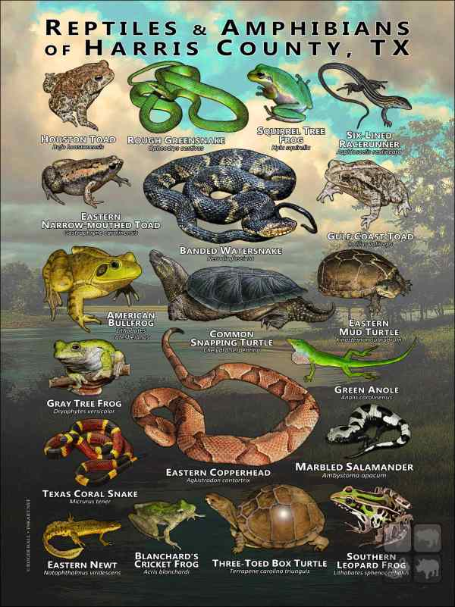
Reptiles & Amphibians

Slide 19
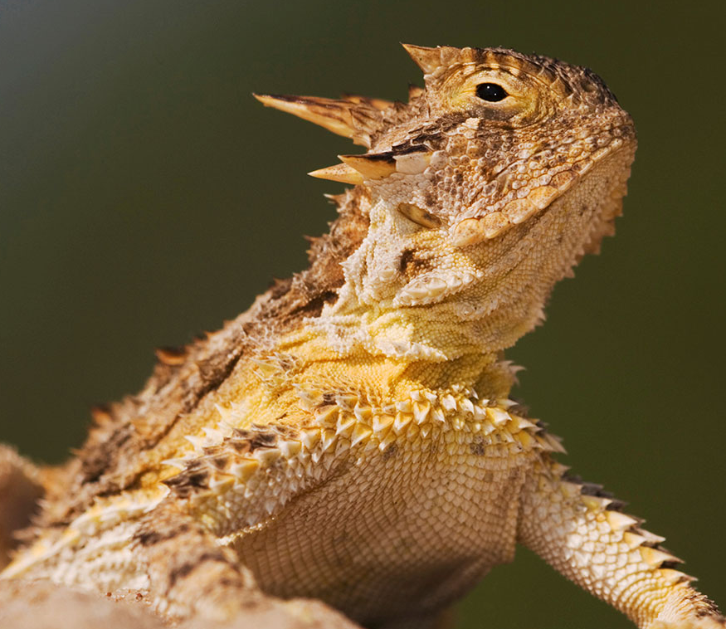
Texas Horned Lizard
• Currently a threatened species in Texas.
• The Texas Horned Lizard was adopted as the Texas state reptile on June 18, 1993.
• The head has numerous horns, all of which are prominent, with two central head spines being much longer than any of the others. This lizard is brownish with two rows of fringed scales along each side of the body.
• They can be found in arid and semiarid habitats in open areas with sparse plant cover. Because they dig for hibernation, nesting and insulation purposes, they commonly are found in loose sand or loamy soils.

Slide 20
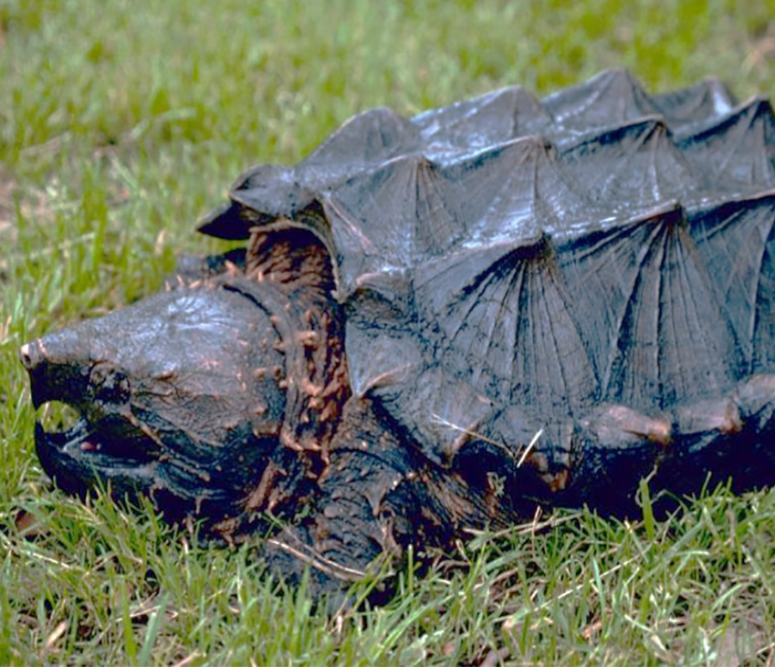
Alligator Snapping Turtle
• Currently a threatened species in Texas.
• They are found in the eastern part of the state, particularly in rivers, reservoirs, sloughs, and swampy lakes.
• They have a distinctive appearance, with a ridged shell, triangularly shaped head, a pointed nose, and a hooked beak.
• They are known for their powerful bite, but are generally more aggressive on land than in the water.

Slide 21
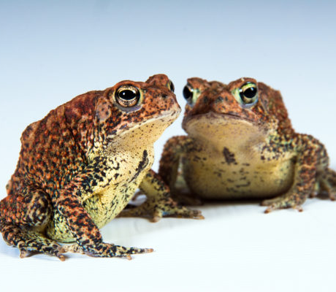
Houston Toad
• Listed as an endangered species in 1970.
• The Houston toad is 2 to 3.5 inches long. Its general coloration varies from light brown to gray or purplish gray, sometimes with green patches.
• Requires loose, deep sands supporting Loblolly pine forest, or mixed post oak-woodland savannah with 60-80% canopy cover and an open understory that supports native bunch grasses and still or flowing waters for breeding
• Often confused with the Gulf Coast Toad.

Slide 22
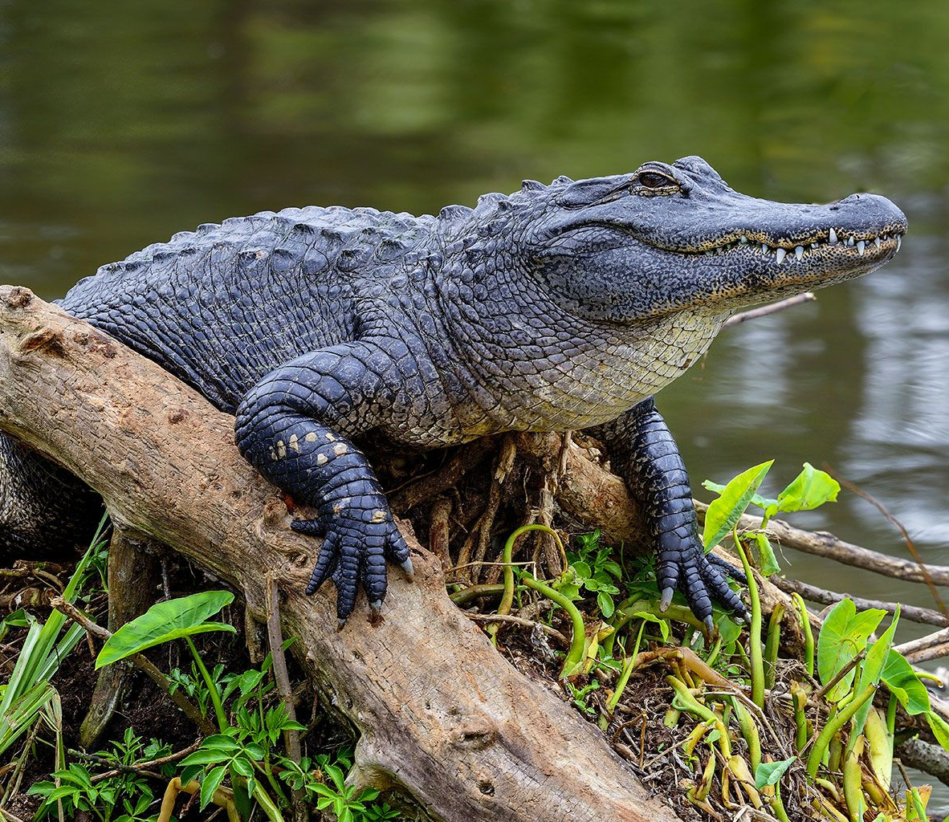
American Alligator
• Both males and females have a dark scaly body with a muscular, flat tail. The skin on their back is armored with embedded bony plates called osteoderms or scutes.
• Have a long, rounded snout that has upward facing nostrils at the end; this allows breathing while the rest of the body is underwater.
• Found in freshwater, slow-moving rivers, swamps, marshes, and lakes. They can only tolerate salt water for brief periods because they do not have salt glands.
• Live about 50 years in the wild.
• They play an important role as ecosystem engineers in wetland ecosystems through the creation of alligator holes, which provide both wet and dry habitats for other organisms.

Slide 23
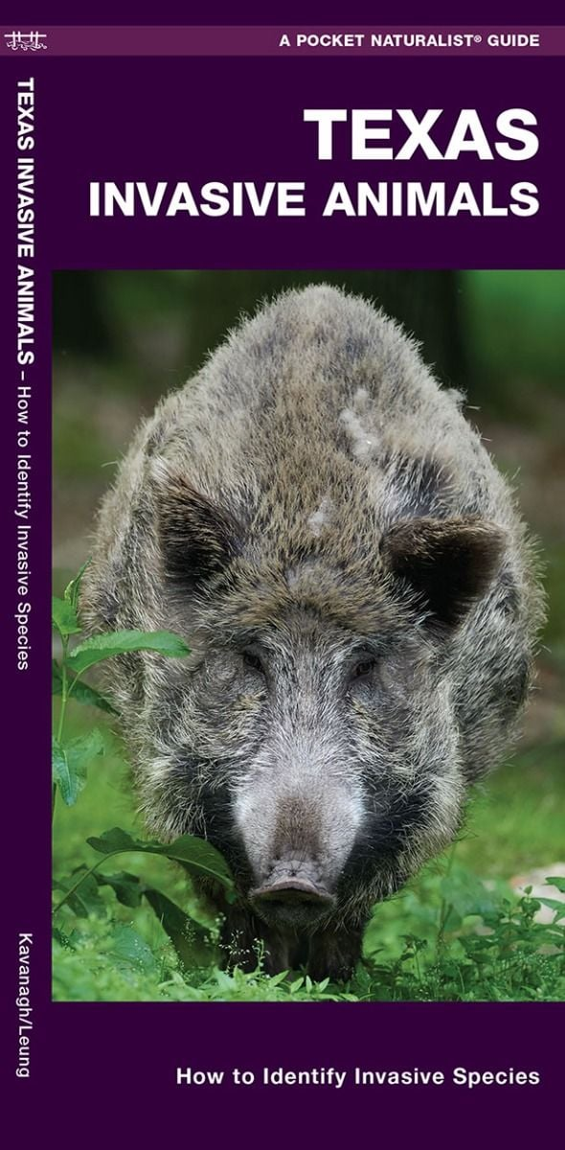
Invasive Wildlife Species

Slide 24
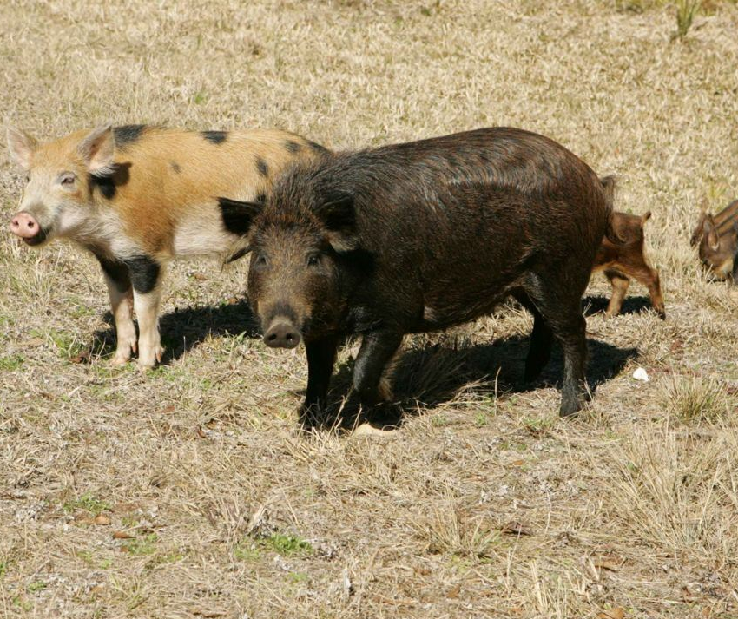
Feral hogs
• There are an estimated 2.6 million residing in the state, causing millions of dollars in damage annually to agriculture, natural resources, and property.
• Feral hogs were introduced to Texas by early Spanish explorers and settlers, who used domestic pigs for meat and lard.
• In the 1930s, ranchers and sportsmen introduced European wild hogs (Russian boars) for sport hunting.
• Outcompete local fauna by agresively driving it away and consuming a lot of resources.

Slide 25
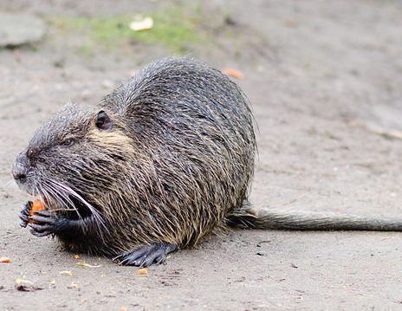
Nutria
• Medium-sized, grayish-brown rodent with a long, round tail with few hairs.
• It looks like a beaver without the large flat tail and has hind webbed feet.
• Are found from Central Texas eastward and on the Texas Coast in marshes, swamps, ponds and lakes.
• Cause damage by burrowing which can lead to erosion, damage roads and more.
• Feed on aquatic vegetation which can lead to vegetation kill off and habitat loss.

Slide 26
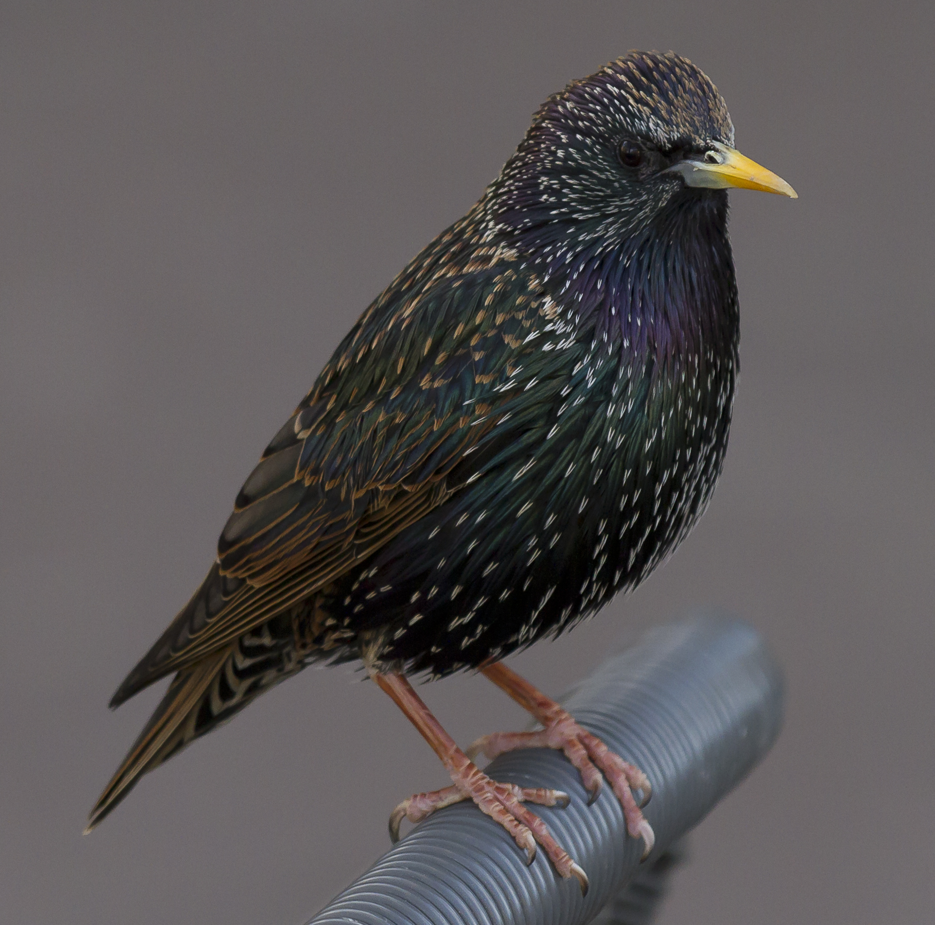
European Starlings
• All are descendant of the original 100 released in 1890-1891 by Eugene Schieffelin, a Shakespeare enthusiast.
• Take over nest cavities, forcing out bluebirds, flickers, and other woodpeckers that nest in holes.
• Iridescent feathers with white/tan tips when new.
• Scientists have discovered that they can taste salt, sugars, citric acid, and tannins.

Slide 27
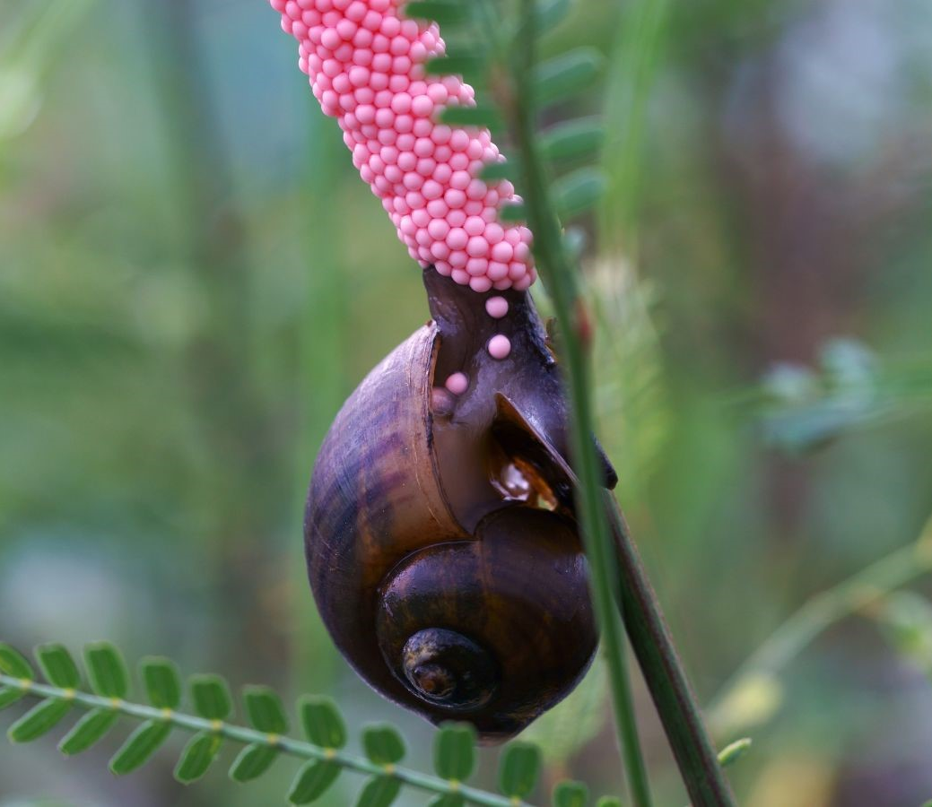
Apple snails
• Large brown shells (as big as a tennis ball), lays bright pink eggs in clusters.
• Apple snails are the biggest living freshwater snails on earth.
• They have an operculum which enables the snail to seal the shell entrance.
• Eggs contain a protein neurotoxin called PcPV2 (Perivitellin-2), which can cause irritation of the skin and eyes of humans.
• Most common predators are Limpkins, Snail Kites, Racoons, and some reptiles.

Slide 28
Other Invasive Species
Zebra and Quagga Mussels: Dreissena polymorpha and Dreissena rostriformis
Red Fire Ants: Solenopsis invicta
Asian Carp: Various species
Black Tiger Shrimp: Penaeus monodon
European Eel: Anguilla anguilla
Giant African Snail: Achatina fulica
Grass Carp: Ctenopharyngodon idella
Hammerhead Flatworm: Bipalium
Jumping Worms: Amynthoides
Lionfish: Pterois
Mediterranean House Gecko: Hemidactylus turcicus
Northern Snakehead: Channa argus
Quilted Melania: Melania quadrasi
Silver Carp: Hypophthalmichthys molitrix
Axis Deer: Axis axis
Barbary Sheep: Ammotragus lervia
European Rabbit: Oryctolagus cuniculus
Gambian Rat: Cricetomys gambianus
Norway Rat: Rattus norvegicus
Sika Deer: Cervus nippo
Nilgai: Boselaphus tragocamelus

Slide 29
Dental Formulas

Slide 30
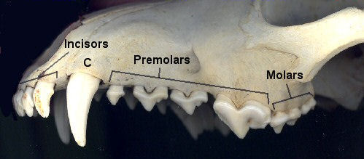
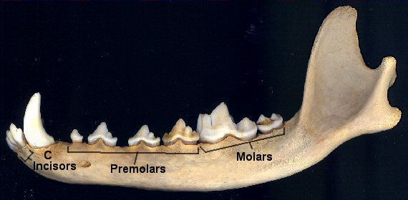
What & How?
Dental formula refers to the number of each type of tooth (incisor, canine, premolar, or molar) found in one quadrant of an animal's mouth. This can be used to determine the species and dietary strategy used by that animal.
Start by counting the teeth on upper and lower jaw, only on the left side of the skull.
Add all upper and lower jaw counts then multiply by 2, to get the total number of teeth.

Slide 31
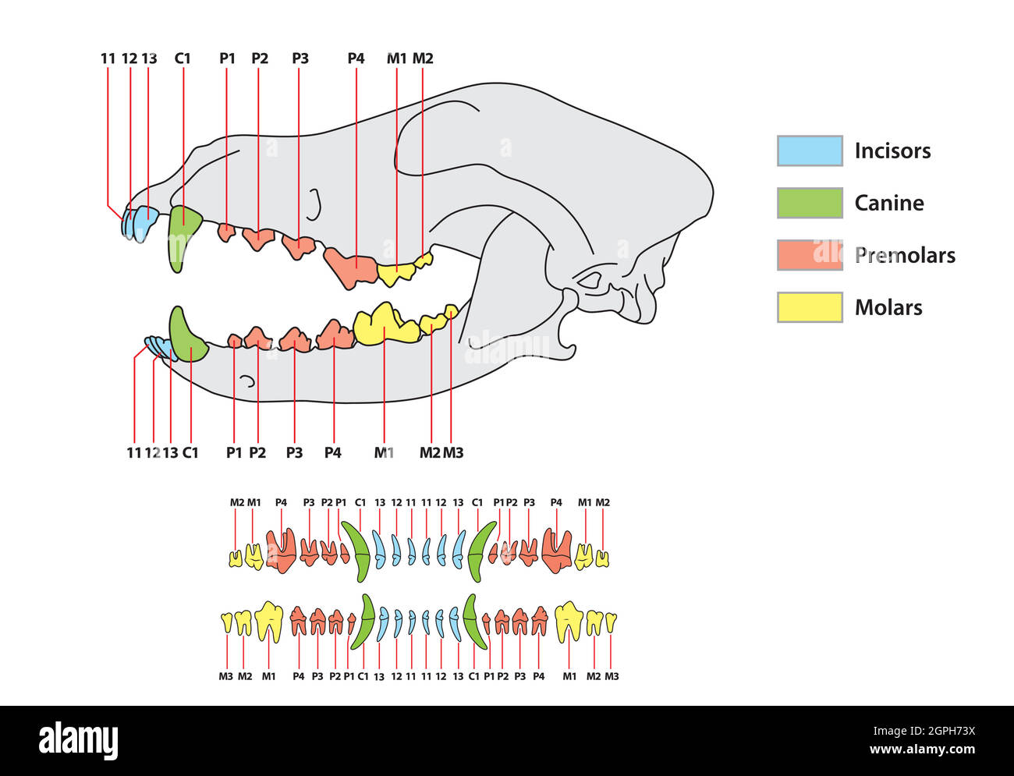
Illustration – Dentition

Slide 32
Dental Formula
 | I (Incisors) | C (Canines) | P (Premolar) | M (Molar) | Total (# teeth)
Dog | 3/3 | 1/1 | 4/4 | 2/3 | 42
Mouse | 1/1 | 0/0 | 0/0 | 3/3 | 16
Racoon | 3/3 | 1/1 | 4/4 | 2/2 | 40
Elephant | 1/0 | 0/0 | 0/0 | 3/3 | 14

Slide 33
Thank you
Ricardo Cagigal, MS
281-782-4121
ricardo.cagigalperez@tpwd.texas.gov

