Slide 1
Renewable Energy and Sustainable Food Systems
Texas Envirothon 2024 Teacher Workshop
February 10. 2024
Kathleen Garland

Slide 2
What are sustainable food systems?
UN Definition: A sustainable food system is a dynamic process in which achieving food and nutrition security today should contribute to food and nutrition security for future generations. (www.un.org)
Let’s unpack this so we can see how energy fits into this definition!
A food system includes agriculture, production and processing, distribution and marketing, preparation and consumption.
It addresses environmental, social, and economic spheres.
By definition, then, a sustainable food system has to be coupled sustainable energy sources.

Slide 3
Let’s brainstorm some ideas of where energy fits into food systems
In Agriculture
Tractor fuels
Fertilizers
Energy for irrigation
Transportation
Energy for infrastructure—buildings, residences, etc.
Producing feed

Slide 4
Let’s brainstorm some ideas of where energy fits into food systems
In production and processing
Packaging
Type of packaging: Styrofoam, plastics, boxes, adhesives
Wrapping, labeling, boxing/bagging
Transportation
Warehousing and storage
Mobile equipment—forklifts, small vehicles
Refrigeration
Waste management
Sorting, chopping, processing, grinding, shaping
Tamper-proofing, expiration dating, chain of custody

Slide 5
Let’s brainstorm some ideas of where energy fits into food systems
In distribution and marketing
Advertising: newspapers, flyers—paper, ink
Digital marketing
Transportation (trucks) and advertising on the transportation
Refrigeration
Forklifts, infrastructure of the distribution centers
Vehicles: aircraft, trains, long-distance haulers, delivery trucks; global shipping

Slide 6
Let’s brainstorm some ideas of where energy fits into food systems
In preparation and consumption
Bagging from grocery store
Waste management of unsold food
Stove, microwave, grill, etc—food preparation devices large and small
Industrial food prep: restaurants and institution food preparation
Takeout containers
Food delivery—groceries and meals
Consumer transportation

Slide 7
Where in the process are we replacing traditional energy with renewable sources?
On the farm
Anaerobic biodigesters replacing manure lagoons
Generate biogas which is used to fuel operations or is sold
https://vitalsigns.edf.org/story/farmers-scientists-seek-solutions-global-warming-caused-cows?gad_source=1
Wind farms and food/fiber farms (not replacing but adding)
Agrovoltaics: farms and solar farms

Slide 8
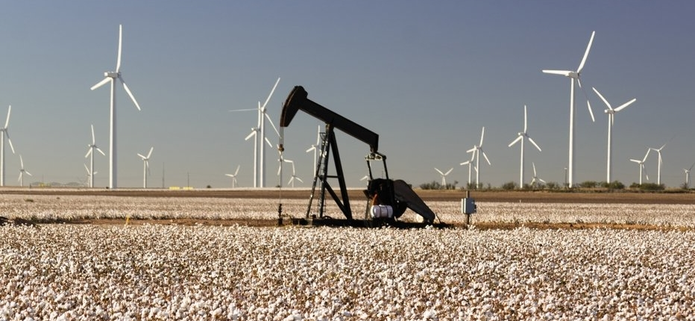
Wind and Cotton in W. Texas: the old and the new

Slide 9
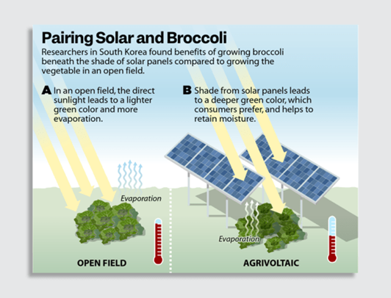
Agrovoltaics: solar + crops = better food with fewer emissions
https://www.weforum.org/agenda/2022/07/agrivoltaic-farming-solar-energy/

Slide 10
Farm Electrification
Electric tractors? A big “maybe”
https://modernfarmer.com/2023/04/electric-tractors-are-rolling-out-in-the-field-heres-what-that-could-mean-for-farmers/
Compact equipment: good; large scale has drawbacks
Solar for other electrical needs
Biodiesel
Can be produced and used on the farm, reducing energy transportation costs
Large equipment that can’t be electrified can use biodiesel

Slide 11
Production and Processing
Takes place in buildings
Has the same opportunities for renewable energy as any other facility:
Solar roof panels
Electric or biodiesel mobile equipment

Slide 12
Distribution and Marketing
Trains: electric locomotives are modern and common
Trucks: conversion to biodiesel
Local delivery: electric vehicles
Marketing
Include the emissions reductions in the market pitches for products and brands
https://www.just-food.com/features/the-road-to-net-zero-big-foods-emission-pledges/?cf-view

Slide 13
Preparation and Consumption
I love this one—how do we reduce emissions by changing the way we prepare and consume food?
The big one, of course—reduce food waste!
https://www.lovefoodhatewaste.com/blog/reducing-food-waste-during-ramadan-because-food-precious
Do we need to eat less meat?
https://www.un.org/en/climatechange/science/climate-issues/food
New protein sources: foods of the future
Insects (crickets, grasshoppers, cicadas)
Seaweed and algae
Lab-grown meat

Slide 14
Other ways of modifying food systems
Dan Barber: How I Fell in Love with a Fish: about regenerative fish farming in Portugal
https://www.youtube.com/watch?v=4EUAMe2ixCI

