Slide 1


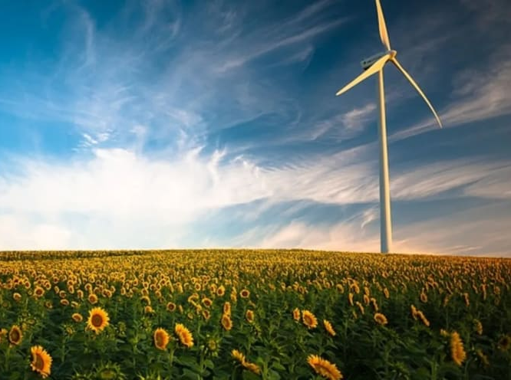
Soil Health & Renewable Energy* for a Sustainable Future
Dennis Brezina
USDA-Natural Resources Conservation Service
State Soil Health Specialist – Temple
*Disclaimer: Not a Subject Matter Expert on Renewable Energy
Photo: Hannah Walters https://forestnation.com/blog

Slide 2
“Everything Old is New Again”
- Jonathan Swift
Bell Bottoms
Trucker Caps
Mini Skirts
Vinyl Albums
Soil Health?
Energy?
Notes:
Retro/Nostalgia – “Everything Old is New Again” - Jonathan Swift
Bell Bottoms
Trucker Caps
Mini Skirts
Vinyl Albums
Soil Health?
Energy?
Biomass Energy is the oldest, most widespread and practical form of renewable energy.
Humans learned to control fire for warmth, cooking & protection as early as 1 MYA

Slide 3
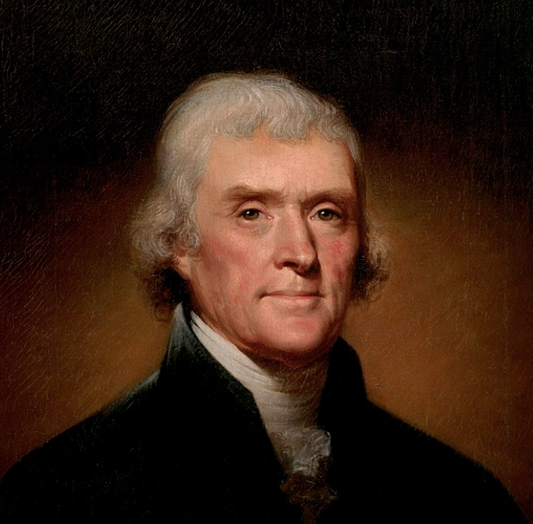
A New Look at an Old Practice
Thomas Jefferson used turnips, buckwheat and vetch as cover crops at Monticello in 1794.
“…indeed I think it important to separate my exhausting crops by alternations of amelioraters (sic).”
Thomas Jefferson to John Taylor, 29 December 1794, Founders Online, National Archives, accessed September 29, 2019,
https://founders.archives.gov/documents/Jefferson/01-28-02-0172 .
Jefferson Painting by Rembrandt Peale - http://www.whitehouseresearch.org/assetbank-whha/action/viewHome
Notes:
Soil Health is more of a New Look at an Old Practice.
Thomas Jefferson used turnips, buckwheat and vetch as cover crops at Monticello in 1794.
“…indeed I think it important to separate my exhausting crops by alternations of amelioraters (sic).”
He wrote that in a Letter to John Taylor in 1794
Ameliorate means to Amend; make better; improve; and it is an Alternative name for Land Improvement.

Slide 4
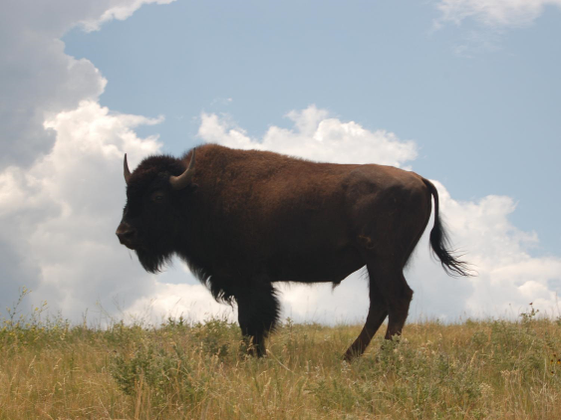
Soil Health - Introduction
1500, Bison population estimated between 30-60 million.
Who was
fertilizing
that grass?
Photo: Dennis Brezina
Notes:
When the Europeans first got to the “New World,” Bison population is estimated to have been between 30-60 million.
There was bison east of the Mississippi River, and even in East Texas.
Who was fertilizing all that grass?

Slide 5
Soil Health & Five Principles
Soil Health: continued capacity of the soil to function as a vital living system that sustains plant and animal health.
Cover the Soil (Armor)
Minimize Disturbance
Plant Diversity (4 Species Types/Functional Groups)
Keep a Living Root Year Round
Livestock Integration
Notes:
Soil Health is the continued capacity of the soil to function as a vital living system that sustains plant and animal health.
The Five Soil Health Principles:
--Cover the Soil (Armor the soil)
--Minimize Disturbance
--Plant Diversity (4 Species Types or Functional Groups)
--Keep a Living Root Year Round
--Livestock Integration to aid in recycling nutrients

Slide 6
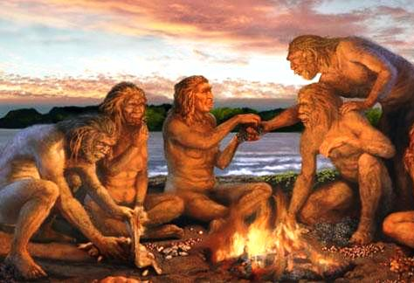
Biomass Energy
Oldest, most widespread and practical form of renewable energy.
Humans learned to control fire for warmth, cooking & protection as early as 1 MYA+
Biofuels - fuels produced from renewable organic material
https://northwesternoutdoorleadershipinstitute.com/2017/08/FAQ_evening_fire.html
Notes:
Biomass Energy is the oldest, most widespread and practical form of renewable energy.
Humans learned to control fire for warmth, cooking & protection as early as 1 MYA.
Changed food habits, Increased consumption/caloric intake/Brain size;
Used it as a tool to hunt, clear land and heat-treat rock to make other tools.
Changed our circadian rhythm, lengthened our activities (not just dawn to dusk), changed our social structure, possibly lead to the development of language.
Cooking led to easier to digest food, smaller teeth & stomachs; Expanded our diet.

Slide 7
Bioenergy (Biofuels and Biomass) https://www.eesi.org/topics/bioenergy-biofuels-biomass/description
Biomass can produce renewable electricity, thermal energy, or transportation fuels (biofuels).
Biomass is living or recently dead plant or animal organisms and any byproducts of those organisms.
Biomass encompasses all living things.
Biomass energy refers to those crops, residues, and other biological materials that can be used as a substitute for fossil fuels in the production of energy and other products.
Living biomass takes in carbon as it grows and releases this carbon when used for energy, resulting in a carbon-neutral cycle that does not increase* the atmospheric concentration of greenhouse gases.

Slide 8
Biomass Energy https://www.eesi.org/topics/bioenergy-biofuels-biomass/description
The energy stored in biomass can be released to produce renewable electricity or heat.
Biopower can be generated through combustion or gasification of dry biomass or biogas (methane) captured through controlled anaerobic digestion.
Cofiring of biomass and fossil fuels (usually coal) is a low-cost means of reducing greenhouse gas emissions, improving cost-effectiveness, and reducing air pollutants in existing power plants.
Thermal energy (heating and cooling) is often produced at the scale of the individual building, through direct combustion of wood pellets, wood chips, and other sources of dry biomass.
Combined heat and power (CHP) operations often represent the most efficient use of biomass (utilizing around 80 percent of potential energy).
  Facilities capture the waste heat and/or steam from biopower production and pipe it to nearby buildings to provide heat or to chillers for cooling.

Slide 9
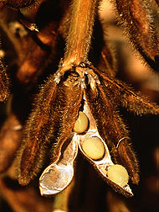
Economics of Biofuels https://www.epa.gov/environmental-economics/economics-biofuels
Positives
  Reduce undesirable aspects of fossil fuel production and use
  Conventional and greenhouse gas (GHG) pollutant emissions
  Exhaustible resource depletion
  Dependence on unstable foreign suppliers
  Increase farm income
Negatives
  Feedstocks require land, water & other resources
  Changes to land use may increase GHG emissions
  Pressure on water resources, air & water pollution,
  and increased food costs
  Some biofuels emit more GHGs than fossil fuels
  on an energy-equivalent basis depending upon how they are grown.
https://www.ars.usda.gov/oc/images/image-gallery/
Notes:
Biofuels—fuels produced from renewable organic material
Positives
- Reduce some undesirable aspects of fossil fuel production and use
- Conventional and greenhouse gas (GHG) pollutant emissions
- Exhaustible resource depletion
- Dependence on unstable foreign suppliers
- Increase farm income
Negatives
- Biofuel feedstocks require land, water, and other resources
- Changes to land use patterns that may increase GHG emissions
- Pressure on water resources, air and water pollution, and increased food costs.
- Some biofuels emit more GHGs than fossil fuels on an energy-equivalent basis

Slide 10
Biofuels https://www.eesi.org/topics/bioenergy-biofuels-biomass/description
Transportation fuels can be produced from biomass, helping to alleviate demand for petroleum products and improve the greenhouse gas emissions profile of the transportation sector.
Biofuels rare a widely available source of clean, renewable transportation energy, until we produce a significant number of electric vehicles that run on renewably-produced electricity.

Slide 11
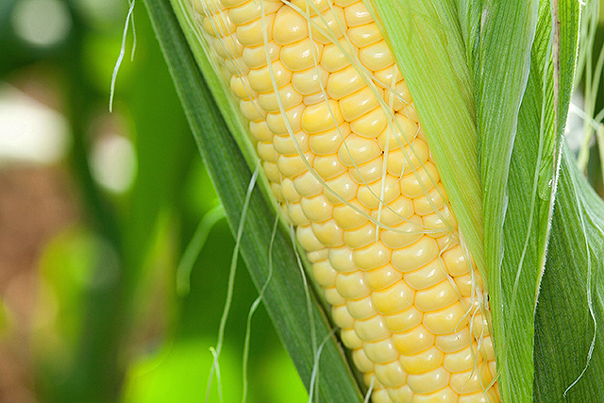
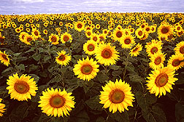
First generation biofuels https://www.epa.gov/environmental-economics/economics-biofuels
Sugar crops (sugarcane, sugarbeet)
Starch crops (corn, sorghum)
Sugar and starch crops are converted
through fermentation to form
bioalcohols (Ethanol, Bio-butanol
& propanol)
Ethanol is the most widely used bioalcohol fuel.
Oils and animal fats can be
processed into biodiesel (used
cooking oil)
Oilseed crops (soybean, sunflower,
canola), and animal fats
https://www.ars.usda.gov/oc/images/image-gallery/

Slide 12
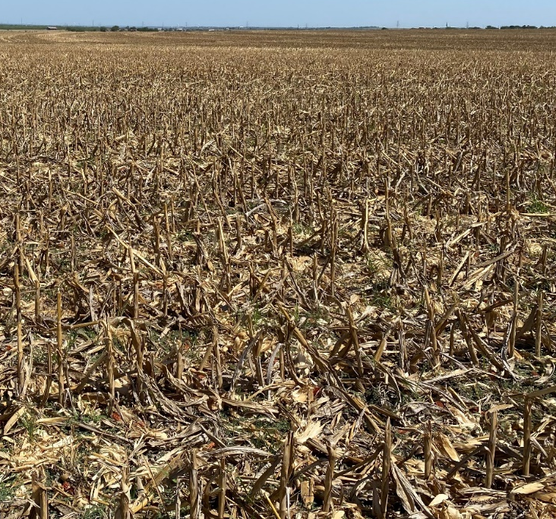
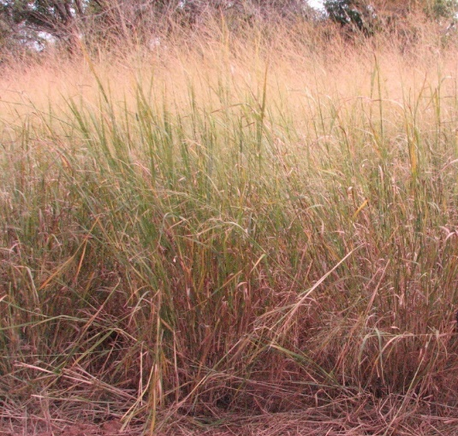
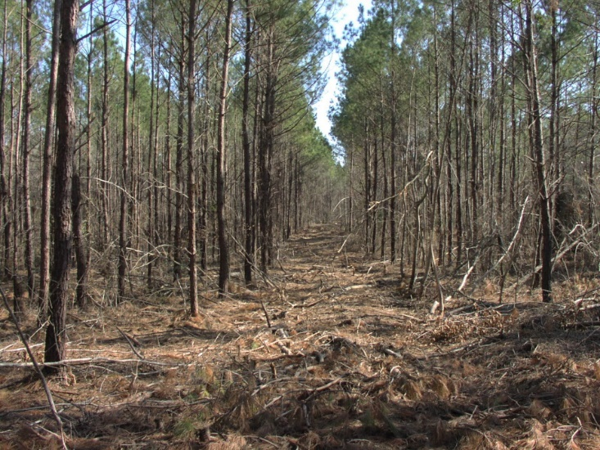
Second generation (cellulose) biofuels https://www.epa.gov/environmental-economics/economics-biofuels
Commercial cellulose biofuel production began in the US in 2013
Non-food crops (switchgrass, wood)
Waste biomass (corn stover, corncobs, straw, wood byproducts)
Non-food feedstocks such as municipal solid waste (MSW),
hybrid poplar & willow
(fast-growing trees that
do not need fertilizers)
Lawn wastes, disaster
debris
https://www.uaex.uada.edu/yard-garden/resource-library/plant-week/switchgrass-biofuel-02-26-2021.aspx
University of Arkansas Extension Plant of the Week: Switchgrass biofuel
Photos (right): USDA

Slide 13
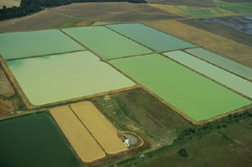
Third generation biofuels https://www.epa.gov/environmental-economics/economics-biofuels
Third generation biofuels use algae as a feedstock
Algae biofuels not yet produced commercially
Expensive to harvest, shading issues, expansive area/space
Algal biomass is composed of carbohydrates, proteins and lipids/natural oils
The bulk of the natural oil made by microalgae is a form of triglyceride
Algae shows promise in producing biodiesel
https://www.ars.usda.gov/oc/images/image-gallery/

Slide 14
Potential economic benefits https://www.epa.gov/environmental-economics/economics-biofuels
Biofuels are produced from renewable feedstocks. Their production and use could be sustained indefinitely.
Second and third generation biofuels can reduce GHG emissions relative to conventional fuels because feedstocks can be produced on marginal land.
Waste biomass has no additional agricultural production requirement, and indirect market-mediated GHG emissions are minimal.
Biofuels can be produced domestically, leading to lower fossil fuel imports.
As biofuel production and use reduces our consumption of imported fossil fuels, we become less vulnerable to the adverse impacts of supply disruptions.
Reducing our demand for petroleum:
  Reduce its price - economic benefits for American consumers
  Increase our petroleum exports

Slide 15
Potential environmental benefits https://www.epa.gov/environmental-economics/economics-biofuels
Biofuels can reduce pollutant emissions.
Ethanol can ensure complete combustion, reducing carbon monoxide emissions.
Biofuel production and use must coincide with reductions in the production and use of fossil fuels to reduce GHG or conventional pollutant emissions, lessen petroleum imports, or alleviate pressure on exhaustible resources.
Biobased Products - Biomass can also provide a renewable substitute for the many industrial products and materials made from petroleum or natural gas – biobased foams, plastics, fertilizers, lubricants & industrial chemicals.
https://www.eesi.org/topics/bioenergy-biofuels-biomass/description

Slide 16
Biomass and Land Use https://www.eesi.org/topics/bioenergy-biofuels-biomass/description
Biomass can reduce our dependence on fossil fuels.
Biomass energy differs from other renewables as it is tied to farms, forests & other ecosystems from which biomass feedstocks are obtained.
The use of biomass has the potential to result in a wide range of environmental and social impacts, both positive and negative, above and beyond its use as a substitute for fossil fuels.
Impacts on soils, water resources, biodiversity, ecosystem function, and local communities will differ depending on what choices are made regarding what types of biomass are used, as well as where and how they are produced.
Biomass must be produced and harvested as sustainably as possible. In this sense, sustainability refers to choosing management practices that minimize adverse impacts and complement local land-management objectives, such as farm preservation, forest stewardship, food production, and wildlife management.

Slide 17
Disadvantages of biofuel production https://www.epa.gov/environmental-economics/economics-biofuels
Biofuel feedstocks include many crops that would otherwise be used for human consumption directly, or indirectly as animal feed. Diverting these crops to biofuels may lead to more land area devoted to agriculture, increased use of polluting inputs, and higher food prices.
Cellulose feedstocks can also compete for resources (land, water, fertilizer, etc.) that could otherwise be devoted to food production.
Changes in land use patterns may increase GHG emissions by releasing terrestrial carbon stocks to the atmosphere. If land is cleared to grow biofuel feedstocks (forests, marginal land) the clearing and subsequent cropping generate GHG emissions.
Biodiversity losses in land conversion.
Biofuel production and processing practices can also release GHGs, especially if chemical fertilizers are applied.

Slide 18
Higher crop prices https://www.epa.gov/environmental-economics/economics-biofuels
Economic models show that biofuel use can result in higher crop prices, though the range of estimates in the literature is wide.
A 2013 study found projections for the effect of biofuels on corn prices in 2015 ranging from a 5 to a 53 percent increase.
The National Research Council’s (2011) report on the RFS included several studies finding a 20 to 40 percent increase in corn prices from biofuels during 2007 to 2009.
Period of 2007 to 2009 (Great Recession) when gas & diesel prices increased.
Increased fuel costs bring increased fertilizer costs.
One land use issue that often arises is the perceived conflict between food production and bioenergy (the so-called ‘food-vs.-fuel’ debate).

Slide 19
Biomass and Land Use https://www.eesi.org/topics/bioenergy-biofuels-biomass/description
Agricultural land may be shifted from producing food to the production of dedicated energy crops.
The use of agricultural crops and lands has contributed in part to increased prices for many of these commodities.
Other factors have contributed to this increase including inflation of the dollar and increased prices of fossil fuels.
Oil and natural gas, in the form of fuel and synthetic fertilizers, are two of the biggest economic inputs in food production and distribution.
Opportunities to reduce the conflict between food and fuel production include an increased use of agricultural wastes, logging residues, food scraps, municipal solid waste and marginal lands.

Slide 20
U.S. policy to support biofuels https://www.epa.gov/environmental-economics/economics-biofuels
The Energy Policy Act of 2005 included economic incentives such as grants, income tax credits, subsidies and loans to promote biofuel research and development. It established a Renewable Fuel Standard mandating the blending of 7.5 billion gallons of renewable fuels with gasoline annually by 2012.
The Energy Independence and Security Act of 2007 (EISA) included similar economic incentives. EISA expanded the Renewable Fuel Standard to increase biofuel production to 36 billion gallons by 2022 (we were about half that according to the USDA Economic Research Service, https://www.ers.usda.gov/data-products/u-s-bioenergy-statistics/ ). In 2022, U.S. ethanol production totaled about 15.4 billion gallons and combined biodiesel/renewable diesel production totaled about 3.1 billion gallons.
To limit GHG emissions, the Act states that conventional renewable fuels (corn starch ethanol) are required to reduce life-cycle GHG emissions relative to life-cycle emissions from fossil fuels by at least 20 percent, biodiesel and advanced biofuels must reduce GHG emissions by 50 percent, and cellulosic biofuels must reduce emissions by 60 percent.

Slide 21
Biomass and Land Use (cont.) https://www.eesi.org/topics/bioenergy-biofuels-biomass/description
Another issue heavily associated with biomass production is greenhouse gas emissions from land management and land use change. These refer to emissions of greenhouse gases (especially CO2, CH4, and N2O) resulting from agricultural inputs, management practices, and land use changes associated with production of biomass.
Direct emissions refer to those resulting from land clearing, agricultural inputs (such as fertilizers), or management practices undertaken in the process of growing or harvesting a biomass crop.
Indirect emissions are associated with market-driven land use change. These are the emissions that occur when forests, grasslands, or other ecosystems are cleared to produce crops or other commodities to compensate for land that has been diverted to energy production.
Biomass markets will add value to biomass products, residues, and productive lands. This value will help improve the economic viability of working lands and act as a positive incentive to help preserve farms and forests from the accelerating threat of urban and suburban sprawl – the greatest land use impact.

Slide 22
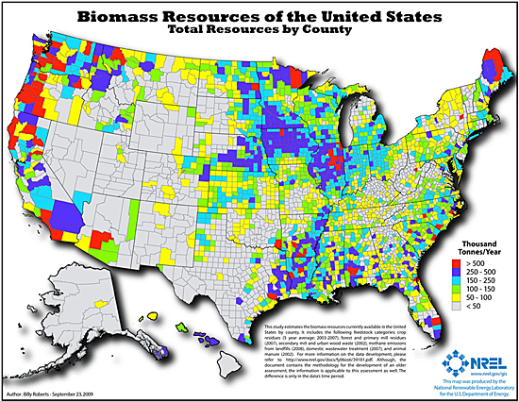
Available biomass resources in the United States. Source: NREL
U.S. Department of Energy Federal Energy Management Program (FEMP)

Slide 23
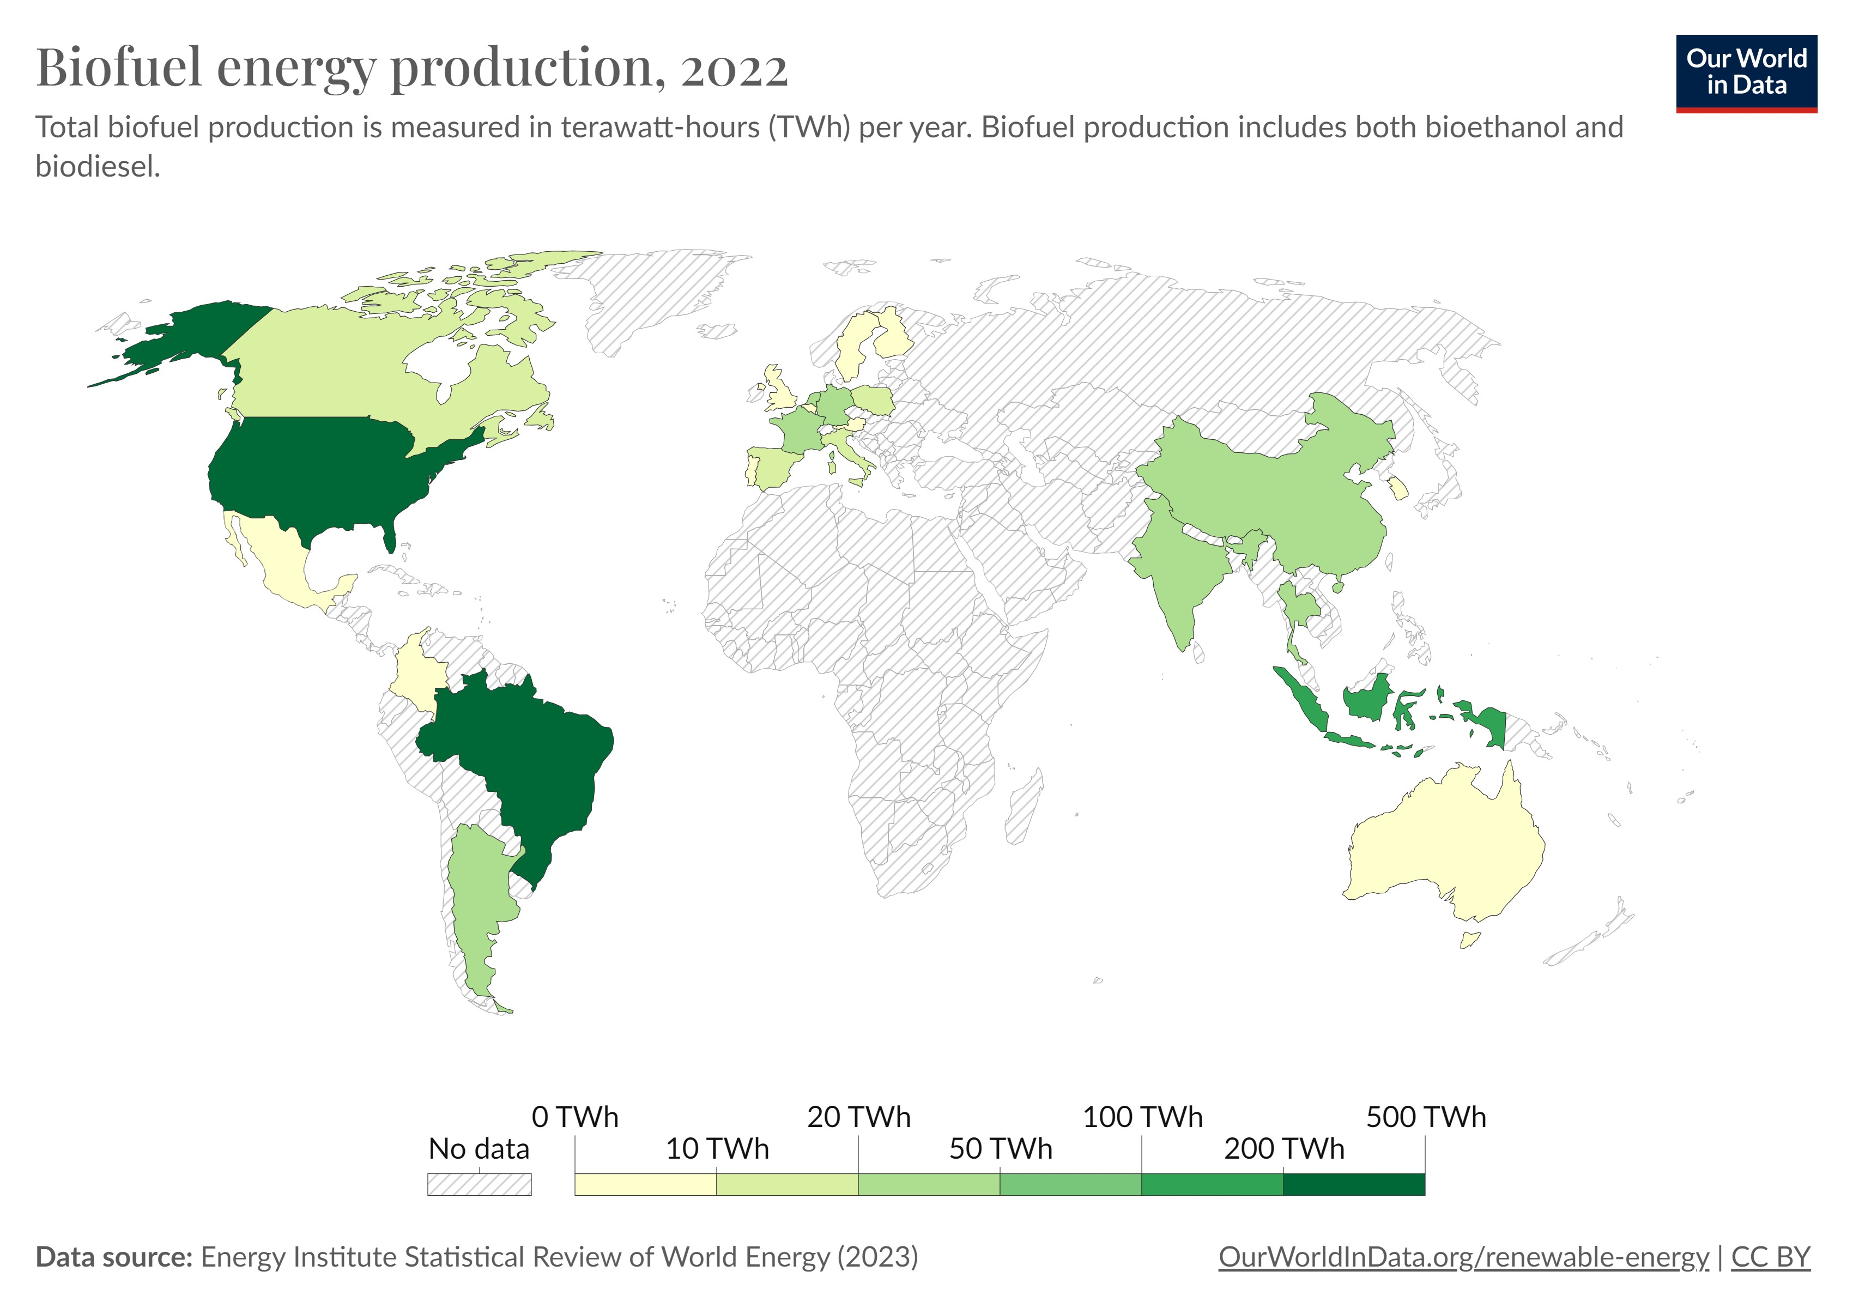
Biofuel Energy Production - 2022 https://ourworldindata.org/grapher/biofuel-production

Slide 24
Biofuels explained https://www.eia.gov/energyexplained/biofuels/
The term biofuels usually applies to liquid fuels and blending components produced from biomass materials called feedstocks. Most biofuels are used as transportation fuels, but they may also be used for heating and electricity generation. Gaseous fuels produced from biomass that are used directly as a gas or converted to liquid fuels may qualify for use in government programs that promote or require use of biofuels.
In 2021, about 17.5 billion gallons of biofuels were produced in the United States and about 16.8 billion gallons were consumed. The United States was a net exporter of about 0.8 billion gallons of biofuels in 2021, with fuel ethanol accounting for the largest share of gross and net exports of biofuels.
Most of biofuel consumption occurs as a blend with refined petroleum products such as gasoline, diesel fuel, heating oil, and kerosene-type jet fuel. However, some biofuels do not require blending with their petroleum counterparts and are referred to as drop-in biofuels.

Slide 25
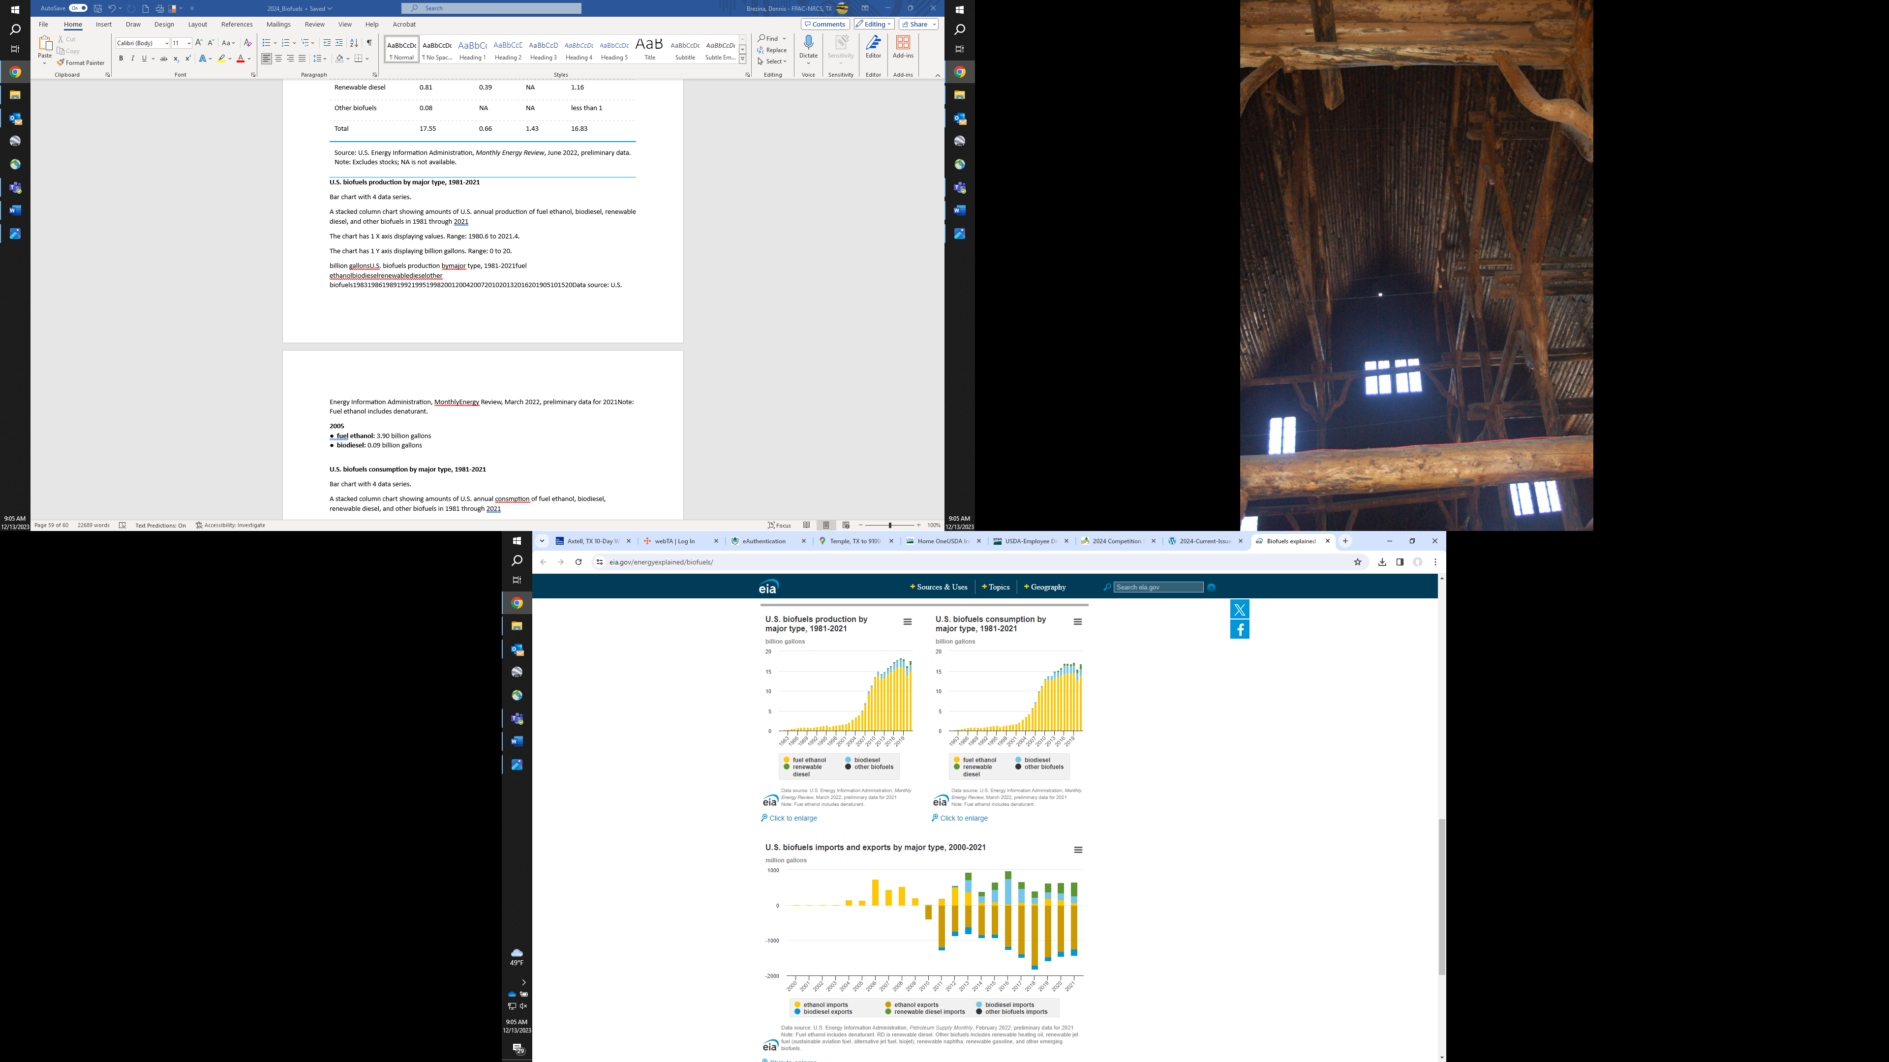
U.S. Biofuels Production & Consumption https://www.eia.gov/energyexplained/biofuels/
Notes:
Fuel Ethanol leads both in Production and Consumption, with Biodiesel increasing both in supply and demand since about 2010.

Slide 26
Biofuels explained https://www.eia.gov/energyexplained/biofuels/
The U.S. Energy Information Administration (EIA) publishes data on four major categories of biofuels that qualify for use in the federal RFS Program:
1. Ethanol—an alcohol fuel that is blended with petroleum gasoline for use in vehicles and accounted for the largest shares of U.S. biofuel production (85%) and consumption (82%) in 2021.
2. Biodiesel—a biofuel that is usually blended with petroleum diesel for consumption and accounts for the second-largest shares of U.S. biofuel production (11%) and consumption (12%) in 2021.
3. Renewable diesel—a fuel chemically similar to petroleum diesel for use as a drop-in fuel or a petroleum diesel blend with small but growing U.S. production and consumption. Renewable diesel's percentage shares of total U.S. biofuels production and consumption were about 3% and 5% respectively in 2021.
4. Other biofuels—include renewable heating oil, renewable jet fuel (sustainable aviation fuel, alternative jet fuel, biojet), renewable naphtha, renewable gasoline, and other emerging biofuels that are in various stages of development and commercialization.

Slide 27
U.S. Biofuel Imports & Exports https://www.eia.gov/energyexplained/biofuels/
Imports
Exports

Slide 28
Switchgrass as a Biofuel?
Most of the public had never heard of switchgrass
2006 President George W. Bush mentions switchgrass in his State of the Union address
“We must also change how we power our automobiles. We will increase our research in better batteries for hybrid and electric cars, and in pollution-free cars that run on hydrogen. We’ll also fund additional research in cutting-edge methods of producing ethanol, not just from corn, but from wood chips and stalks, or switchgrass. Our goal is to make this new kind of ethanol practical and competitive within six years.”
Notes:
Perspective: this address from Bush to today’s H.S. students is about like JFK’s “We choose to go to the Moon” speech was to me.

Slide 29
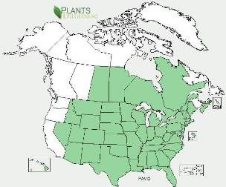
Biology and Adaptation
Panicum virgatum
Switchgrass is adapted* to much of North America.
Not a Food Crop
Late growth not palatable to Livestock
https://plants.usda.gov/home/plantProfile?symbol=PAVI2

Slide 30
Biology and Adaptation (cont)
Perennial warm-season grass native to North America east of the Rocky Mountains and south of 55°N latitude.
Switchgrass grows 3 to 10 feet tall, typically as a bunchgrass, but the short rhizomes can form a sod over time.
Switchgrass has high yield potential on marginal cropland and will be productive in most rain-fed production systems east of the 100th meridian.
Productive switchgrass stands can be grown west of the 100th meridian with irrigation (remember that asterisk?)
Notes:
55° N latitude is about Edmonton, AB, which is roughly the northern most limit of the Great Plains.

Slide 31
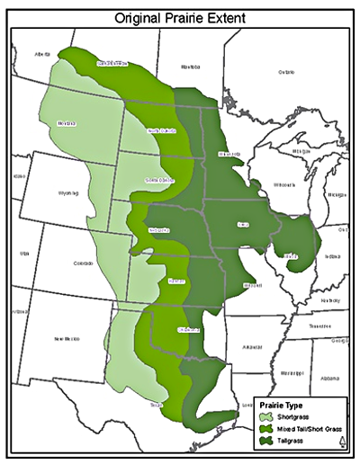
Original Prairie Extent
Tallgrass Prairie
Mid-grass Prairie
Shortgrass Prairie
Feed & Fiber Crops are grown in all of them, but primarily in those dark green areas.
The Tallgrass Prairie Preserve Docent Program
https://www.tgp-docents.com/docentnews/DNL-201501.html

Slide 32
Conservation Reserve Program (CRP)
Land conservation program administered by the USDA-Farm Service Agency (FSA).
Created in 1985, CRP is one of the largest private-lands conservation programs in the United States.
Voluntary participation by farmers and landowners.
For a yearly rental payment, farmers take marginal cropland out of agricultural production and plant species to control erosion & improve environmental health and quality.
10 to 15-year Contracts.
Long-term goal of program: re-establish land cover to prevent soil erosion, improve water quality & improve wildlife habitat.
CANNOT graze or harvest until after the contract lease expires.
Notes:
Some references mention the Conservation Reserve Program (CRP)

Slide 33
CRP Enrollment
Current total of acres in CRP enrollment is 24.8 million.
In 2023 alone, producers nationwide enrolled over 3.9 million acres into CRP.
USDA-FSA paid more than $1.77 billion to over 667,000 agricultural producers and landowners in 2023.
After the contract, the producers can leave it in grass (often graze or hay), put it back in cropland, or in some areas re-enroll for an additional period/payment contract.
The land generally qualifies for Organic production after the length of the contract.
Notes:
One thing that is being done with a lot of CRP land after the contract expires is to plant the area to an organic crop (often peanuts or cotton). The land has not had any chemical treatment or fertilizer for a period long enough that it qualifies for USDA Organic. This is typically done for a short time (2-3 years), and then the land is often put back into CRP.

Slide 34
Summary
Biomass can be used for Bioenergy (renewable electricity & thermal energy) and Biofuels for transportation
3 Generations of Biofuels
Production, Consumption and Export of Biofuels has increased in the last 20 years
Positive and negative land use issues in the production of Biofuel Feedstocks
Waste Biofuel Feedstocks offer a sustainable alternative to production of Feedstocks

Slide 35
References
Economics of Biofuels - U.S. Environmental Protection Agency
https://www.epa.gov/environmental-economics/economics-biofuels
Bioenergy (Biofuels and Biomass) - Environmental & Energy Study Institute
https://www.eesi.org/topics/bioenergy-biofuels-biomass/description
https://www.eesi.org/briefings/view/051023farmbill
Biofuels explained U.S. - Energy Information Administration
https://www.eia.gov/energyexplained/biofuels/
Biofuel energy production, 2022 - Our World in Data
https://ourworldindata.org/grapher/biofuel-production
https://www.eia.gov/energyexplained/biofuels/
http://soils.usda.gov/
https://www.ars.usda.gov/oc/images/image-gallery/
Notes:
35

Slide 36
References (Additional Information)
https://guides.loc.gov/renewable-energy/biomass
https://drtlud.com/BEF/index.htm
https://www.nrel.gov/research/re-biomass.html
https://www.eia.gov/energyexplained/biofuels/
https://www.eia.gov/energyexplained/biofuels/biodiesel-rd-other-basics.php
https://www.wbdg.org/resources/biomass-electricity-generation
https://education.nationalgeographic.org/resource/biomass-energy/
https://www.energy.gov/eere/bioenergy/biopower-basics
https://www.energy.gov/science/doe-explainsbiofuels
https://extension.psu.edu/biodiesel-a-renewable-domestic-energy-resource
https://forestnation.com/blog/from-the-ground-up-understanding-the-soil-impacts-of-renewable-energy/
https://justenergy.com/blog/waste-to-energy-systems-landfills-electricity/#:~:text=The%20simplest%20way%20of%20turning,waste%20in%20an%20anaerobic%20digester
https://www.nass.usda.gov/Charts_and_Maps/Agricultural_Prices/pricecn.php
Notes:
36

Slide 37
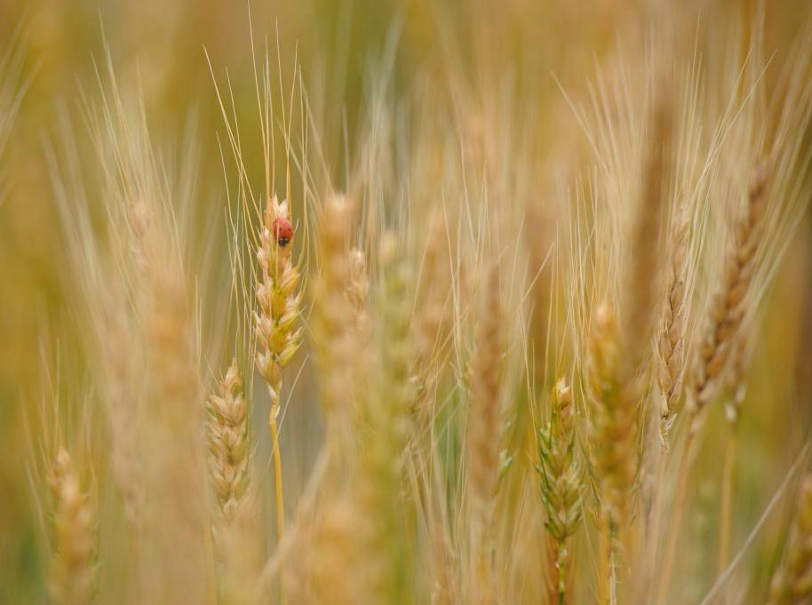
Contacts
USDA-Natural Resources Conservation Service
  Dennis Brezina
  State Soil Health Specialist
  101 South Main
  Temple, TX 76501
  (254) 742-9886 dennis.brezina@tx.usda.gov

Slide 38


USDA Nondiscriminatory Policy
In accordance with Federal civil rights law and U.S. Department of Agriculture (USDA) civil rights regulations and policies, the USDA, its Agencies, offices, and employees, and institutions participating in or administering USDA programs are prohibited from discriminating based on race, color, national origin, religion, sex, gender identity (including gender expression), sexual orientation, disability, age, marital status, family/parental status, income derived from a public assistance program, political beliefs, or reprisal or retaliation for prior civil rights activity, in any program or activity conducted or funded by USDA (not all bases apply to all programs). Remedies and complaint filing deadlines vary by program or incident.
Persons with disabilities who require alternative means of communication for program information (e.g., Braille, large print, audiotape, American Sign Language, etc.) should contact the responsible Agency or USDA's TARGET Center at (202) 720-2600 (voice and TTY) or contact USDA through the Federal Relay Service at (800) 877-8339. Additionally, program information may be made available in languages other than English.
To file a program discrimination complaint, complete the USDA Program Discrimination Complaint Form, AD-3027, found online at How to File a Program Discrimination Complaint and at any USDA office or write a letter addressed to USDA and provide in the letter all of the information requested in the form. To request a copy of the complaint form, call (866) 632-9992. Submit your completed form or letter to USDA by: (1) mail: U.S. Department of Agriculture, Office of the Assistant Secretary for Civil Rights, 1400 Independence Avenue, SW, Washington, D.C. 20250-9410; (2) fax: (202) 690-7442; or (3) email: program.intake@usda.gov.
USDA is an equal opportunity provider, employer, and lender.
Notes:
38

