Slide 1


DIVISION OF STUDENT AFFAIRS
Student Fee Advisory Committee
Fall 2025

Slide 2


THANK YOU
for your service!

Slide 3
REVIEW OF ALL DSA BUDGET ADJUSTMENTS
Reduction Plan

Slide 4
Center for Student Advocacy and Community
Transition of Services and Programs
Dean of Students Office
Hawk Pantry & Food Access Programs: Provides free food (canned goods and non-perishables), toiletries, hygiene products, and assistance applying for aid through community agencies.
Basic Needs Persistence Grant: Addresses insecurities related to food, housing, transportation, mental and physical health, childcare and technology, promoting persistence and degree completion for students experiencing hardship.
Gowns for Grads: Offers caps and gowns to graduating students facing an unforeseen circumstance.
Office of Student Involvement and Leadership
Community Programming: Events and initiatives to foster connection and engagement among students within the UHCL community. Programming focuses on building a vibrant student experience and supporting student development through collaborative activities that reflect student interests and needs.
First Generation Student Support: Provides support and resources to help first-generation college students transition, adjust, and navigate the campus environment, promoting successful academic and social experiences.
Notes:
$321K in salary
68K in M&O

Slide 5
*NEW*
DSA Business Services Team
September 1
Sirena Birkeland, DBA
Megan Bearden
Jamie Hester
Karinn Jones

Slide 6
*NEW*
DSA Administrative Support Team
June 1 and September 1
Kimberly Duren
Student Engagement Portfolio
Shirley Edun
Community and Wellness Portfolio

Slide 7
*NEW*
DSA Assessment Manager
June 1
Ebony Brunn
VPSA Office
Lead and partner with the DSA Assessment Committee

Slide 8
SHRL
DEPARTMENT UPDATES
Campus Recreation
Career Development
High level staffing and programmatic changes
Dean of Students
Health Services
Student Housing and Residential Life
Jaime Richeson will serve in a joint position of Residence Hall Director and Student Conduct
Added a Graduate Assistant
Military and Veterans
ONSP
Campus Recreation and Wellness
OSIL
Consolidation of positions to create a Program Manager for Recreation Operations and Member Services
Added a Graduate Assistant
CMHC
Student Media and Comms

Slide 9
SHRL
DEPARTMENT UPDATES
Campus Recreation
Career Development
High level staffing and programmatic changes
Dean of Students
Center for Career Development
Health Services
Adjusted a Coordinator to a Graduate Assistant to support Employer Relations
Military and Veterans
Dean of Students
ONSP
Incorporated Basic Needs and Food Access Programs
Annabelle Camero will transition to DOS to continue supporting the basic needs persistence grant
Jaime Richeson will serve in a joint position of Residence Hall Director and Student Conduct
OSIL
CMHC
Student Media and Comms

Slide 10
SHRL
DEPARTMENT UPDATES
Campus Recreation
Career Development
High level staffing and programmatic changes
Dean of Students
Health Services
Health Services
A Clinic Manager/Nurse Practitioner has been created to lead the department
Part-time Nurse Practitioner will be added to be an additional provider
Part-time Nurse Practitioner will be added for psychiatry (move from CMHC)
Military and Veterans
ONSP
Veteran and Military Resource Center
OSIL
Transition of evaluation of military experience for academic credit to department
CMHC
Student Media and Comms

Slide 11
SHRL
DEPARTMENT UPDATES
Campus Recreation
Career Development
High level staffing and programmatic changes
Dean of Students
Health Services
Orientation and New Student Programs
Adjusted the Assistant Director position to a Program Manager
Military and Veterans
ONSP
Student Involvement and Leadership Programs
OSIL
Program Manager to oversee leadership, first gen, and community engagement Programs
Audrey Pena will transition to Coordinator for Community Engagement
Graduate Assistant was added to support registered student organization management
CMHC
Student Media and Comms

Slide 12
SHRL
DEPARTMENT UPDATES
Campus Recreation
Career Development
High level staffing and programmatic changes
Dean of Students
Counseling and Mental Health Center
Health Services
Psychiatry is transitioned to Health Services
Staffing adjustments made with current and upcoming vacancies
Military and Veterans
ONSP
Student Media and Communications
OSIL
No significant changes
CMHC
Student Media and Comms

Slide 13

FINANCIAL OUTLOOK
Student Service Fees
BUDGET FORCASTING
Enrollment projections
Market Study Salary Increases (year 2 and year 3)
Deficit Management
PREPARED FOR UNCERTAINTIES WITH STEADY RESERVES
No base requests this year
Per Executive Order, still unable to increase the fee

Slide 14



Projection Chart
Base Projection | FY25 | *FY26 | FY27 | FY28 | FY29
Base | 4,860,848 | 4,307,385 | 4,410,983 | 4,567,983 | 4,620,983
Administration Charge |  | 362,914 | 352,879 | 365,439 | 369,679
Salary Mandate | - |  | 53,000 | 53,000 | 53,000
Comp YR 2 (FY2026) & YR 3 (FY2027) |  | 103,598 | 104,000
Required Base | 4,860,848 | 4,773,897 | 4,920,862 | 4,986,422 | 5,043,662
Projected Revenue on prior year enrollment | 4,788,583 | 4,788,526 | 4,788,526 | 4,788,526 | 4,788,526
Base Shortfall | (72,265) | 14,629 | (132,336) | (197,896) | (255,136)
*FY26 Reduced SSF base budget by $553,463
Reduced central funding by $388,698

Slide 15
FY 25 YEAR END
SFAC Reserve | (1,562,407.26)
VPSA Approved Sweep | *(1,244,356.59)
SFAC FY26 One Time Approval | 298,828.50
Salary Mandate | 157,000.00
Reserve | 2,000,000.00
Balance | (350,935.35)
*58% Salary/Wage/Fringe
42% M&O/Travel

Slide 16

HOW WILL YOU DECIDE?
Mission
The Division of Student Affairs strives to create empowering experiences that strengthen the educational journey for UHCL students. Through our programs, support services, and other resources, we commit to building a supportive, engaging community that cultivates personal development and success for all students.
Vision
Accommodating all students through individualized and meaningful experiences that brings comfort and life to their UHCL journey, while preparing them to positively contribute to campus and society.

Slide 17
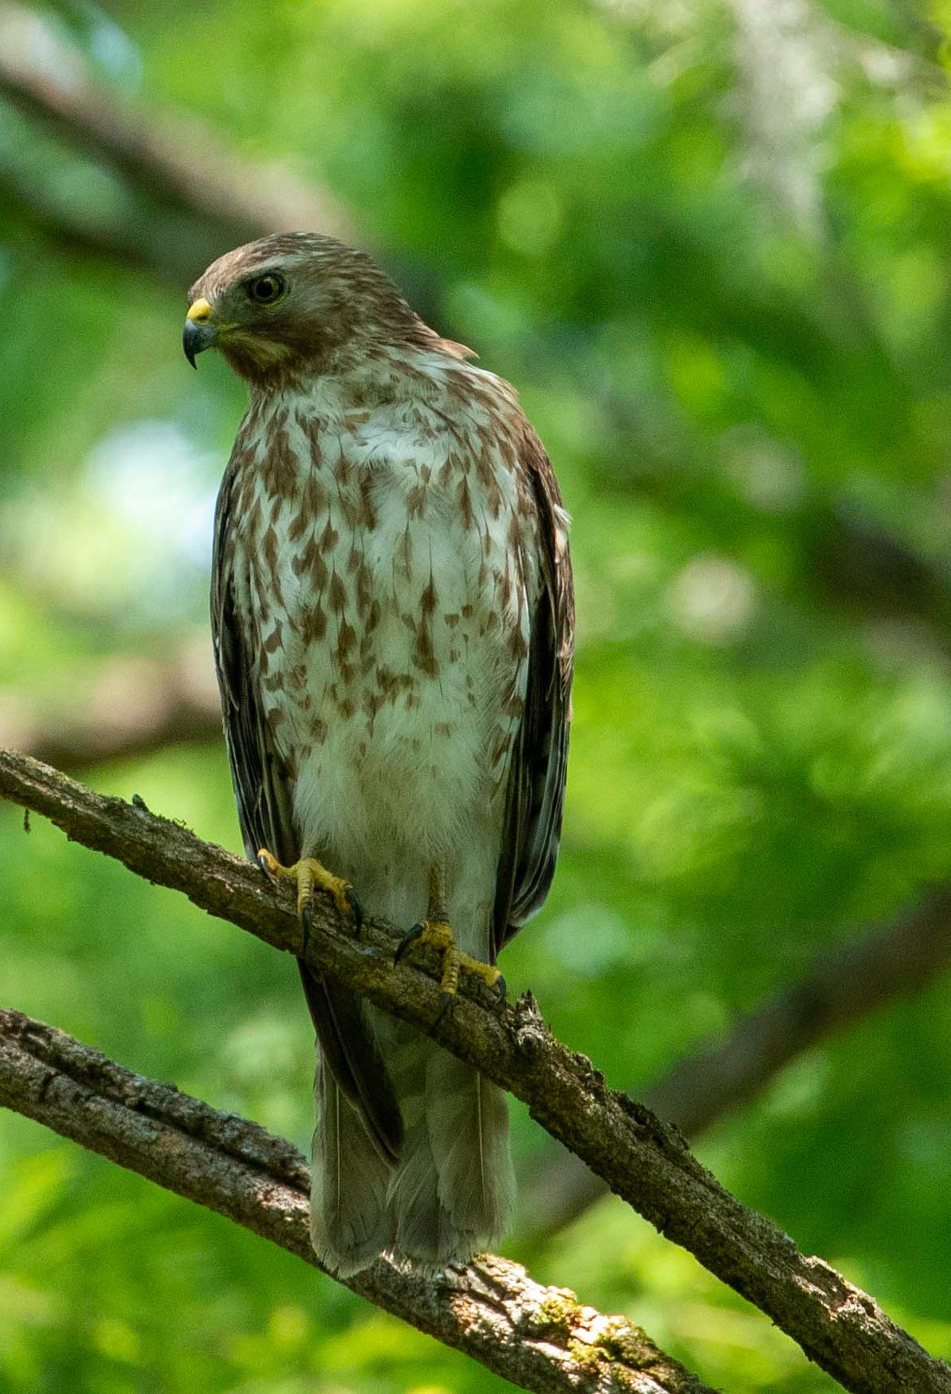



QUESTIONS?
Thank you!

