Slide 1
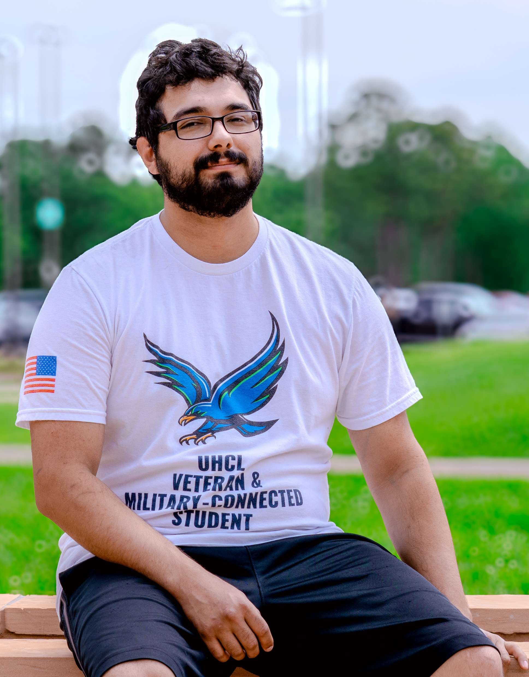
Capt. Wendell M. Wilson
Veteran & Military Resource Center
SFAC Presentation 2026-2027
Luis Polanco De Leon – Director
Thursday, October 16, 2025

Slide 2

Mission
To serve and empower military-connected students by providing comprehensive support, access to campus and community resources, and opportunities for personal and academic success.
Vision
To be a leading center for military-connected student success in higher education, promoting achievement, engagement, and meaningful support through dedicated advocacy and innovative services.

Slide 3
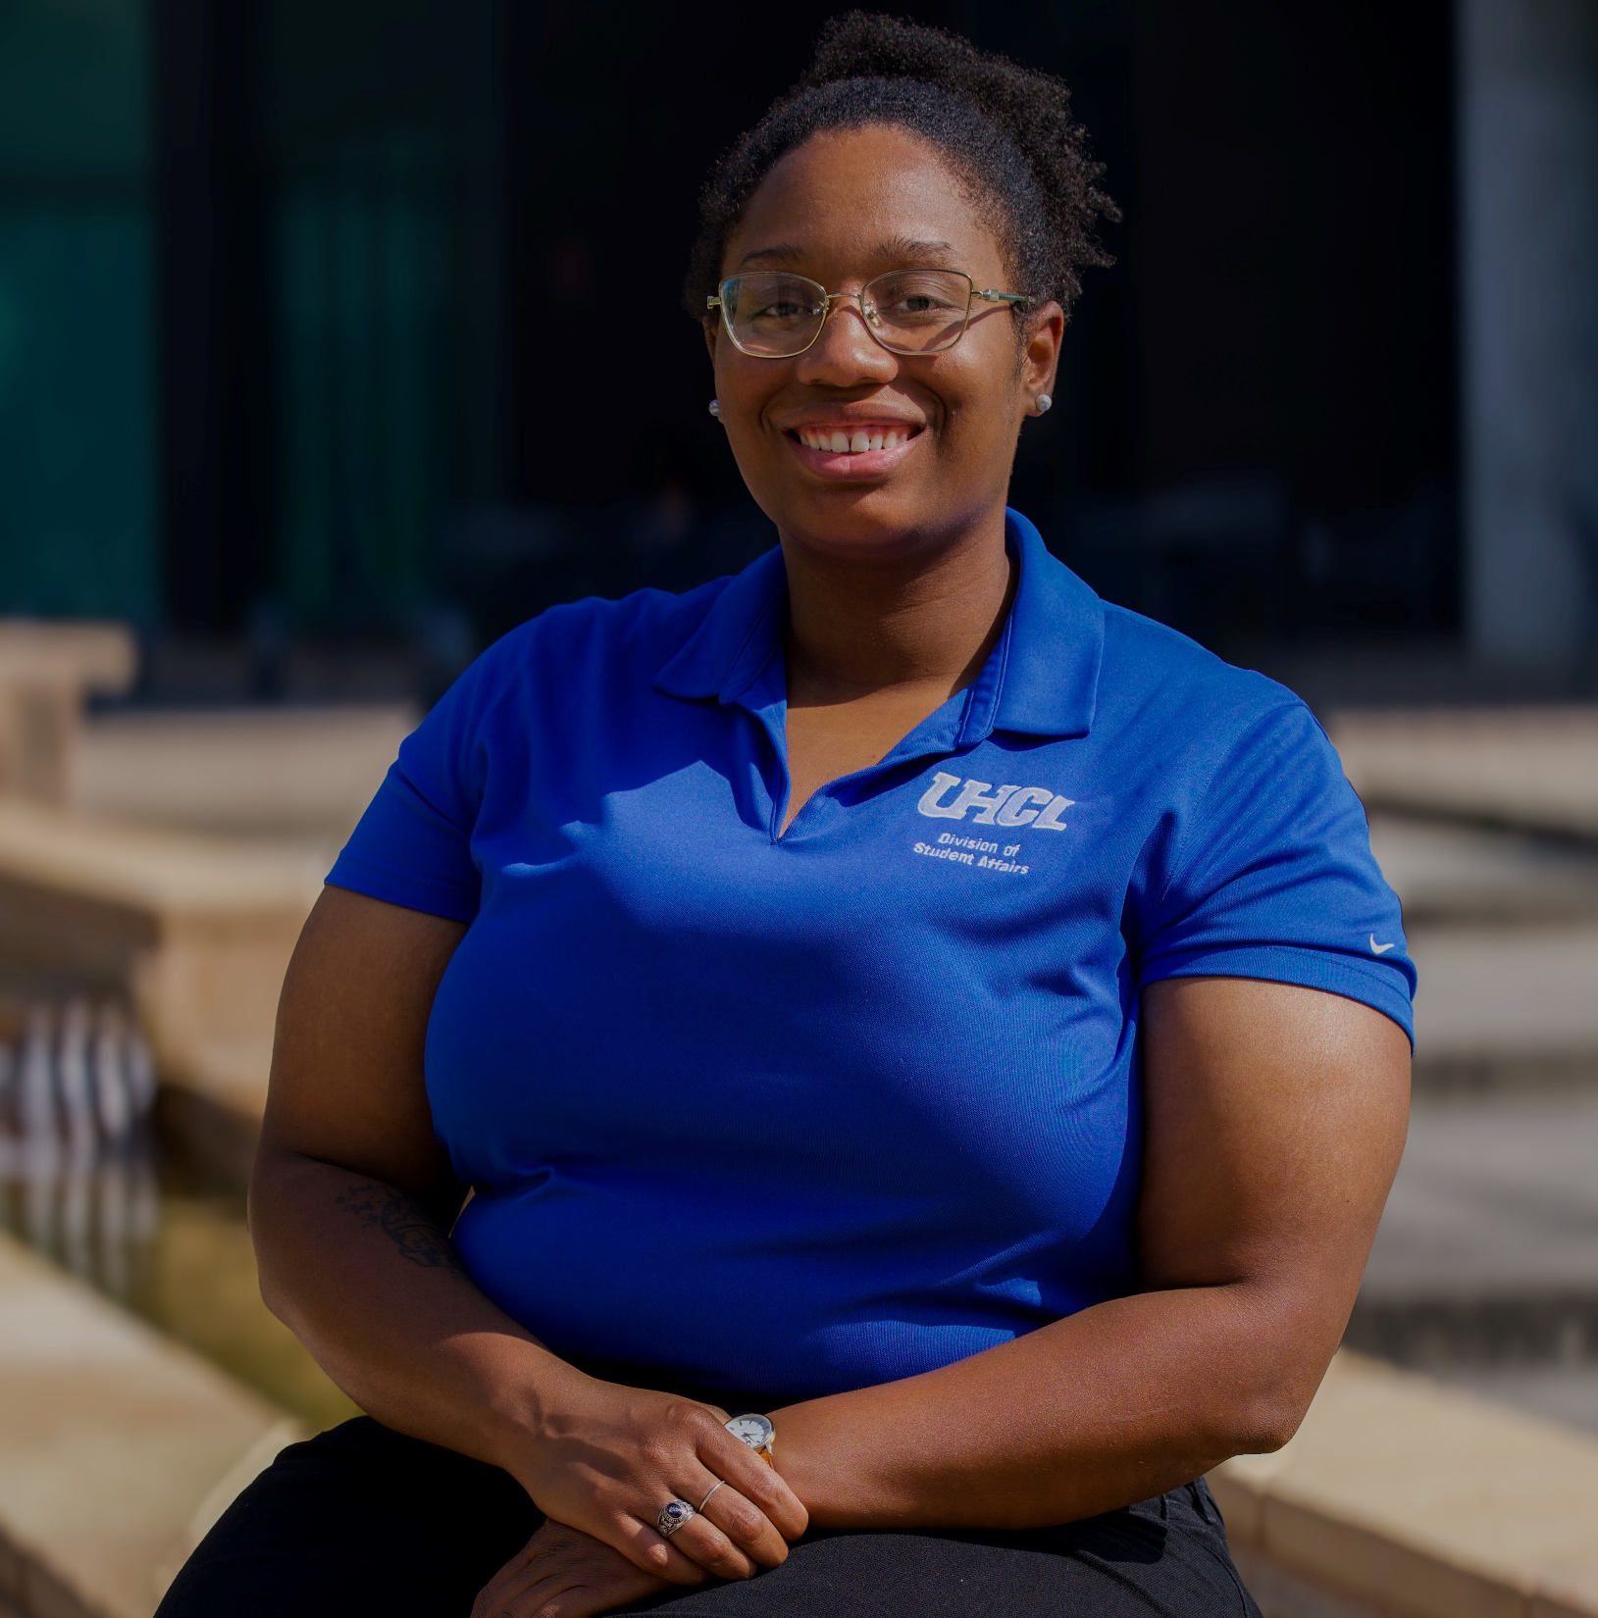
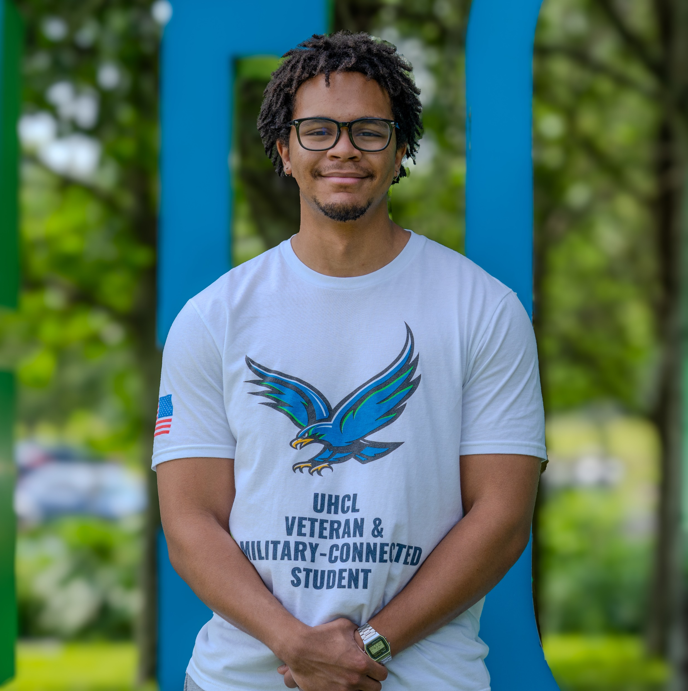
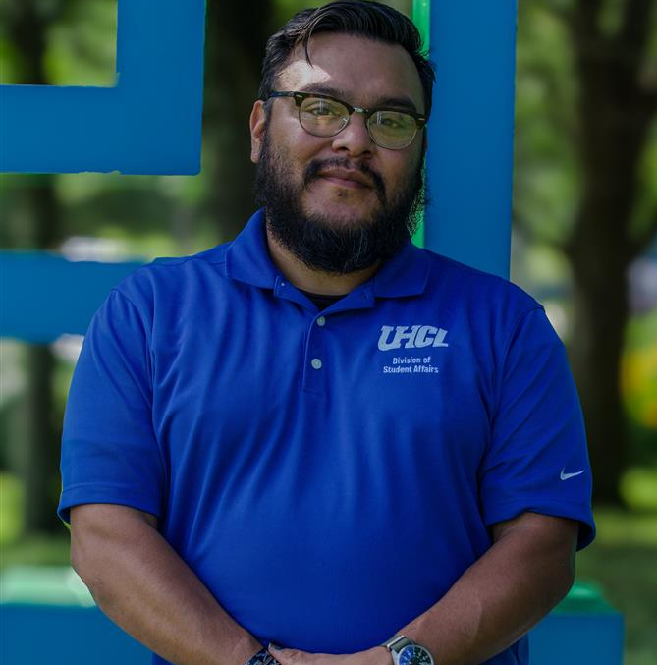
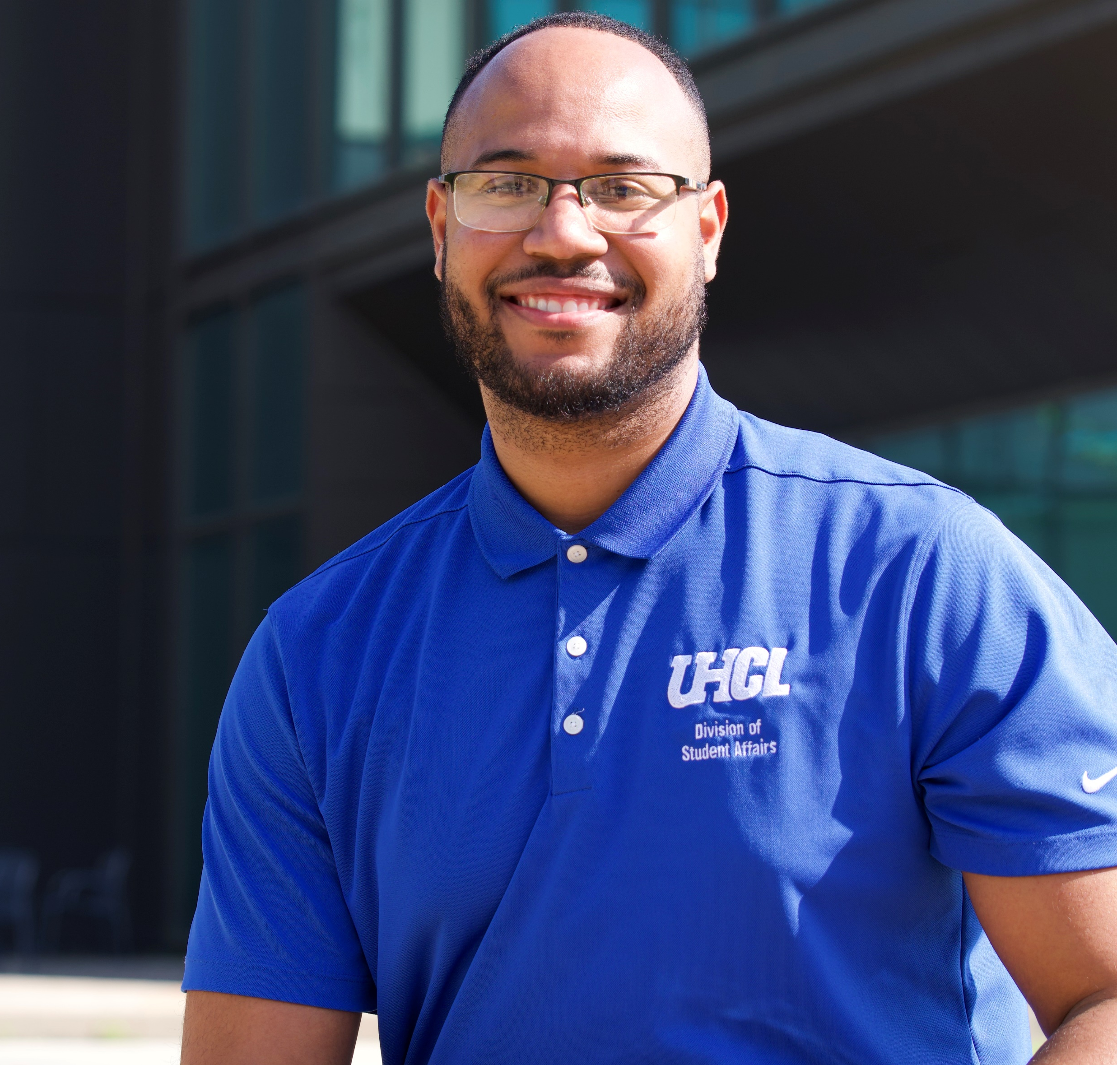
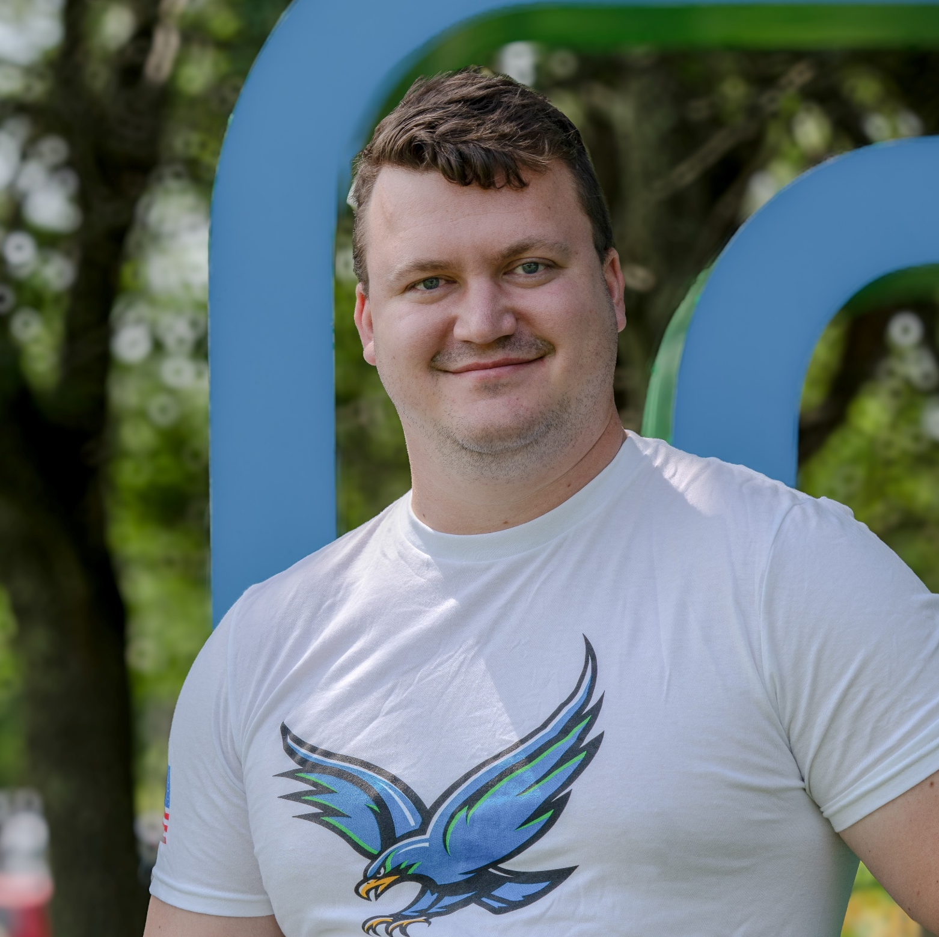
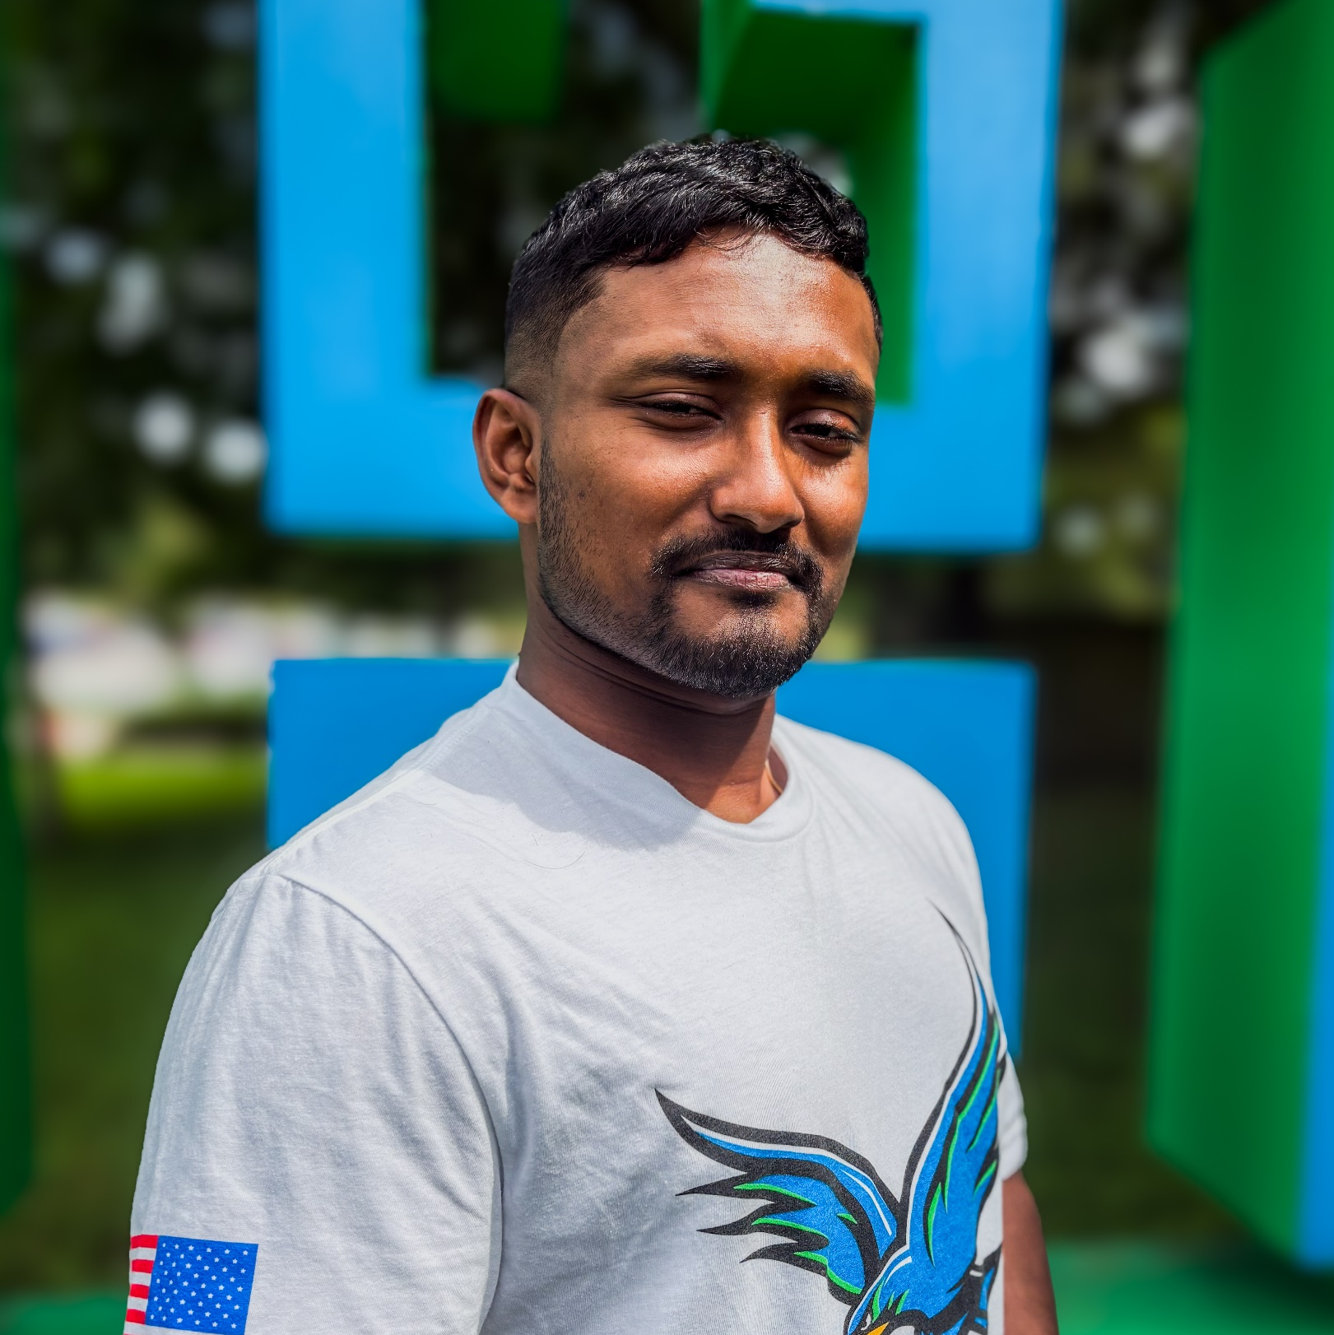
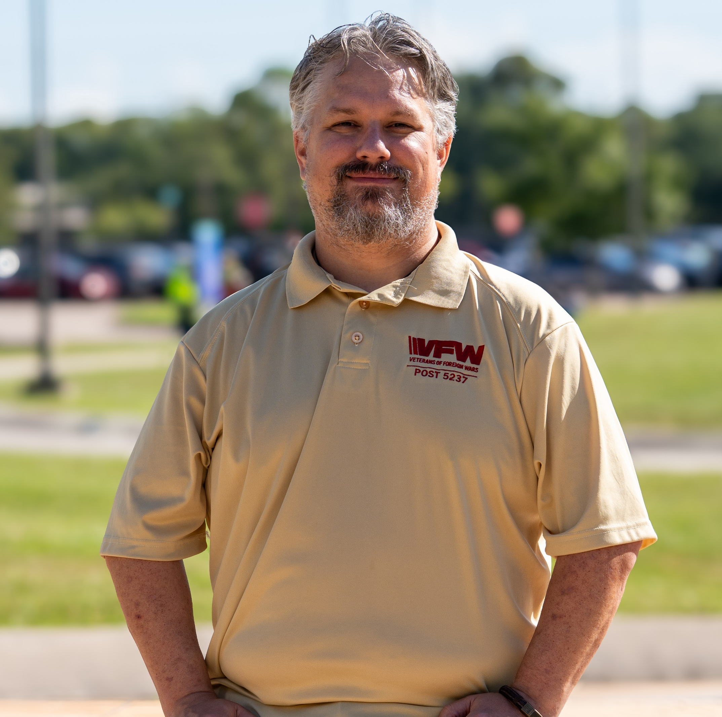
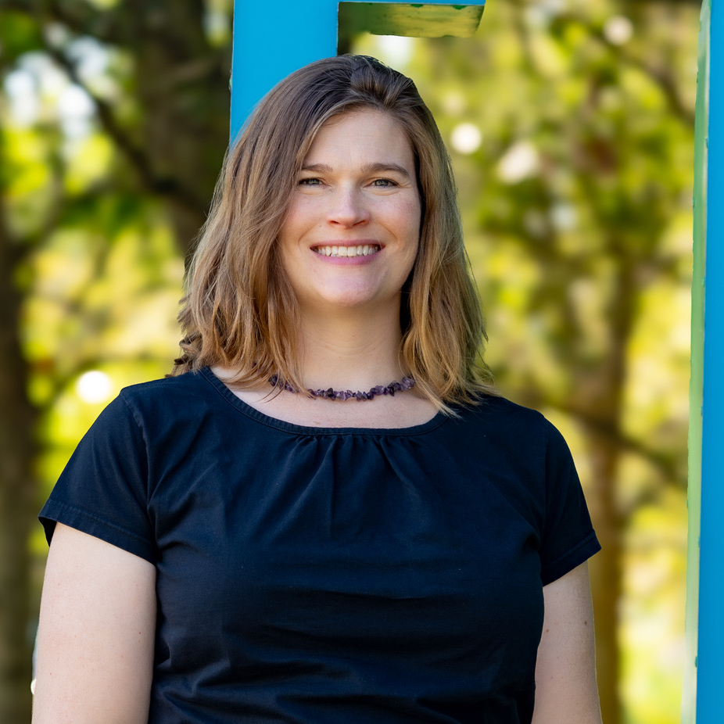
Luis Polanco De Leon
Marguerite Alix (Maggie)
Director, Veteran & Military Resource Center
Eric Irving
Coordinator, Veteran & Military Resource Center
Student Worker
London Fereaud
Student Worker
David Losoya
Coordinator, Veteran & Military Resource Center
Brandon Cates
VA Work-Study
Student Worker
Salma Davila
Tristan Thomas
Damien Guerrero
Jared Browning
Student worker
Moises Cardona
Jaroy Taylor
VA Work-Study
Elizabeth Johnson
VA Work-Study

Slide 4
IMPACT OF STUDENT FEE ALLOCATION
Enhanced Programming & Engagement
👥 938 Students Engaged
🎓 1,000+ VA Certifications Processed
💼 4 Student Workers Hired
💬 7 Major Events Hosted
Student fee funding allows the Veteran & Military Resource Center (VMRC) to deliver impactful programs that strengthen community and connection among military-connected students. Events such as Veterans Day, the Military-Connected Year-End Celebration Dinner, and resource workshops create meaningful spaces for learning, recognition, and engagement. These programs increase visibility, promote belonging, and enhance the overall UHCL student experience.
CHALLENGES
Expanded Student Support & Outreach
Funding has also enabled the VMRC to hire dedicated student workers who serve as the first point of contact for military-connected students. Their presence allows the office to extend our outreach, improve response time to inquiries, and provide consistent assistance with benefits, resources, and events. This additional support has significantly increased our capacity to reach and assist more students each semester.
Building Sustainable Growth
By combining programming with student employment opportunities, the VMRC continues to strengthen both service delivery and engagement. Each dollar invested expands outreach, enhances program quality, and ensures every military-connected student has access to the guidance and resources they need to succeed.

Slide 5
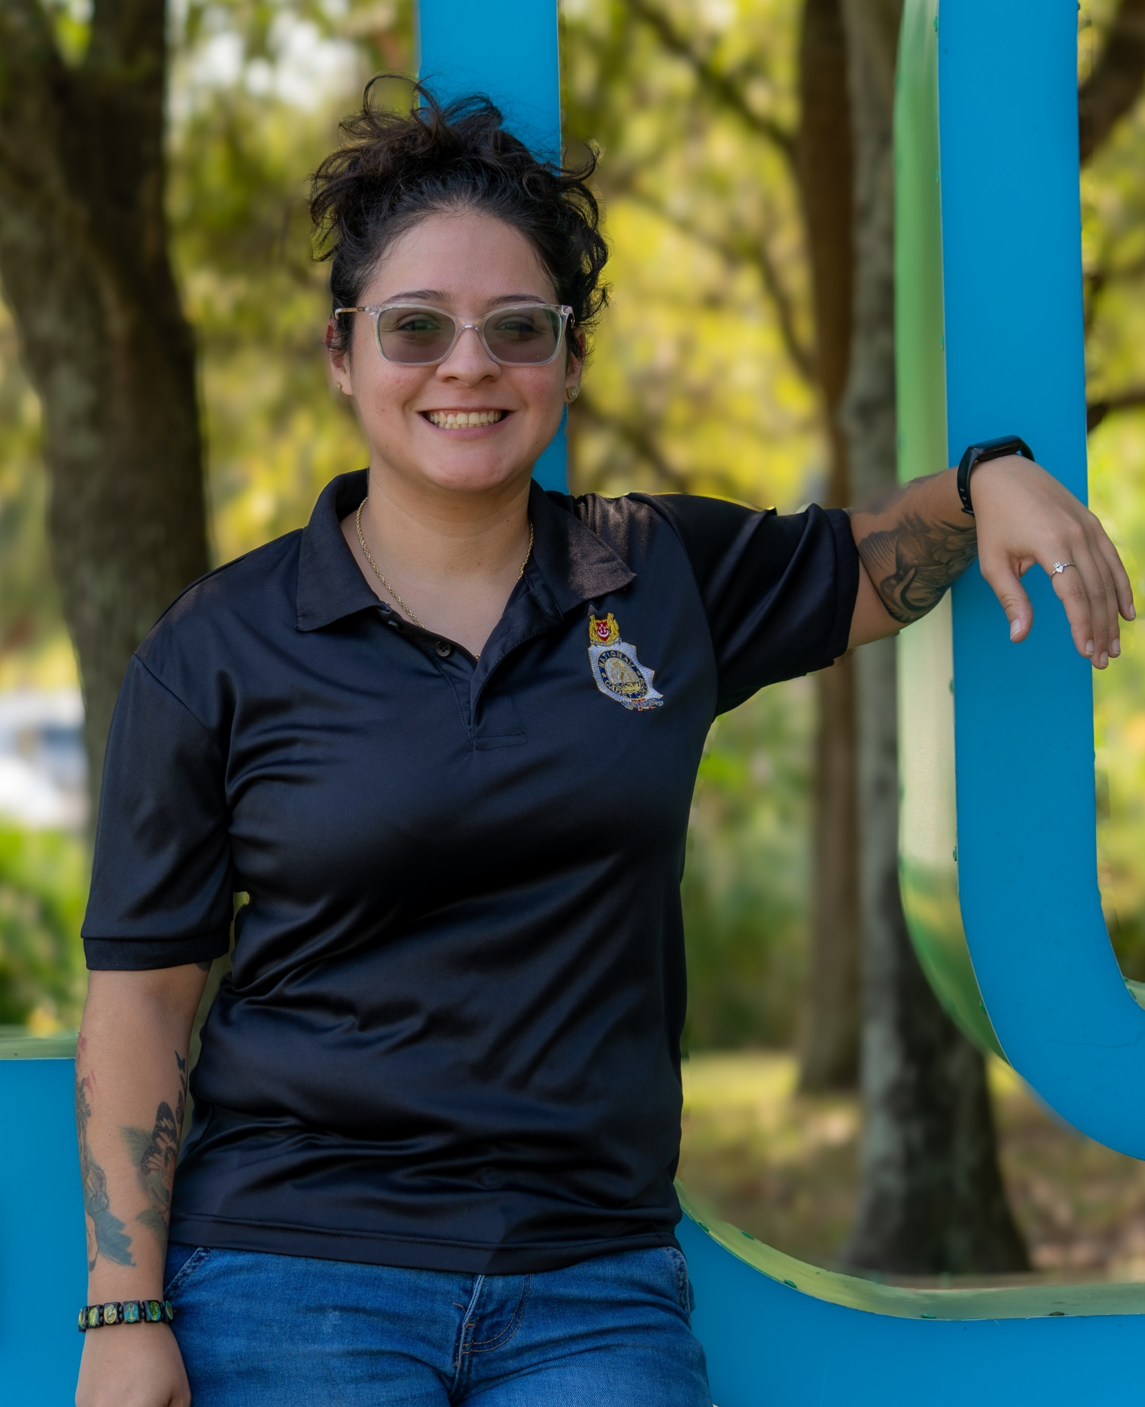
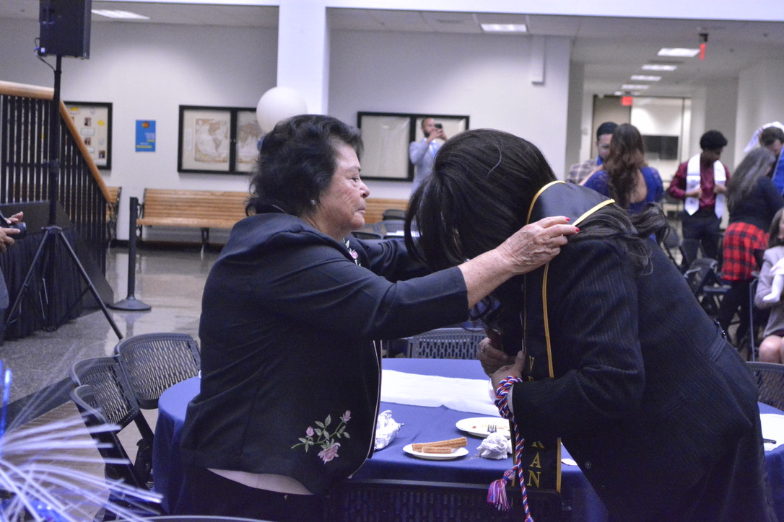
STUDENT VOICE
“The Veteran and Resource Center at UHCL has greatly supported veteran students by guiding us through our GI Bill benefits, assisting with paperwork, and resolving any issues that arise. Their dedication makes the transition from military to college life smoother, allowing veterans to focus on academics instead of financial or administrative concerns.” – Salma Davila
“Thank you so much for such a beautiful evening at the military-connected dinner. I did not expect my Mother to place the stole on me, what a great surprise!” – Maria Luisa
“The VMRC at UHCL has been instrumental in helping me navigate my GI Bill benefits. Their informative events and supportive office culture have made a meaningful impact on my academic journey.” – Elizabeth Johnson

Slide 6
VMRC BY THE NUMBER
CHALLENGES

Slide 7


CHALLENGES & OPPORTUNITIES
CHALLENGES
OPPORTUNITIES
Sustaining student worker funding remains a key challenge, as reliance on one-time allocations limits long-term stability for daily operations and event support.
Short-term funding cycles restrict the VMRC’s ability to launch multi-year initiatives and maintain uninterrupted, high-quality service delivery.
Evolving federal and state benefit processes require continuous staff training and system updates to ensure compliance and timely certifications.
Strengthen partnerships with UHCL departments and community organizations to share resources, enhance visibility, and co-host programs that promote student belonging and engagement.
Expand data-informed programming by tracking attendance, satisfaction, and outcomes to improve decision-making and align with Student Affairs’ assessment priorities.
Build on new initiatives such as Information Sessions and the Military-Connected Celebration Dinner to expand community connection and reinforce UHCL’s supportive campus culture.

Slide 8
BUDGET OVERVIEW
Sources of Funding | Uses of Funding
Central / Education & General (Fund 2064) FY2026 Budget: $195,787 | Two SCO for Benefits / Certifications
 | Part of Director Salary
 | Office Operations (telephones, office supplies, copier)
Student Services Fee (SFAC Fund 3049) FY2026 Budget: $116,303 | Student Events
 | Part of Director Salary Student Wages
VA Funding-Annual Reporting Fee/Income (Fund 2080) FY2026 Budget: $6,000 | Defray costs of Certification ($16 / certification)

Slide 9
FY25 & FY26 Funding Utilization
EXPANDING ACCESS & STUDENT SUPPORT
FY25 One-Time Funding – $14,000 (Student Wages)
FY26 One-Time Funding – $25,000 (Student Wages)
Used to hire student assistants who provided office coverage, managed phone/email inquiries, and supported events.
Improved customer service, faster response times.
Offered on-campus employment and professional experience for military-connected students.
Expanded student worker team to maintain consistent service and administrative coverage.
Increased availability for benefits certification support and outreach programming.
Strengthened VMRC’s ability to meet the needs of a growing military-connected population.
CHALLENGES
These allocations directly enhanced service quality, student employment opportunities, and community engagement across UHCL’s military-connected population.

Slide 10
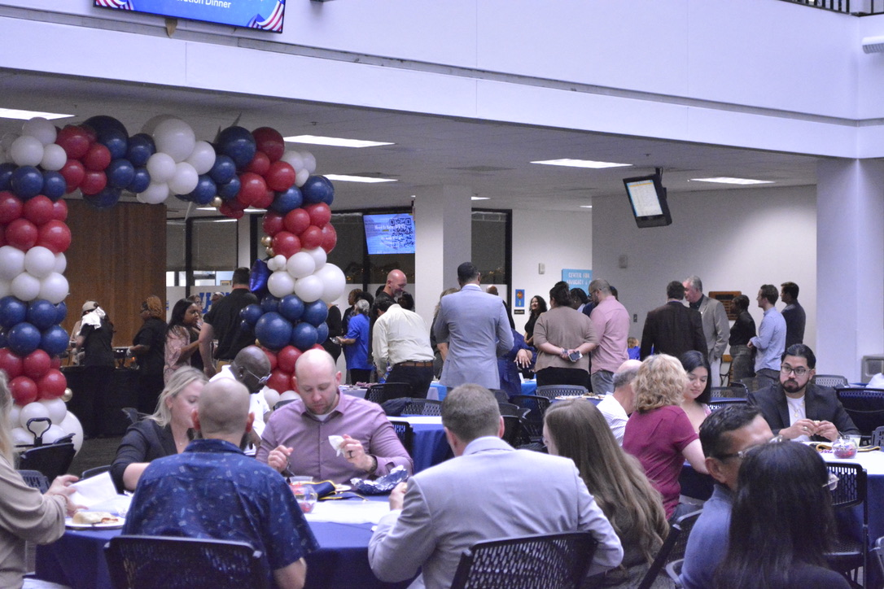
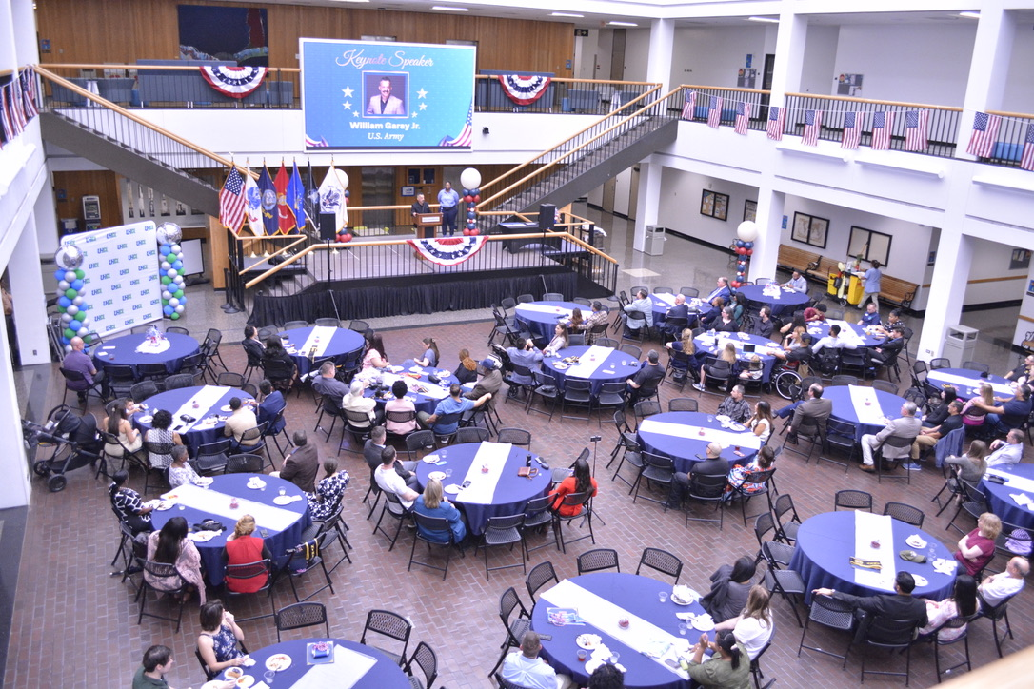
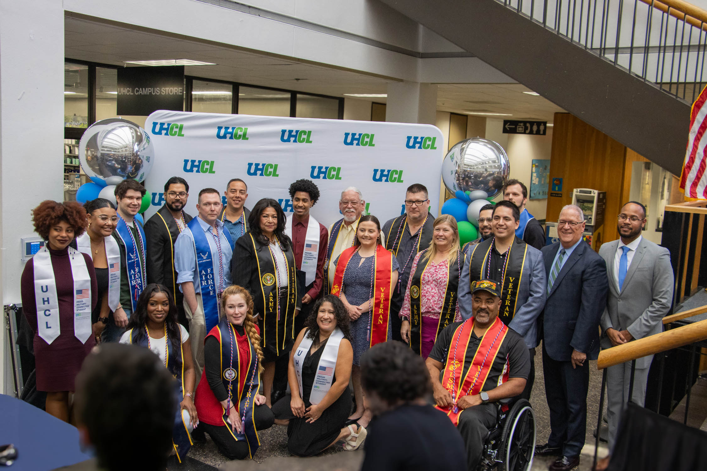
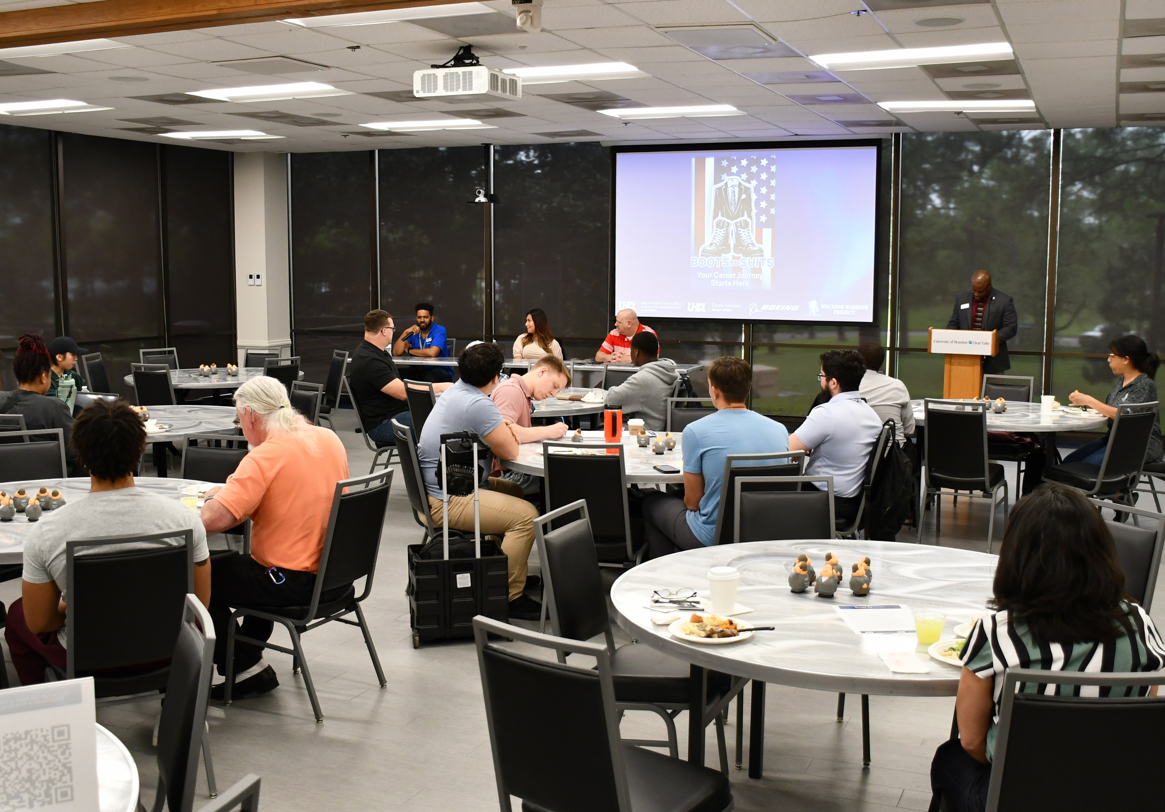
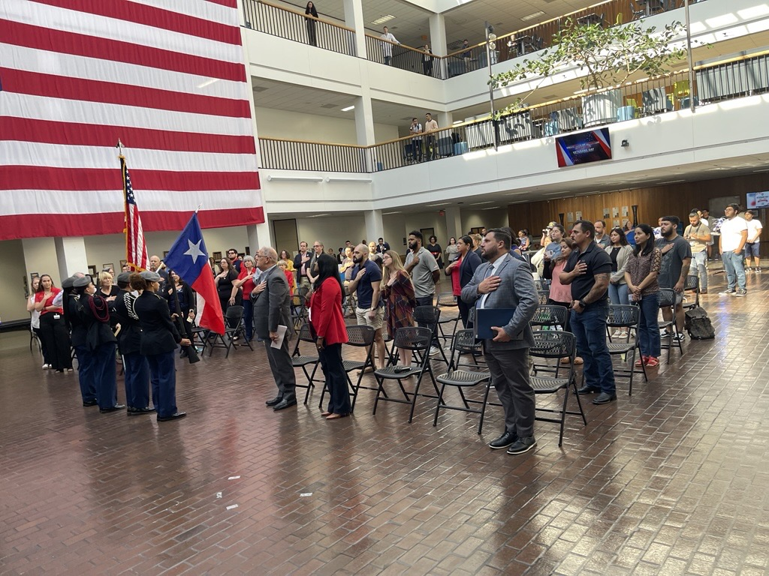
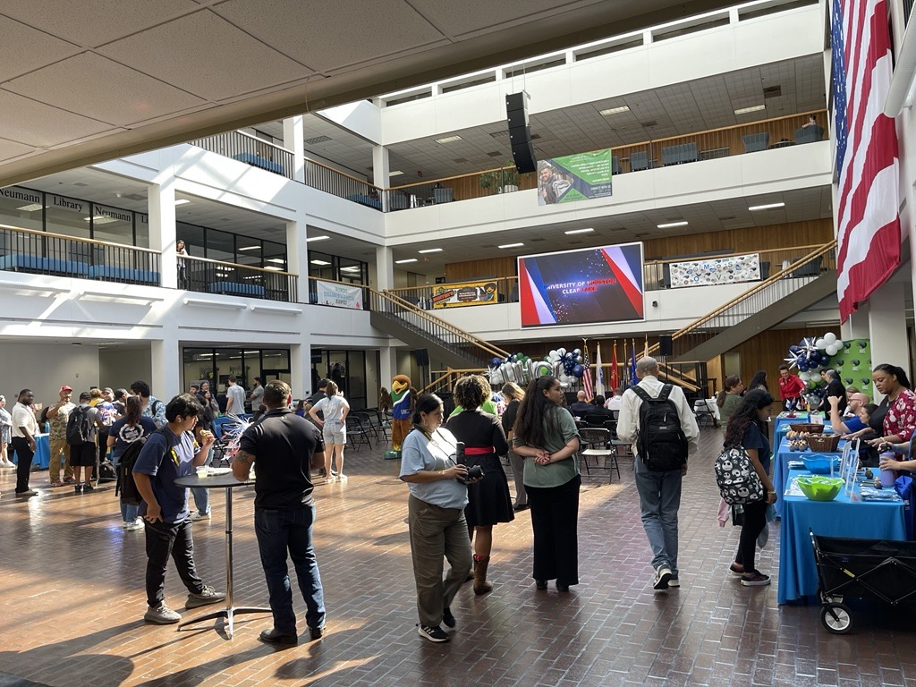
FY26 / FY27 ONE-TIME FUNDING REQUEST – INVESTING IN STUDENT SUCCESS
Fiscal Year | Amount Requested | Purpose & Justification
FY26 | $10,000 | Programming support for the Military-Connected Year-End Celebration Dinner – catering, logistics, recognition materials.
FY27 | $35,000 | $20,000 – Student Wages: Maintain consistent office coverage and student outreach. $15,000 – Programming & Engagement: Sustain key initiatives such as Veterans Day events, information sessions, and the Year-End Celebration Dinner.
CHALLENGES
“This funding directly supports four student workers and over 900 military-connected students annually through meaningful employment, engagement, and recognition.”

Slide 11
ACCOMMODATING A 5% FY27 BUDGET REDUCTION
Challenge | Adjustment / Response | Impact on Services
Limited funding flexibility may reduce capacity for programming and student engagement activities. | Consolidate or scale back smaller programs while preserving flagship events like Veterans Day and the Military-Connected Celebration Dinner. | Programming remains student-centered, with signature events like Veterans Day and the Celebration Dinner preserved.
Rising costs for events, supplies, and outreach materials. | Seek sponsorships and campus partnerships to offset event and material costs. | Student engagement remains consistent through partnerships and resource-sharing.
Reduced available funding for non-essential operations. | Streamline expenditures and optimize student worker hours to maintain service levels. | Core operations, certifications, benefit processing, and front-desk service, continue uninterrupted.
Maintaining quality student experience amid reduced resources. | Focus resources on direct student support, benefit navigation, and high-engagement programs. | Students continue to receive timely, personalized support despite budget adjustments.
CHALLENGES
⚠️
🔄
🎯

Slide 12



Thank
YOU.
QUESTIONS?

