Slide 1
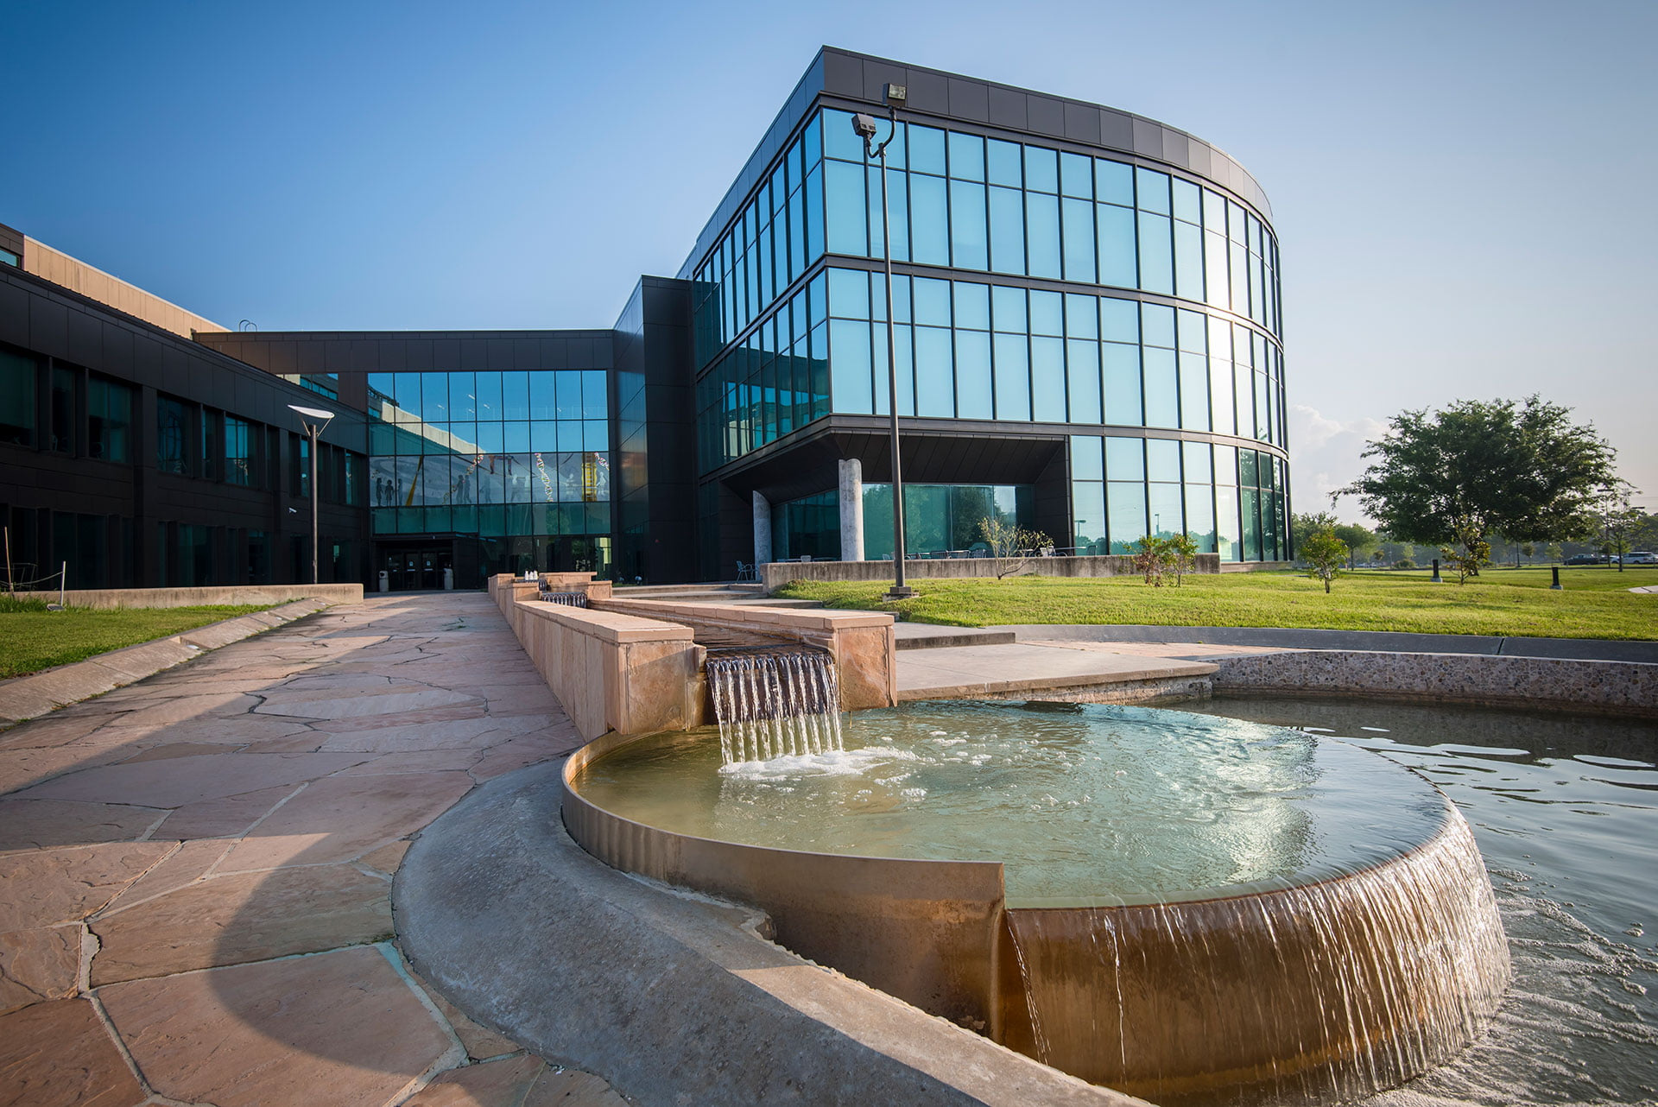

SFAC PRESENTATION
FY2027

Slide 2




MISSION
The mission of the University of Houston-Clear Lake (UHCL) Student Media is to amplify student-driven expression, innovative storytelling, and impactful journalism. We strive to inform, educate, and engage the UHCL campus and surrounding communities through journalistic best practices. UHCL Student Media serves as a professional learning environment where students can gain valuable skills and experiences across various media channels.
CORE PROGRAMS
The Signal
The Signal Stories
SFAC PRESENTATION
Notes:
Sergio

Slide 3
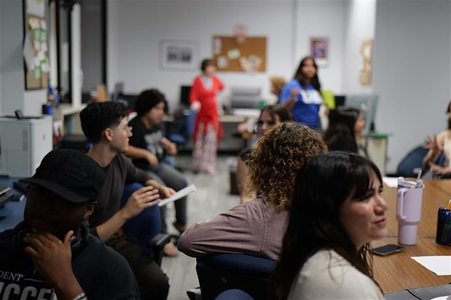
Benefits for Students
Student Media aligns with DSA’s mission by focusing on developing the students’ professional skillsets and amplifying their voices. Student Media functions as an area where students build and practice the following skills:
Writing
Copyediting
Photography
Digital Design
Business Management
Marketing
Video and audio production
Journalism reporting
Community building
Leadership
Empowerment and Freedom of Expression
Professional Development
Civic Engagement
Enhance Campus Culture
SFAC PRESENTATION
Notes:
Sergio

Slide 4

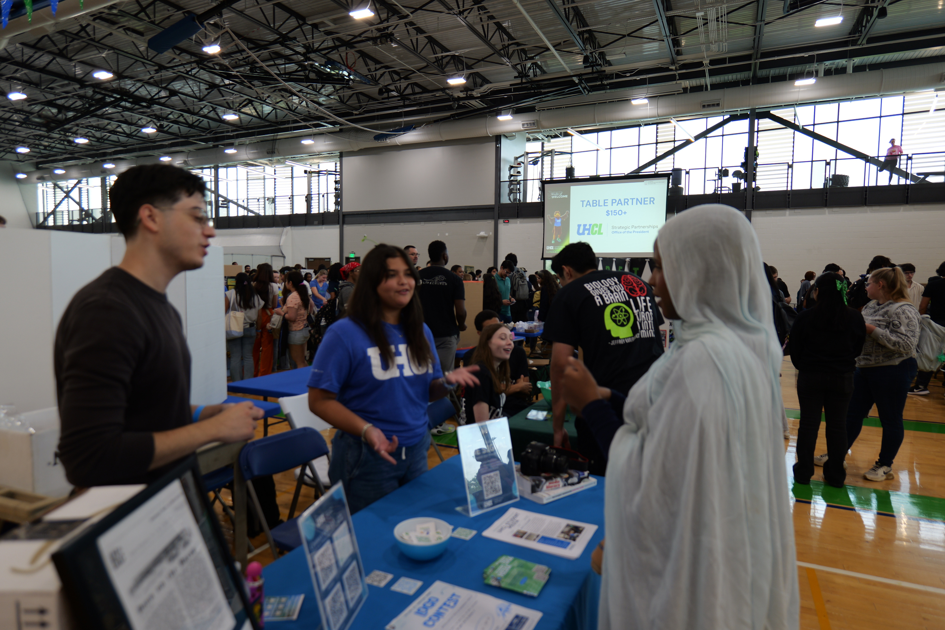
SUCCESS, CHALLENGES & OPPORTUNITIES
SFAC PRESENTATION

Slide 5
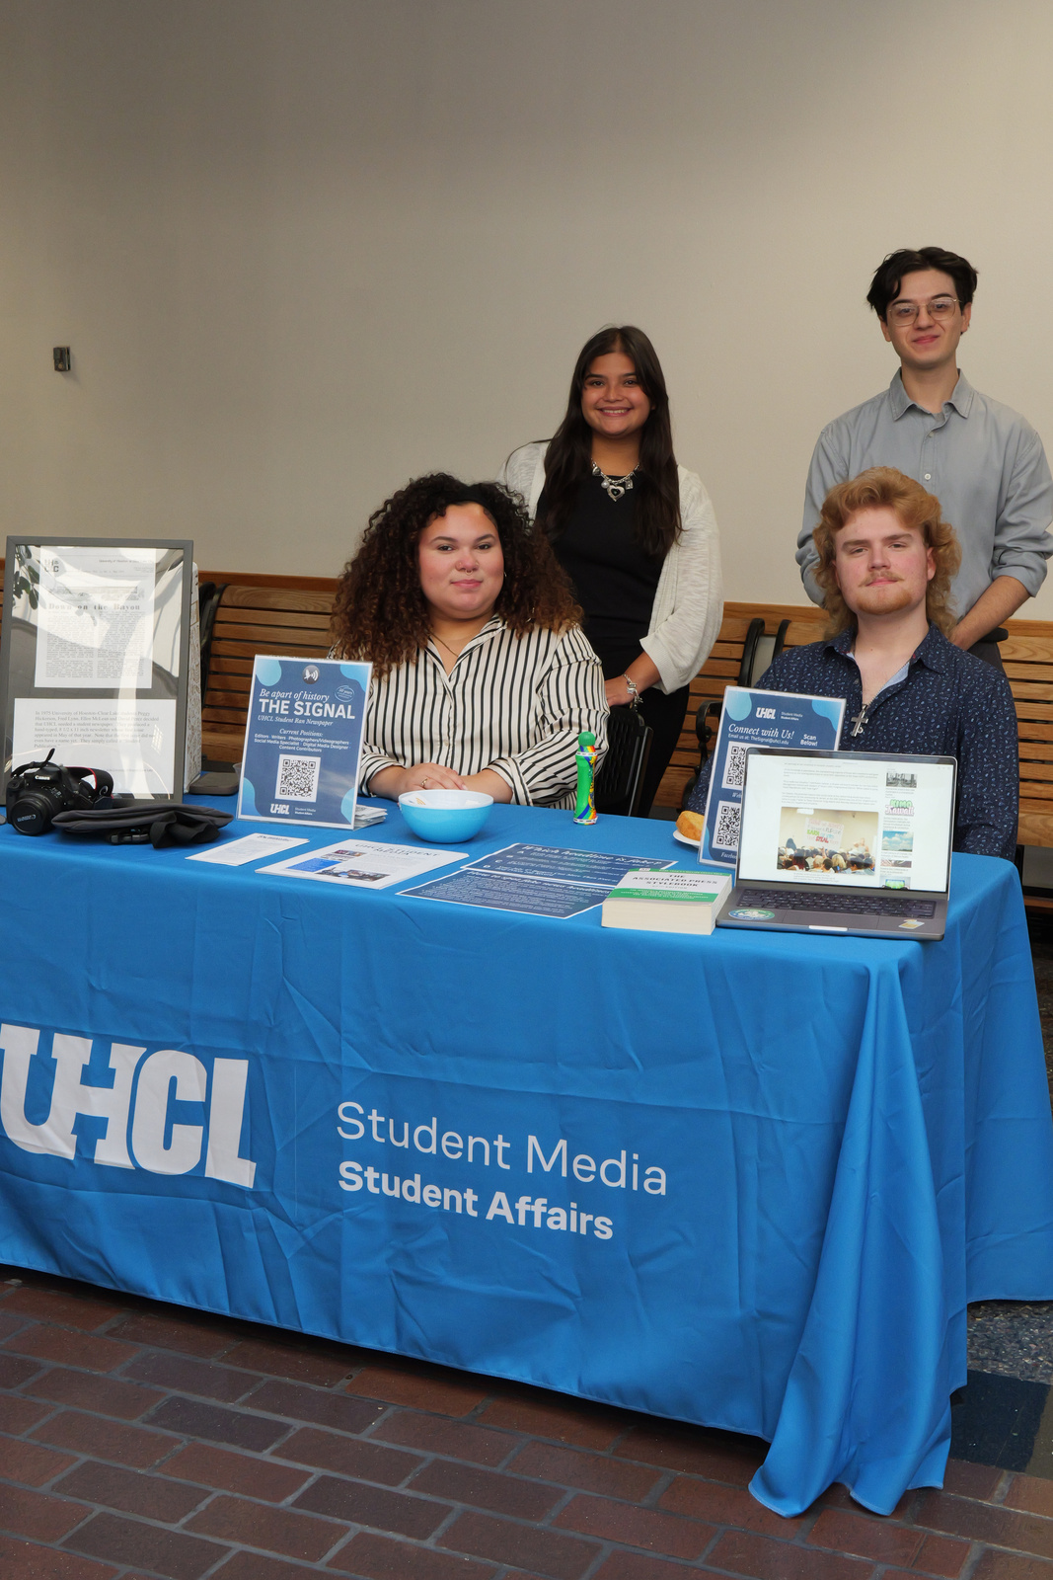
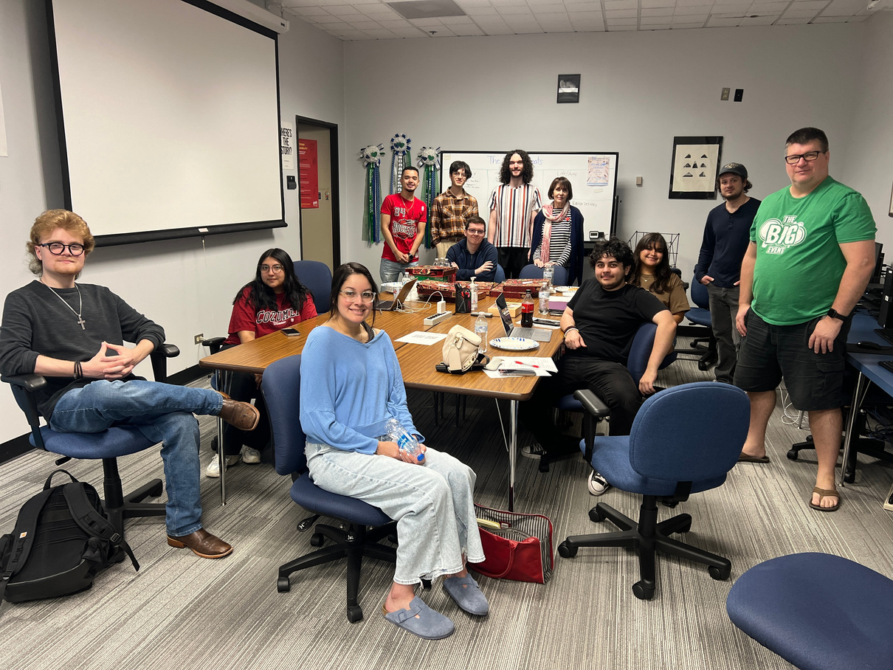
SUCCESSES
Grew our staff from two to seven. (Oct 2025)
Launched a new website in January 2025. Over FY25, we increased viewership on www.thesignalnews.net by 7315.26%.
Published 60 articles and have 8,078 views. (Oct 2025)
At least 85% of students reported being able to move up at least one proficiency level in six communication skill areas.
Established a partnership with the Communications Program. We are currently in our second semester of offering a Media production class.
Sponsored three students to attend the spring 2025 Texas Intercollegiate Press Association Conference.
With the 550% increase in recruitment and the 150% increase in retention, Student Media is growing at a rate where more students are getting involved in student-driven, experiential, and hands-on skill development.
SFAC PRESENTATION
Notes:
Lisa

Slide 6
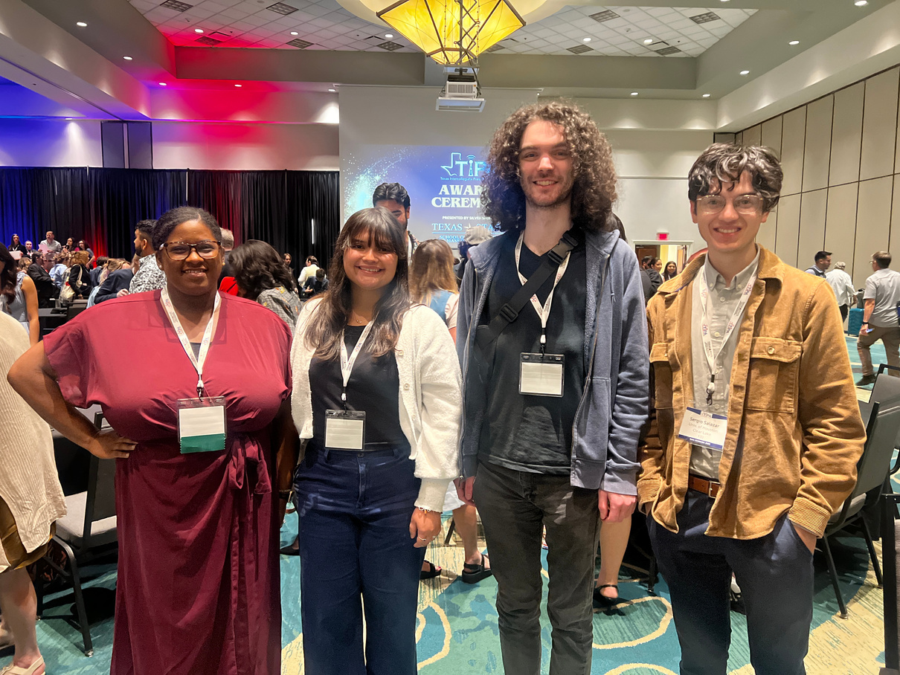
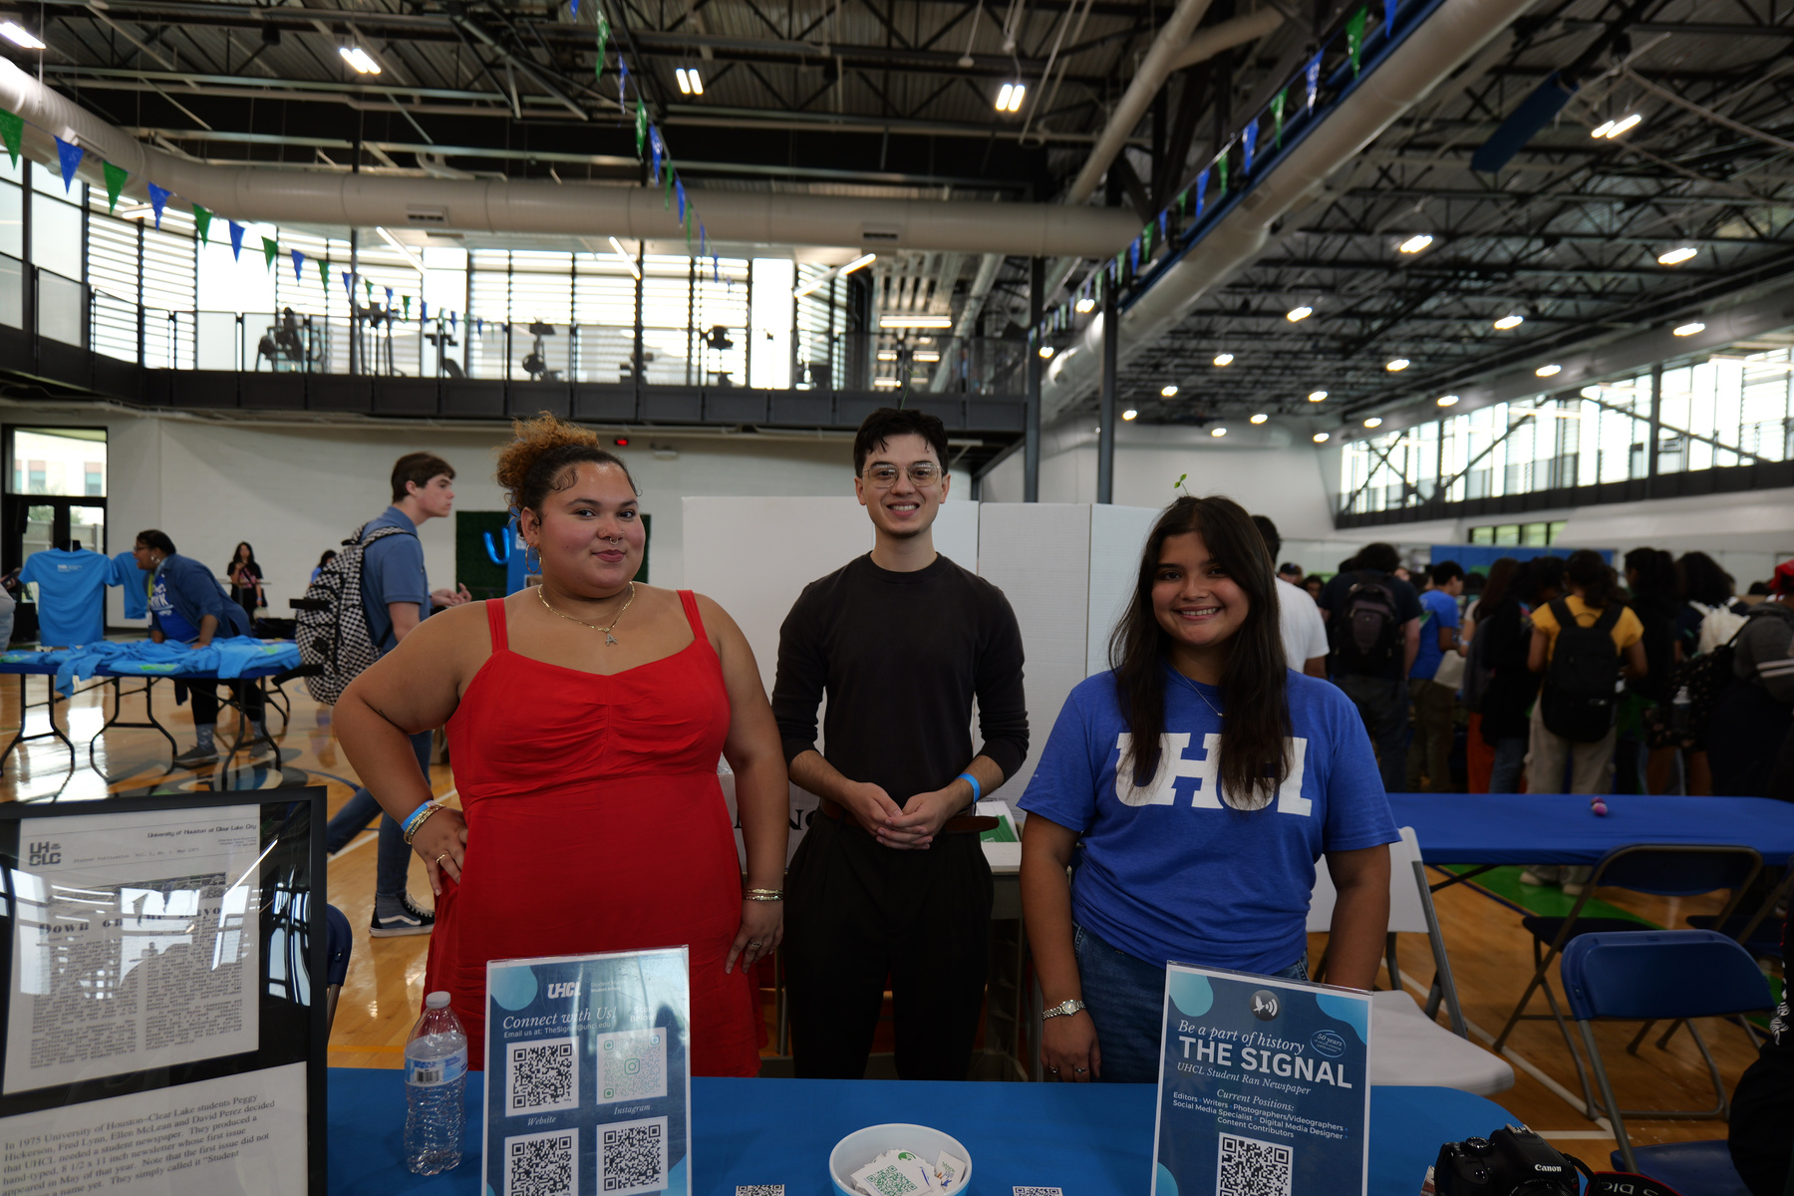
WHAT OUR STUDENTS ARE SAYING!
Notes:
Sergio
Lisa
Severin

Slide 7
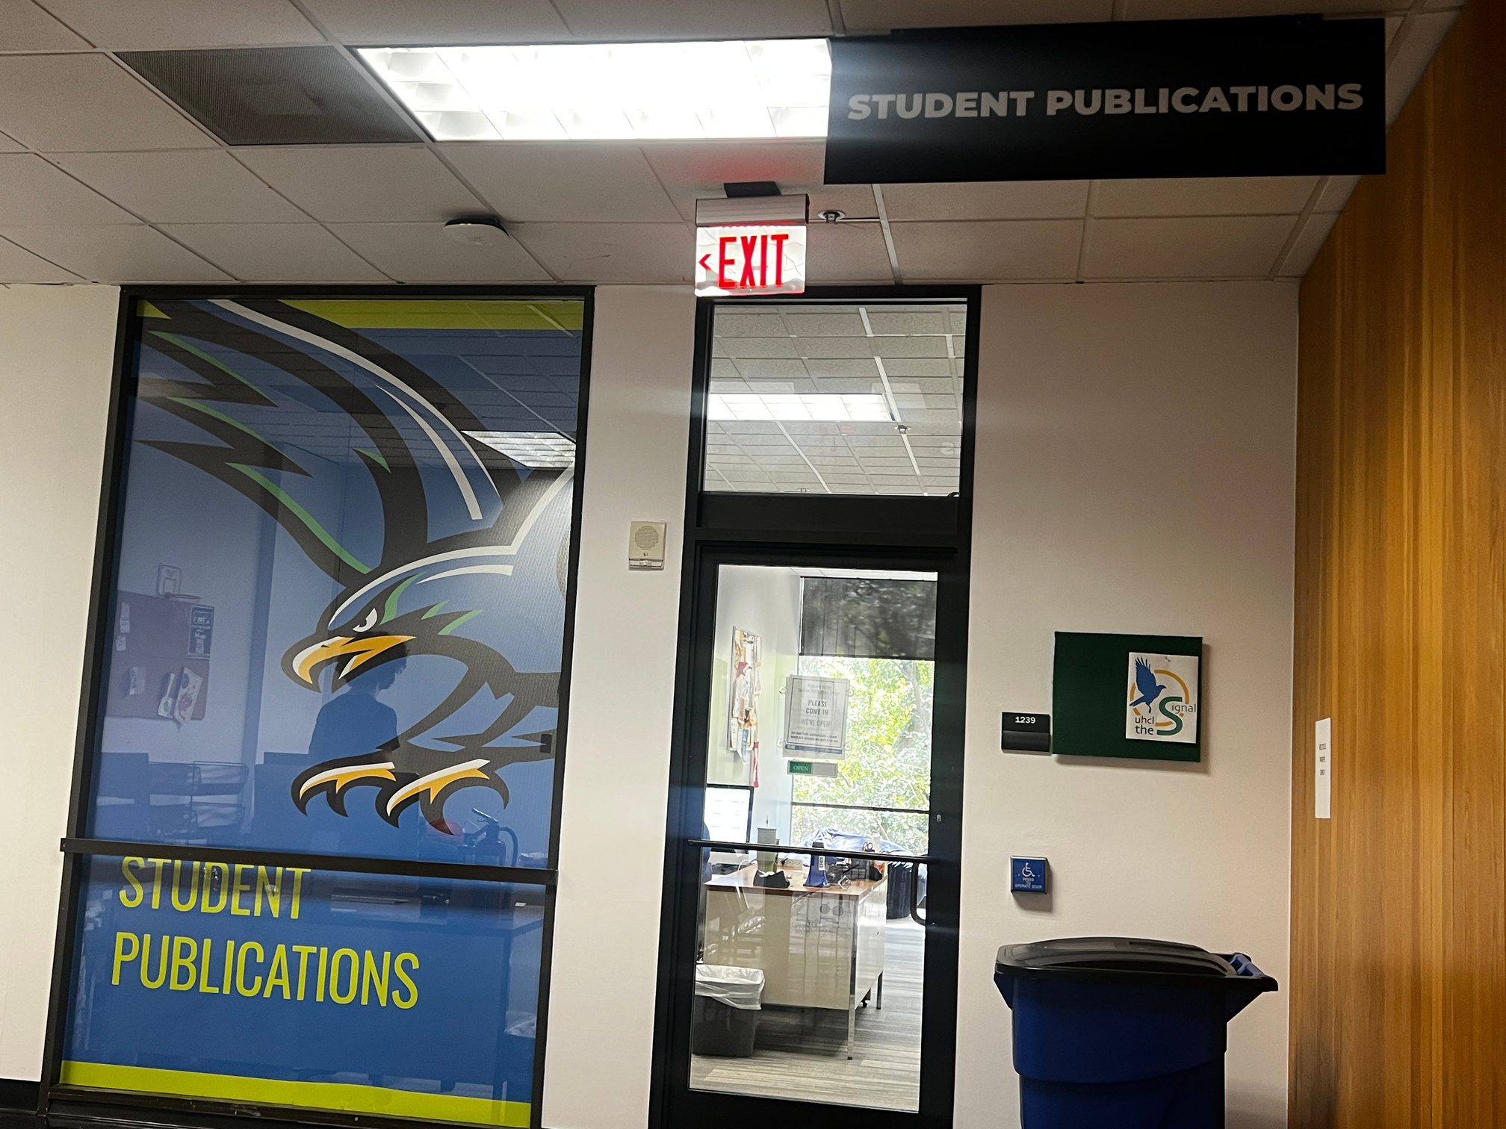
CHALLENGES
Staffing/ Beat Editors
As The Signal continues to grow, one of the foreseeable challenges is the number of editors on staff. Editors play a critical role in maintaining the quality, accuracy, and consistency of the publication. Without enough editors, it becomes increasingly complex to manage the expanding workload—from reviewing articles and fact-checking to coordinating deadlines and supporting writers.
SFAC PRESENTATION
Notes:
Lisa

Slide 8
OPPORTUNTIES
Expanding Student Media: This year, the Manager of Communications & Student Media and the editorial team are expanding The Signal to include video and photojournalism. This will give students of all majors opportunities for digital storytelling and skill building.
Establishing a Formal Faculty Advisory Board: Creating a faculty advisory board for the collegiate newspaper presents a strategic opportunity to strengthen the program both academically and operationally. A dedicated board made up of faculty members from diverse departments, such as journalism, communications, business, and design, can provide valuable guidance, mentorship, and institutional support to the student-led publication.
Advertisement: Introducing advertising to The Signal benefits both the publication and Student Media, offering a chance to generate revenue by selling ad space to local businesses and campus departments. This income can support hiring student contractors, expanding distribution, or enhancing digital content. Additionally, students gain valuable experience in media sales, marketing, client relations, and business operations, relevant to modern communications careers.
SFAC PRESENTATION
Notes:
Lisa
- Expanding Student Media
- Faculty Advisory Board
Severin
- Advertisement

Slide 9

BUDGET
SFAC PRESENTATION

Slide 10


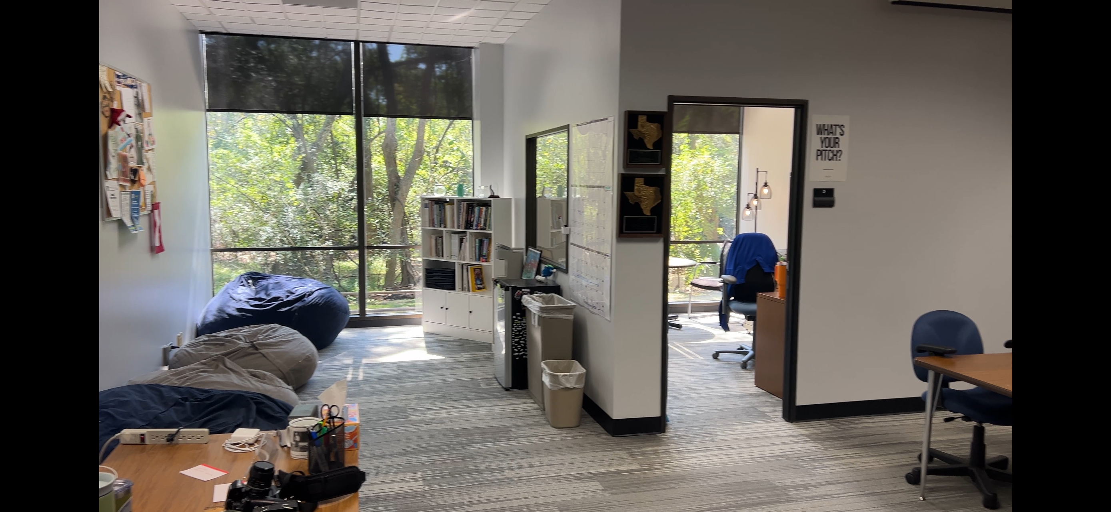
Professional Employee Salaries and Fringe Benefits
$88,304
Student Media Office Operations,
Student Contractor Pay and Student Travel
$48,872
$137,176
100% of Student Media’s funding source comes from student fees.
SFAC PRESENTATION
Notes:
Katrina

Slide 11
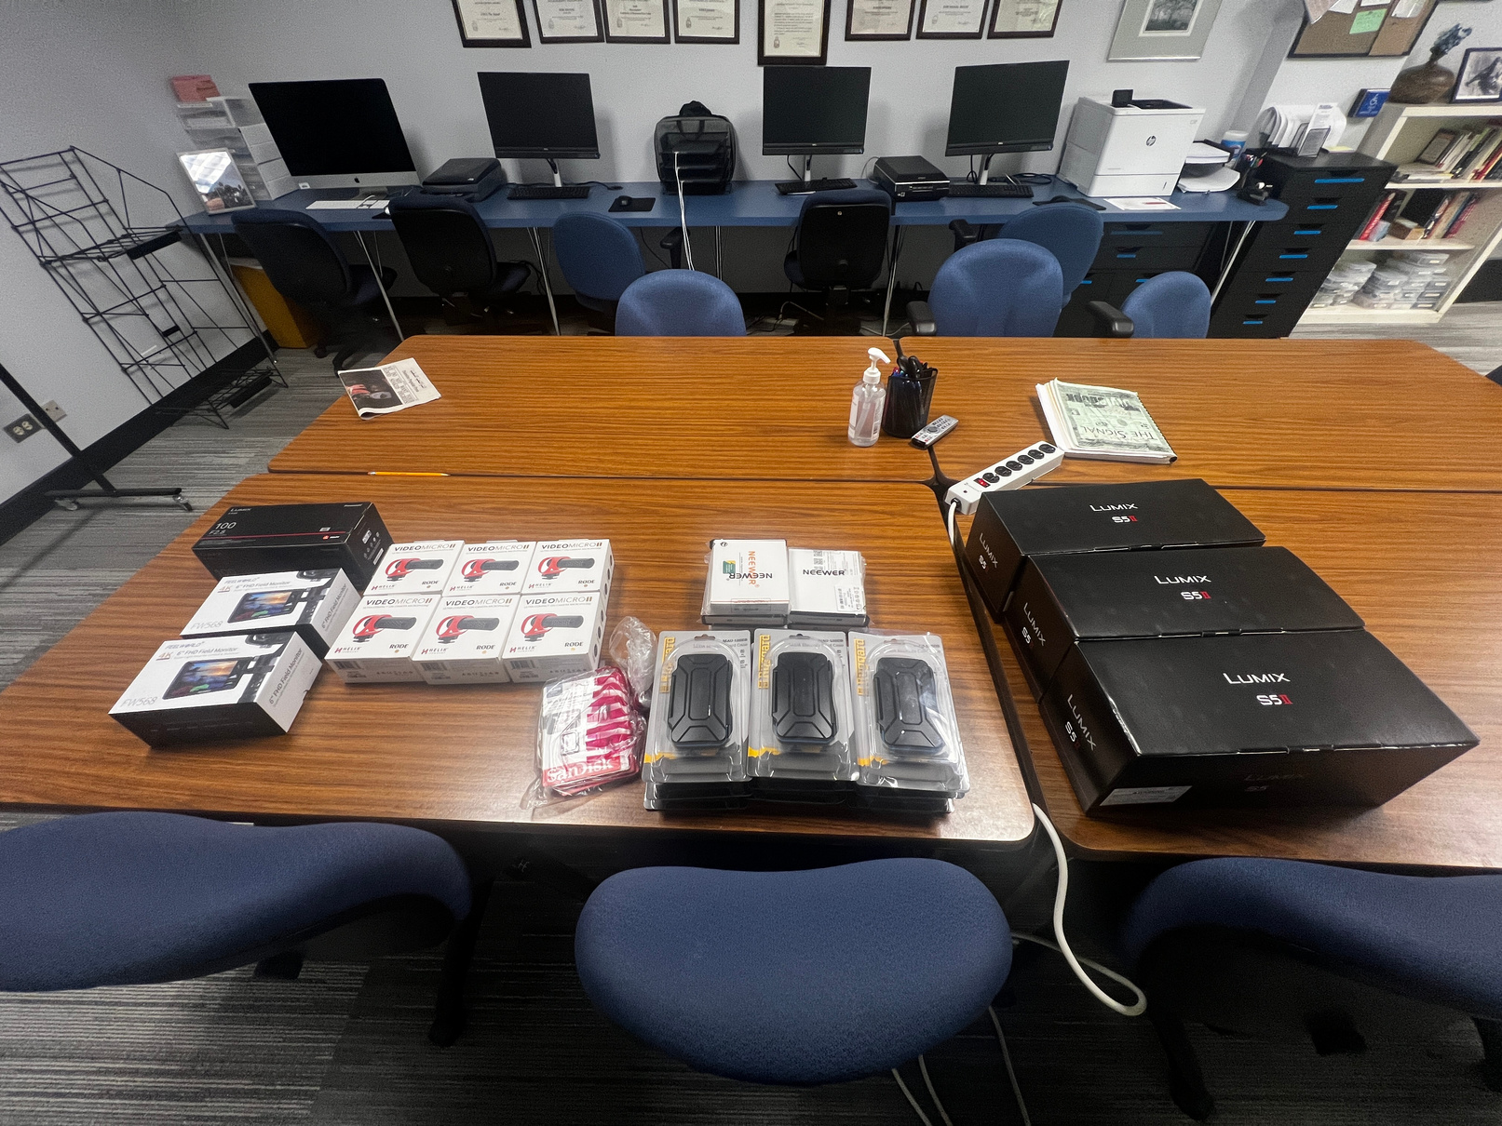
FY25 One Time Funding Usage
$8,449.97 / $15,000
Purchased:
(3) Lumix Cameras - $6,710.25
(1) 100 MM Lense - $794.00
(6) Shotgun Microphones - $351.00
(5) Battery Chargers - $140.45
(8) 256 GB Memory Cards - $175.04
(2) HDMI Attachable Monitors - $185.00
(9) Memory Card Cases - $94.23
Backorder:
(5) DJI Osmo 3 - $4,229.30
SFAC PRESENTATION
Notes:
Katrina

Slide 12
COST SAVINGS
5% Reduction
$7,113.10
Student Media would accommodate reductions inin paid student contractors by recruiting more contributors and forming additional partnerships with Communications courses. Additionally, we would review the number of students we can support through student travel.
SFAC PRESENTATION
Notes:
Katrina

Slide 13

PLAN FOR FY 26 & 27 ONE-TIME FUNDING
Total One-Time Funding Request for FY 26 & 27
$35,900
The Student Media one-time funding requests will:
Expand resources and areas of application for students
Provide professional development opportunities
Establish revenue sources to support additional student contractors
Establish connections internally and externally
Bring Student Media up to traditional standards
Increase visibility of our student journalists and UHCL
SFAC PRESENTATION
Notes:
Katrina

Slide 14
STUDENT MEDIA
ONE TIME REQUEST
FY 26 & 27
SFAC PRESENTATION

Slide 15

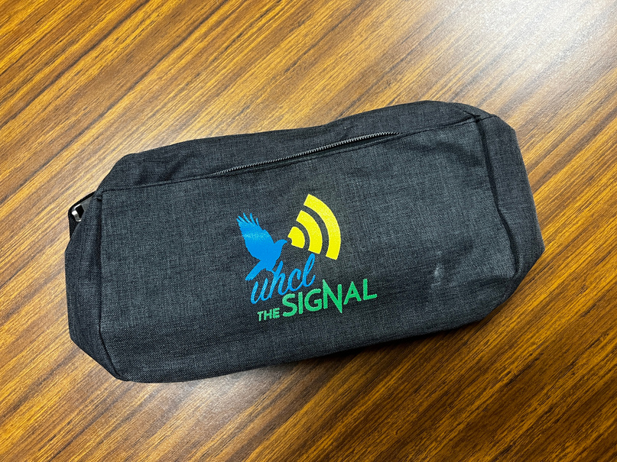
Student Media One Time Ask - FY26
$8,200
Podcasting Equipment: $2,700
Two Outreach Student Contractors tasked with building internal/external connections : $3,500
Signal Promotional Items for tabling and campus/community outreach events: $2,000
FY26
SFAC PRESENTATION
Notes:
Lisa
- Podcast
Severin
- Outreach Cordinators
- Promo Material

Slide 16




Student Media One Time Ask - FY27
$27,000
Two Outreach Student Contractors tasked with the establishment of a Consistent and Self-Sustaining Advertising Infrastructure
$12,600
Fall National College Media Convention
$8,400
Mailchimp
$1,200
Signal Promotional Items for tabling and campus/community outreach events
$3,000
Printing Budget of Newspapers
$2,500
FY27
SFAC PRESENTATION
Notes:
Severin
- Outreach/ Ad Contractors
- Mailchimp
- CMA
Sergio
- Printing
Lisa
- Promo Material

Slide 17

QUESTIONS
SFAC PRESENTATION
Notes:
Katrina

Slide 18
THANK
YOU
STUDENT MEDIA SFAC PRESENTATION
FY2027

