Slide 1




STUDENT FEE ADVISORY COMMITTEE (SFAC)
VISION
BUDGET PROPOSAL
OCTOBER 16, 2025
To empower every student at the University of Houston-Clear Lake by fostering an inclusive and responsive environment where diverse voices are heard, academic excellence is pursued, and meaningful connections are built. We strive to be a catalyst for positive change, advocating for student needs while navigating the complexities of university governance, ensuring that all students feel valued and engaged in their educational journey.
MISSION
The Student Government shares the goal of the University of Houston-Clear Lake to produce students who are enriched by their university experience and who are afforded the widest opportunities for personal and professional development. The Student Government recognizes the need to provide a more responsive environment for students entering academia. Therefore, the mission of the Student Government, as it relates to the strategic design of the university, is to join the university in its efforts to create a climate which fosters academic excellence.

Slide 2
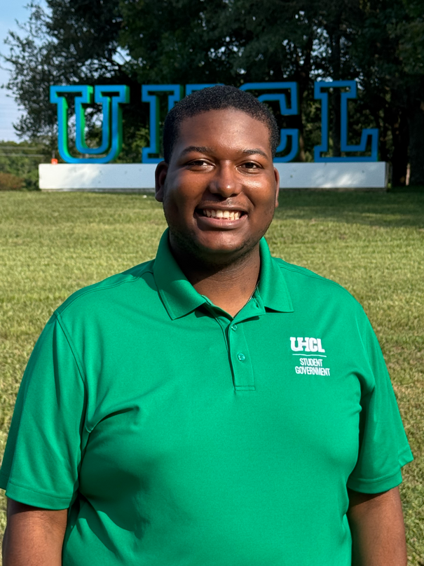
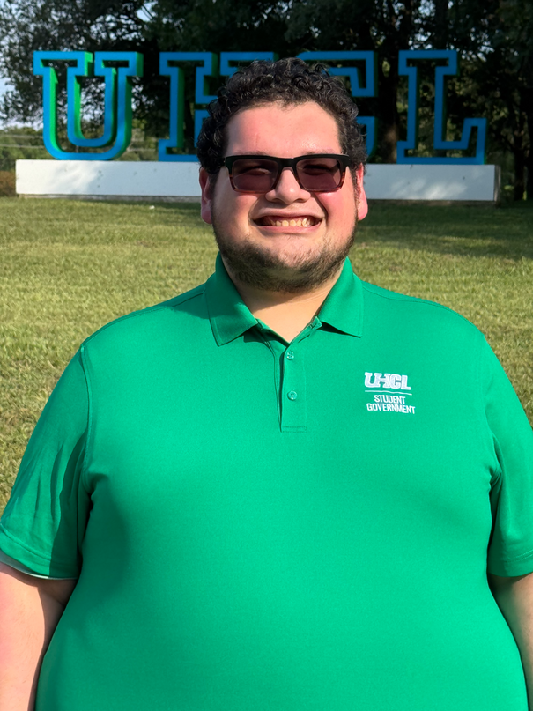

STUDENT GOVERNMENT
Student Government currently cosnsits of the President, 3 Vice Presidents, and four Senators, with every college being represented in the Senate. Student Government is a growing body on campus and we are excited to continue carrying it forward!
EXECUTIVE COUNCIL
Zachary Sheriff - President
Misael Gamez - VP
Charenna Kona - VP
Vacant - VP
STUDENT SENATE
Sunny Dhanjal - COB Senator
Vilmar Cerda- COE Senator
Tega Eshareturi - CSE Senator
Philip Abraham - CSE Senator
Vacant - HSH Senator

Slide 3


BUDGET WORKSHEET:
FY24-25 ACTUAL EXPENSES
FALL 2024 EXPENSES - Supported by Student Fees | EXPENSE
Executive Council Salary/Wages | $12,164
M & O
Signature University Events, Outreach Initiatives, and Promotions (Commuter Appreciation Week, DVA Event, President’s Luncheon, Senate Tabling, General Assembly Meetings, Halloween Fest, Chili Cook-off, Weeks of Welcome, etc.) | $6,516
Office Supplies | $1,333
Uniforms (Polos, T-Shirs) | $2,138
Professional Development (ASGA Virtual Conference, ASGA Membership Dues | $1,533
Misc. (Late fees, travel, name tags) | $108
Total | $11,890

Slide 4
FY25 & FY26 APPROVED FUND REQUESTS
FUND REQUEST YEAR | APPROVED
FY24-25 | $25,860
FY25-26 | $27,920

Slide 5







How does SG support the mission of Student Affairs and UHCL?
Advocacy
Outreach
Organize
WHAT HAVE WE LEARNED?
12
General Assemby Meetings
10
Department/ RSO Collaborative Partners
7
Senate Initiatives
37 Total
Outreach Initiatives, Events, and Meetings
Senate Survey
Senate/Dean Meetings
  103 Participants
  94% (97 of 103) were satisfied with their courses.
  Students want more class sections taught by different professors to have options in schedule, teaching style, and difficulty level.
  Improved COE Field Placement Processes
  Worked with COE to get Bi-lingual Education Workshops aligned with student availability
  Interest raised in creating new graduate programs in special education to meet student demand and career goals

Slide 6
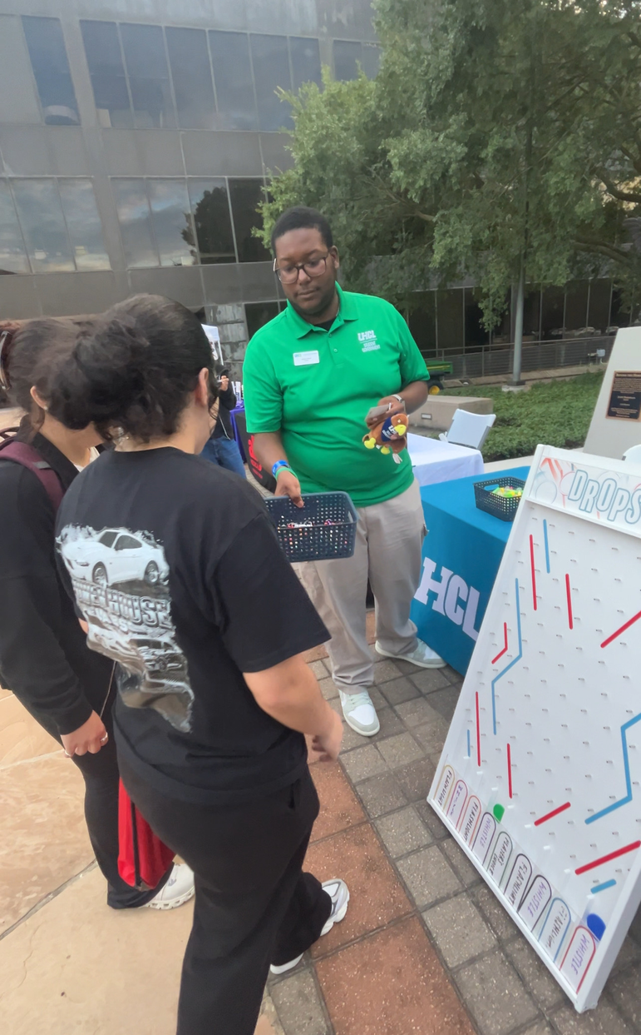
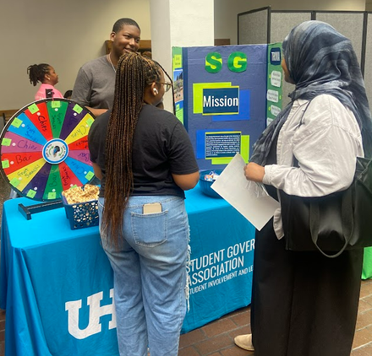
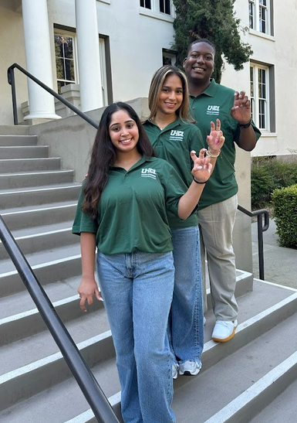
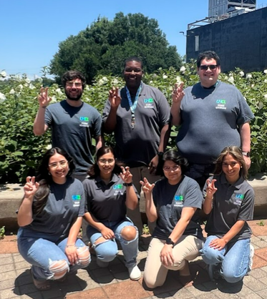
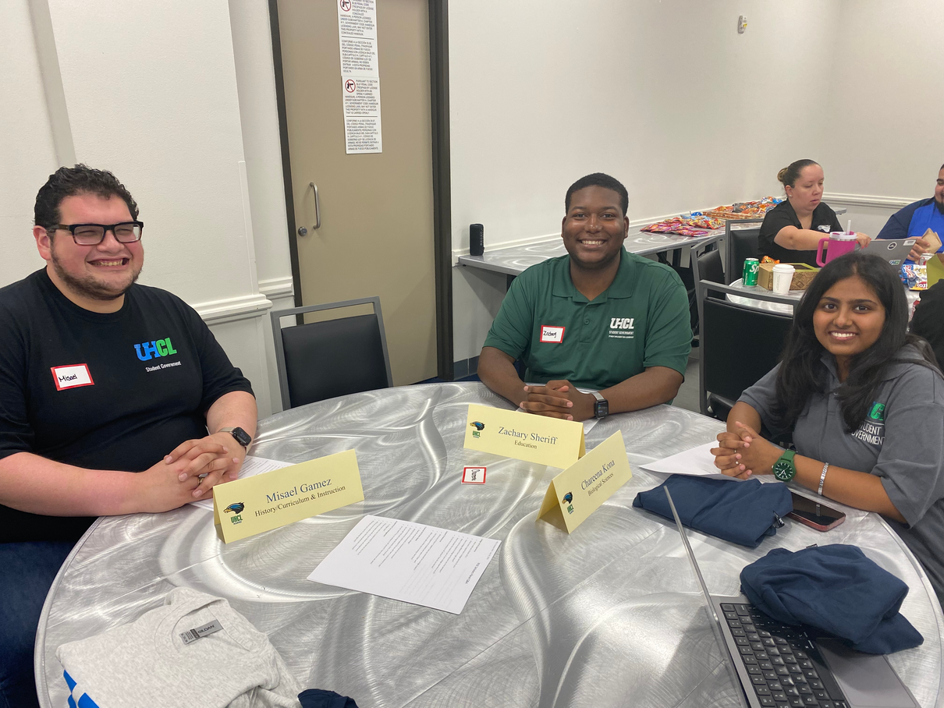
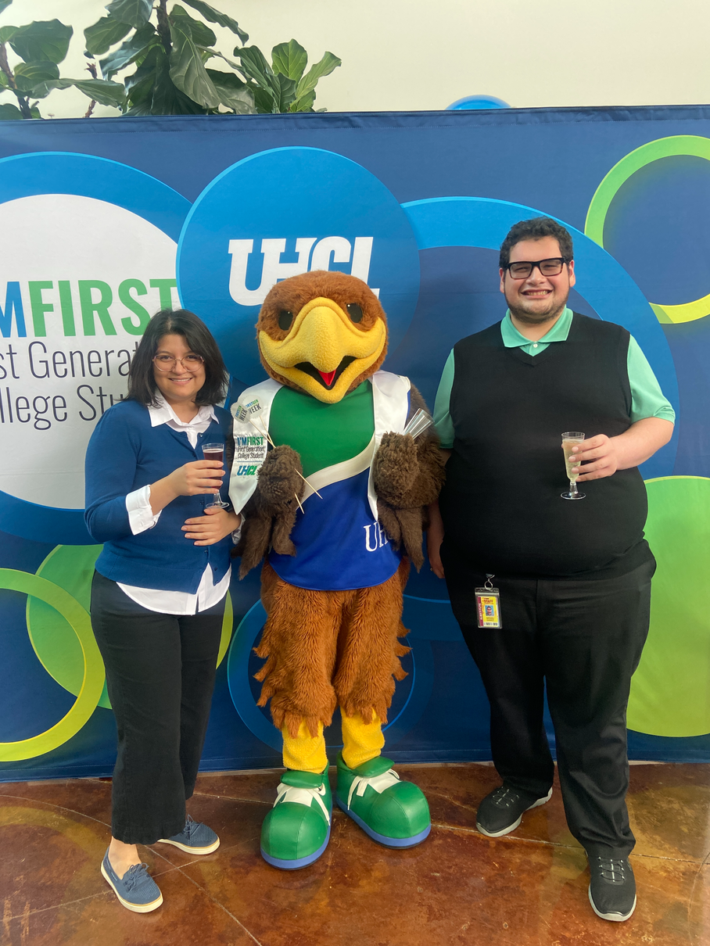
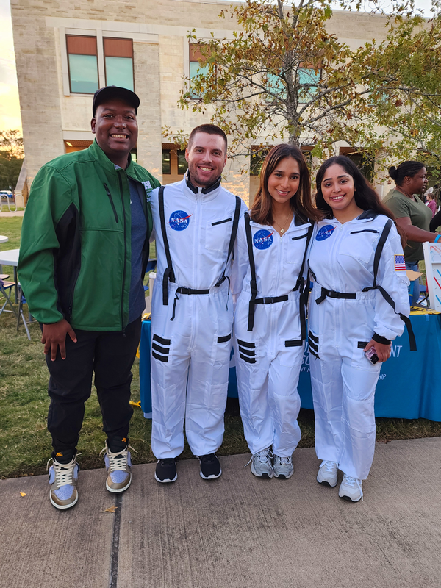
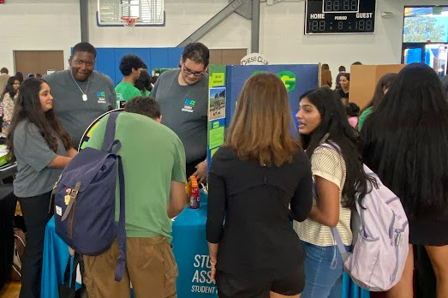
FY 24-25 ACCOMPLISHMENTS
  Weeks of Welcome Orientation Sessions
  Welcome Back Bash
  Student Organization Expo
  Commuter Appreciation Week
  SG Domestic Violence Awareness Event
  Halloween Fest
  Lighting at the Letters
  SG President’s Luncheon
  Chili Cook-Off
  Committee Meetings
  Monthly Meetings with Administration
  Bi-Monthly General Assembly Meetings
  SG EC & Senate Retreat & Transition Meeting
  ASGA Virtual Training
  Common Hour Resolution
  Senate Tablings
  Senate Survey
FY 25-26 NEW INITIATIVES
  “Ask Your Senator” Office Hours
  Constitution Adoption
  Domestic Violence Awareness Ally Workshop

Slide 7



CHALLENGES & OPPORTUNITIES
  SG Model Transition
  Common Hour
2. Incentives for Senate
2. Senate Outreach Tabling
3. Committee Recruitment
3. New Constitution

Slide 8


FY24-25 SWEPT FUNDS
Student Government returned $5,313 in funding for FY25. Funding was unspent in salary/wages and from the professional development trip to the NACA Student Government Institute. SG was waitlisted upon NACA registration, and did not attend due to limited room and board. Additionally, delays in hirings and EC vacancies contributed to unspent funds.
FUNDING | ACTUAL | DESCRIPTION
Salary/Wages | $5,846 | Funding was unspent in salary/wages. Delays in hirings and EC vacancies contributed to unspent funds.
M/O Travel/Professional Development | $9,774 | Funding was unspent on travel/professional development trip to the NACA Student Government Institute. SG was waitlisted upon NACA registration, and did not attend due to limited room and board.
Returned/Rollover | ($10,307) | Rollover approved for Travel/Professional Developmemt
Total Swept | $5,313

Slide 9


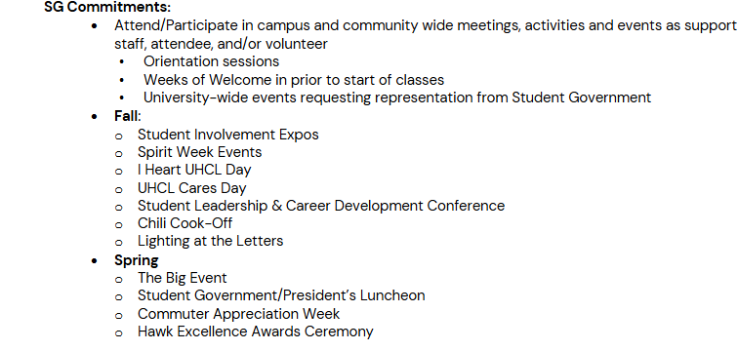
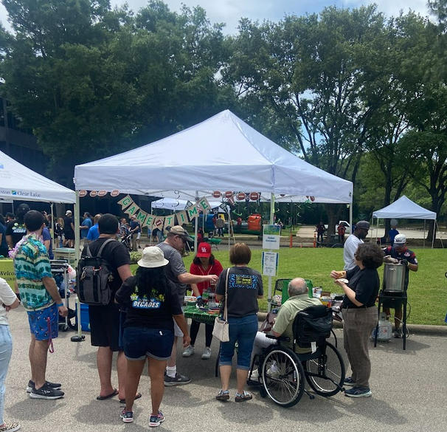
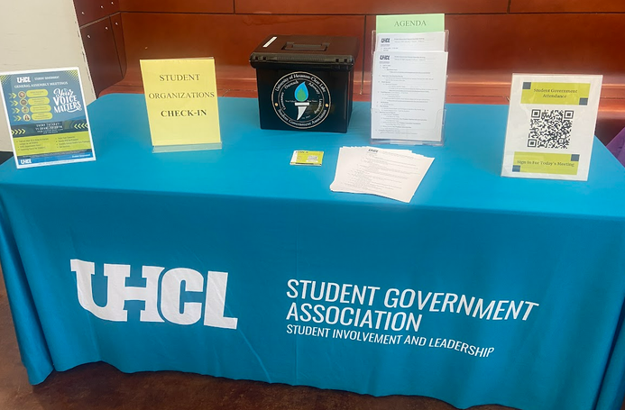

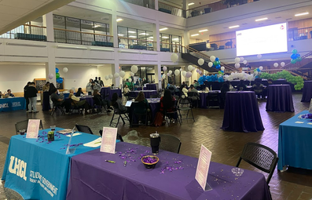

WHY REQUEST FUNDING? SG OFFICER POSITION AGREEMENT

Slide 10
NEW FY25-26 FUND REQUESTS
REQUEST | COST | Description
ASGA Annual Membership | $600 | Provides Student Government (SG) with access to national resources, best practices, and networking opportunities that strengthen campus governance, leadership development, and student engagement throughout the year. SG has been an ASGA member for several years.
ASGA Virtual Training Conference | $900 | Offers comprehensive leadership and professional development training for SG officers, senators, committee members, and interested students. Participation enhances leadership skills, teamwork, and recruitment by connecting students to national peers and governance experts. This training is virtual and will be open to all students.
Total | $1,500

Slide 11
NEW FY26-27 FUND REQUESTS
PROJECT | EXPENSE | DESCRIPTION
EC salary/wages | $12,000 | $12,000 ($18,300 wages - $6,300 base funding = $12,000 to be requested)
Professional Development | $10,000 | $2,500 lodging/airfare/meals x 4 EC members = $10,000
SG Signature Events | $4,000 | $2,000 Fall/$2000 Spring to support general assembly meeting food, Domestic Violence Awareness event, Weeks of Welcome student activity, Chili cook-off, President’s Luncheon, SG Day, SG transition meeting, retreats, Senate/Committee Rep trainings, meetings, Senate Tabling refreshments, etc.
Promotional Items | $4,000 | These items will help with brand recognition and help students become more aware of our outreach and advocacy on campus.
EC Parking Passes | $420 | $105 Parking permit x 4 EC officers: EC participation is required at campus events, admin meetings, speaking engagements, even on days they may not have class. Parking passes will allow the future cohorts of Student Government leaders to have close access to campus and be able to attend the functions, events, and meetings in a timely manner.
Total | $30,420

Slide 12





BUDGET
REDUCTION
SG has $2,000 in base funding.
A 5% reduction is $100.
SG would limit purchases of food and office supplies.

