Slide 1



Center For Student Engagement
SFAC FY27 Funding Request

Slide 2


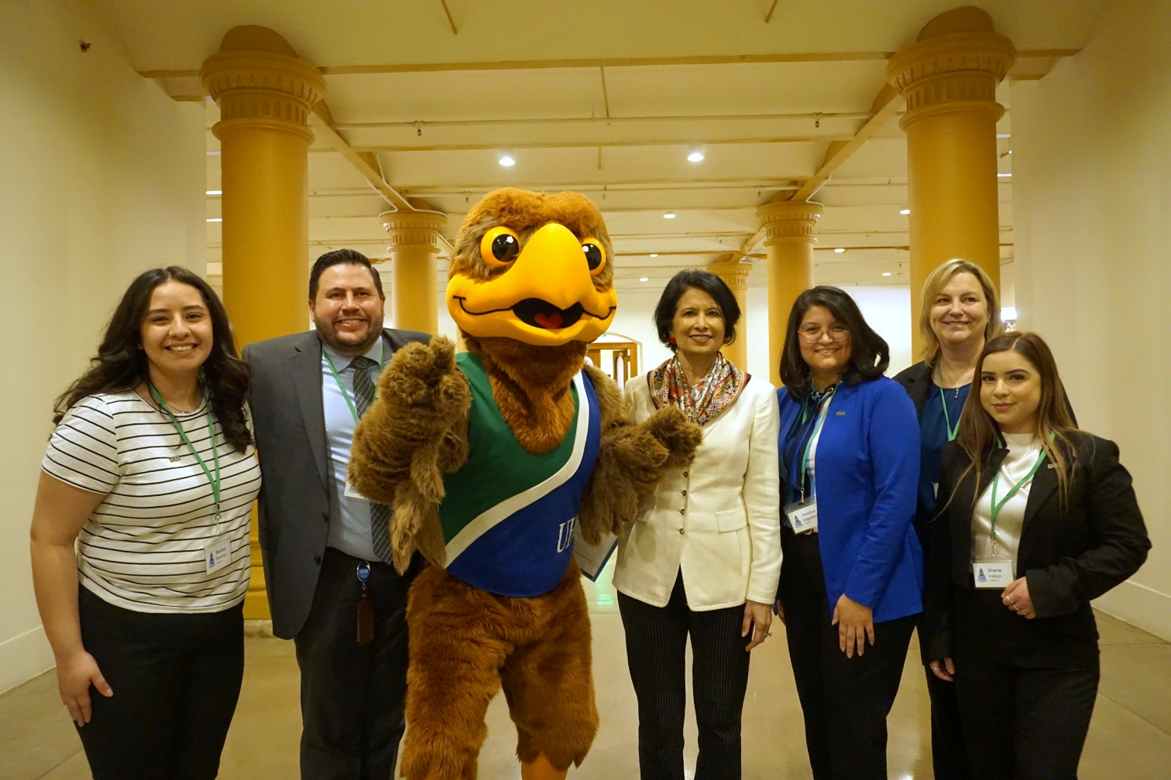

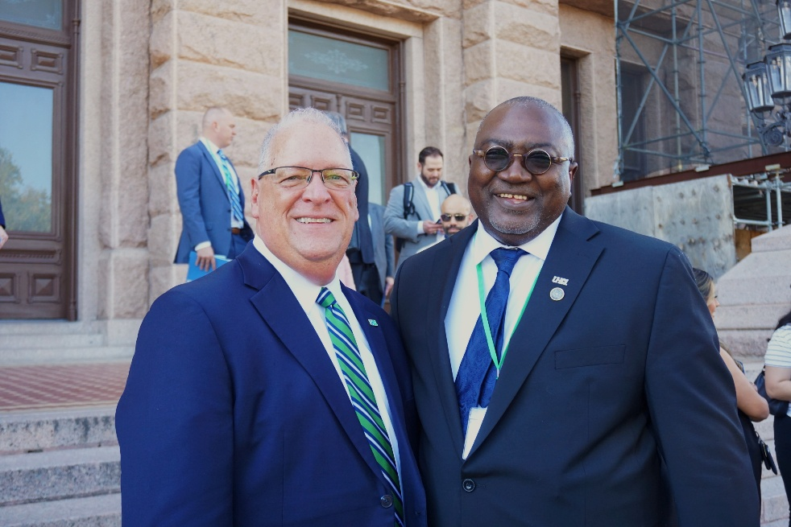
Center For Student Engagement
Mission
The Center for Student Engagement (SE) enriches student success by creating vibrant, co-curricular experiences that build community, foster leadership, and extend learning beyond the classroom. Through purposeful programs, spirited traditions, and campus partnerships, we help students connect, grow, and lead. We empower students to make an impact at UHCL and in the world.

Slide 3

SE Programs & Services
Campus Activities & Traditions – Bash, Homecoming, Lighting of the Letters
Student Organizations – Support, advising, risk management
Leadership Development – HLI, Conference, trainings/workshops
Civic Engagement – Cares Day, Service Week, voter engagement
Community Engagement – First-Generation and Community Building Initiatives

Slide 4

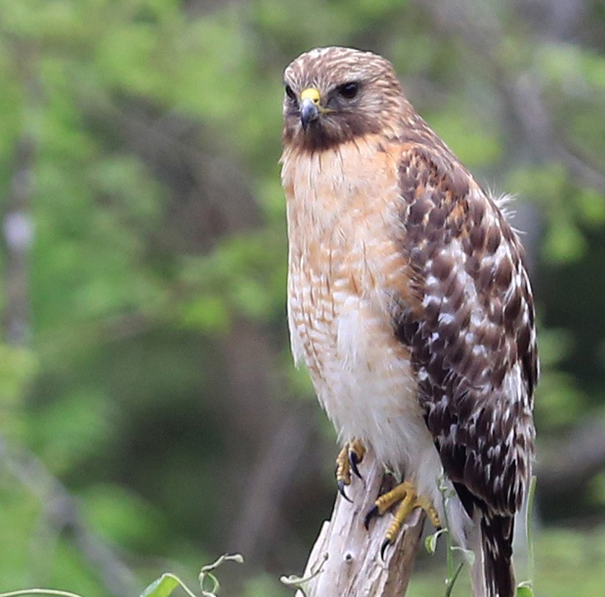
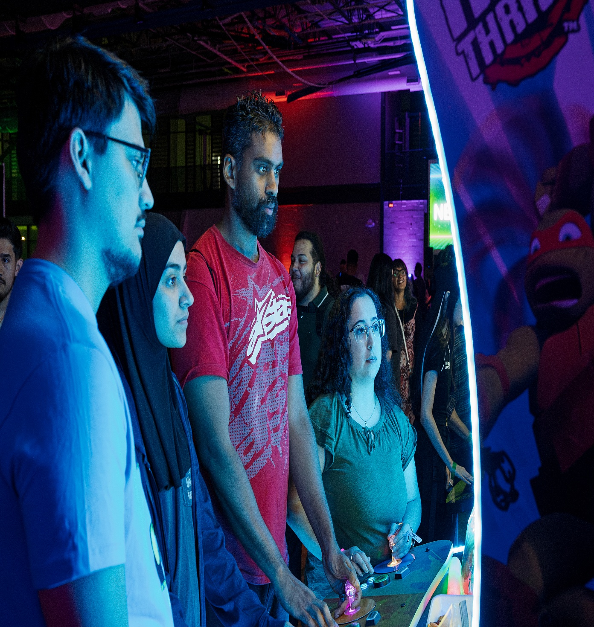



Our Impact in Action
Student engagement is the heartbeat of campus life
Key Metrics (FY25):
1,100+ participants at Homecoming Week
Welcome Back Bash Continued Success
370 at Altitude: Neon Night
81 active student organizations
Launch of Service Week
27th Annual Student Leadership and Career Development Conference

Slide 5

Growth & New Initiatives
HawkLink – Student Engagement Platform
HLI Welcomes Largest Cohort
Growth of Campus Traditions
Community-Building Initiatives
Lounge Spaces – Activating Spaces
Spirit Programs

Slide 6

Challenges & Opportunities
How we Improve
Challenges
Expanding Campus Traditions
Meaningful assessment Data
Opportunities
HawkLink Platform
Activation of Lounge Spaces
Growth of Spirit Programs

Slide 7
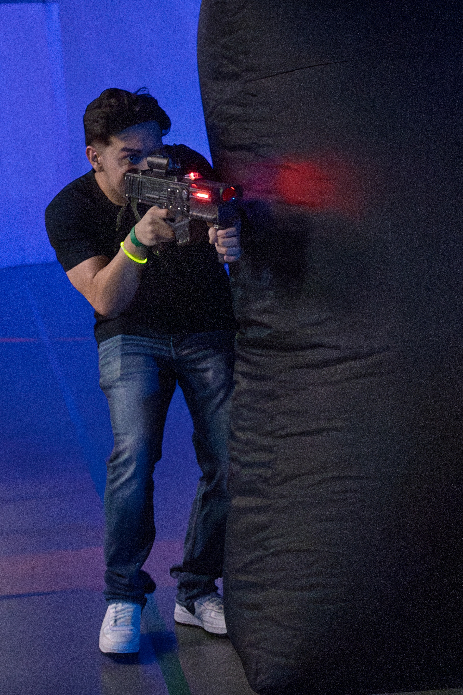



Budget Overview
25-26 Breakdown
SSF – Base Funds: $608,563
SSF – One Time: $35,000
SSF – Rollover: $35,963
Designated Fund: $3,878
Fund Balance: $5,808
Total: $689,212
Usage
Salary & Wages: $392,840
Fringe: $97,756
M&O – General: $188,617
M&O Travel: $10,000

Slide 8
Total FY26 Request: $30,000
Spirit Programs – $30,000 Purpose: Redeveloping and expanding spirit programs to energize campus life, unify traditions, and build pride.
Breakdown:
Uniform packages & performance gear – $2,800
Safety panels – $1,600
Tumble track – $150
Spirit signage & marketing – $1,000
Competition & certification costs – $2,150
Space needs & training – $1,500
Travel & Cheer Camp – $8,000
Performance coach – $2,500
Mascot & Flight Crew updates – $10,250

Slide 9
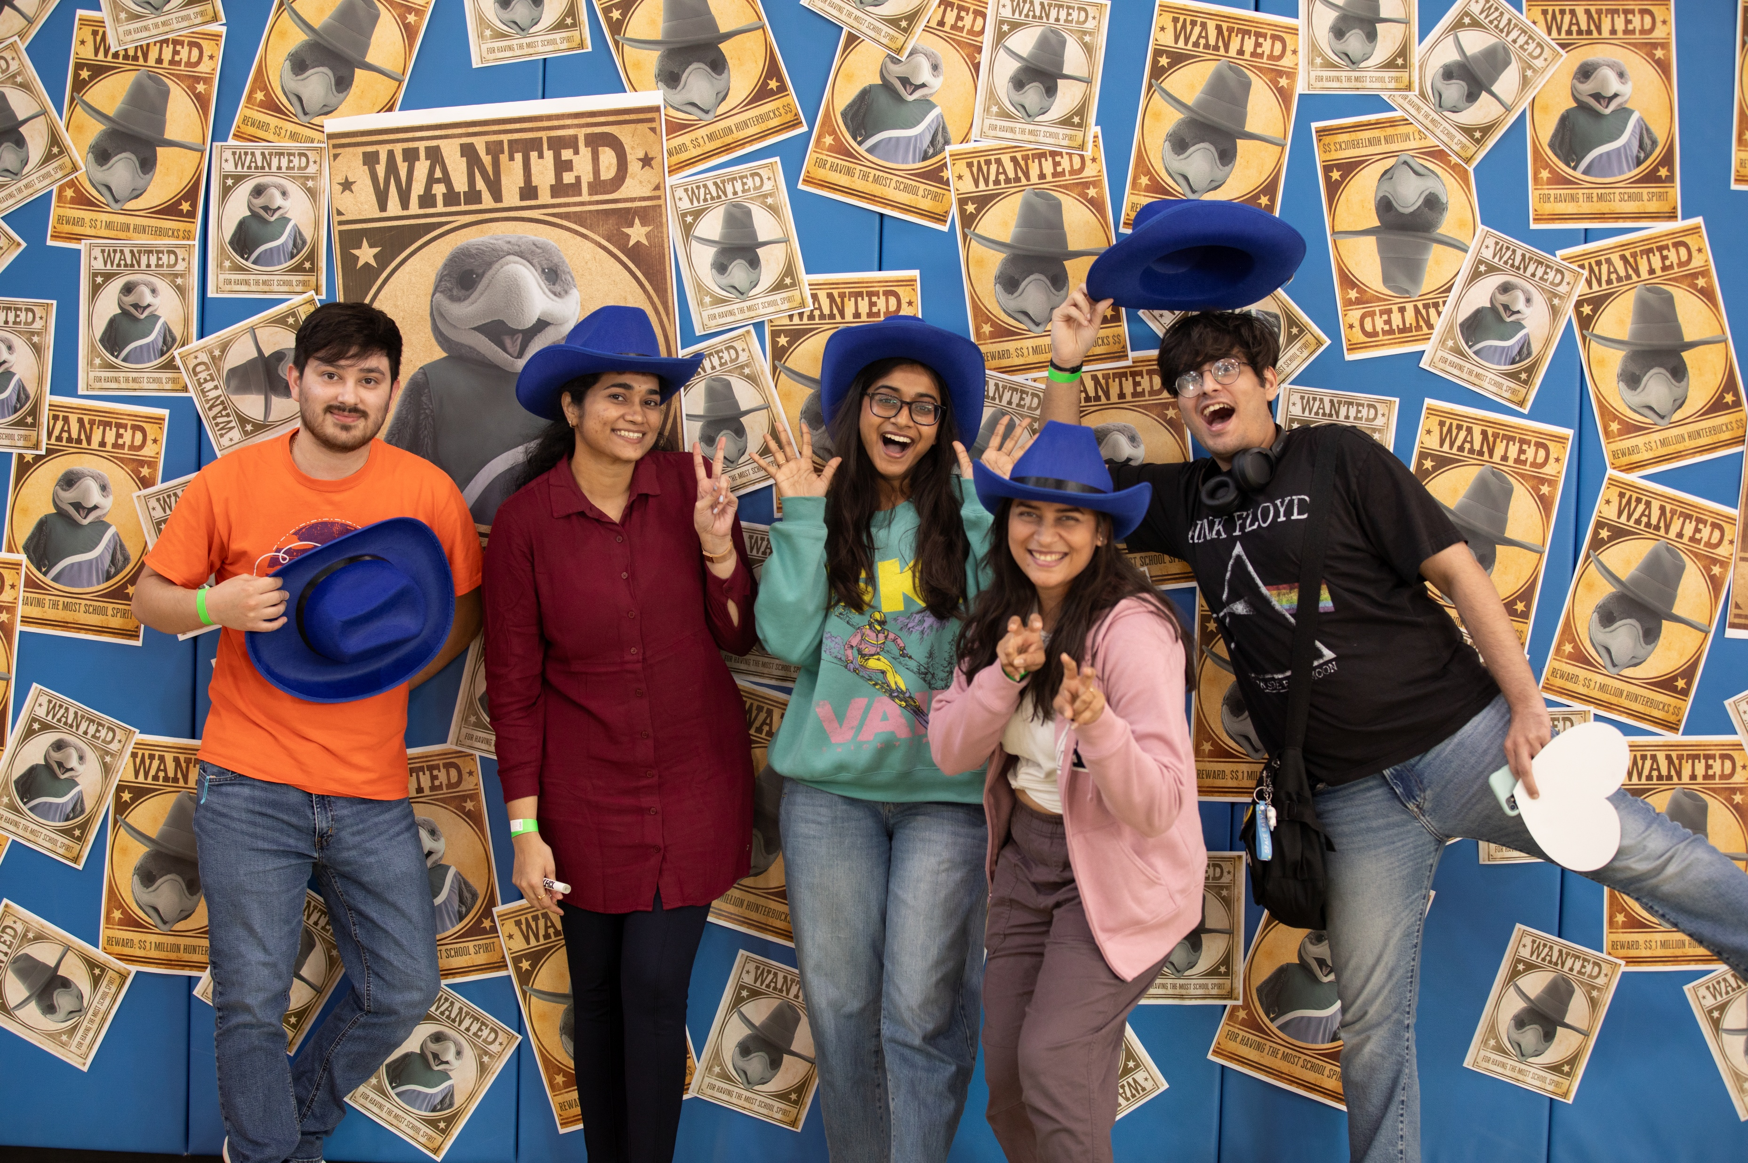
Total FY27 Request: $105,500
Purpose: To expand engagement, leadership, and community connection across the full student lifecycle.
Category | Amount | Purpose
Homecoming | $20,000 | Strengthen UHCL’s largest campus tradition
Altitude | $10,000 | Celebrate year-end success and graduates
Welcome Back Bash | $10,000 | Launch engagement early each fall
First-Year Experience LLC | $15,000 | Support new students’ transition and retention
Graduate Assistant | $14,500 | Sustain student organization support
Student Staffing (Evening/Weekend) | $13,000 | Extend access to SOCAL & Lounge
National First-Gen Week | $5,000 | Celebrate and engage first-gen students
Alternative Break/Service Learning | $10,000 | Develop civic leadership & service mindset
Spirit Programs Continuation | $8,000 | Maintain training, space, and coaching support

Slide 10
Fiscal Responsibility & Adaptability
If faced with 5% reduction ($29,688):
Prioritize signature programs (Homecoming, Bash, HLI)
Reduce professional development
Adjust student staffing and secondary programs first
Leverage partnerships and shared marketing

