Slide 1
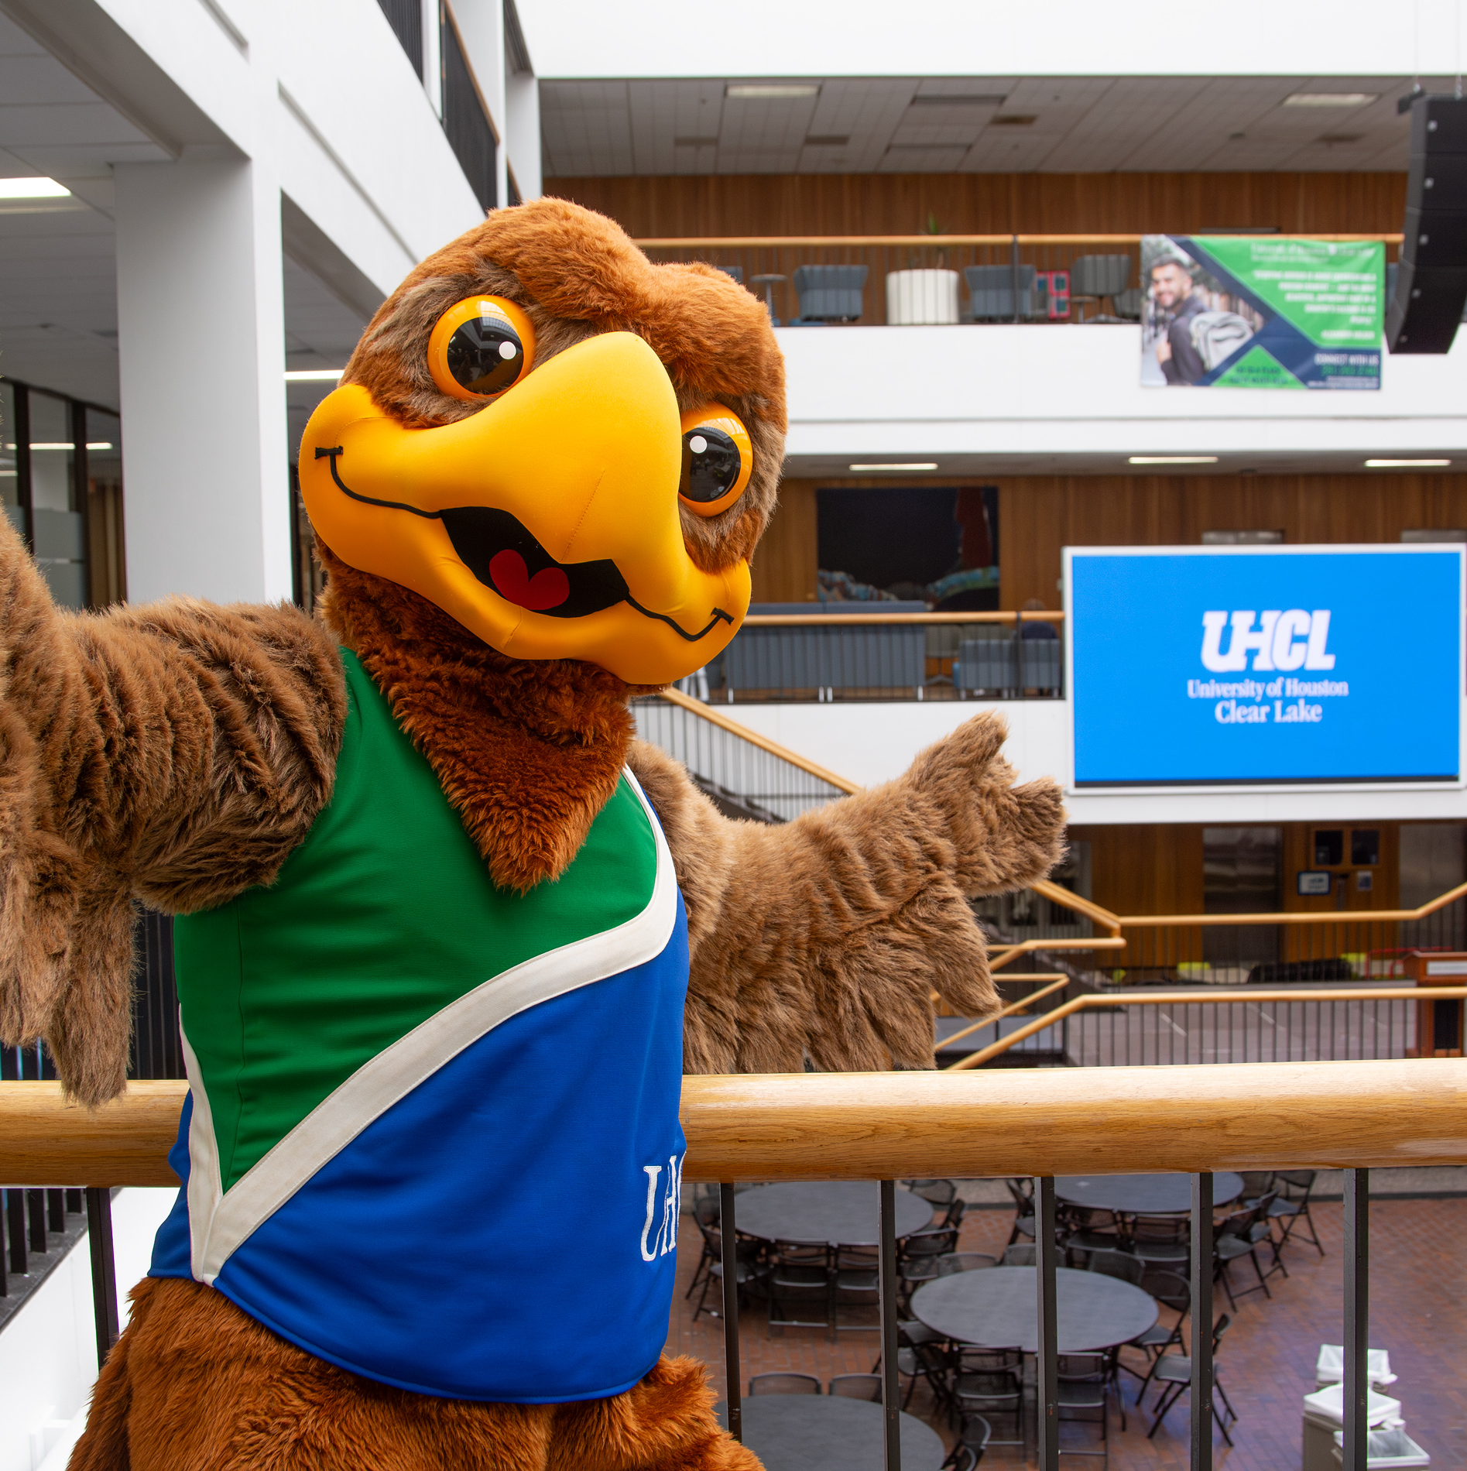
SFAC Presentation: Division of Student Affairs

Slide 2
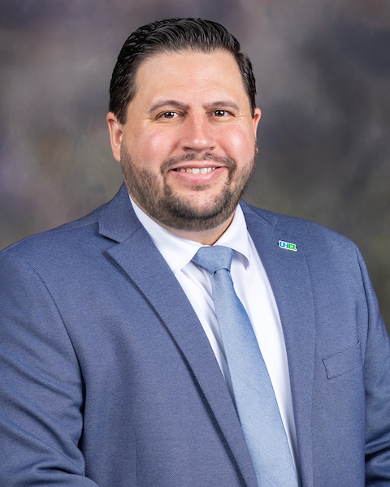

PRESENTER
Dr. Andrew Wiemer
Assistant Vice President

Slide 3





About DSA
Mission
The Division of Student Affairs strives to create empowering experiences that strengthen the educational journey for UHCL students. Through our programs, support services, and other resources, we commit to building a supportive, engaging community that cultivates personal development and success for all students.
Vision
Accommodating all students through individualized and meaningful experiences that brings comfort and life to their UHCL journey, while preparing them to positively contribute to campus and society.
Strategic Objectives
Provide high impact experiential learning opportunities and services.
Facilitate meaningful experiences that promote a desire for life-long learning.
Develop initiatives designed to inspire positive social functionality.

Slide 4

OVERVIEW DSA Data
Overall DSA Programming (September 1, 2024 – August 31, 2025)
456 events
13,285 documented attendance touchpoints.
Weeks of Welcome (WOW) – Fall 2025
17 Departmental Events
23 Campus-Wide Open Houses (an increase from 11 in Fall 2024).
2,000+ documented student touchpoints in FY25.
What’s the Scoop?, Ice Cream Social – 213 Students
Hawk Welcome Crew and Welcome Tables
Bayou Building – 784 student touchpoints
SSCB – 617 student touchpoints

Slide 5
OVERVIEW DSA Data
Communications and Outreach
The Division also provides centralized communications to ensure students are aware of programs, services, and opportunities.
Utilization data for FY25 includes:
207 communications and marketing requests completed.
274 Hawk Headlines submissions processed.
55 campus-wide email requests
19 divisional-wide email requests distributed.

Slide 6
FY25 and FY26
Funding Utilized
ONE - TIME

Slide 7
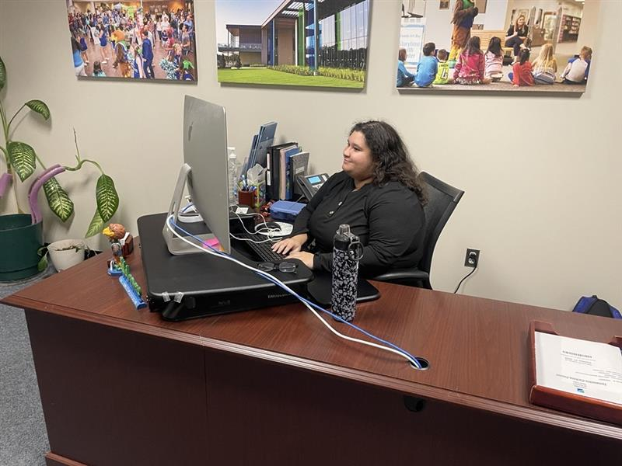
Divisional
Requests
FY25 and FY26 Funding
DSA Student Workers
$22,000
Funds two student worker positions in the Office of the Vice President for Student Affairs
Respond to high demand for communications services (207 marketing requests, 274 Hawk Headlines submissions, 55 campus-wide email requests, and 19 divisional-wide email requests in FY25).
Provide professional and welcoming service at the front office of the Vice President for Student Affairs.
Assist with divisional programming, event preparation, and student outreach.
The continuation of this funding allows the Division to maintain operational capacity, enhance communication efforts, and provide valuable employment experiences for UHCL students.
FY25 and FY26 Funding
Request – FY27
Request – FY26 Spring
Overview of Requests

Slide 8
FY27
New Divisional Requests
ONE - TIME

Slide 9
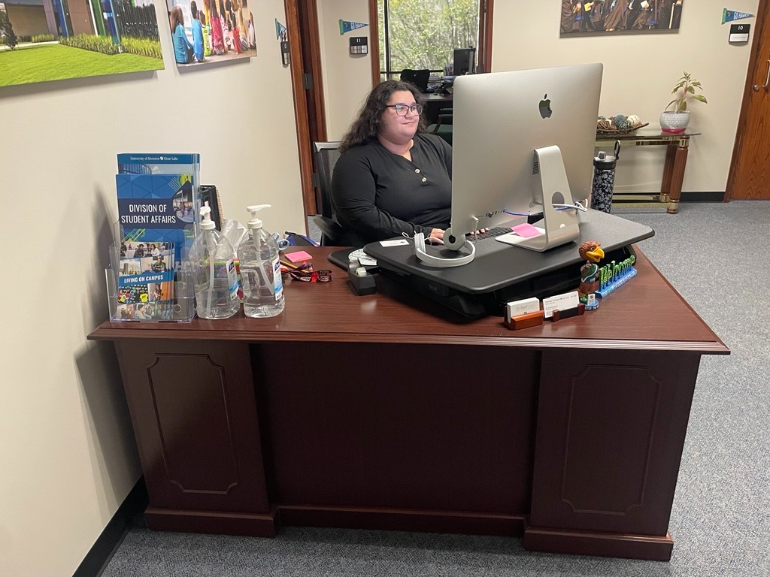
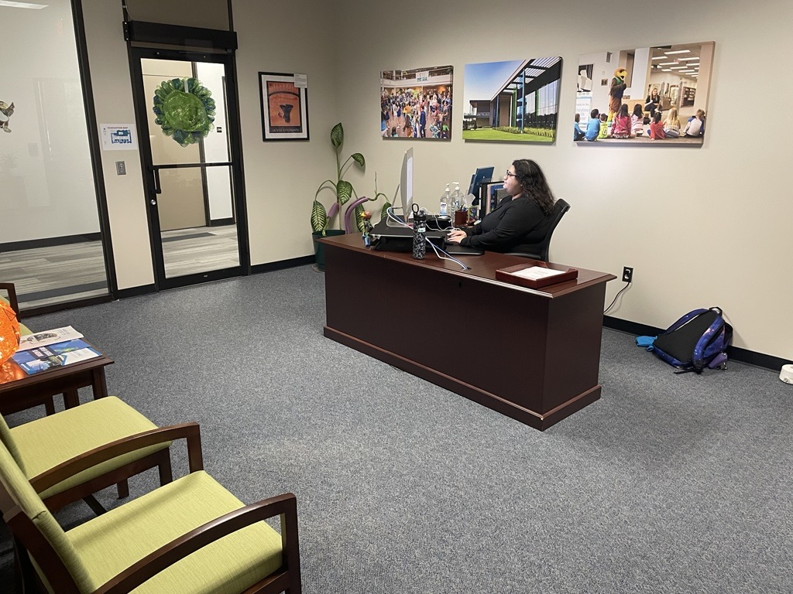
Divisional
Requests
DSA Student Workers
$22,500
Purpose:
Fund two student worker positions in the Office of the Vice President for Student Affairs
Justification:
Provide critical support for:
  Divisional communications
    Design and Marketing
    Hawk Headlines
  Daily operations of office
Support DSA Communications workload:
  207 marketing requests
  274 Hawk Headlines
  55 campus-wide & 19 divisional emails (FY25)
Maintain operational efficiency and service quality
Request – FY27
FY25 and FY26 Funding
Request – FY27
Request – FY26 Spring
Overview of Requests

Slide 10

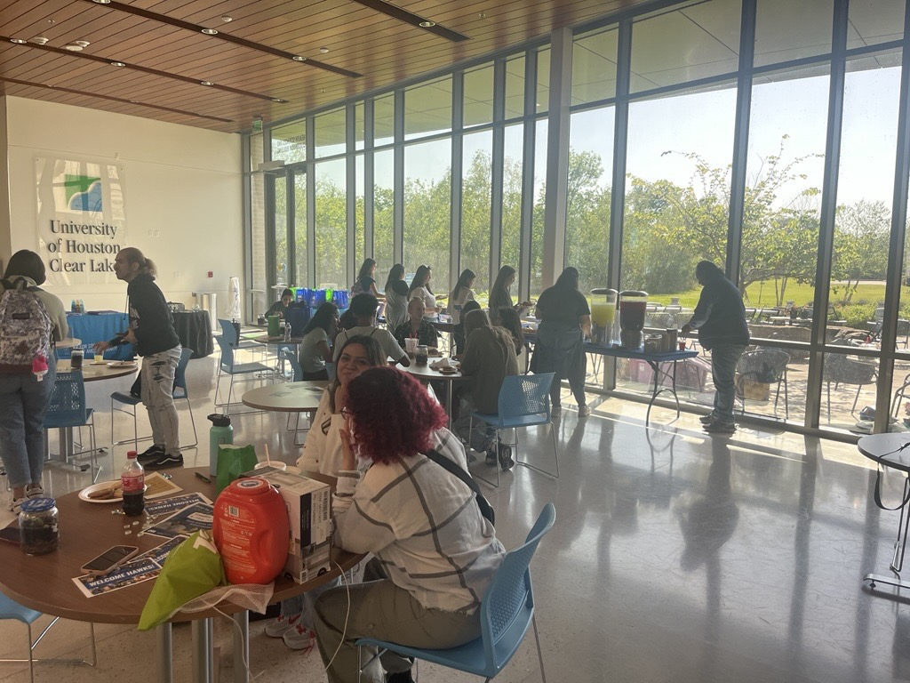
Divisional
Requests
Pearland Student Affairs Programming
$14,000
Purpose:
Sustain engagement initiatives at UHCL Pearland
$7,000 per semester (previously funded by SFAC in Student Engagement – FY26)
Justification:
Supports expanded programming by full-time Pearland staff
FY25 and FY26 activities have included:
  Coffee Bars, Homecoming Celebration, Cookie Breaks, Resume Workshops
  Pizza Events, Taco Night, Finals Week programming
Demonstrated strong participation and demand
Provides engagement experiences for Pearland students
Funding covers supplies, food, giveaways, and marketing materials
Departments can apply for funding through DSA
Request – FY27
FY25 and FY26 Funding
Request – FY27
Request – FY26 Spring
Overview of Requests

Slide 11
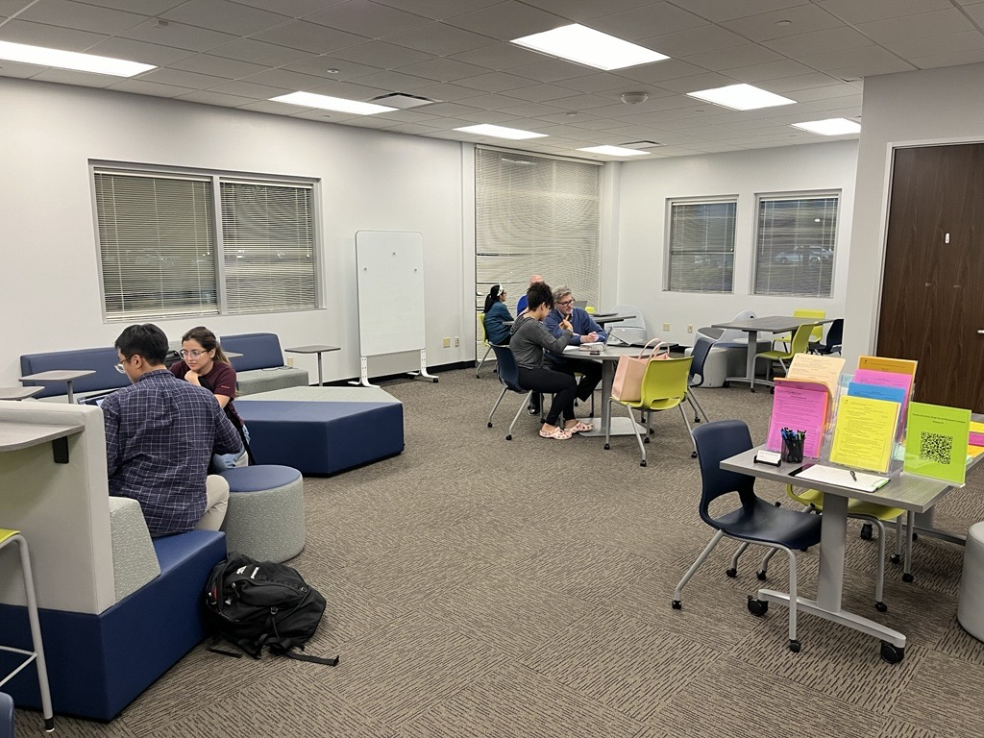
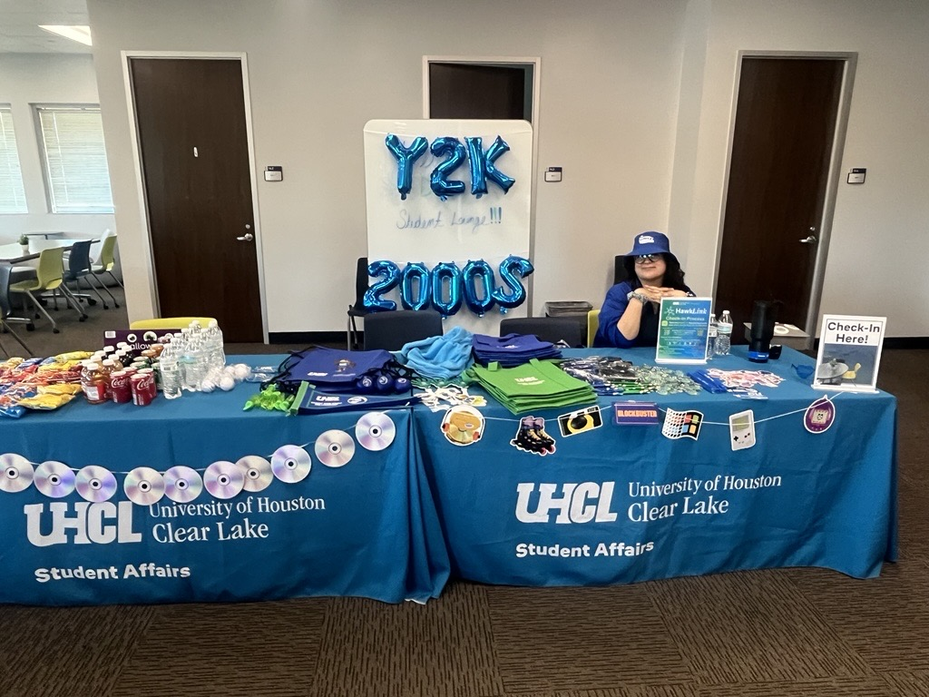
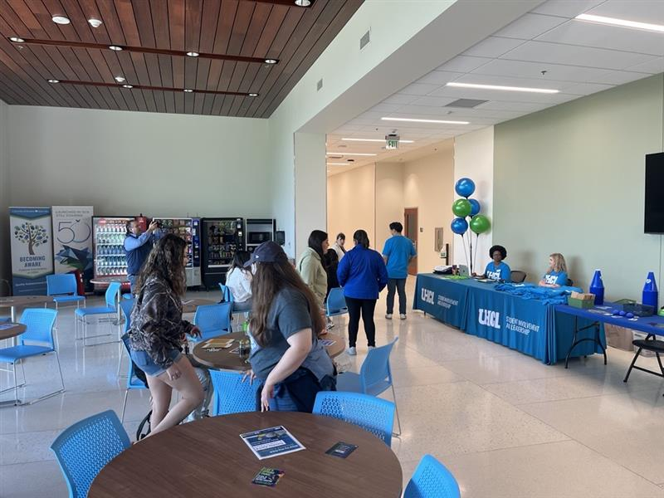
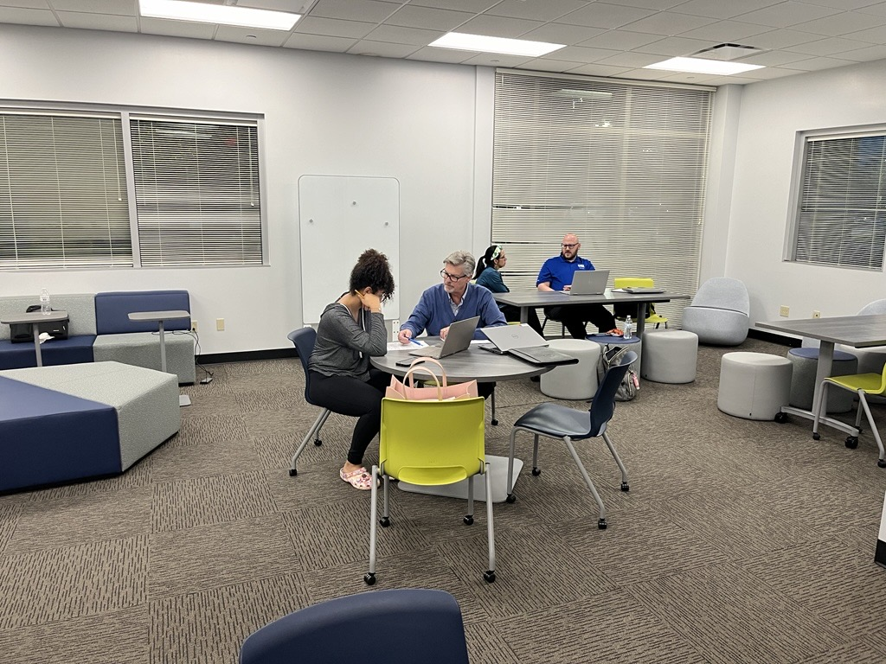
Divisional
Requests
Pearland Student Affairs Programming
FY25 and FY26 Funding
Request – FY27
Request – FY26 Spring
Overview of Requests

Slide 12

Divisional
Requests
Communications and Marketing Support
$144.00
Purpose:
Grammarly licensing for Division communications
Justification:
Ensures professional-quality writing across all platforms
Enhances accuracy, tone, and consistency in messaging
Supports credibility and effective student outreach
Request – FY27
FY25 and FY26 Funding
Request – FY27
Request – FY26 Spring
Overview of Requests

Slide 13

Divisional
Requests
Weeks of Welcome – Fall 2027 & Fall 2026
$10,000
Purpose:
Sustain UHCL’s signature welcome programming for new and returning students
Uses:
Marketing & outreach, banners.
T-shirts, giveaways, etc.
What’s the Scoop? Ice Cream Social
Campus-Wide Open House
Hawk Welcome Crew resources
Justification:
Cornerstone of student engagement and belonging
Fall 2025: 17 events, 23 open houses, 2,000+ student touchpoints
Maintains program quality and cost efficiency
Request – FY27 & FY26
FY25 and FY26 Funding
Request – FY27
Request – FY26 Spring
Overview of Requests

Slide 14
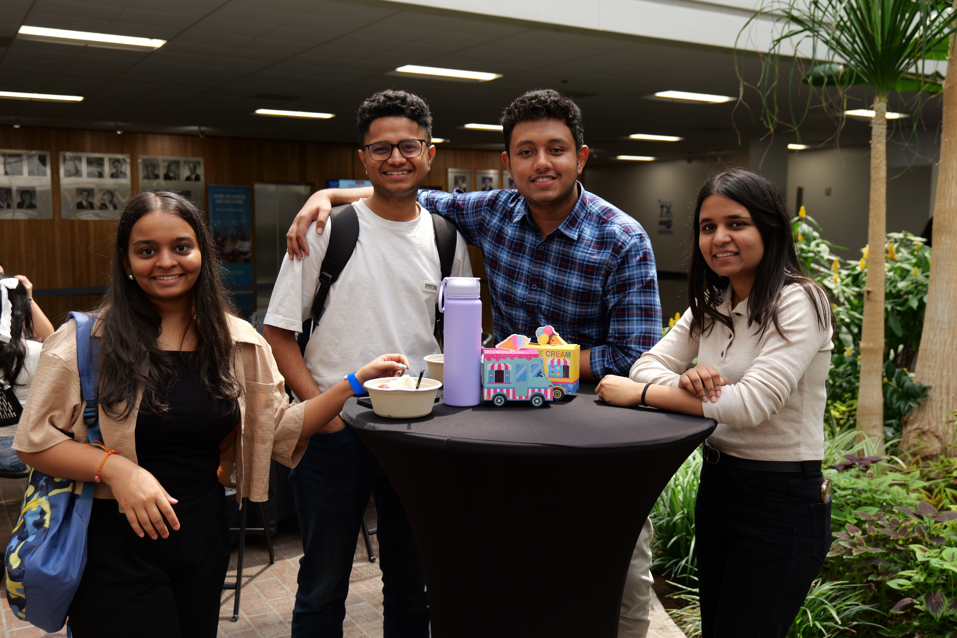
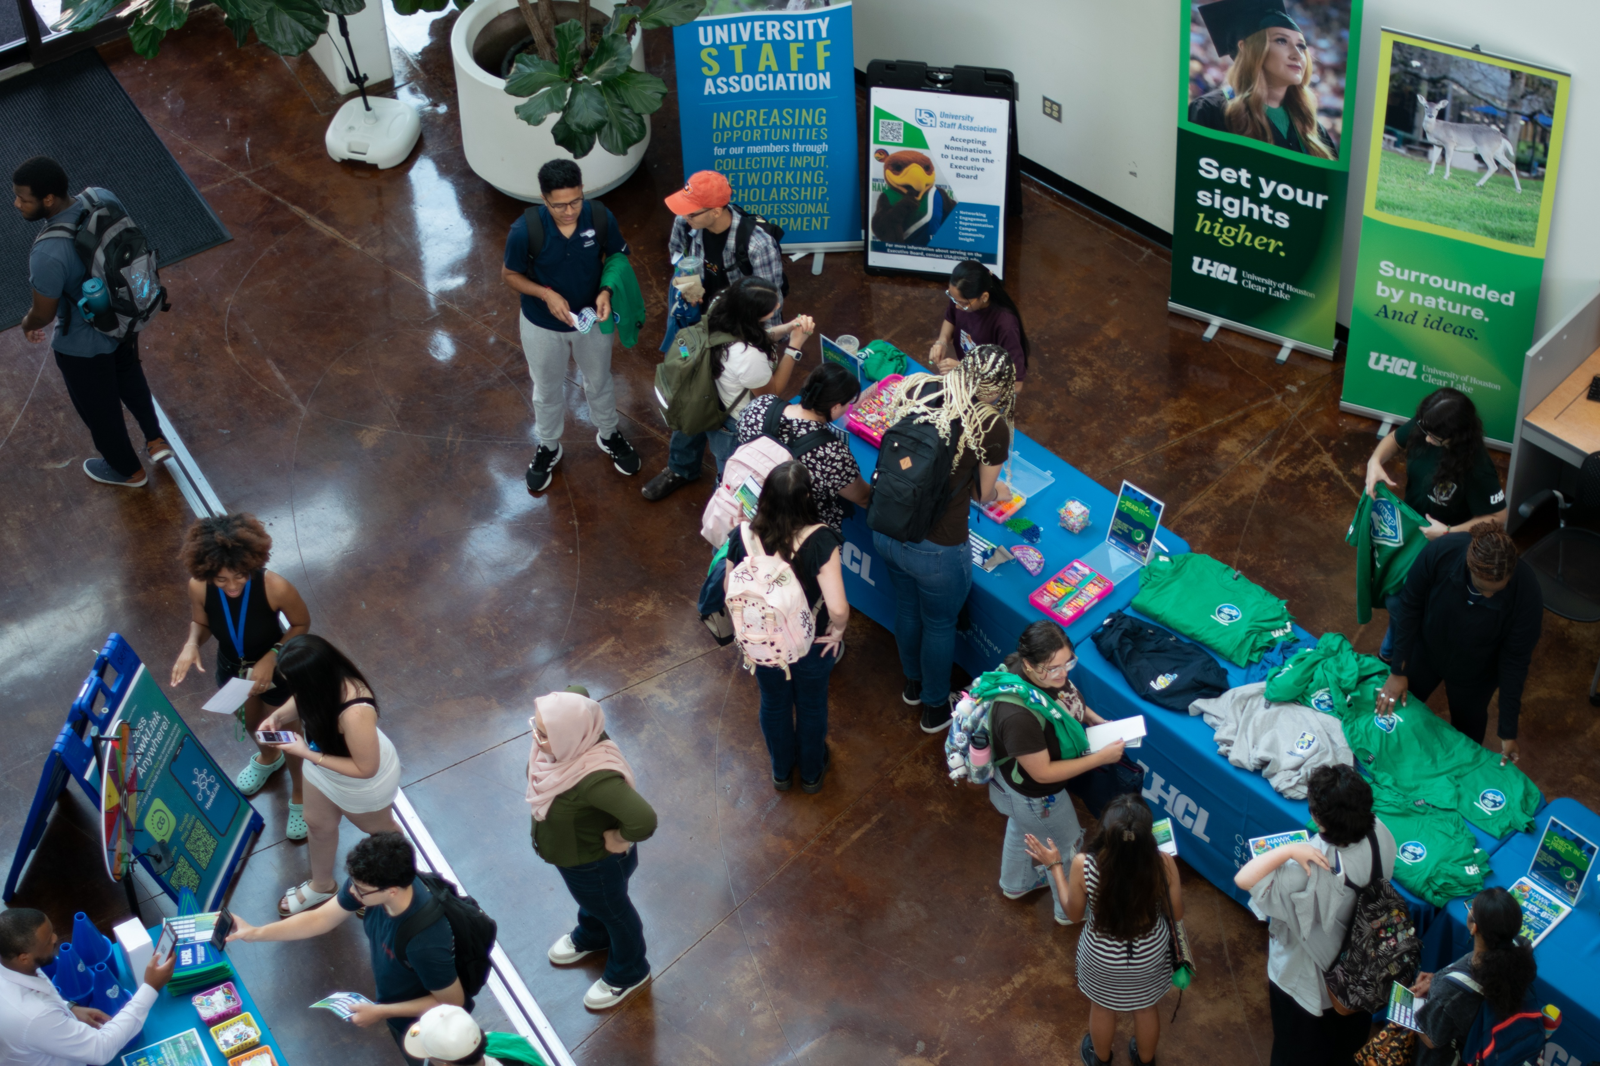
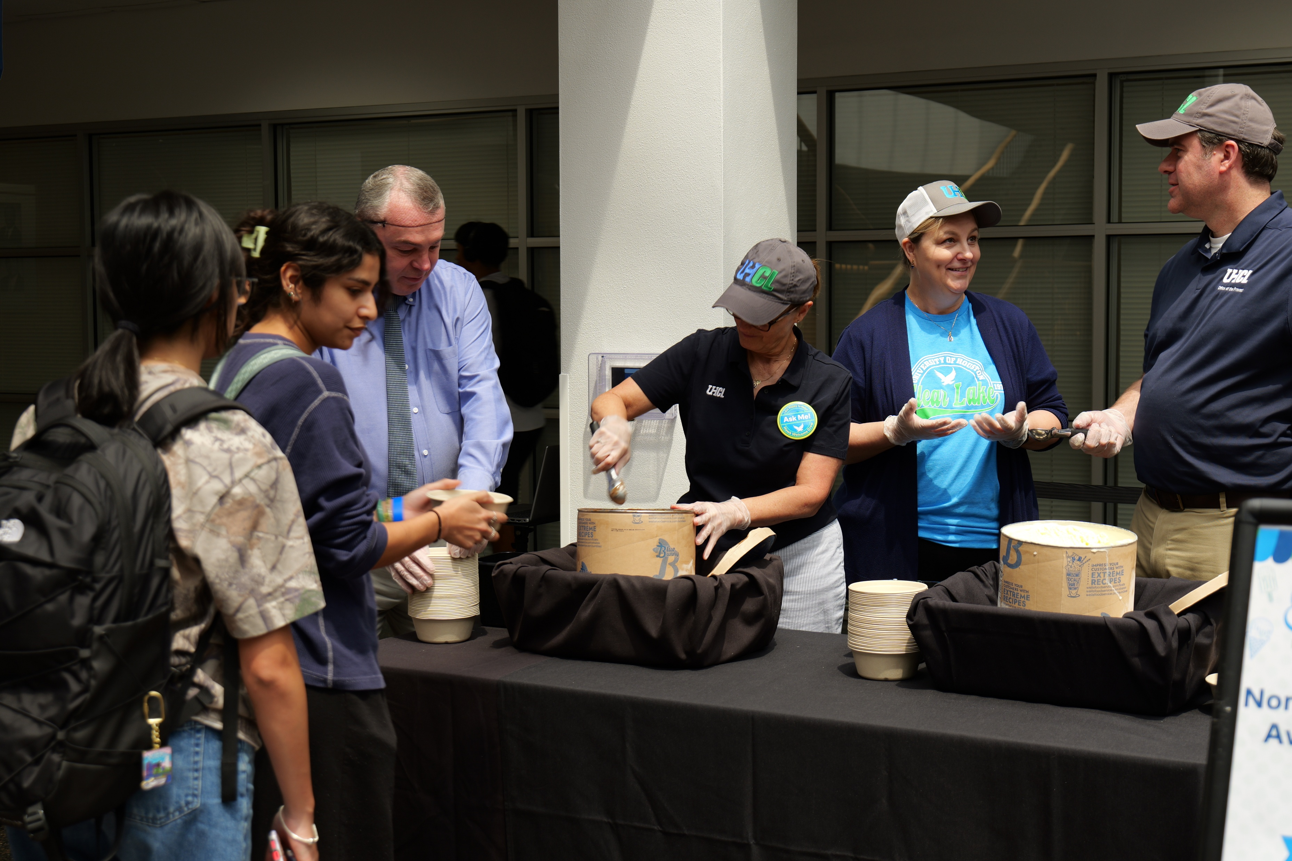
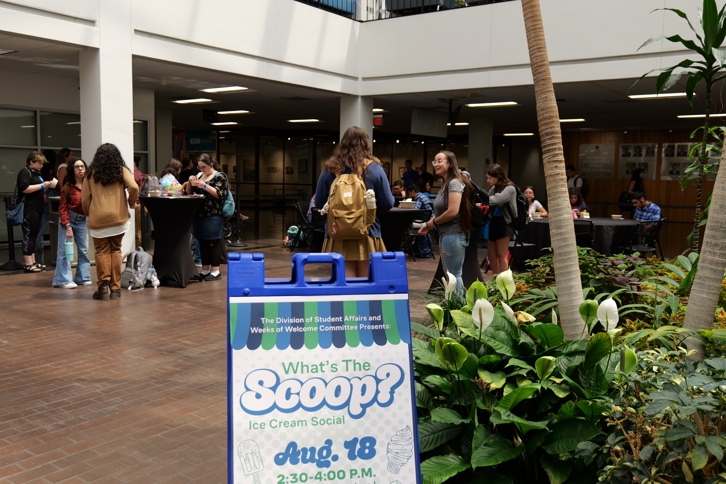
Divisional
Requests
FY25 and FY26 Funding
Request – FY27
Request – FY26 Spring
Overview of Requests

Slide 15
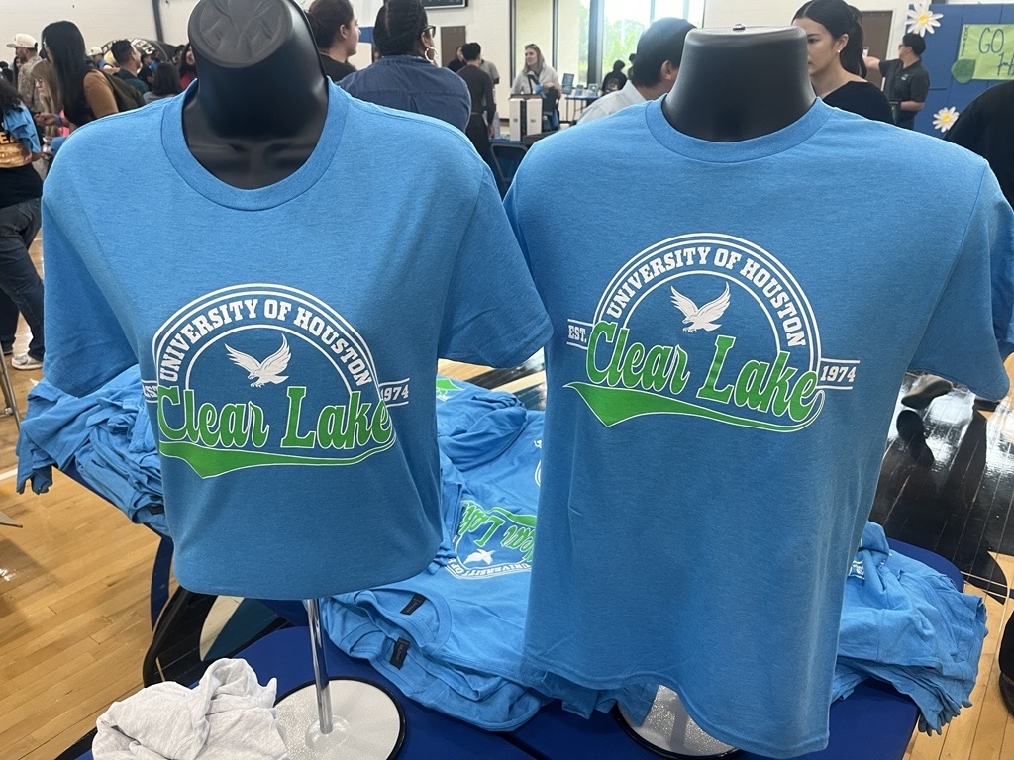
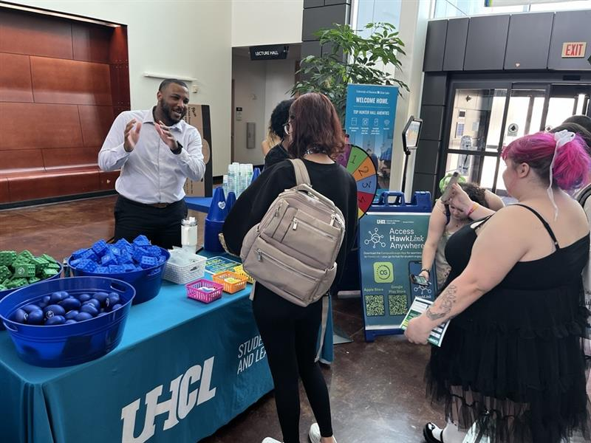
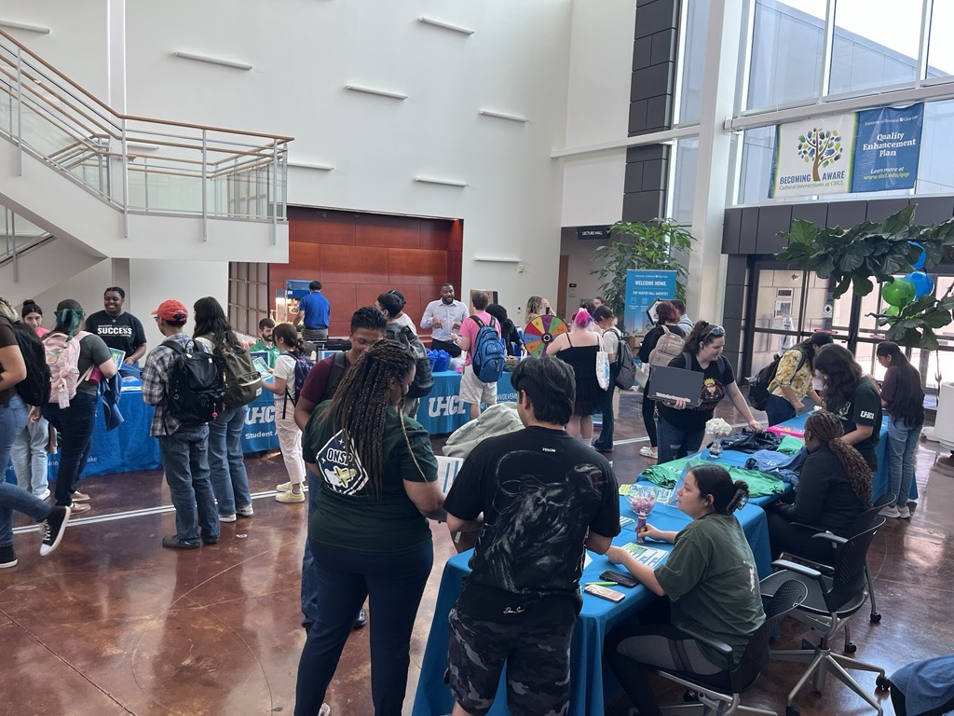
Divisional
Requests
FY25 and FY26 Funding
Request – FY26 Spring
Request – FY27
Overview of Requests

Slide 16
FY26 (Spring)
New Divisional Requests
ONE - TIME

Slide 17

Divisional
Requests
Communications and Marketing Support
$2,823.50
Purpose:
Expand communication tools and media capacity
Uses:
Grammarly licenses – $144
Camera kit – $2,679.50 (Lumix camera, wireless mics, etc.)
Justification:
200+ marketing requests, 274 Hawk Headlines in FY25
Enhances professionalism and visual storytelling
Improves event marketing and social media presence
Request – FY26 Spring
FY25 and FY26 Funding
Request – FY27
Request – FY26 Spring
Overview of Requests

Slide 18
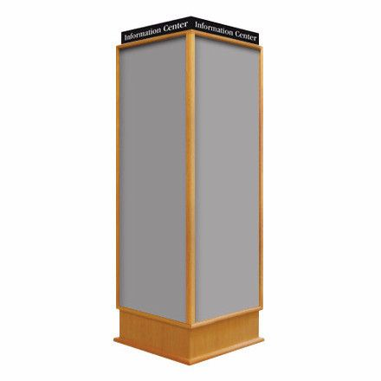
Divisional
Requests
Campus Posting Board Kiosks
$8,500
Purpose:
Install bulletin board kiosks in campus buildings for event promotion
Justification:
Centralized, visible event information hubs
Reduces poster clutter; supports organized communication
Promotes student life and awareness of campus events
Request – FY26 Spring
FY25 and FY26 Funding
Request – FY27
Request – FY26 Spring
Overview of Requests

Slide 19

Divisional
Requests
Utility Vehicle (UTV/Golf Cart)
$20,000
Purpose:
Transport event equipment and supplies efficiently across campus
Includes concrete pad for parking
Justification:
Supports DSA events and programs
Reduces setup time and physical strain on staff
Improves safety, efficiency, and event quality
Request – FY26 Spring
FY25 and FY26 Funding
Request – FY27
Request – FY26 Spring
Overview of Requests

Slide 20
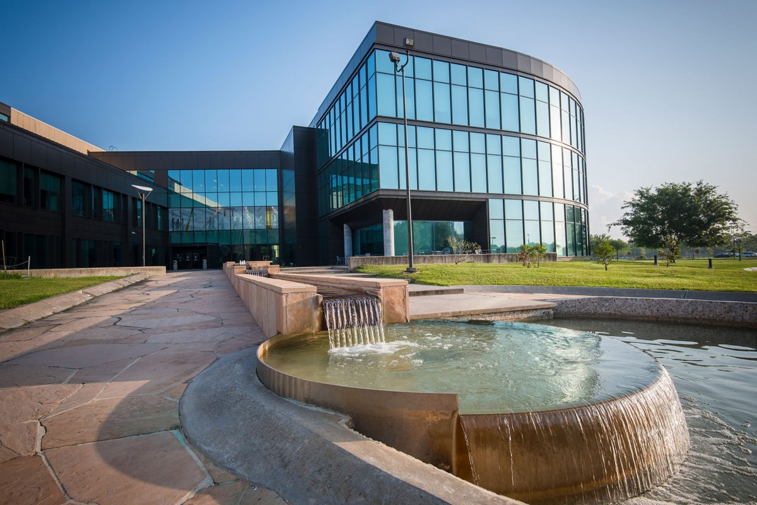
Divisional
Requests
SSCB​
FY25 and FY26 Funding
Request – FY27
Request – FY26 Spring
Overview of Requests
CREATING SPACES AND EXPERIENCES FOR STUDENT LIFE AND SUCCESS​
First floor:
Center for Career Development
Center for Student Engagement
Dean of Students Office
Health Services (with psychiatry)
Orientation and New Student Programs
Veteran and Military Resource Center
Second floor:
Campus Activities Board
Student Organization Center and Lounge (SOCAL)
Third floor:
Counseling and Mental Health Center
DSA Administration Suite
Student Media/The Signal

Slide 21
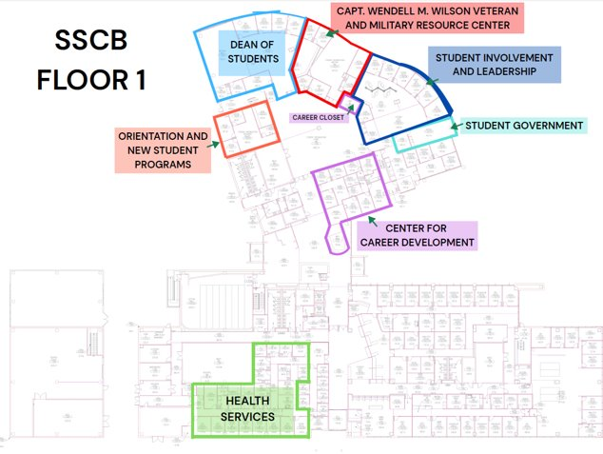
Divisional
Requests
FY25 and FY26 Funding
Request – FY27
Request – FY26 Spring
Overview of Requests

Slide 22
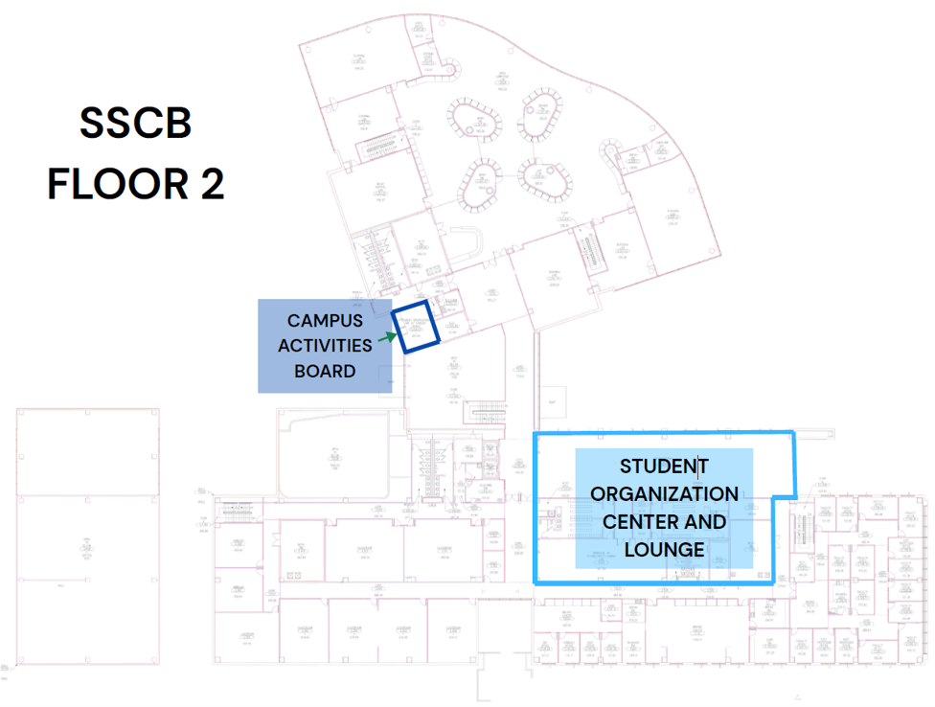
Divisional
Requests
FY25 and FY26 Funding
Request – FY27
Request – FY26 Spring
Overview of Requests

Slide 23
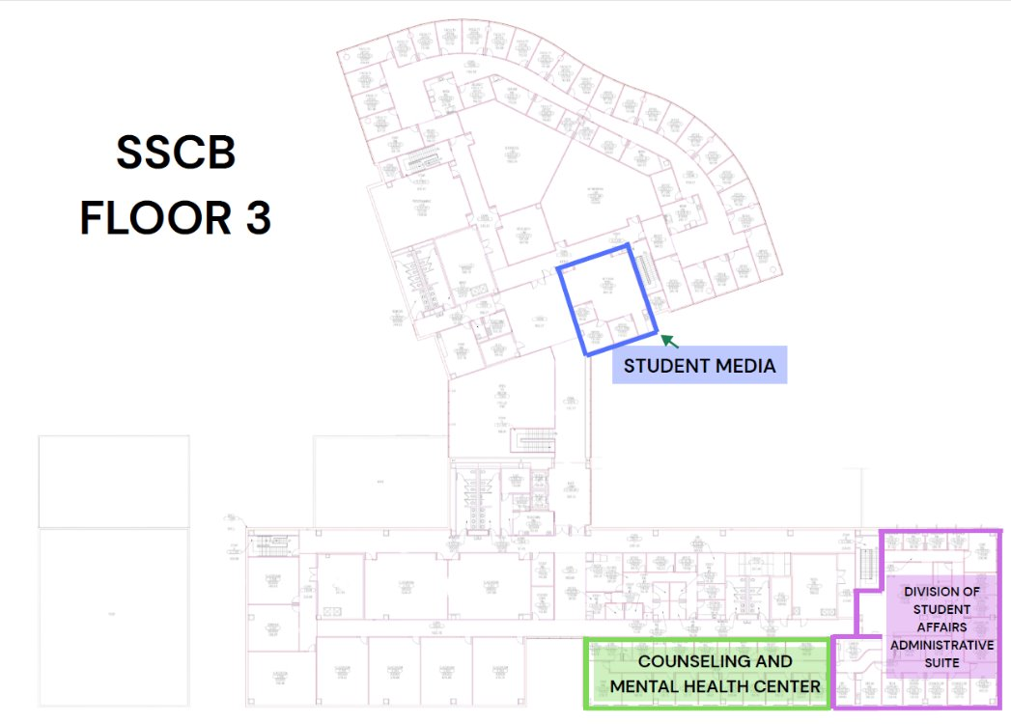
Divisional
Requests
FY25 and FY26 Funding
Request – FY27
Request – FY26 Spring
Overview of Requests

Slide 24
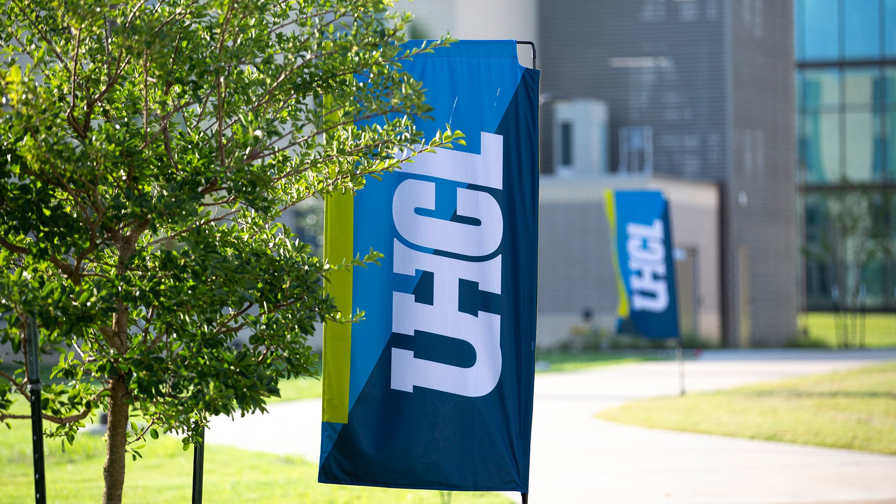
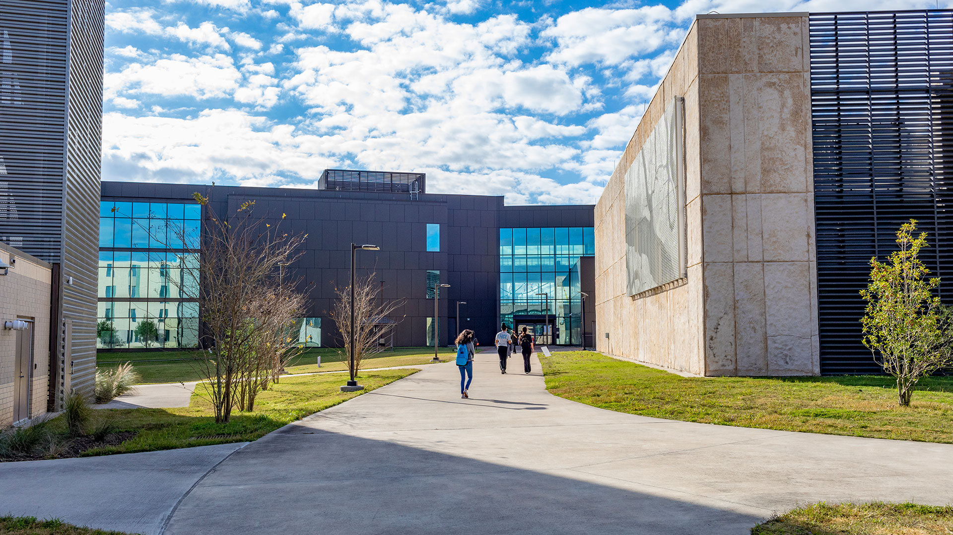
Divisional
Requests
Construction Project & Hunter’s Hangout
Up to $100,000
Purpose:
Complete SSCB first-floor renovations
Expand Hunter’s Hangout as a premier student space
Uses:
Furniture, signage, tech, TVs, wraps, cleaning
Justification:
Creates a student-centered hub for engagement & services
Centralizes key departments (Career, Veterans, Dean of Students, etc.)
Enhances accessibility and sense of community
Hunter’s Hangout upgrades: modern, welcoming, UHCL-branded space
Funds roll over to FY27 if needed
Request – FY26 Spring
FY25 and FY26 Funding
Request – FY27
Request – FY26 Spring
Overview of Requests

Slide 25

Divisional
Requests
Summary Overview
Key Points:
Intentional, student-focused investments by the Division of Student Affairs
Aligned with UHCL priorities of engagement, belonging, and student success
Totals:
FY26 (excluding construction): $41,323.50
Construction Project/Hunter’s Hangout: $100,000 (rollover option into FY27)
FY27: $46,644
Combined Total:
  Operations: $87,967.50
  Construction/SSCB Project: $100,000
  Grand Total: $187,967.50
Requests Overview
FY25 and FY26 Funding
Request – FY27
Request – FY26 Spring
Overview of Requests

Slide 26
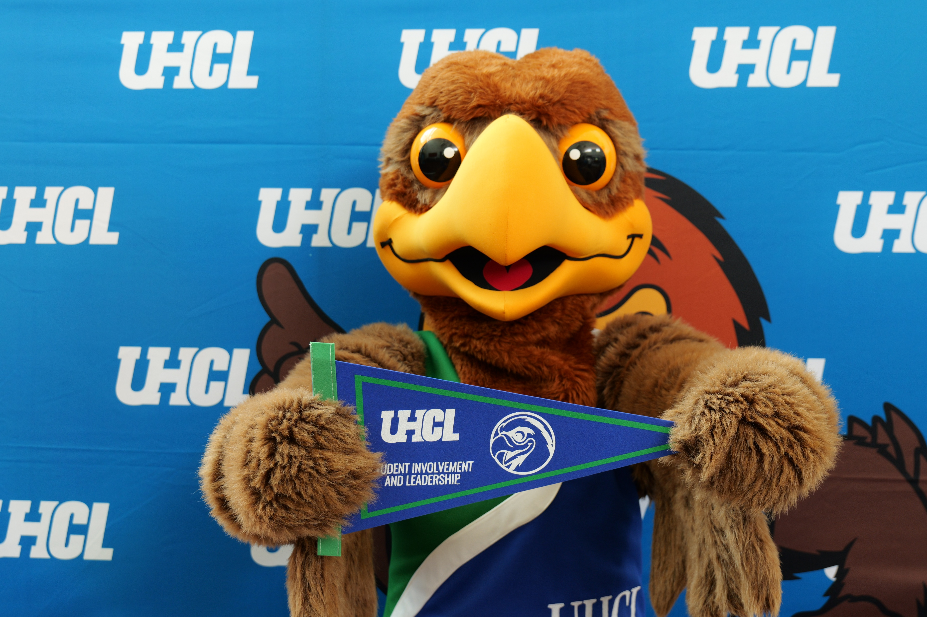
Divisional
Requests
Impact Highlights
These allocations will:
Enhance UHCL’s physical spaces with upgraded student gathering areas
Ensure continued success of Weeks of Welcome and major student life programs
Improve communication and outreach through professional tools & media capacity
Sustain meaningful student life at Clear Lake and Pearland campuses
Requests Overview
FY25 and FY26 Funding
Request – FY27
Request – FY26 Spring
Overview of Requests

Slide 27

Divisional
Requests
Funding Priorities (Ranked)
Requests Overview
Priority | Initiative | Amount | Fiscal Year
1 | Student Workers | $22,500 | FY27
2 | Weeks of Welcome (WOW) | $10,000 | Spring FY26
3 | Weeks of Welcome (WOW) | $10,000 | FY27
4 | Pearland Student Affairs Programming | $14,000 | FY27
5 | Communications & Marketing Support | $2,823.50 | Spring FY26
6 | Communications & Marketing Support | $144 | FY27
7 | Campus Posting Board Kiosks | $8,500 | Spring FY26
8 | Utility Vehicle (UTV/Golf Cart) | $20,000 | Spring FY26
9 | Construction Project & Hunter’s Hangout | $100,000 | FY26 (rollover if needed)
FY25 and FY26 Funding
Request – FY27
Request – FY26 Spring
Overview of Requests

Slide 28

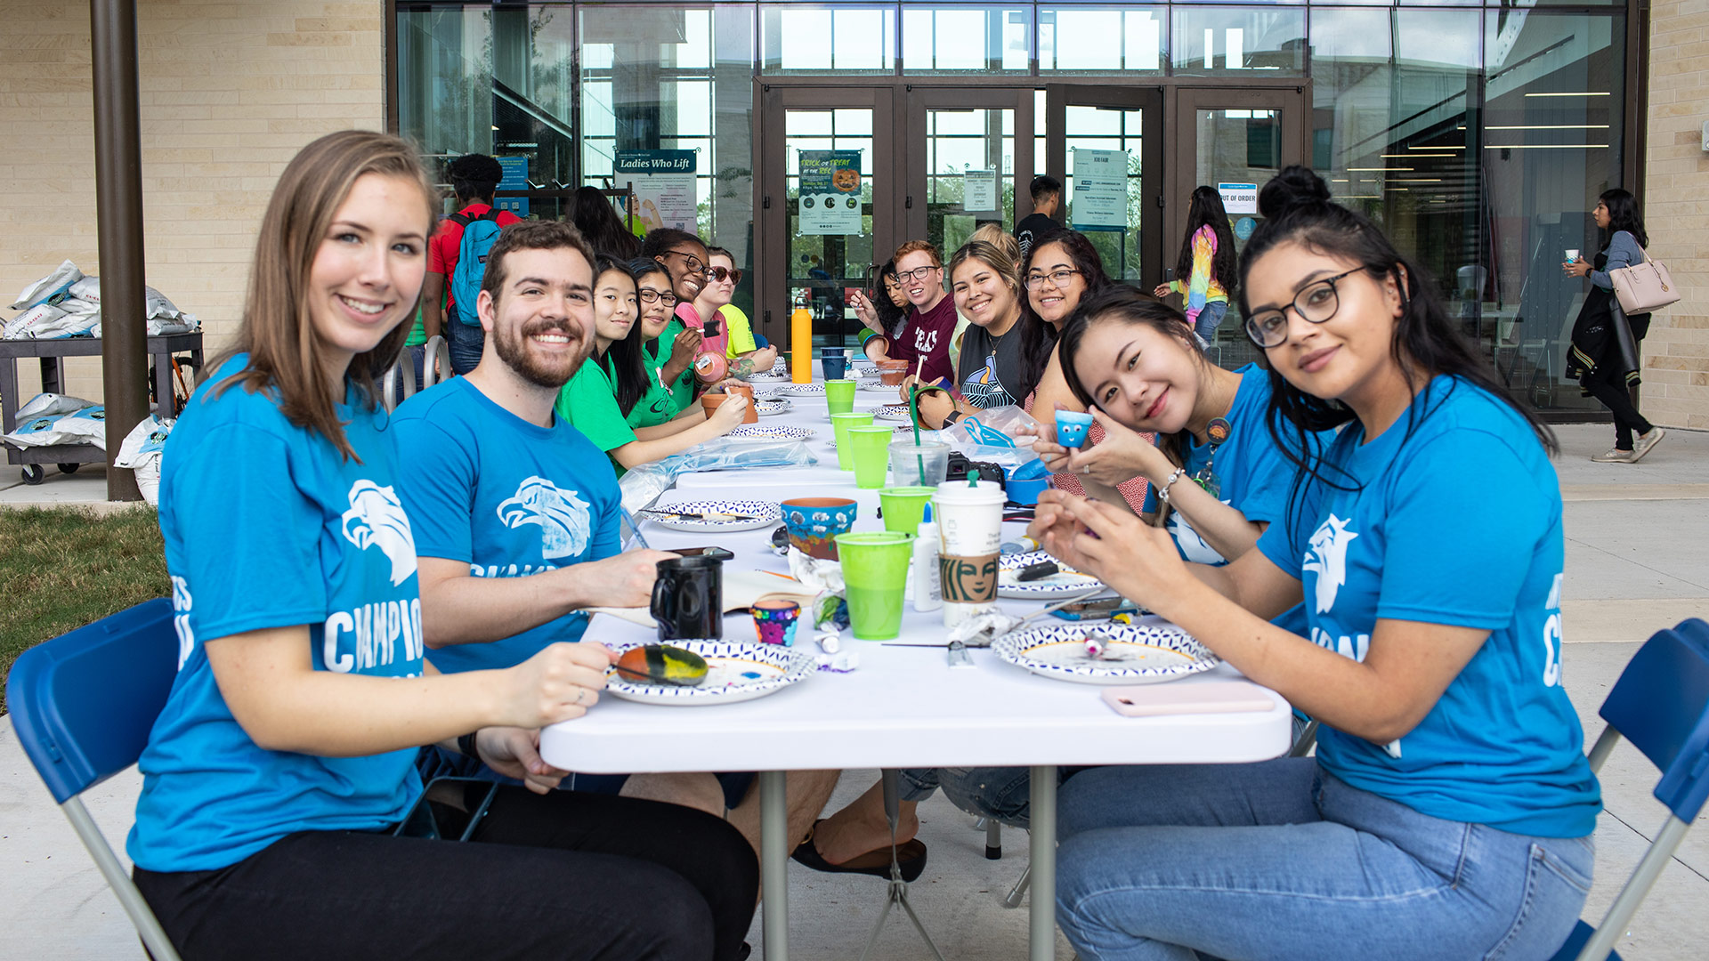
Divisional
Requests
Closing and Thank You
Key Takeaways:
Strategic, student-centered investments strengthen the UHCL experience.
Funding supports student life, visibility, and operational excellence.
Commitment to sustaining a welcoming and connected campus.
Thank You
We appreciate SFAC’s continued partnership and support for UHCL students.
Requests Overview
FY25 and FY26 Funding
Request – FY27
Request – FY26 Spring
Overview of Requests

Slide 29
Thank You
SFAC
UHCL.EDU

