Slide 1
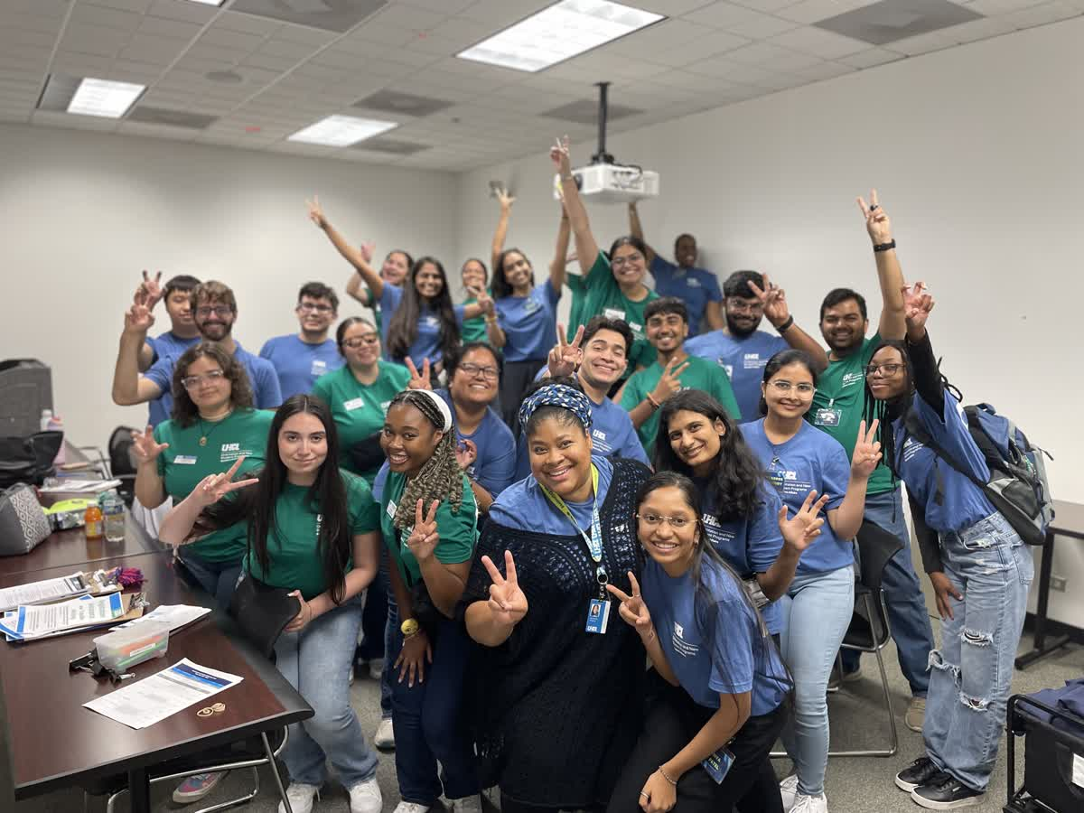

Orientation and New Student Programs
2025 SFAC Presentation
Fall 2025
Thursday, October 16, 2025

Slide 2


Who Is
ONSP
MISSION STATEMENT
The Office of Orientation and New Student programs facilitates orientation and transition programs to construct the bridge to connect new students to the resources and experiences needed to thrive in the university setting. Orientation and New Student Programs engage with the student population through intentional programming to ensure students feel comfortable and welcomed at the University of Houston – Clear Lake.
NEW STUDENT CORE COMPONENTS
Academic Support
Career Exploration
Community Awareness
Faculty & Academic Engagement
Financial Wellness
Healthy Living
Leadership Development
Personal Growth
Social Engagement
Technology & Services

Slide 3



Office
Programs & Initiatives
PRE-ORIENTATION LAUNCHPAD MODULES
NEW STUDENT ORIENTATION
NEW STUDENT & FAMILY TRANSITION PROGRAMS
Mandatory in-person orientation program to support the unique transition needs of first-year, transfer, international, and graduate students.
Mandatory online modules available as soon as students are admitted. Lay a strong foundation for enrollment and student success.
Office programs and initiatives aimed to support the holistic development of new students and families throughout their university experience.

Slide 4

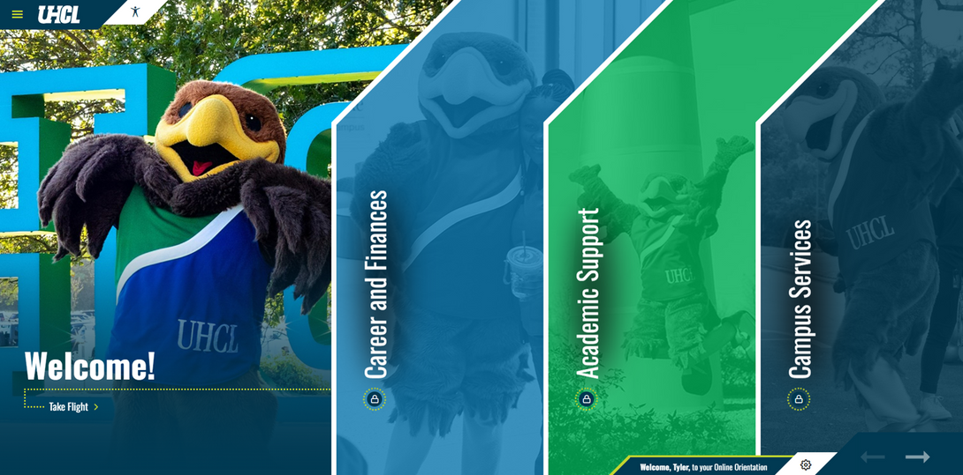
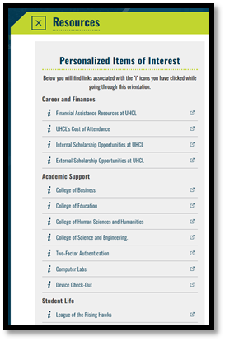
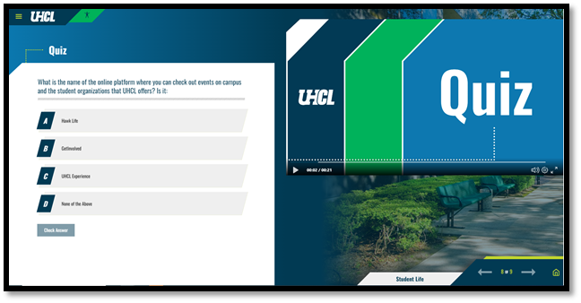
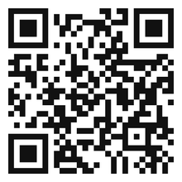
PRE-ORIENTATION LAUNCHPAD MODULES
Launched May 2024 with full-campus collaborative support.
Highlights include:
7 engaging modules, covering: Student Life, Safety, and more
Videos, interactive quizzes, and personalized points of interest, population-specific info, FAQ, glossary and more!
Family/Guest access, Spanish translation, digitally accessible.
3,590 FY25 admitted students completed all 7 modules (Increase of 1,156 compared to FY25)
96% felt more welcomed and reassured about their decision to attend UHCL.
98% agreed the Checklist and Next Steps sections clarified what they need for a successful start.
Quiz success: 89-99% correct answers across all sections.
VISIT: HTTPS://ORIENTATION.UHCL.EDU/

Slide 5
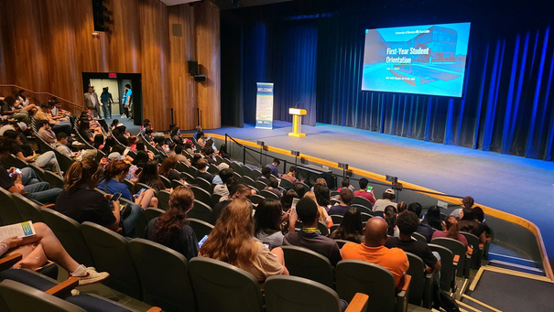
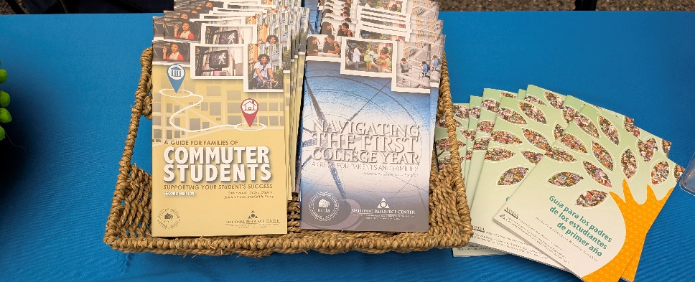
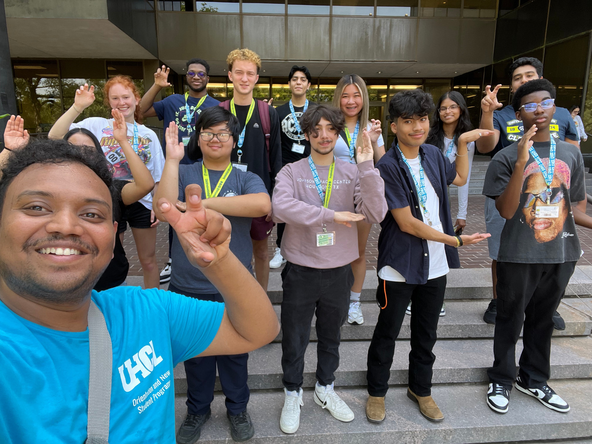
NEW STUDENT ORIENTATION
FY25 NSO Program Enhancements
Strengthened student process transition across the 3-Step Orientation process & Enhanced enrollment coordination, utilizing new back-end tracking with Advising and Enrollment Management to resolve advising holds before orientation.
Maintained population-specific support through breakout sessions for First-Year, Transfer, and International students.
FY25 NSO By The Numbers
8 Orientation Programs (↓ from 16 in FY24)
1,571 student participants (≈ FY24 total: 1,728)
386 family & guest participants (↑ from 374); $15,440 guest revenue (↑ from $14,960)
Student Evaluation Highlights
94% felt their concerns about starting UHCL were addressed
89% understood how to be academically successful
94% better understood Career Services
96% gained awareness of personal safety resources
94% learned about mental health warning signs and resources
93% were encouraged to use Get Involved/Hawk Link for engagement

Slide 6
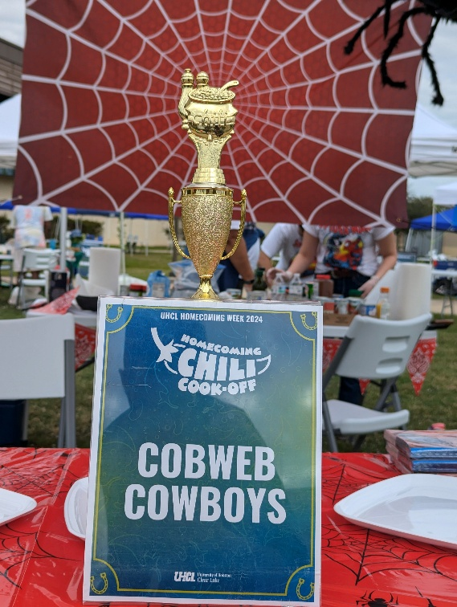
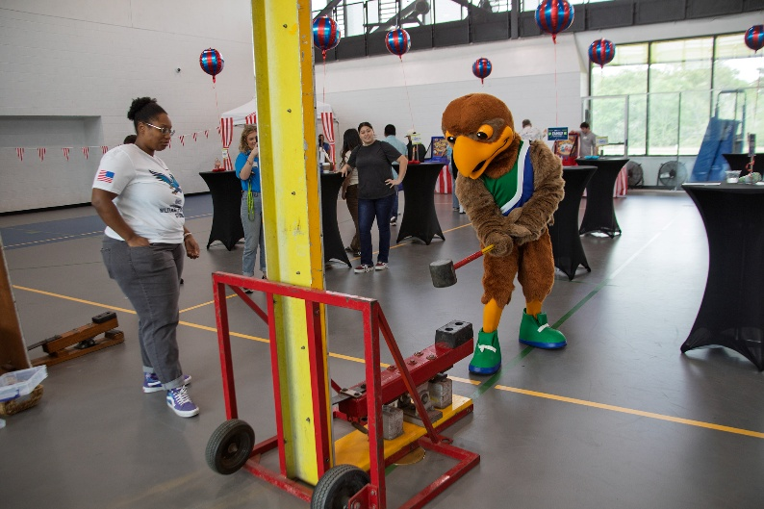
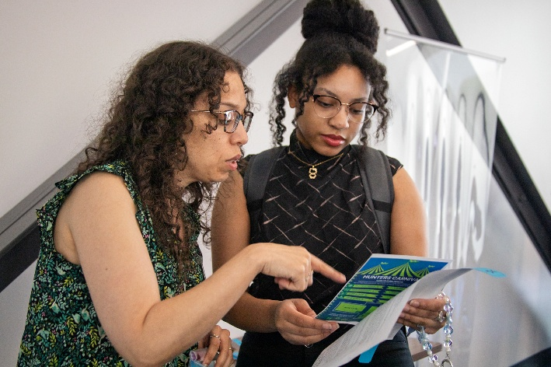
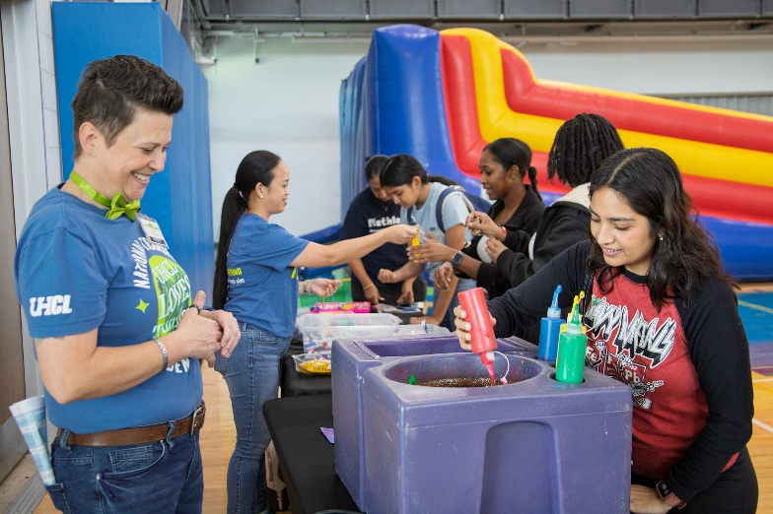
NEW STUDENT & TRANSITION SUPPORT PROGRAMS
FY25 Program Enhancements
Redeveloped the UHCL Family Weekend experience to enhance family and guest engagement.
Prioritized high-impact programming and event quality during staff transition period, with fewer programs but comparable engagement levels to FY24.
Maintained strong student engagement and launched planning for expanded Hawk Launch programming in FY26.
FY25 New Student & Transition Support Programs By The Numbers
22 Student Leaders held paid Orientation Leader Student Leadership Positions alongside 4 Student Orientation Assistants.
Facilitated 11 events (Aug 2024 – Apr 2025) with 1,013+ participants. Event Highlights Include:
Late-Night Breakfast (181 attendees)
What’s The Scoop? Ice Cream Social (250 attendees)
ONSP Cares Valentines (100 attendees)
UHCL Family Weekend (181 attendees)
Hunter’s Haunted Hideaway Escape Room (43 attendees)
Unwind & Design (50 attendees)

Slide 7
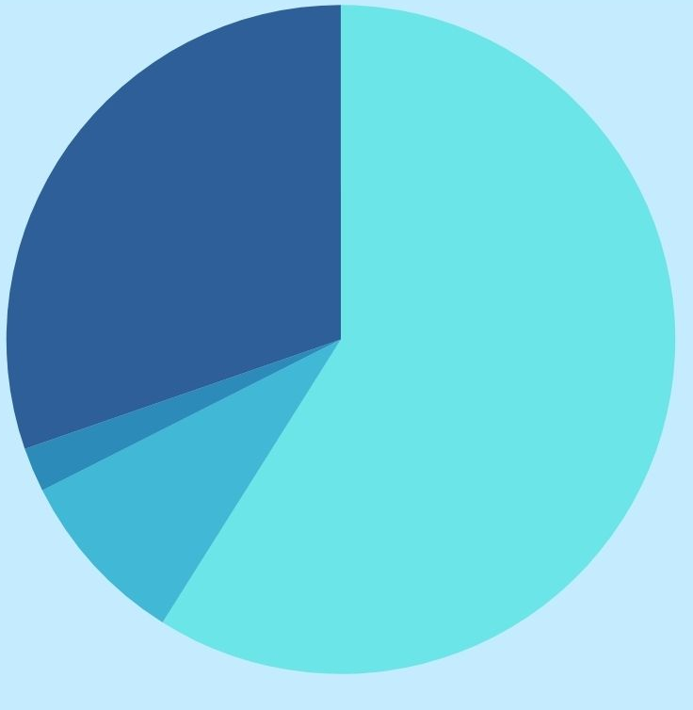
ORIENTATION AND NEW STUDENT PROGRAMS
FY26 BUDGET OVERVIEW
Student Service Fees Base - ~59%
Estimated $294,663
Office Professional Staff: Director, Program Manager Coordinator.
4 Office Orientation Student Assistants, 25 Orientation Leaders
Office General M&O (Office & Program Supplies)
Office Professional Development & Training Travel
Mandatory Orientation Fee - ~30%
Estimated $151,500 (Dependent on UHCL Enrollment)
All New Student Orientation Programs
Including: Food, Promotional Items and most program expenses.
Annual Contract For Orientation Launchpad
Partial Salary Student Employees.
Mandatory Orientation Fee
30%
Student Service Fees Base
59%
Student Service Fees One-Time Funding - ~9%
Estimated $43,000
New Student Programs
Weeks of Welcome, Lunch With A Prof, Late Night Breakfast and more.
Optional Program Charges
2%
FY27 5% SFAC Reduction
$15,883.15 Reduction in General M&O
Optional Program Charges - ~2%
Estimated $10,700 (Dependent on participant levels)
Orientation Guest Program
Student Service Fee
One-Time
9%

Slide 8
ORIENTATION AND NEW STUDENT PROGRAMS
CHALLENGES
OPPORTUNITIES
SUCCESSES
Rebuilding capacity with a fully staffed team while regaining operational rhythm across programs.
Balancing large-scale programs that appeal to all students with targeted experiences for specific populations.
Rising costs and limited revenue growth reduce flexibility to enhance programs.
Expanding the Hawk Launch pathway to sustain engagement beyond orientation day.
Strengthening family and guest connections through Family Weekend, newsletters, and webinars.
Leveraging data integration to demonstrate orientation’s impact on student persistence.
Building cross-campus partnerships & sponsorships.
• Reestablished a fully staffed, stable team driving long-term consistency and growth.
• Achieved 3,363 Launchpad completions, 1,571 orientation attendees, and $13,400 in guest revenue.
• Hosted 15+ year-round programs engaging over 1,200 students in key transition moments.
• Relaunched Family Weekend and expanded communication touchpoints with families and guests.

Slide 9
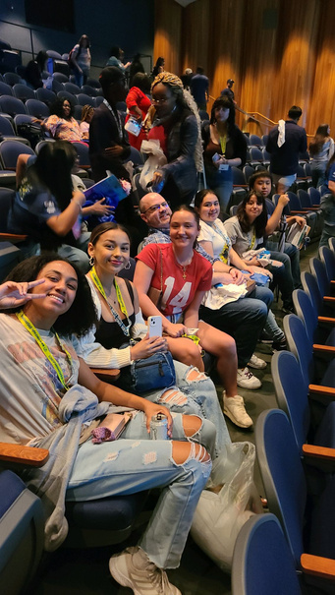
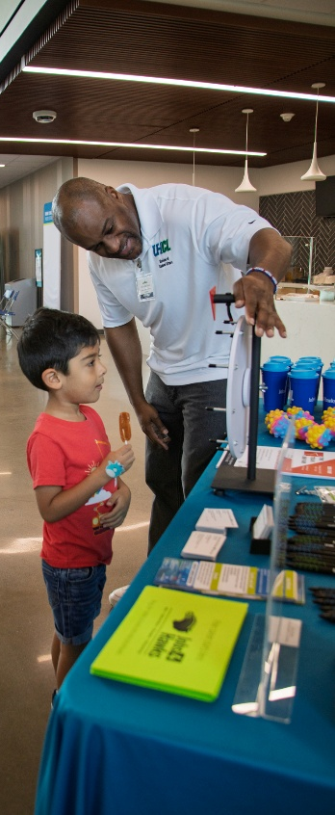
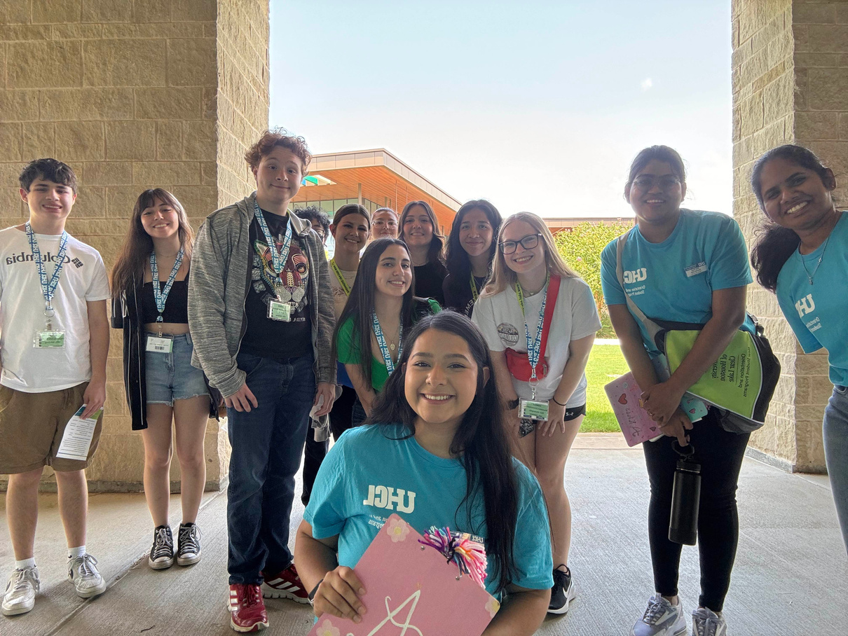
Student
Testimonials
“Overall, [New Student Orientation was] a great experience. Really put into perspective how many resources we have available to us.”
“Despite there being several points where I already knew the information being presented, I did not feel bored. Throughout the entire [New Student Orientation] event, everyone made sure to keep the encouraging and fun atmosphere going, which no doubt helped the new students immensely for the coming semester. By the end of the event, I felt better than I did before about being a full-time student at UHCL.”
“I found the Orientation Launchpad pre-orientation modules to be quite useful, and I cannot think of any improvements that need to be made. The aspects that were the most useful to me were the parts that told me more about the school. I found that the modules were quite different from the actual orientation itself, which was a pleasant surprise.”
“Everyone had great energy overall, and orientation DID make me excited to attend school again. I was nervous to be around a large group again since 2020, but the staff was very welcoming.
“Our leader and students did great! They kept me engaged, even on sections of the presentation that weren’t very interesting (but necessary!)”

Slide 10
FY26 SFAC ONE-TIME APPROVED FUNDING
UHCL Family Weekend - $8,000
Builds on FY25 success engaging 181 attendees (families, guests, and students) with positive post-event feedback.
Continued funding supports the event on March 28, 2026, with a projected 250+ family participants.
Strengthens family connection to UHCL and encourages continued student persistence and satisfaction.
Hawk Launch Program Funding - $15,000
FY25 new student programming events reached 1,013+ students through 11 programs.
FY26 roadmap expands high-impact programming through the new Hawk Launch Series filtered across academic milestones (Weeks of Welcome, Midterms, Finals Support). FY26 Impact This Far:
FY26 Roadmap includes 14+ programs: Monthly Hawk Launch Academy Workshops & Hawk Hangout socials.
Orientation Model Support- Up to $20,000
Serves 1,500+ new students annually through the 3-Step Orientation Process (Launchpad, Advising, and NSO). without increasing student cost ($50 / $60 rates maintained since 2014).

Slide 11

FY26 SFAC ONE-TIME FUNDING REQUEST:
NODA GRADUATE ASSISTANT $12,000
Orientation and New Student Programs is requesting $12,000 in FY26 one-time SFAC funding to host a Summer NODA Graduate Assistant (Intern) through the national NODA Internship Program. This position will directly enhance family engagement, strengthen transition programming, and advance UHCL’s national reputation in orientation and student success.
Impact of Position Support:
Supports 1,500+ new students and 400+ family members during Summer 2026.
Expands Family & Guest Orientation coordination and summer Hawk Launch programming.
Strengthens student leader training, assessment, and event logistics during peak orientation months.
Provides support (May–Aug) to sustain quality operations without increasing orientation fees ($50 / $60).
Positions UHCL as a national NODA host site, showcasing innovation & best practices in student affairs.
Impact of Funds:
Supports 12–14 weeks of full-time summer staffing, including housing, stipend, and professional development expenses required by the NODA Internship Program.

Slide 12

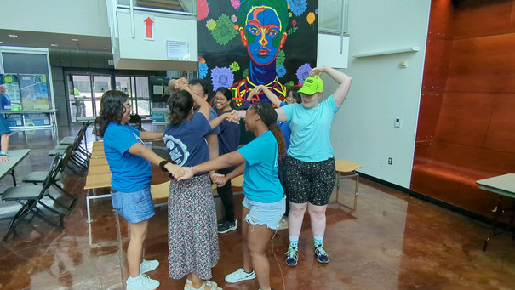


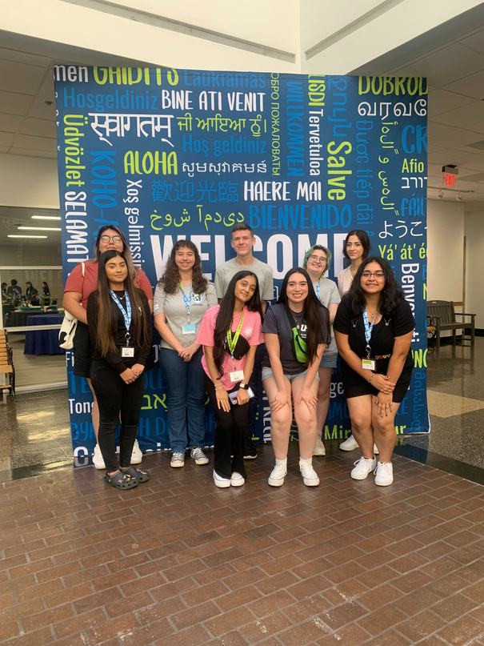
FY27 SFAC ONE-TIME FUNDING REQUEST:
HAWK LAUNCH $15,000
Orientation and New Student Programs is requesting $15,000 in FY27 one-time SFAC funding to continue the Hawk Launch programming series, which was successfully reintroduced in Summer/Fall 2025 with previous SFAC support. This funding will allow the program to continue through Summer/Fall 2026.
Hawk Launch Programming Impact:
Strengthens student preparedness and excitement for their UHCL journey
Builds lasting connections with peers, Orientation Leaders, staff, and faculty
Encourages leadership development and active campus involvement
Promotes a stronger sense of community and Hawk pride
FY26 Impact So Far (10 FY26 Programs Remaining)
Hawk Launch Fall Kick-Off – 114 Attendees
95% of participants can identify 2 UHCL services/programs to support student success.
98% of participants feel more motivated to participate in UHCL campus activities.
Hawk Hangout: Pearland Pop-Up – 40 Attendees
Hawk Launch Academy: Adulting 101 Workshop – 14 Attendees
80% feel more confident in their ability to apply financial strategies to manage their personal expenses.

Slide 13
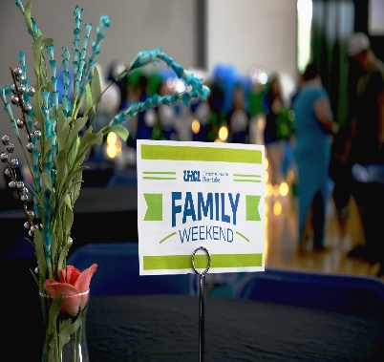
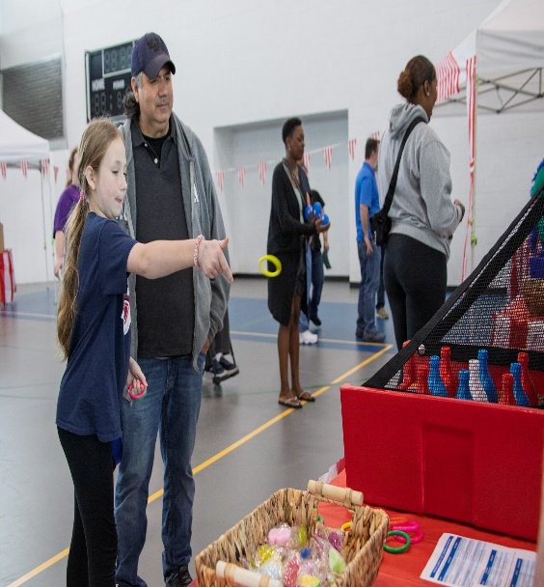
FY27 SFAC ONE-TIME FUNDING REQUEST:
UHCL FAMILY WEEKEND $15,000
Orientation and New Student Programs is requesting $15,000 in FY27 one-time SFAC funding to continue and expand the UHCL Family Weekend tradition, strengthening family, guest, and student connections while promoting Hawk pride and campus involvement.
FY25 Highlights
Hosted 181 participants on March 29, 2025, featuring:
Hunter’s Family BBQ with UHCL Leadership, Faculty, and Spirit Squad
Hunter’s Carnival & Attractions (ring toss, inflatables, crafts, photo booth)
Mock Classroom Experiences and Information Sessions with UHCL professors from four colleges and offices
Campus Tours, Resource Sessions, and a Social Media Challenge
Partnered with university offices for collaborative financial support and program impact
UHCL Family Weekend Impact
Builds meaningful connections between families, students, and the UHCL community.
Strengthens family engagement in student success and persistence.
Enhances UHCL’s reputation as a family-centered, student-first institution.
FY26 event (March 28, 2026) projects 250+ attendees through expanded outreach and collaboration.

Slide 14





Thank You
Q & A
281.283.2420
Orientation@uhcl.edu
www.uhcl.edu/orientation
SSCB 1.202.01
Orientation Launchpad Visit: https://orientation.uhcl.edu/

