Slide 1



The Dean of Students Office 2025 SFAC Presentation October 17, 2025

Slide 2


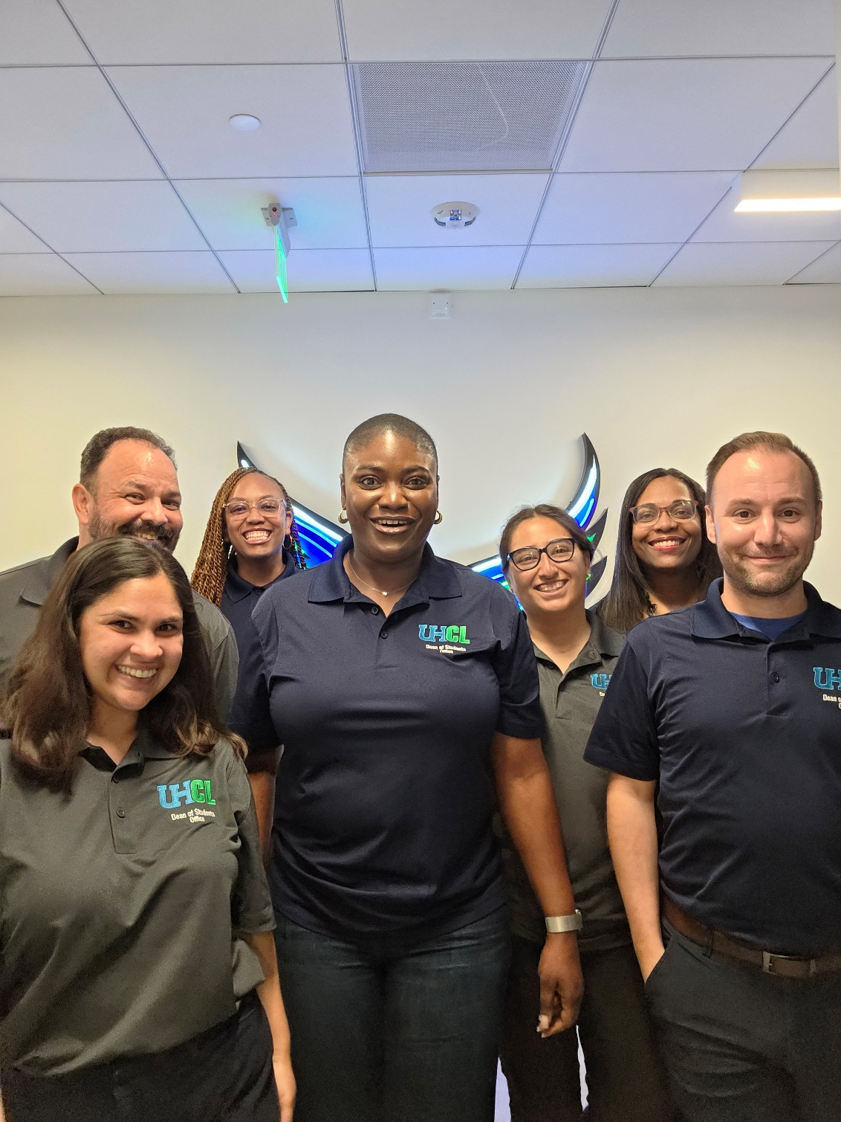

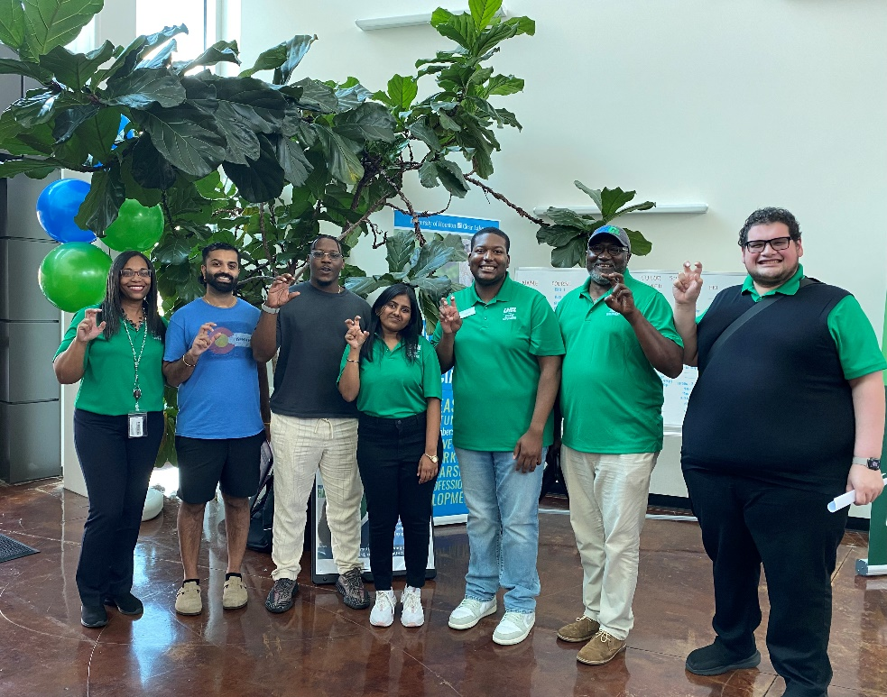
Mission and Vision
Mission: The Dean of Students Office is committed to creating a community of Honor, Character, and Excellence. Utilizing a comprehensive approach to student development, we foster ethical decision-making, uphold student rights and responsibilities, and provide distinctive student services.
Vision: The Dean of Students Office hopes to inspire students to engage and succeed in their individual pursuit of learning, growth, and transformation.

Slide 3

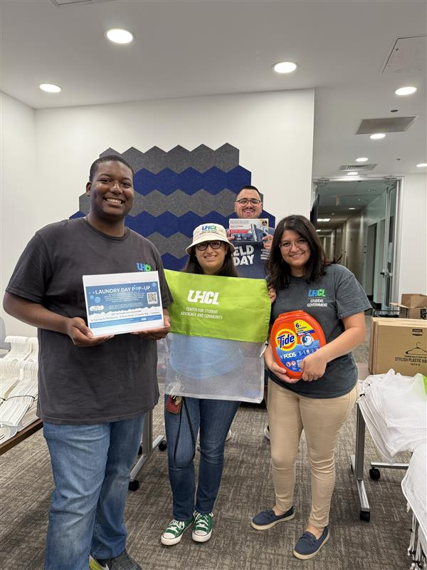



Overview of Services
Academic Honesty
Basic Needs Assistance
Emergency Resources
Programs & Workshops
SFAC Coordination
Student Care
Student Conduct
Student Government Advising
Student Travel

Slide 4

The Benefit to Students
Upholding Academic Integrity
Emphasis on Student Care
Serving Basic Needs
Student Connection
Protecting Student Confidentiality
Student Referrals to Resources
A Safe Campus Community
Timely Student Response

Slide 5

Budget Overview

Slide 6

By the Numbers (Data)
Academic Honesty
350% increase in Academic Honesty violations
Basic Needs Grant
$86,160.00 Basic Needs Grant funding awarded to students
DOS Office Inquiries
280 in Total (Informal Complaints, Academic Issues, Hawk Emergency Fund Requests, etc.)
Hawk Emergency Fund
$2,900.00 Hawk Emergency Fund funding awarded to UHCL students

Slide 7
By the Numbers (Data) continued
Student Care
5% increase in student mental health reports
Student Conduct
54% increase in student conduct incident reports
Student Housing
56% decrease in student housing incident reports

Slide 8
Significant Changes Since Last Year
Hired a new AVP/Dean of Students
Absorbed and managed Basic Needs Services for students
Developed a new Student Handbook
Incorporated the NABITA Rubric with student mental health cases
Established a new Dine & Dialogue with the Deans initiative
Streamlined Student Travel processes
Installed and furnished a new multi-use conference room

Slide 9
Challenges
Students are presenting more complex mental health needs
Artificial Intelligence is impacting academic integrity and student learning
Expiration of the Basic Needs Grant
The need for additional Hawk Pantry support

Slide 10
Opportunities
Strengthening Basic Needs support
New Hawk Pantry Relocation and Houston Food Bank Partnership
New FamilyU Initiative to provide additional support services for students who are parents
Dean of Students Office Relocation offers opportunities to enhance student privacy and create a welcoming environment for students

Slide 11
FY27 SFAC Funding Requests
Hawk Pantry – Equipment and Supplies ($10,000.00)
Funding will be utilized for pantry shelving, retail display racks, refirgerated and freezer coolers, food bins, and supplies
Hawk Pantry – Food ($24,000.00)
Funding will be utilized monthly ($2,000.00/month x 12 months) for food and necessary food-related supplies
This is contigency funding pending the New Hawk Pantry construction and Houston Food Bank partnership

Slide 12
Questions?

