Slide 1
Center for Career Development
Student Fee Allocation Committee (SFAC)
Presentation
Dr. LaMar Black – Director
Thursday, October 16, 2025

Slide 2
Overview
Our mission is to educate and empower UHCL students through holistic career development practices that establish meaningful connections and opportunities through global outreach.
Budget Overview
Programs
Impact
Student Experience
Coming Soon
Challenges & Opportunities
Funding Requests
Budget Reduction

Slide 3

Base Budget Overview
Income
Student Service Fees - $479,167 (87%)
  Salaries and Wages for Staff (Professional and Student Workers)
  Fringe Benefits for Staff
  Maintenance and Operations (Copier, Phones, etc.)
  Student Career Services Programming
Student Service Fees (one-time requests) $31,840 (.06%)
  One-time request to help support Jobs4Hawks career portal, career closet, hawk mentorship program, micro-internship platform, and career fair venue costs.
Other Designated Funds - $12,000 (.02%)
  Income from employers that attend career fairs utilized for student events and programming.
Gift/Donations - $15,000 (.05%)
  Income received from corporate partner to help support and expand career programming and resources associated with student professional development.
  Rollover from Gifts - $16,471
Total Income - $554,478
Expenses
Salaries and Wages for Staff – $375,242
Fringe Benefits - $ 92,102
Other Expenses - $87,134
Computer/Software- $16,094
Program Events – $24,340
Maintenance and Operations - $46,700
Total Expenses - $554,478
$479,167 – SFAC Funds
$75,311 – Gift Funds/Central Funds/Sales
$554,478 - Total Budget for FY27

Slide 4
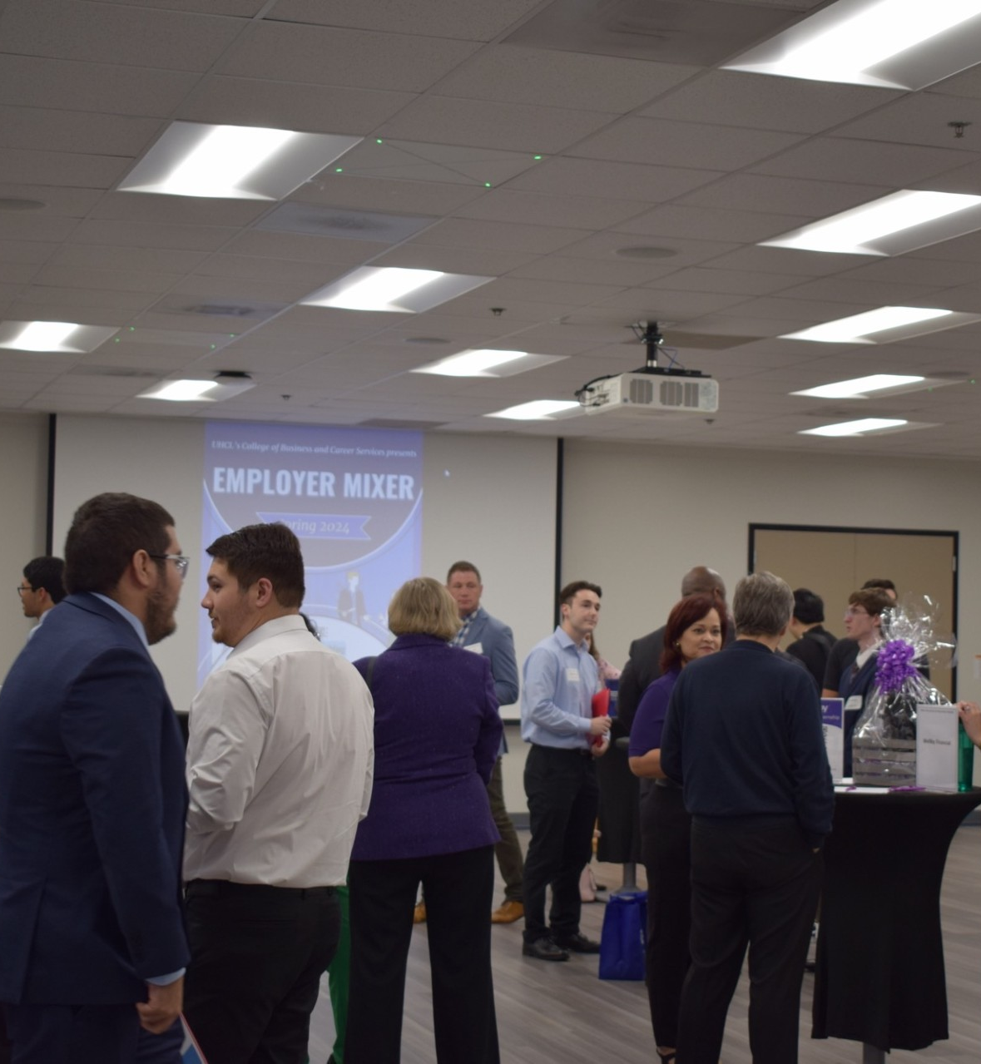
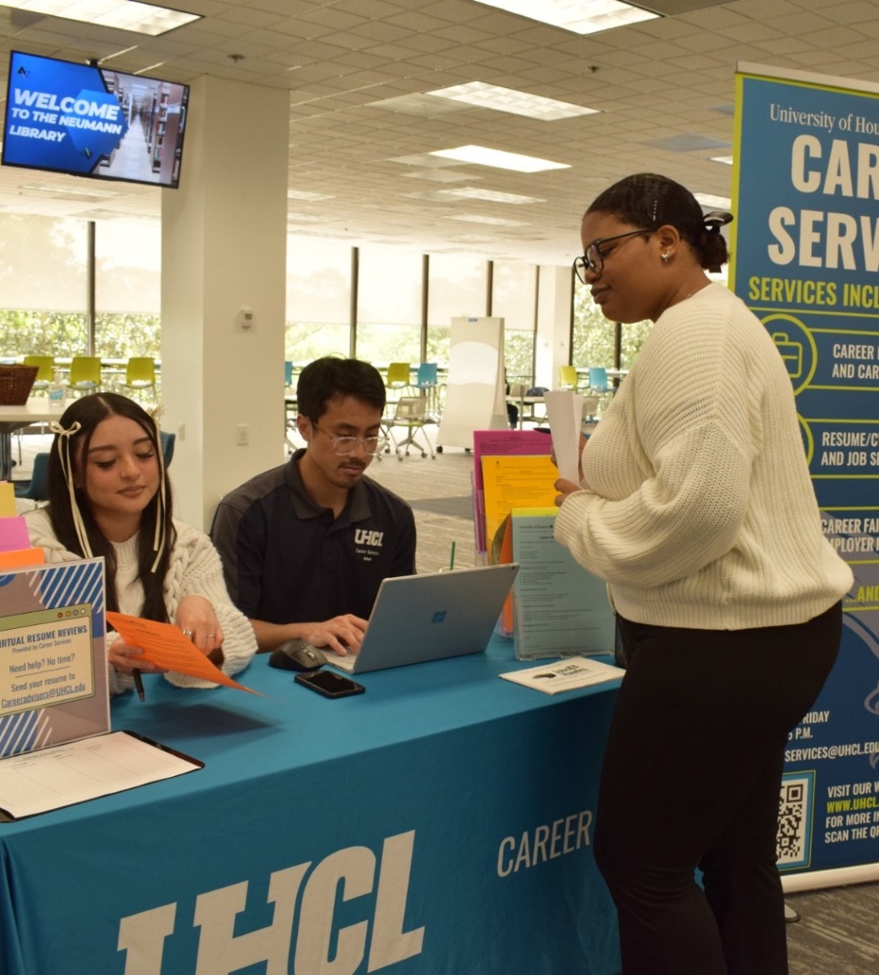
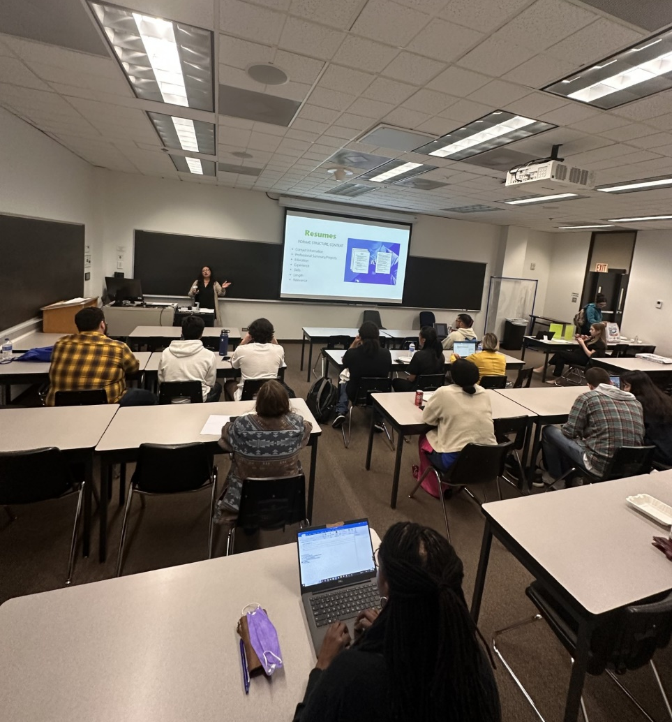
Programs & Services
Career Coaching & Exploration
Job & Internship Assistance
Career Networking Events
Community Engagement
Career Tools & Assessments

Slide 5
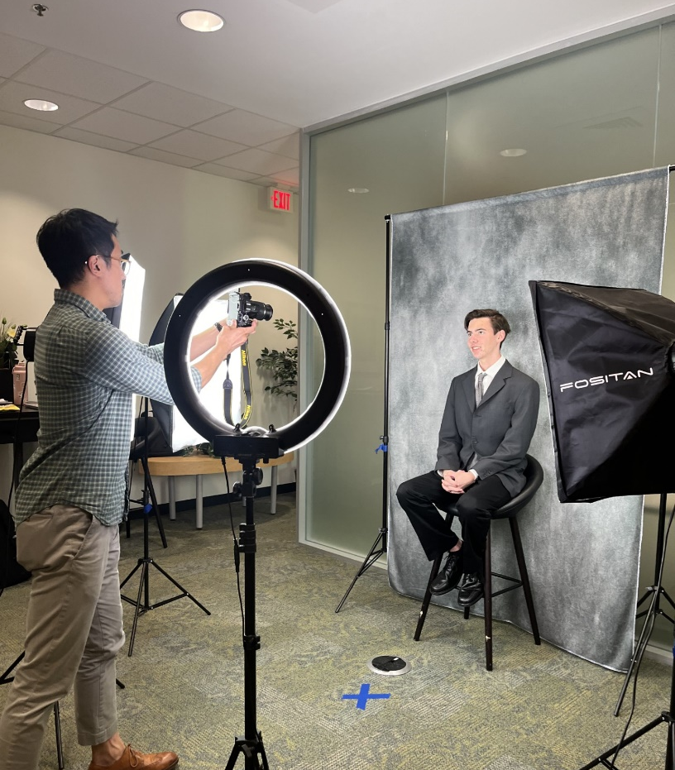
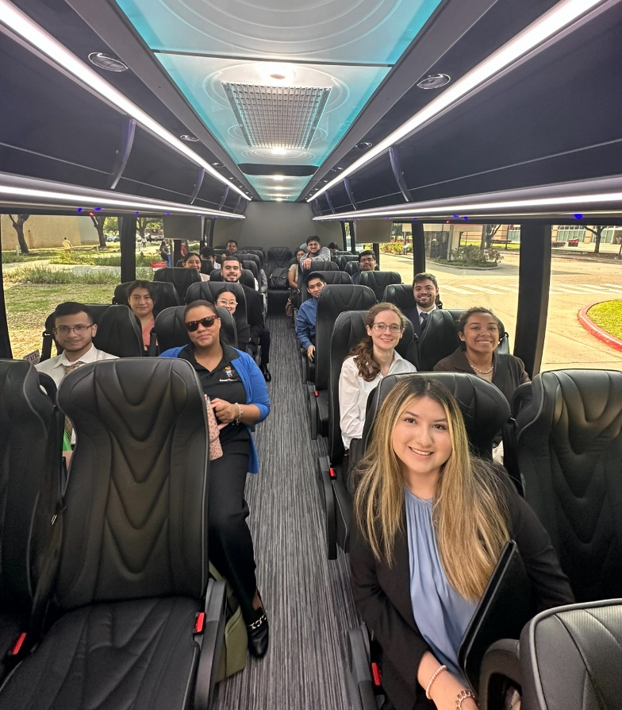
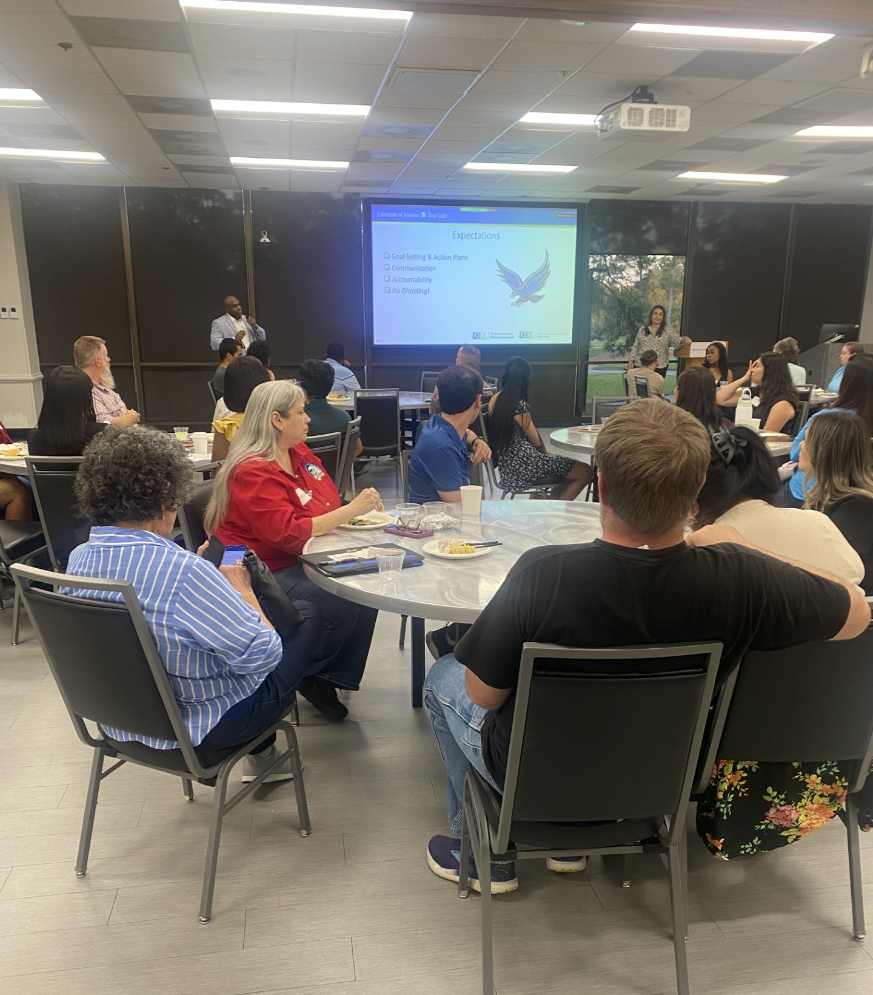
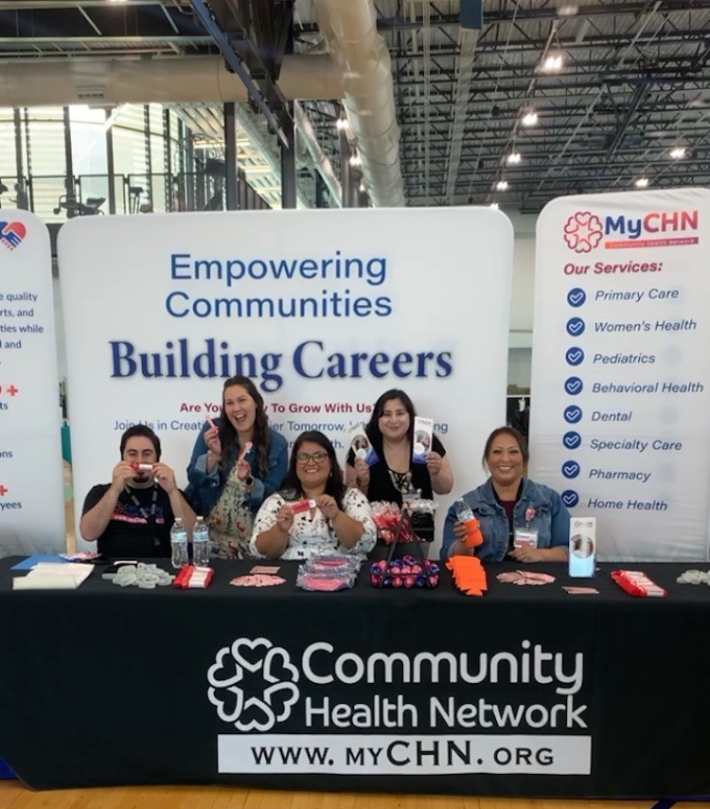
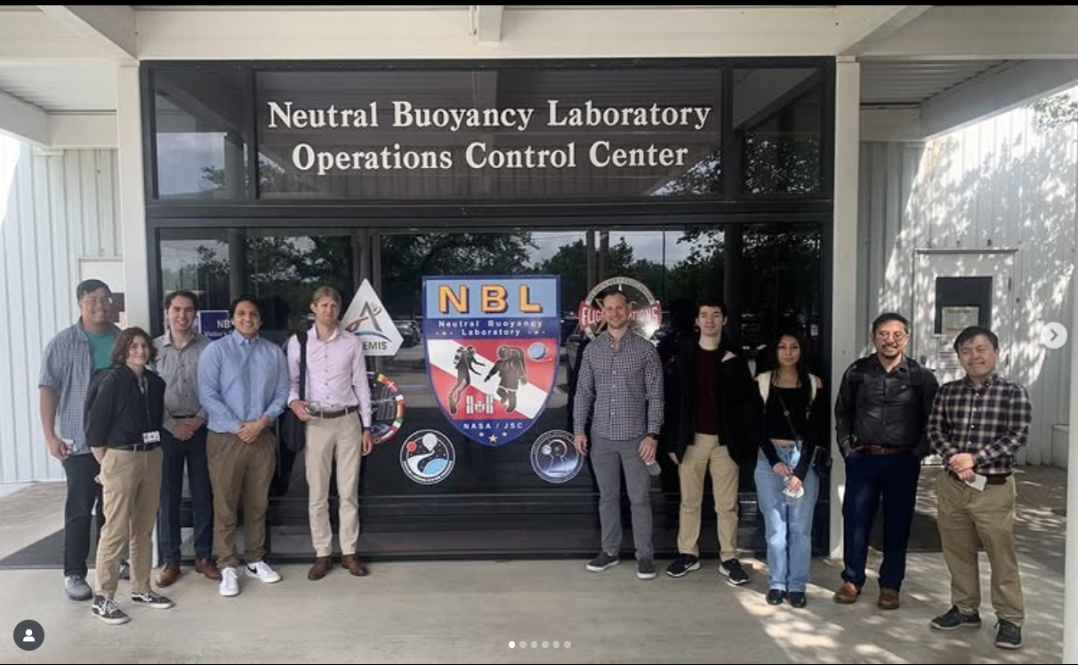
Career & Internship Fairs
Employer Panels & Mixers
Employer Site Visits
Professional Headshots
Hawk Mentorship Program

Slide 6

Impact
7 Signature Events
  176 Employers (5% incr. from FY ‘24 (n=159))
  1066 Students (28% decr. from FY ’24 (n=1207))
Student Appointments –
  1494 (8% incr. from FY ’24 (n=1382))
Satisfaction Surveys
  The coach and I were able to come up with a plan that is useful to me in dealing with my concerns.
    The career coach achieved an average Likert score of 4.7 (Scale 5.0).
  After attending this presentation, I have a better understanding of career readiness competencies?
    The career coaches achieved an average Likert score of 4.8 (Scale 5.0).
Facilitated and/or partnered on 78 on-campus events
  1503 students engaged (19% incr. from FY ’24 (n=1266))
  Classroom visits, employer information sessions, panels, workshops, etc.
Jobs4Hawks Usage
  Student Activations – 4541 (5% incr. from FY ’24 (n=4333))
  Employer Activations – 2523 (22% incr. from FY ’24 (n=2060))

Slide 7
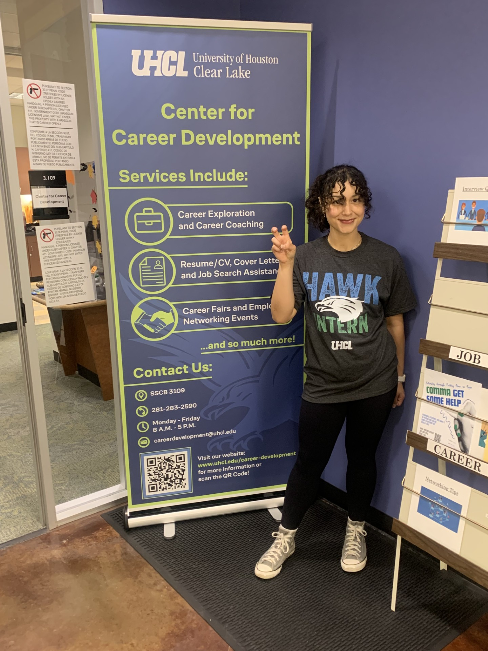
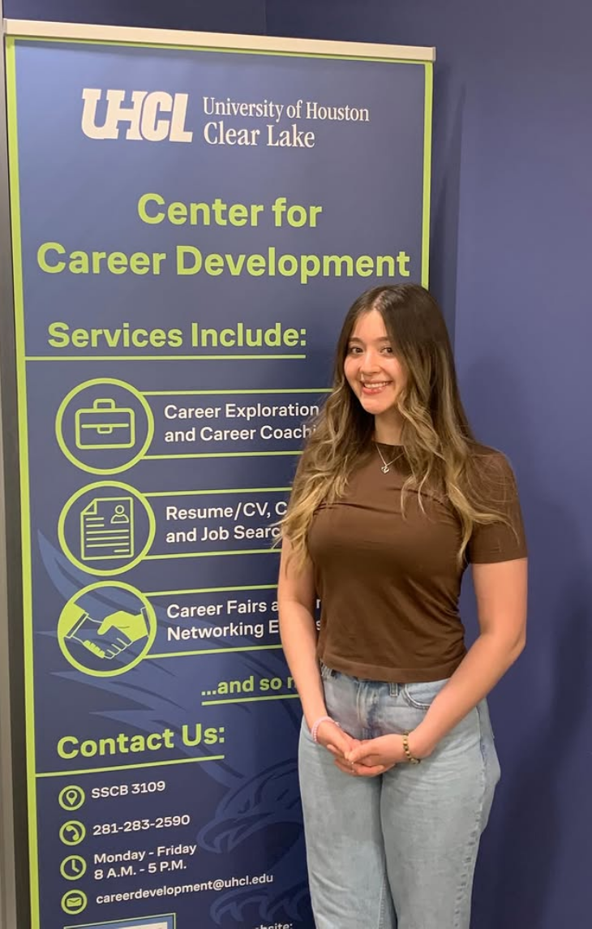
Testimonials
"During my internship at Danners, I gained valuable hands-on experience and a deeper understanding of what it’s like to work in a professional company setting. I was able to apply my skills in real-world situations, collaborate with a team and learn how different departments operate together to achieve company goals”.
"Honestly, I find myself taking risks and voicing my opinion in front of senior leaders and HR professionals with decades more experience than me and they have valued those thoughts a lot. I never thought I would have the confidence for that but, hey! Like always, I am going to thank you for being such a foundation in where I am at today 😊. I have truly grown so much and since meeting you at the Donuts event, I cannot stress enough how instrumental you were/are in my personal and professional development”!

Slide 8

New Programs
&
Initiatives
Job Shadow Program
Employer Site Visit Program
Expansion of Experiential Learning
Hawk Mentorship Program

Slide 9

Opportunities
Challenges
Increased Engagement
Faculty Partnerships
External Funding Sources
Technology
First-and-Second-Year Students
Industry Engagement

Slide 10
New Funding Requests
No New Funding Requests –
  FY ‘24 & FY ’25
New Funding Requests –
  FY ‘26 – $56,020
    Hawk Mentorship Program – $6,000
    Jobs4Hawks - $5,000
    Career Closet - $3,500
    Professional Headshot Machine - $34,600
    Micro-internship Platform - $2,500
    Career Fair Space Rental – $4,420
  FY ’27 – $31,840
    Hawk Mentorship Program – $12,000
    Jobs4Hawks - $5,000
    Career Closet - $3,500
    Micro-internship Platform - $2,500
    Career Fair Space Rental – $8,840
  Total Requested - $87,860

Slide 11
FY ’27 Budget Reduction
Salary & Wages
  Reduction in staffing would be detrimental to the operations of the department and cause a disruption of our services.
  Reduce ability to innovate programming and activities.
  Reduce 1:1 engage opportunities with students.
  Reduce potential engagement with community partners.

Slide 12
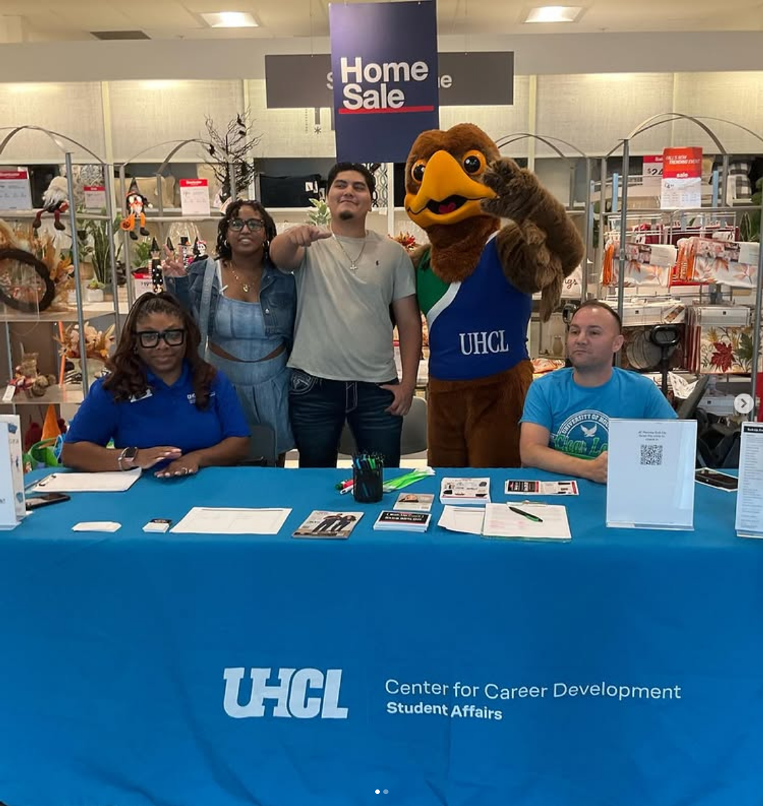
Go Hawks!!
Center for Career Development
SSCB 3109
Phone: (281) 283-2590
CareerDevelopment@uhcl.edu

