Slide 1



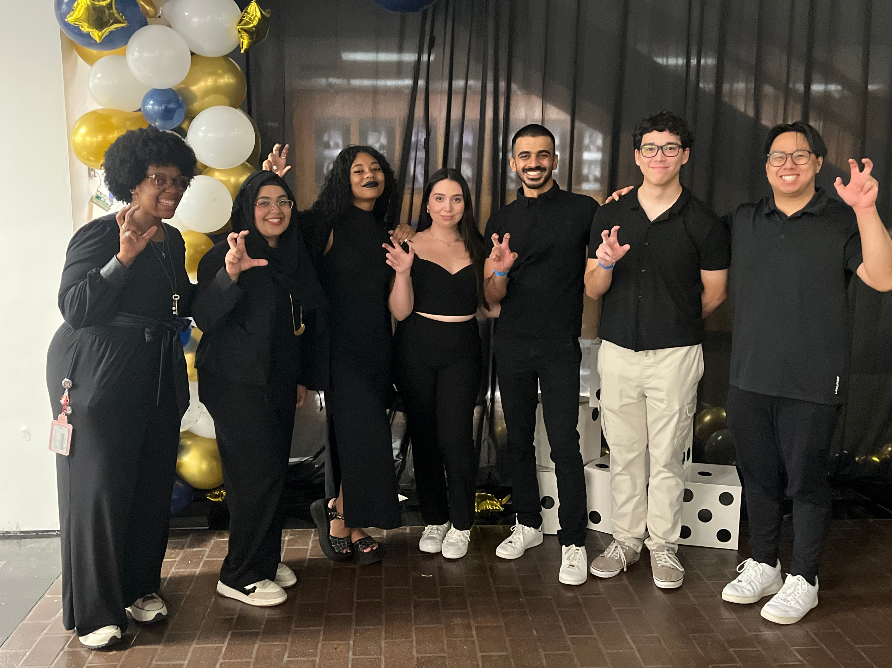

CAMPUS ACTIVIES BOARD
STUDENT FEE ADVISORY COMMITTEE​ BUDGET PROPOSAL​
THURSDAY, OCTOBER 16, 2025

Slide 2


AGENDA
Meet the team
About CAB
Challenges and Opportunities
Budget Overview
CAB Growth and Testimonies
FY26 and FY27 New Requests
Reduction Accommodation
Thank You
03
04
06
07
08
09
11
12

Slide 3

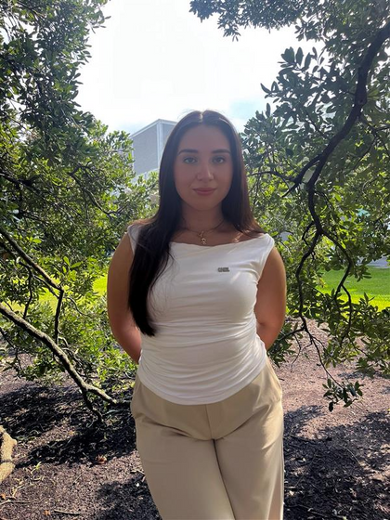
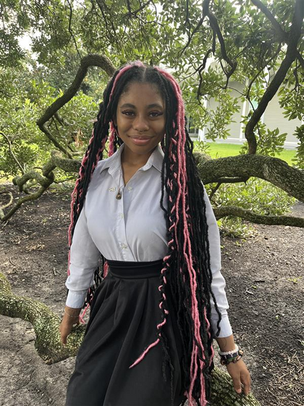
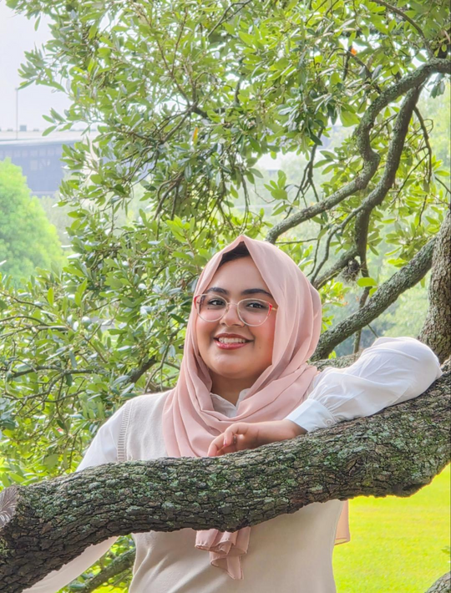
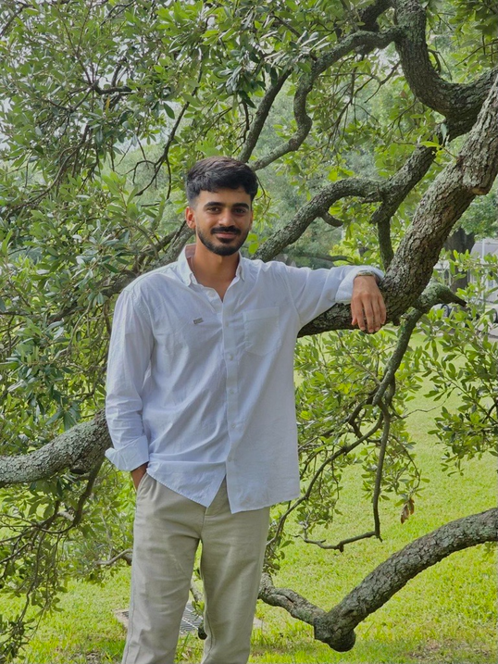
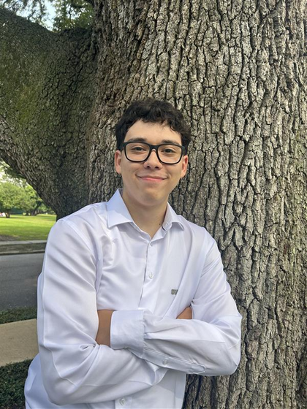
MEET THE TEAM
Calvin Nguyen
Kimberly Lara
Damian Clarke
Advisor
President
Vice-President
Aiman Fatima
Reece Tuscano
Angel Garcia
Hawk Spirit & Tradition Coordinator
Recruitment & Retention Coordinator
Brand Coordinator

Slide 4
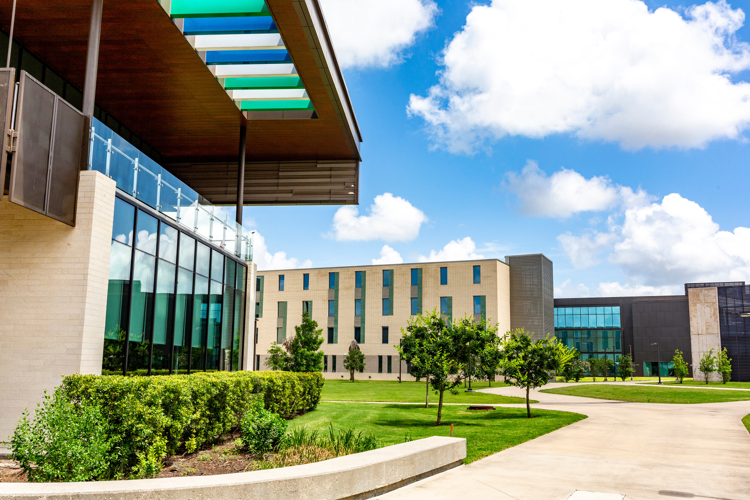
ABOUT CAB
The Campus Activities Board (CAB) is a student-led, fee-funded organization at the University of Houston-Clear Lake (UHCL) focused on enhancing campus life through inclusive, engaging programs. CAB plays a central role in cultivating a vibrant campus culture by planning and hosting a variety of recreational and entertainment-based events throughout the academic year.
Open to all students, CAB events are designed to build community and encourage student involvement, helping participants connect with peers and the university beyond the classroom.

Slide 5
MISSION AND PURPOSE
OPPORTUNITY TO LEAD​
CAB’s mission is to enrich the student experience by promoting campus engagement and a strong sense of community through dynamic, accessible programming.
We fulfill this mission by organizing large-scale signature events, collaborating with key partners such as Hawks 4 Community, the Activities Funding Board, and the Office of Student Engagement.
These efforts ensure that every student—whether traditional or nontraditional—has the opportunity to participate in and contribute to UHCL’s campus culture.
Shape the student experience through leadership roles
Plan, organize, and execute impactful campus events
Build skills in teamwork and community engagement
Ensure free, high-quality events through student fee funding
Empower students to lead and create lasting memories
Serve as a cornerstone of student life at UHCL

Slide 6
SUCCESS
CHALLENGES
OPPORTUNITIES
Committees offer more tailored events and leadership roles
Mentorship and peer learning can strengthen engagement
Collaborations with other USOs can expand reach
Co-hosted events foster Hawk spirit and community pride
Challenges create space to innovate and lead student life
200 students at Casino Night during WOW
150 students at first Spring Thing
Supports leadership development beyond the executive board
Builds long-term impact through mentorship and peer learning
Officer compensation is not competitive
Limited to 10 paid hours despite greater demands
Difficult to engage a consistent student audience
Resource and budget constraints require strategic planning

Slide 7
FY26 Budget Overview
Usage of Funds – FY26 One-Time Requests
$7,500 to support Hawk Tunes (now Spring Thing)
$7,500 to launch new Film Series
$7,903 to supplement student wages beyond base budget
Expands innovative programming and engagement
Supports supplemental staffing for event success
FY26 Base Budget - $43,789
$13,600 – Student Wages (underfunded)
$26,789 – Event Programming
$3,400 – M&O (Supplies)

Slide 8
I loved I Heart UHCL. Specificallly, there was a lot to do and I liked the individual small prizes and merch that was given. The only thing, is that I wish there were more large events like this throughout the year and I wish there was more chances for involvement in events.”
“Lighting of the Letters has been an incredibily important event for me, it has constantly provided me a sense of community and companionship allowing me to feel a part of UHCL and connect with other students. This event has given me the opportunity to meet and create lasting relationships that have helped me in the long run.”
“When I moved into the country, events like I Heart UHCL were one of the only avenues I had to meet other people. These campus events were what helped me find comofrt and make a place for myself in the USA and have given me the ability to persevere. I Heart UHCL and Lighting of the Letters are important events that helped me thrive and navigate my college experience.”
CAB IMPACT AND STUDENT TESTOMIALS
Taylor M.
Riley R.
Juan F

Slide 9
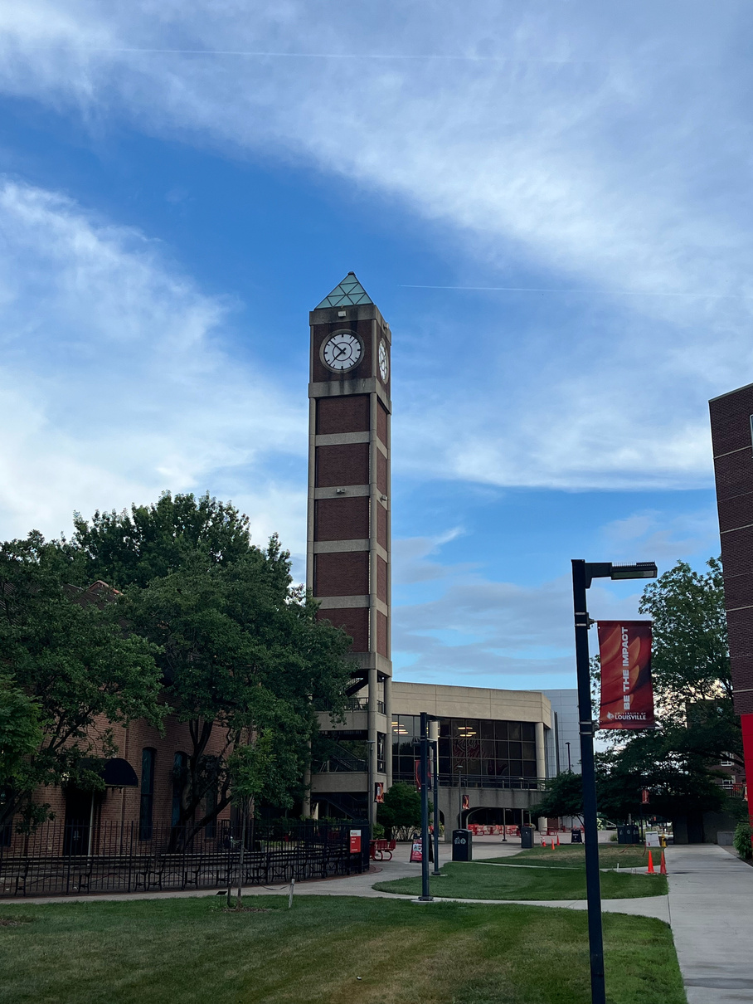
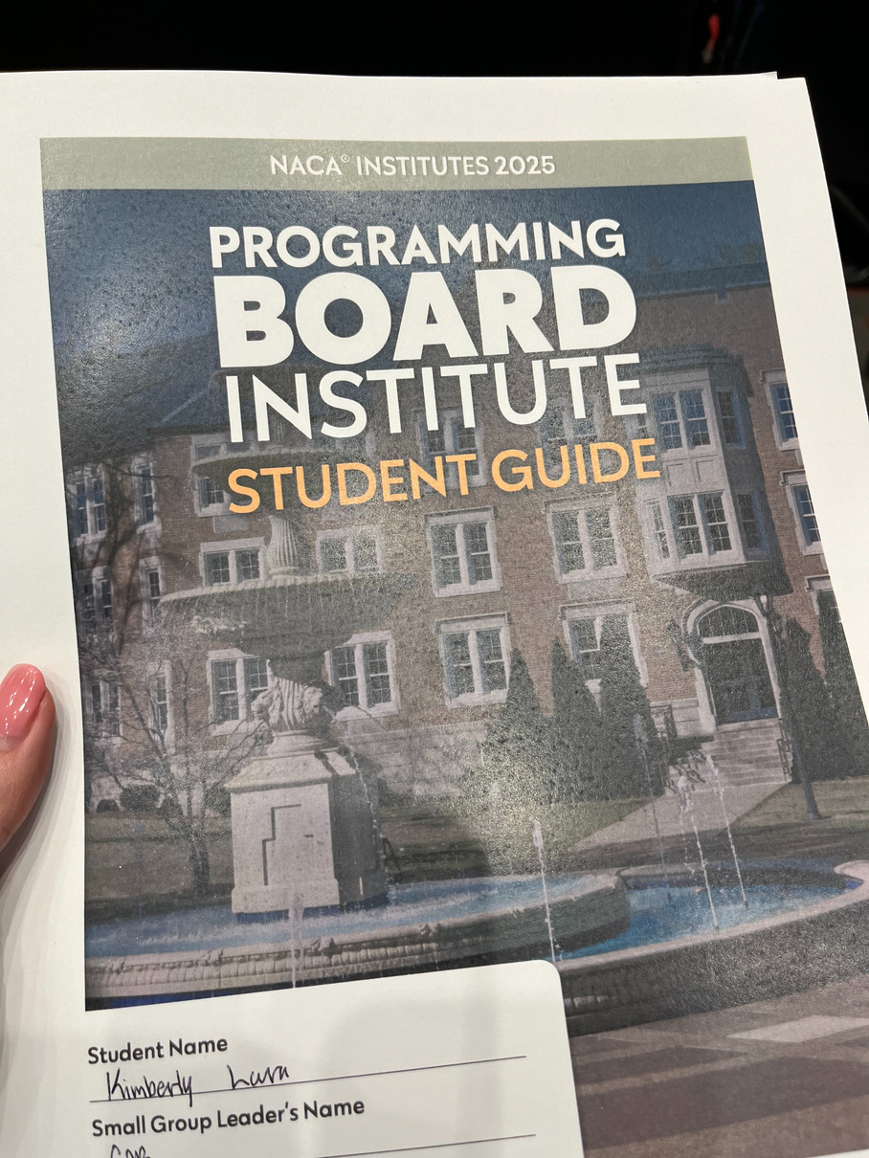
FY26 FUND REQUESTS
FY26 Funding Requests:
$12,000 – Officer Development: Support student leaders’ growth by attending the NACA Programming Board Institute for leadership training and peer mentoring skills.
$10,000 – Weeks of Welcome: Fund large-scale kickoff events (e.g., Casino Night, Wing Night) that help connect students and boost engagement at the start of the year.

Slide 10
FY27 FUND REQUEST
FY27 Funding Requests:
$7,903 – Officer Wage Support: Supplement wages to make officer roles more accessible and competitive for diverse student leaders.
$10,000 – Spring Thing Expansion: Grow CAB’s spring signature event into a major campus tradition with increased participation and impact.
$10,000 – Weeks of Welcome: Continue successful signature events to welcome students and build early momentum for involvement.
$12,000 – Continued Officer Development: Maintain leadership training for new Executive Board members to ensure consistent, high-quality programming.

Slide 11
ACCOMMODATING ​A 5% FY27 REDUCTION
Accommodating a 5% Budget Reduction in FY27
Total Reduction Needed: $2,189 (5% of $43,789 base budget)
Priority: Protect quality and accessibility of key programs:
Spring Thing
I Heart UHCL
Weeks of Welcome (Wing Night, Casino Night)
Planned Adjustments:
Entertainment & Vendor Costs: Cut by ~$1,500 by negotiating rates, limiting external performers, and focusing vendors on events with 250+ attendees
Maintenance & Operations: Cut by ~$689 through tightening discretionary supply and marketing budgets, while preserving essential expenses
Goal: Minimize impact on student experience while maintaining core, impactful programming and campus spirit

Slide 12
THANK YOU

