Slide 1

STUDENT FEE ADVISORY COMMITTEE
Special Meeting
April 25, 2025

Slide 2
Meeting Agenda
Orientation and New Student Programs
Central Funding Reduction
Student Service Fee Reduction

Slide 3
Orientation and New Student Programs
One-Time Request

Slide 4
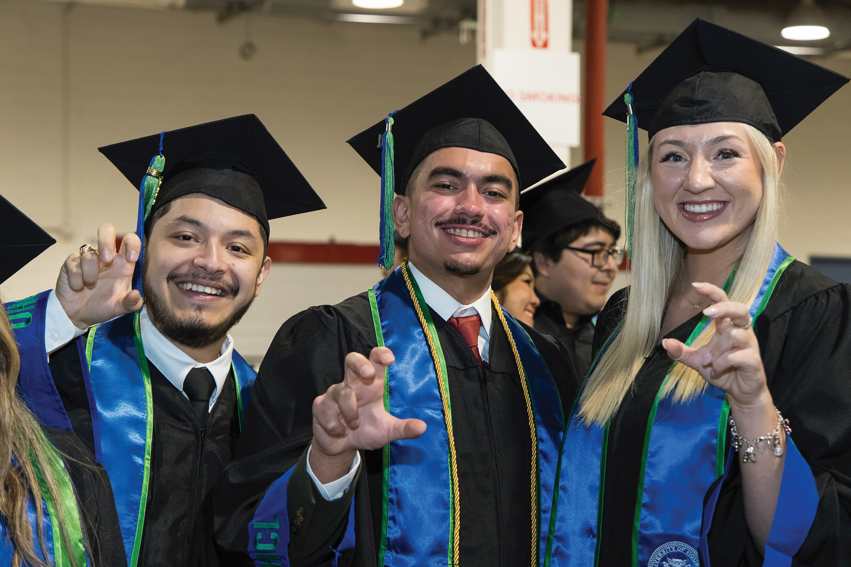
ONSP
Orientation and New Student Programs
Central Funding
Request: up to $40,000 for FY 26 and FY27 ($20,000 per year)
Student Service Fees
Most of the new-student orientation expenses are paid by the Orientation Fee, but increased prices without an increase in the Orientation Fee has created a budget gap.
  Reduced to a one-day model that is not population specific
  10 sessions throughout the summer
  2-3 session in the spring
A proposal to increase the Orientation Fee was not permitted for FY 2026; the Governor has an Executive Order for no tuition or mandatory fee increases for the next biennium. If that changes, this request will be rescinded.

Slide 5
Central Funding
Reduction Plan

Slide 6
ONSP
Fund 1 and Fund 2 Budget Initiatives
Central Funding
Division of Student Affairs
Student Service Fees
Counseling doctoral interns
Partial funding for 3 full time positions
Full funding for 1 full time position
Mascot program support
Career Fair support
New Student Programs
Campus Activities Board
Counseling Outreach Programs
*No reduction in services. Funding has been shifted to student service fees or revenue dollars.

Slide 7
ONSP
Central Funding Support
Central Funding
Office of Military and Veteran Services
Student Service Fees
VA requirements
Effective December 5, 2023, VA revised the suggested ratio to one (1) SCO full-time employee (FTE) for every 125 GI Bill students and/or dependents enrolled in the educational institution.
UHCL requires 3 certifying officials to meet this requirement.

Slide 8
Student Service Fees
Reduction Plan

Slide 9
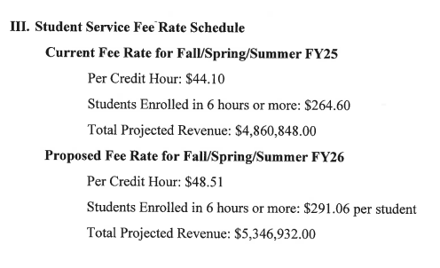
ONSP
Student Fee Revenue Projections
Central Funding
Student Service Fee Rate Schedule (FY26 Report)
Student Service Fees
FY26 Recommendations:
https://www.uhcl.edu/dean-of-students/student-fee-advisory-committee/documents/sfac-fy26-final-report.pdf
SFAC website:
https://www.uhcl.edu/dean-of-students/student-fee-advisory-committee/

Slide 10
ONSP
Student Fee Revenue Projections
Central Funding
No reduction and no increase in enrollment
Base Projection | FY25 | FY26 | FY27 | FY28 | FY29
Base | 4,860,848 | 4,965,008 | 5,118,008 | 5,271,008 | 5,281,008
Salary Mandate | - | 10,000 | 10,000 | 10,000 | 10,000
Comp YR 2 (FY2026) & YR 3 (FY2027) |  | 143,000 | 143,000
Administration Fee | 104,160
Required Base | 4,965,008 | 5,118,008 | 5,271,008 | 5,281,008 | 5,291,008
Projected Revenue on prior year enrollment | 4,773,897 | 4,773,897 | 4,773,897 | 4,773,897 | 4,773,897
Base Shortfall | (191,111) | (344,111) | (497,111) | (507,111) | (517,111)
Student Service Fees

Slide 11
ONSP
Student Fee Revenue Projections
Central Funding
FY26 reductions and no increase in enrollment
Student Service Fees
Base Projection | FY25 | FY26 | FY27 | FY28 | FY29
Base | 4,860,848 | 4,143,000 | 4,400,160 | 4,553,160 | 4,563,160
Salary Mandate | - | 10,000 | 10,000 | 10,000 | 10,000
Comp YR 2 (FY2026) & YR 3 (FY2027) |  | 143,000 | 143,000
Administration Fee | 104,160 | 104,160
Required Base | 4,965,008 | 4,400,160 | 4,553,160 | 4,563,160 | 4,573,160
Projected Revenue on prior year enrollment | 4,773,897 | 4,773,897 | 4,773,897 | 4,773,897 | 4,773,897
Base Shortfall | (191,111) | 373,737 | 220,737 | 210,737 | 200,737

Slide 12
ONSP
Student Fee Revenue Projections
Central Funding
FY26 reductions and no increase in enrollment
Base Projection | FY25 | FY26 | FY27 | FY28 | FY29
Base | 4,860,848 | 4,143,000 | 4,677,912 | 4,830,912 | 4,840,912
Salary Mandate | - | 10,000 | 10,000 | 10,000 | 10,000
Comp YR 2 (FY2026) & YR 3 (FY2027) |  | 143,000 | 143,000
Administration Fee | 104,160 | 381,912
Required Base | 4,965,008 | 4,677,912 | 4,830,912 | 4,840,912 | 4,850,912
Projected Revenue on prior year enrollment | 4,773,897 | 4,773,897 | 4,773,897 | 4,773,897 | 4,773,897
Base Shortfall | (191,111) | 95,985 | (57,015) | (67,015) | (77,015)
Student Service Fees
*As enrollment increases, base requests can be considered in the future by SFAC to reinvest into the Division of Student Affairs

Slide 13
ONSP
Student Fee Revenue Projections
Central Funding
FY26 Reductions
Student Service Fees
Funding Priorities
Reinvest in and restructure departments based on DSA priorities and central funding reduction
Create base budget reserves to support UHCL mandates/initiatives
  Market salary adjustments
  Merit increases, if/when deemed
  Administration fee
Right set operations based on enrollment forecasting
  Reduction in M&O funding
  Reduction in force
Most importantly, continue to invest in the student experience and student success

Slide 14

Requests for today
Vote of approval for ONSP
Vote of support for E&G reductions
Vote of support for SSF reductions

Slide 15
Thank you!
Questions?

